Slide 1
NPRR 1188 – System Impacts Overview
Vamsi Paruchuri
Xiangjun Xu
October 22, 2026
Outline:
NPRR 1188 overview
SCED and DAM changes
Market Manager UI & External webservice changes
Report Changes
Q&A
Key Takeaways
NPRR 1188 project is in design and development phase, impacts QSEs Market Submissions EWS APIs
Requires Meters installations in the field for CLRs and go through qualification process before Go-Live.

Slide 2
NPRR 1188 Overview
NPRR 1188 enables nodal dispatch for Controllable Load Resources (CLR) that are not ALR’s
Aggregate Load Resources (ALR) will continue to be settled at Load Zones (LZ)
New Resource Nodes (RN) and ERCOT-Polled Settlement (EPS) meters will be added for CLR’s that are not ALR’s.
CLRs should have the Meters installed in the field and go through qualification process to be able to participate in the market from the Go-Live date.
MOTE Testing: Week of Dec 14th, 2026 ( Market notice will provide exact date and details)
Go-Live date: Week of Jan 25^{th,} 2027 ( Market notice will provide exact date and details)

Slide 3
SCED and DAM Changes for CLR’s that are not ALR’s
SCED
  Changed from LZ to nodal dispatch
  EPS meters and RN’s will be added
  New telemetry: ONTEST and ONHOLD – basepoint will be set to telemetry MW
  OUTL status – not consuming energy, telemetry MW = 0
DAM
  Can submit energy bids for DAM Ahead Market
  RN’s will be added
  DAM LPC = 0, dispatch range will be [0, MPC-LPC] in DAM

Slide 4

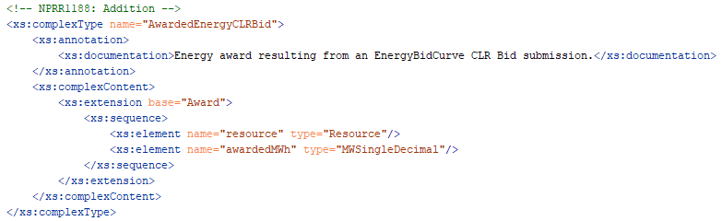
External Webservice XSD Changes
RTMEnergyBid will be renamed to EnergyBidCurve, as it will be used for both Realtime and Day Ahead Markets:
GitHub: api-specs/ews_NPRR1188/xsds
ErcotTransaction.xsd
ErcotTransactionTypes.xsd
AwardedEnergyCLRBid added to carry awards resulting from EnergyBidCurve CLR bid submissions
ErcotAwards.xsd
ErcotAwardTypes.xsd

Slide 5
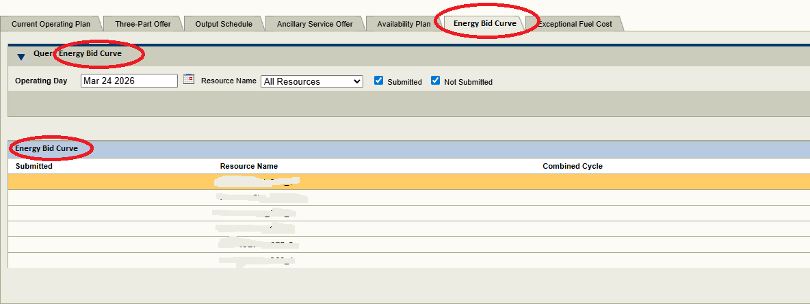
Market Manager (MMS UI) Changes

Slide 6
Report Changes
CDR
  DAM Aggregate Credit Exposure
Extracts and Disclosures
  2-Day DAM Energy Curves
  2-Day SCED Energy Curves
  2-Day DAM Bids and Offers Reports
  60-Day DAM Disclosure Reports
  60-Day SCED Disclosure Reports

Slide 7
NPRR 1188 Q&A
Will current Settlement Point names for the CLRs stay the same or change as well?
  Currently, for all CLRs, the Settlement Point name is the applicable Load Zone name.
  With this implementation
    CLRs that are not ALRs will be mapped to Resource Node Settlement Points (changing with NPRR1188)
    For CLRs that are ALRs, the Settlement Point name will stay at the applicable Load Zone name (no change).
Will there be DA Energy Awards for DA Energy Bids at the Resource?
  Yes, there will be cleared DA Energy Bid awards for CLRs.
If you are awarded DA Energy Bid at Resource, will it be considered a DA Energy Purchase in the DAM?
  Yes, DA Energy purchase @ CLR Settlement Point.
Will the MRID be the same or change?
  Currently the MRID contains ‘REB’, will it be ‘EBC’? Ex - QSE.20260813.REB.ResourceName
    Yes, MRID will change from ‘REB’ to ‘EBC’.
For ADERs, how will they continue to submit their RT Energy Bids if the RT Energy Bid tab is going away?
Energy Bid Curve will be used for both Realtime and Day Ahead Markets.

Slide 8
NPRR 1188 Q&A
6. Q:Can ERCOT run a DAM simulation during MOTE testing?
A:ERCOT will not run DAM simulation during MOTE testing.
  If ERCOT does not plan on running DAM simulation, can ERCOT provide sample Award files in advance? We need EBC award files to see if our code will parse the file correctly.
  A:Yes, ERCOT will provide generic sample CLR Bid Award file in advance
Q: What happens if a CLR does not install an EPS meter? Will that CLR still operate in the market?
  A: To participate in the Market after NPRR1188, only CLRs that are co-located with generation are required to install an EPS meter. All other CLRs can continue to use either EPS or a TDSP-read meter.
Q: When will new RNs be added to the model?
  A: New RNs will be added to JAN_ML3 – 01/27/2027
  Q:Can ERCOT post the list in advance? We need to setup our configuration to allow our MPs to submit using new RN names for MOTE testing. As of right now, we do not know the new names that will be used.
  A: We will provide the update in next TWG meeting.
9. Q: Can ERCOT confirm that existing Settlement Point names for original resource name will be used? Meaning, if ERCOT is creating new RN names, I would assume there will be new SP names too but if that is not the case, and existing SP names will exist, then we just need to double confirm that existing SPs will be associated with new CLR RN names.
    A: New resource nodes (Settlement Points) will be created for CLRs.

Slide 9
Questions/Comments?
Xiangjun.Xu@ercot.com
Vamsi.Paruchuri2@ercot.com

