Slide 1
NERC EMSWG Update
ERCOT TWG
Wei Qiu
Lead Engineer, Event Analysis, NERC
October 22, 2026

Slide 2
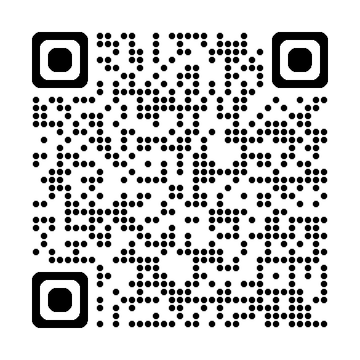
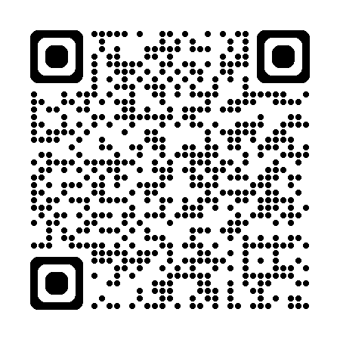
2026 Monitoring and Situational Awareness Technical Conference
Location: ComEd, in Chicago, IL
Date: Tue. 10/6 - Wed. 10/7
Agenda
Speaker Biographies

Slide 3
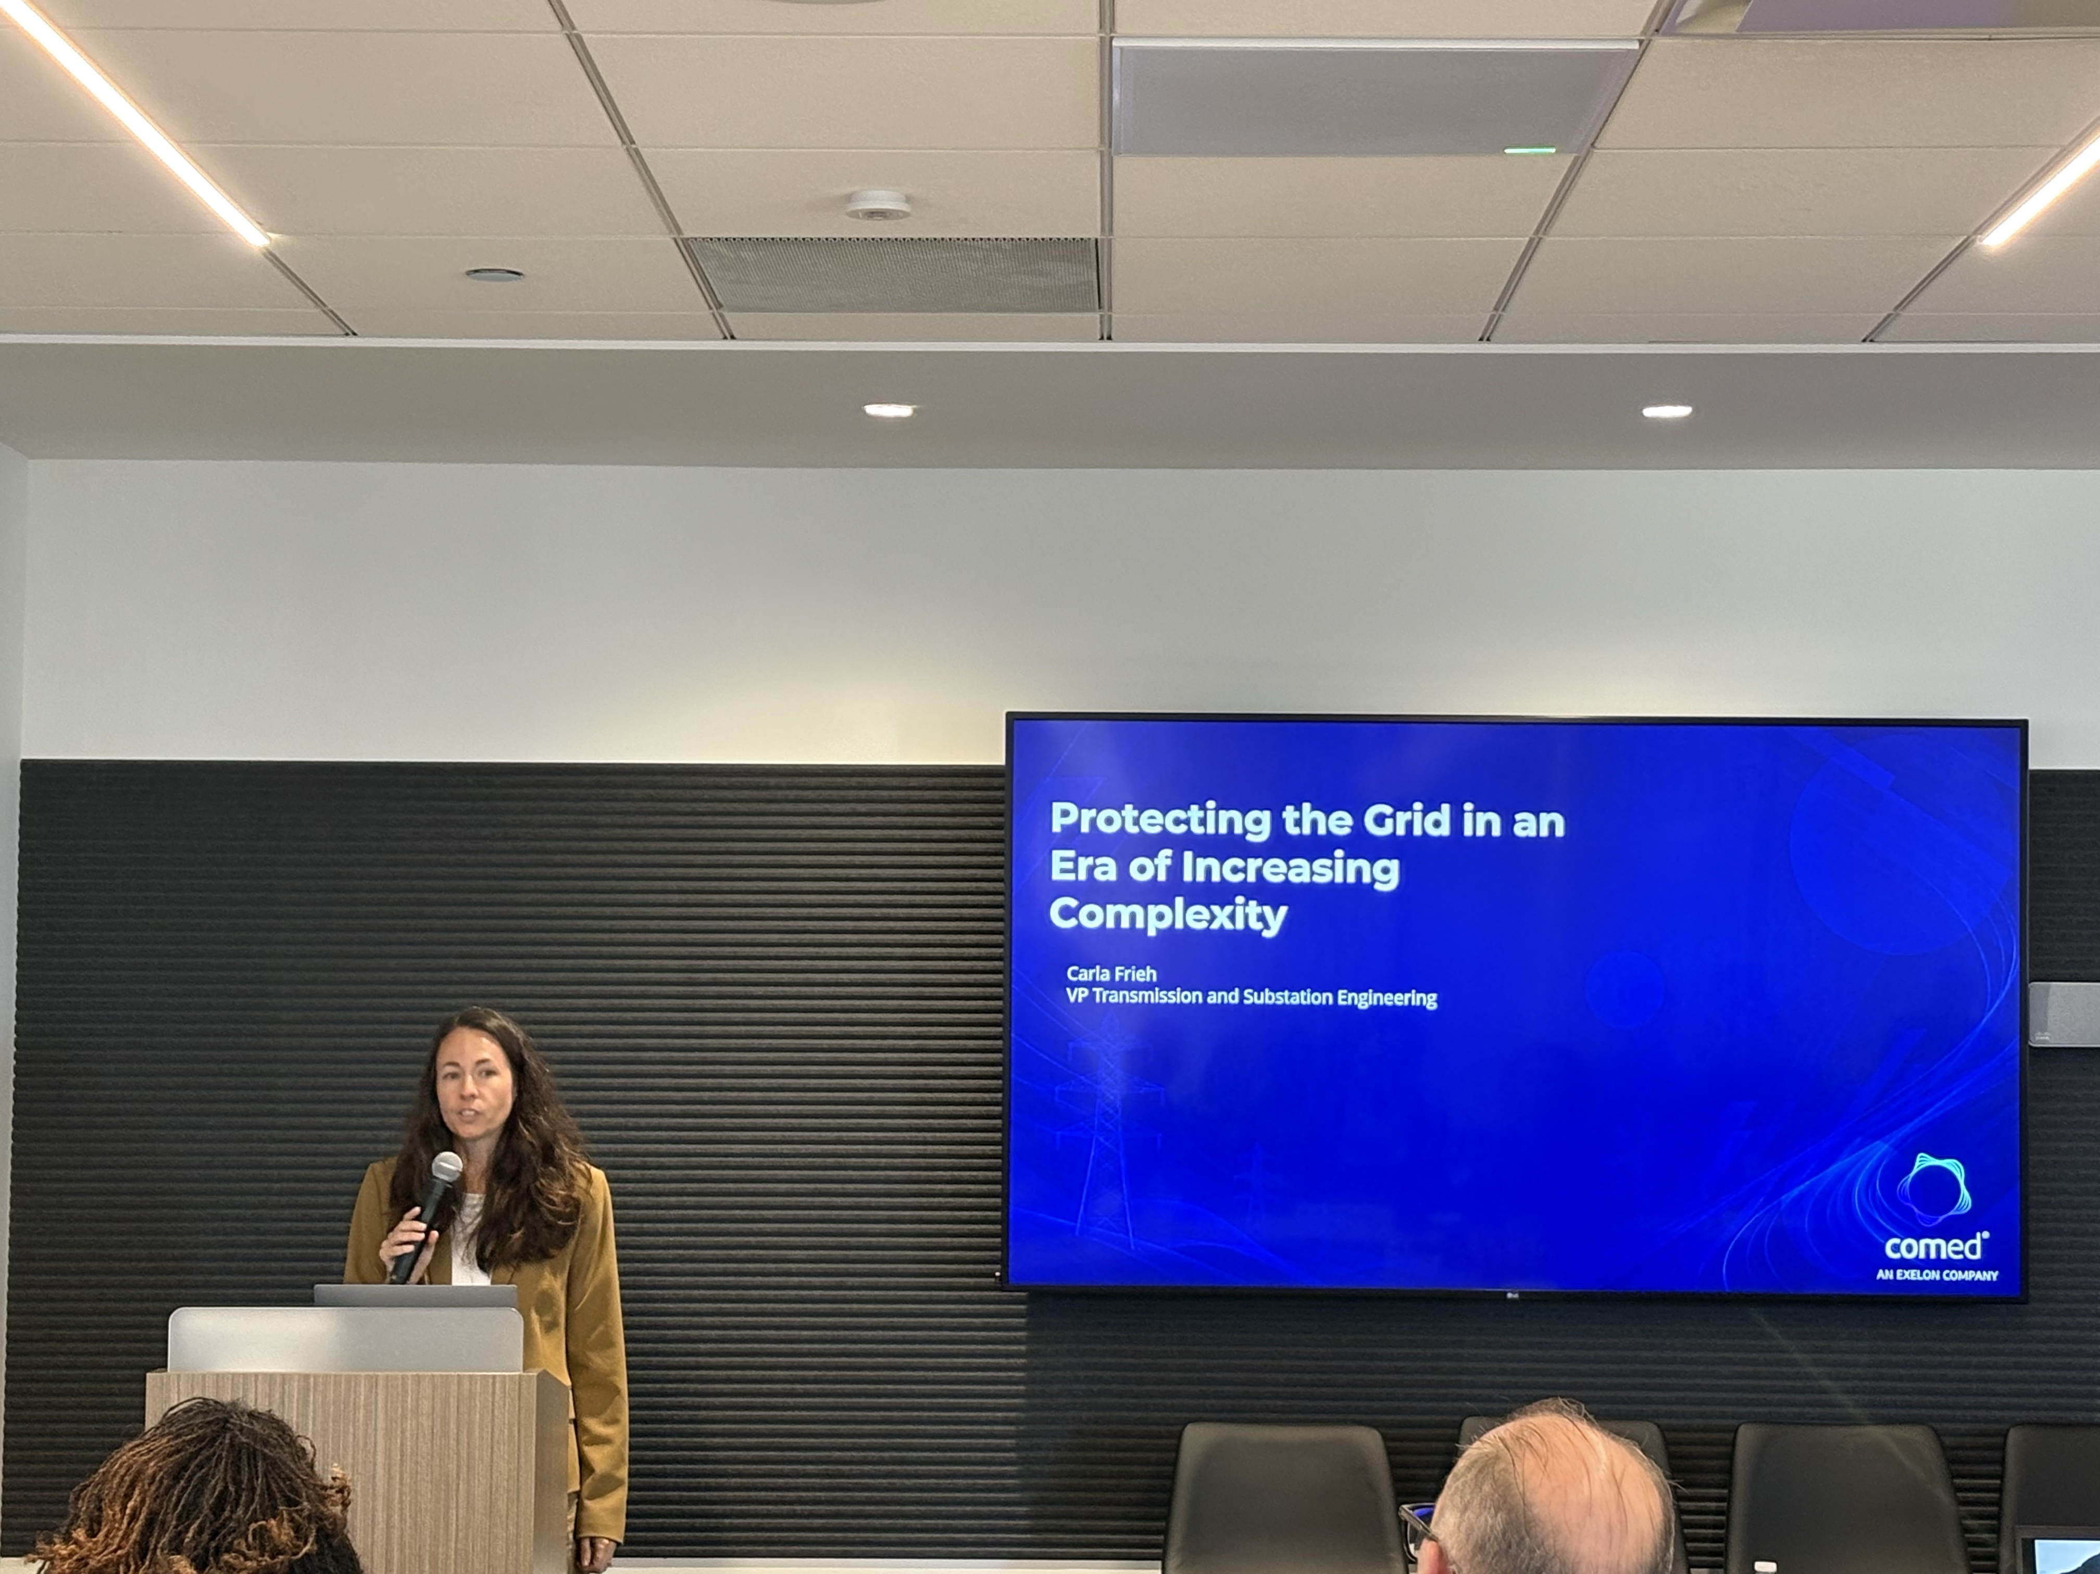
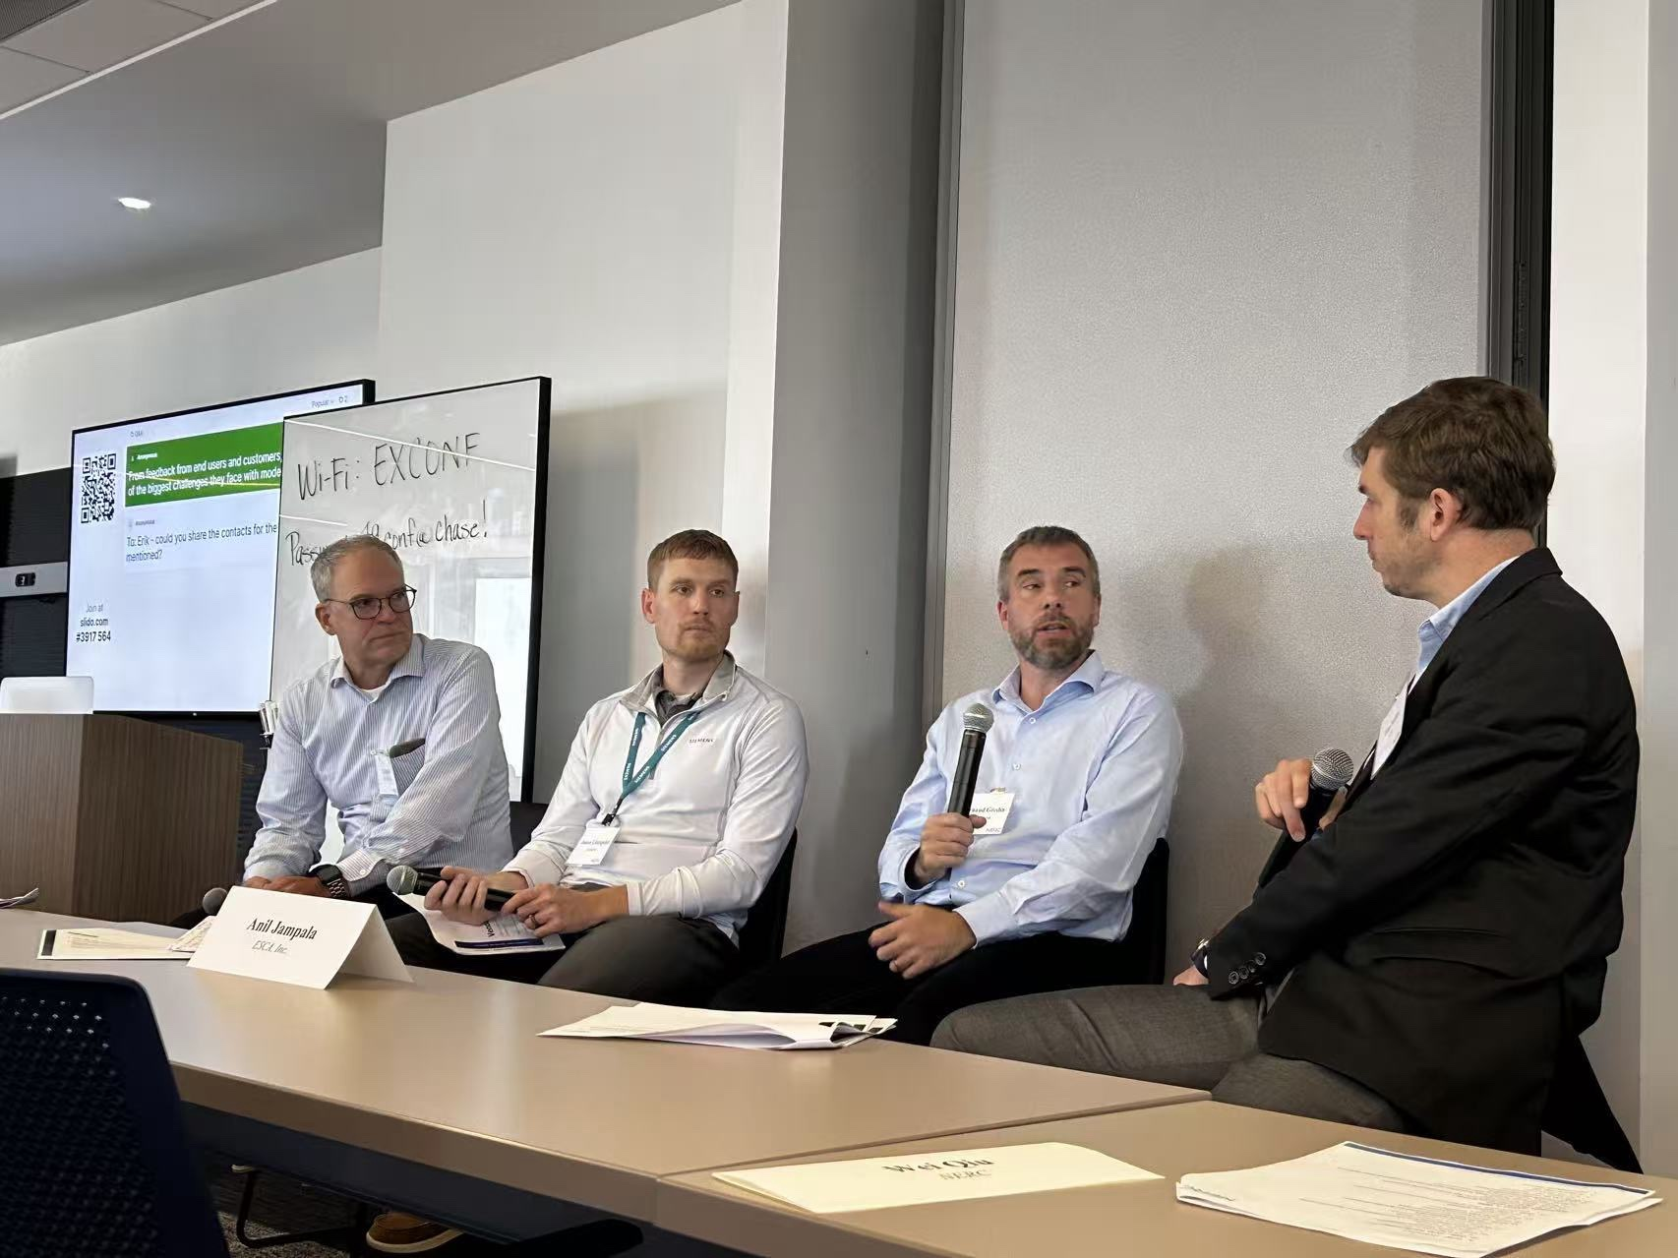
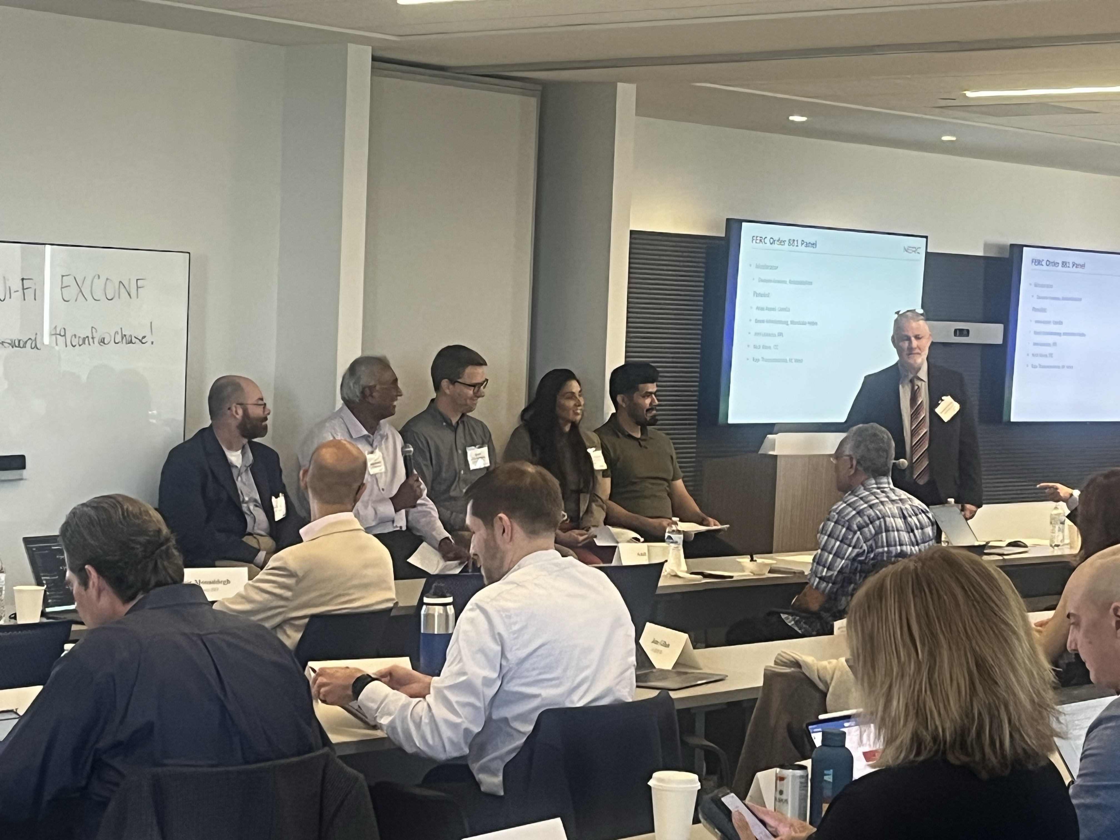

Slide 4
Agenda
EMS overview - NERC
Panel Discussion
  FERC 881 - Manitoba Hydro, ITC, ComEd, RC West, and FPL
  EMS vendor – GE Vernova, OSI, and Siemens
Situational Awareness Tool – SPP
Modeling Validation – BC Hydro
Sub synchronous oscillation – Dominion and ERCOT
AI
  Weather AI -ANL
  State Estimation through Dynamic System AI - PNNL
Human Factors in an Age of Accelerating Complexity - Resilient Grid

