Slide 1
RIOO Repower – Modification of Existing Generation
Prudhvi Gurlinka
Grid and Market Solutions (GMS)
October 22, 2026
Outline:
Recap: July 2026 Release
What is Repower?
Repower or RSCR?
Repower in RIOO
Key Milestones
Key Takeaways
Starting with the R11 release (tentatively 12/16/2026), you can modify, retire and add units at an existing site in a single INR.
After ERCOT review, your changes are applied to RIOO-RS on your PLD – no manual loading.
Notes:
Follow-up to the June TWG session. In June we showed operational substation selection in the INR. Today: an overview of Repower - how existing units are changed through an INR in RIOO.

Slide 2
Recap: July 2026 Release – RS Substation Selection
Previously, an INR could only use substations created in RIOO-IS
Since 07/10/2026, you can select any operational substation from RIOO-RS
Substation details auto-populate in the INR
New equipment can be added, but existing generators could not be changed (RSCR only)
Repower builds on this foundation
Notes:
Quick recap of what went live on 07/10. The key limitation then: an INR on an operational substation could only ADD equipment. Changing existing generators was RSCR only. Repower removes that limitation.

Slide 3
What is Repower?
Repower (Modification of Existing Generation) is the full or partial replacement or upgrade of equipment at an existing site – often changing its configuration and MW output.
Modify
Update existing units – for example new turbines or inverters, or a higher MW rating
Retire
Retire existing units – they are removed from RIOO-RS on your PLD
Add
Add new units alongside the units that stay
All in one INR, starting from your operational substation in RIOO-RS.
Notes:
Plain-language definition from the project requirements. The new part: one INR can now modify, retire and add units at the same site. Before, only 'add' was possible in an INR.

Slide 4
Repower or RSCR?
Use an RSCR
Updating registration data for equipment that is staying the same
Corrections and routine updates
Use a Repower INR
Increasing real power rating by 1 MW or more within a year
Replacing inverters, turbines, generators or power converters (10 MW+ facility)
Changing IBR control settings in a way that requires further study
Changing or adding a POI (10 MW+ facility)
Growing a generator under 10 MW to 10 MW or more
Notes:
Rule of thumb: RSCR = updating data about equipment that is not physically changing. Repower INR = a physical change to the site that needs to go through the interconnection process. The five items on the right are exactly the start-page questions - if any is Yes, use a Repower INR. (Confirm wording with the RIOO business team before presenting.)

Slide 5
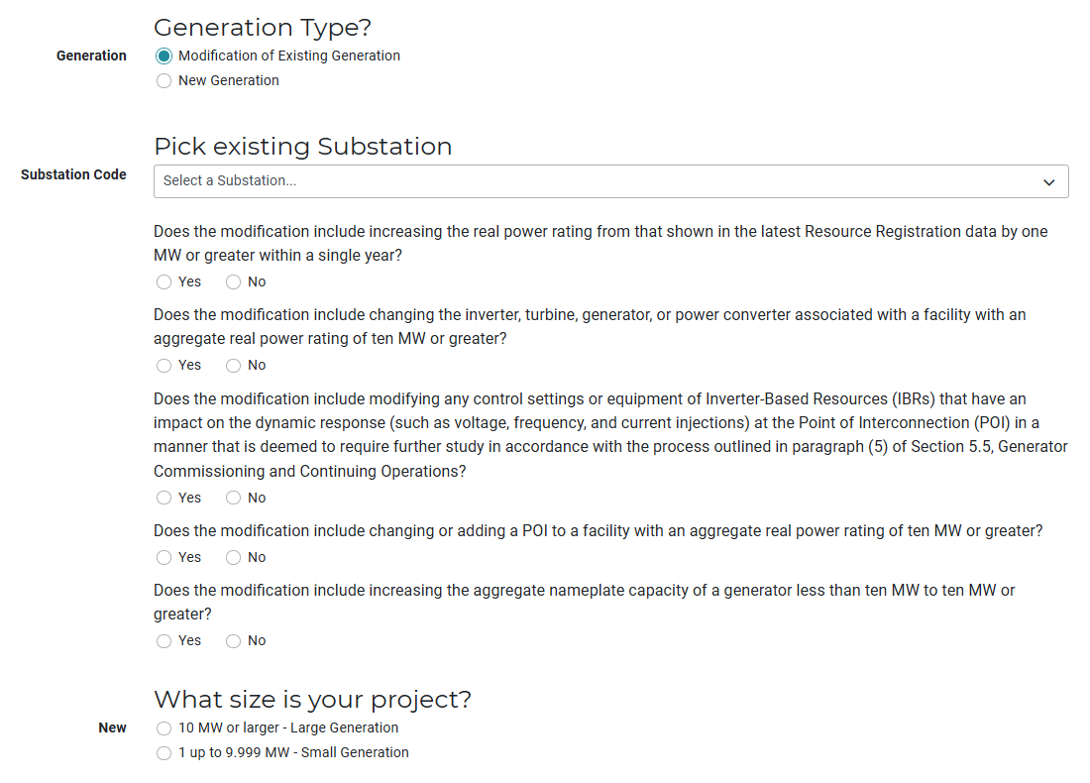
Starting a Repower INR
Choose "Modification of Existing Generation"
1
1
2
Pick your operational substation
2
Answer the five modification questions
3
3
Start the INR as the Resource Entity.
Notes:
Start the INR as the RE. The first question is now Generation Type: New Generation or Modification of Existing Generation. Pick the substation from the list of operational substations, then answer the five modification questions from the Repower or RSCR slide.

Slide 6
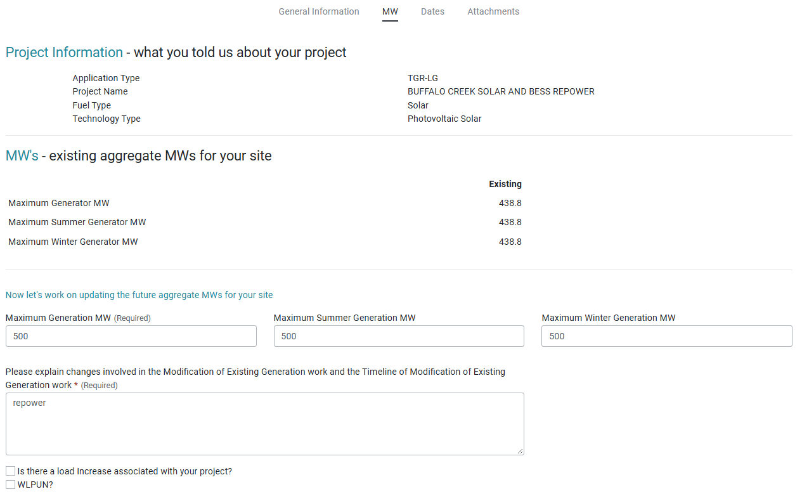
Your Project Information
Existing MW from RIOO-RS (read‑only)
1
Enter your future MW
2
Describe the changes and timeline
1
3
2
Site control proof only if you need more land.
3
Notes:
Most project information - location, company - is pre-filled from the substation you picked. The MW page shows today's MW from RIOO-RS (read-only) above the future MW you enter. Describe the changes and timeline in the text box. Proof of site control is only required if the project needs additional land.

Slide 7
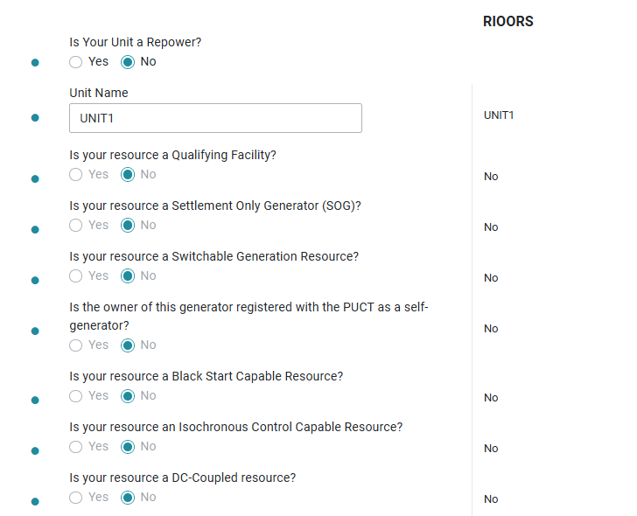
Choosing Which Units Change
"Is your unit a Repower?" – Yes opens the unit for updates
2
1
1
Current RIOO-RS values are shown next to each field
2
3
Answered No: the unit stays as is (read‑only)
3
You can also add new units or retire existing ones.
Notes:
This is the heart of Repower. Every existing unit at the substation is listed. Answer Yes for the units you are changing - those open up, with the current RIOO-RS value shown next to each field. The example shows a unit answered No: its fields are locked. You can still add brand-new units, and retire existing units - retirements take effect on your PLD.

Slide 8
After You Submit
Submit your INR
ERCOT review
Your PLD
Available in
RIOO-RS
Good to know
ERCOT reviews your before and after MW values
All changes in one Repower INR share a single PLD
Changes are applied to RIOO-RS automatically – no manual loading
Retired units are removed from RIOO-RS on your PLD
Units you did not mark as Repower stay unchanged
Notes:
After submission ERCOT reviews the request - the review screen shows before and after MW. On the PLD, the changes are applied to RIOO-RS automatically. One PLD per Repower INR.

Slide 9
RIOO Repower – Key Milestones
07/10/2026 – Delivered: Operational substation selection available in the INR workflow
R11 Release (tentatively 12/16/2026): Repower (Modification of Existing Generation) becomes available
Notes:
July release is in Production. Repower is planned for the R11 release, tentatively 12/16/2026.

Slide 10
Questions/Comments?
Srinath.Gurlinka@ercot.com
Sreenivas.badri@ercot.com

