Slide 1
ERCOT
Technology Working Group (TWG)
Weijun Ji
Sreenivas Badri
October 22, 2026
Outline:
Antitrust Admonition
Agenda
Sequence of discussion Items

Slide 2
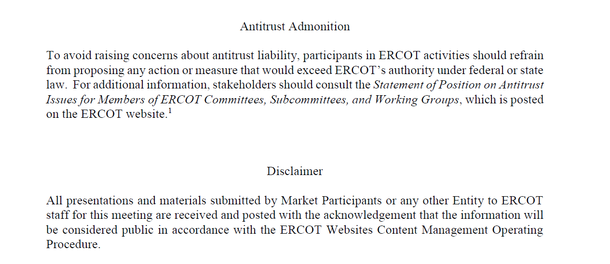
ERCOT TWG

Slide 3
Webex Meeting Reminders
Webex Meeting Reminders - Same as other ERCOT forums
Please keep line muted
If you have a question, please use the Webex chat feature to either:
Type in your question, or
Type in “Question” and wait to be recognized to state question
Your question will be addressed either during the presentation or at the end. If time does not permit, ERCOT SMEs will provide a response through Webex chat before the meeting concludes or respond to you via email after the meeting.
Presenters are requested to complete their presentation within allotted time and give time to participants to ask questions.
The meeting facilitator will provide time checks to remind presenters and participants of the remaining time for each agenda item.

Slide 4
Agenda
Item # | Item Description | Presenter(s) | Start Time
1 | Antitrust admonition and General updates | Sreenivas Badri | 2:00 PM
2 | NERC EMS WG updates | Wei Qui | 2:02 PM
3 | Project Updates | Troy Anderson | 2:10 PM
4 | 2026 October and November (R10 & R11) release changes Market Submissions Data and Information Products | Katherine Li Jamie Lavas | 2:20 PM
5 | SCR829 – NDCRC QSE Test Request API implementation – Timelines update | Nick Barbas | 2:40 PM
6 | Market Data Transparency (MDT) SLA Conversion | Jamie Lavas | 2:50 PM
7 | RIOO Repower Implementation and demo | Prudhvi Gurlinka | 3:00 PM
8 | DPC Process Automation Tool – Go-Live and Temporary DPC Formal Transition to DPC Submission Forms and Submission Exception Handling updates. | Yugendher Karedla | 3:25 PM
9 | NPRR1188 project system impacts – Q&A Session | Vamsi Paruchuri Xiangjun Xu | 3:40 PM
10 | Round Table discussion | Weijun Ji | 3:55 PM
11 | Adjourn | Weijun Ji | 4:05 PM

Slide 5
NERC EMS WG
  NERC EMS WG updates – Wei Qui

Slide 6
Project Updates
  Project updates – Troy Anderson

Slide 7
2026 October and November (R10 & R11) Release changes
      Market and Outage Scheduler Submissions – Katherine Li
      Data and Information Products – Jamie Lavas

Slide 8
SCR829 – NDCRC QSE Test Request API Implementation
SCR829 – NDCRC QSE Test Request API implementation – timelines update – Nick Barbas

Slide 9
Market Data Transparency (MDT) SLA Conversion
Market Data Transparency (MDT) SLA Conversion – Jamie Lavas

Slide 10
RIOO Repower
RIOO Repower Implementation and demo – Prudhvi Gurlinka

Slide 11
DPC Process Automation Project
DPC Process Automation Tool – Go-Live and Temporary DPC Formal Transition to DPC Submission Forms and Submission Exception Handling updates - Yugendher Karedla

Slide 12
NPRR1188 Project
NPRR1188 project system impacts – Q&A session
– Vamsi Paruchuri/Xiangjun Xu

Slide 13
ERCOT TWG – Round Table Discussion
ERCOT TWG – Round Table Discussion
  Future Topics of Interest
  Topics and presentations from TWG members

Slide 14
Thank You
Questions/Comments/Feedback?
You can reach Sreenivas at
Sreenivas.Badri@ercot.com and Weijun at weijun.ji@lcra.org

