Slide 1
Outline
  Temporary DPC submission - Formal Transition to DPC Submission Forms using DPC Dashboard.
  Fall back options/Submission issues exception handling
This effort provides new tool to Market Participants to facilitate DPC submission process for Temporary DPCs.
Downstream Production Changes (DPC)- Process Automation
Yugendher Karedla / Yong Ma
Oct 22, 2026

Slide 2
Downstream Production Changes (DPC)
Downstream Production Change (DPC) is a standard process that makes changes to the Network Model in production in between the weekly model loads without having to load a new model (database load).
This process is managed by the multiple teams at ERCOT (Network Modeling, GMS, Shift Engineers, Operations etc.).
DPC process helps update the network model in both Energy and Market Management systems (EMS and MMS) incorporating the changes submitted by the transmission operators that are critical to maintaining the reliability of the system.
The DPC process allows ERCOT to make specific data modifications in real-time including:
  Static Line / Transformers Ratings
  Dynamic Line Ratings
  Line / Transformer Impedance
  Contingency Definition updates
  Enabling and Disabling of Contingencies
  GTC updates
  RAP and RAS changes
GTC and RAP/RAS definition updates related DPCs are submitted by ERCOT Operations team.

Slide 3
Downstream Production Changes (DPC)
DPC process is intended to make model changes in production between weekly model loads as necessary, not for model changes that can follow normal NOMCR timelines.
Current High level DPC Process
MP
(Submits Model changes for DPC)
NMMS
Review Model and Create DPC
Jira Process
1. Review and Approve by Operations team
2. Track DPC implementation in EMS/MMS systems across multiple models
EMS/MMS
DPC process demands significant collaboration efforts between several departments within ERCOT and market participants. It requires significant amount of manual effort to create, validate, track and implement DPCs in multiple environments across multiple weekly model loads.
The manual nature of DPC tasks often leads to inefficiencies, delays, and increased resource loading across several departments within ERCOT. This multifaceted process demands extensive time and resources to ensure accuracy and efficiency.

Slide 4
Distinction between Permanent and Temporary DPC type updates
  Permanent DPC types
    DPC updates that will be done in Production , but they also will need to go into Network Model
    These DPC updates will continue to be applied in Production for few more model loads, before they are included within NMMS CIM XML file.
    All DPC types are eligible for Permanent DPCs.
    Continue to follow the current process of submitting Permanent DPC NOMCRs into ERCOT modeling system.
  Temporary DPC types
    DPC updates that does not need to go into Network Model.
    DPC updates that requests ERCOT control room to make a temporary update to model data due to a field outage / field work, that can last for up to 2 weeks.
    Below are the 2 major Temporary DPC types that ERCOT receives from MPs
      Static Line / Transformers Ratings
      Enabling and Disabling of Contingencies
    New DPC UI Tool is developed to provide ability for MPs to quickly submit temporary DPCs, with effective dates to ERCOT production system.
  A new DPC Dashboard will be developed that provides full list of DPCs (both permanent and temporary DPCs) with their status (planned / Implemented) with a historian for past DPCs implemented.

Slide 5
DPC notifications from ERCOT CR
One address per organization — you manage the members
Suggested format
ercotdpcnotifications@[yourdomain]
ercotdpcnotifications@lcra.org
ercotdpcnotifications@oncor.com
ercotdpcnotifications@aep.com
ERCOT configures once
TO manages recipients
One address per org — no changes needed when your team membership changes
Add or remove team members from the alias without any ERCOT involvement
Instant staff changes
No personal emails at ERCOT
New hires added, departing members removed — all within your own systems
Individual addresses are never stored on the ERCOT side
NOTIFICATIONS SENT TO THIS ALIAS
✕
Rejected
⏰
Temporary DPC expiring
DPC rejected by ERCOT; rejection reason included in the notification
Sent XX days/hrs before expiration (6hrs??);

Slide 6
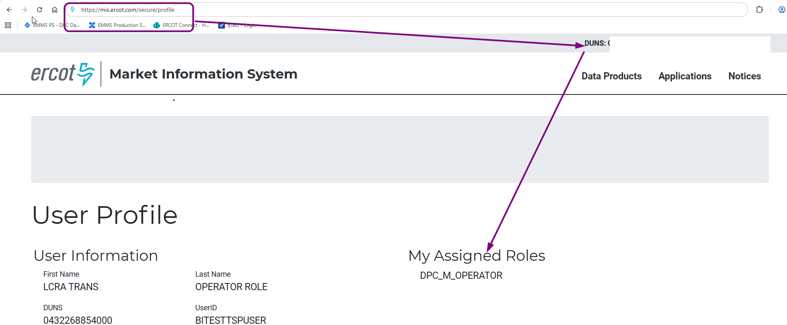
DPC Dashboard Access
Access control
  Application access will be granted via digital certificates
  New roles must be added to the certificate for authorization
    Operator (DPC_M_OPERATOR)
    ReadOnly (DPC_M_VIEW)
    Effective for MOTE from 07/13/2026
    Effective for PROD from 08/28/2026
  How do I know if I have role in my certificate
  This is for PROD - https://mis.ercot.com/secure/profile
  Link will be available from current OSUI page (This feature will be available from September)

Slide 7
New DPC Tool – High Level Implementation Details
  DPC Tool support following DPC Types
    Update Static Line / Transformers Ratings
    Enabling and Disabling of Contingencies
  DPC Tool Data Flows:
NMMS Mage
(Network Model)
Permanent DPCs
DPC
Importer
OS UI
MPs
DPC Tool
ERCOT Review & Approval (DPC Dashboard)
EMS/MMS
Temporary DPCs
MPs DPC dashboard (All DPCs)

Slide 8
Contingency DPC updates:
NMMS MAGE vs DPC Submission Form— decision table
Category | Definition change needed? | NOMCR to NMMS MAGE? | Status set in submission in NMMS MAGE | Separate Temporary DPC? DPC Submission Form from Dashboard
Permanent | Always to NMMS MAGE | Yes | Set directly to desired (enabled/disabled) state | No
Temporary — no definition change | No | No | No | Yes — sole submission
Temporary — modifying existing | Yes | Yes | Retain previous status | Yes Just add a comment in temporary submission form- “Implement NOMCR# before this”
Temporary — brand-new | Yes (by definition) | Yes | Disabled (default) | Yes Just add a comment in temporary submission form- “Implement NOMCR# before this”

Slide 9
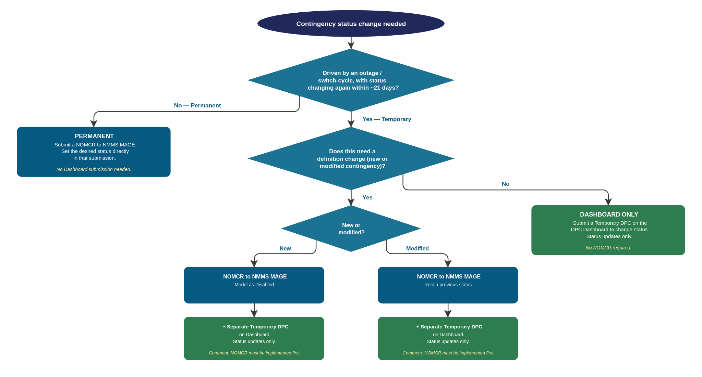
The same logic, as a decision tree

Slide 10
Temporary DPC Submissions – Parallel Period & Switchover - Updates
Transition Temporary DPC submission to DPC UI
◦ October 21, 2026 — Confirmed full-transition date
Reference: Market Notice M-A082626-02
From this date, Temporary DPCs will be submitted only through the new DPC submission forms
NMMS MAGE will no longer be used for Temporary DPC submissions
ercotdpcsupport@ercot.com for any clarifications

Slide 11
Temporary DPC Submissions – Quick Reference (Effective Oct 21, 2026) - Updates
Effective October 21, 2026, Temporary DPCs must be submitted through the DPC Dashboard
The scenarios below describe how exceptions are handled
Scenario 1: Submitted to NMMS MAGE only
Scenario 2: DPC Dashboard access/issue
Scenario 3: Submitted to both systems
TO submits Temporary DPC in NMMS MAGE
TO is unable to submit via the DPC Dashboard UI (access or technical issue)
TO submits the same Temporary DPC in both NMMS MAGE and the DPC Dashboard UI
ERCOT Network Modeling team reviews and rejects the submission
TO notifies ercotdpcsupport@ercot.com and networkmodelcoordinators@ercot.com
DPC Dashboard UI submission is treated as primary
TO will be notified to resubmit via the DPC Dashboard UI
TO submits the Temporary DPC via NMMS MAGE as a temporary fallback
The NMMS MAGE submission will be rejected
ERCOT assists in resolving the access/technical issue

Slide 12
Questions/Comments?
ercotdpcsupport@ercot.com

