Slide 1
2026 October & November (R10 & R11) Releases – Market & Outage Scheduler Changes
Katherine Li
October 22, 2026
Outline:
2026 October (R10) Release
2026 November (R11) Release
Key Takeaways
  One Market submission change planned in October (R10) release.
  No Market or Outage Scheduler submission changes planned in November (R11) release.

Slide 2
2026 October/November (R10/R11) Releases
2026 October (R10) Release will be deployed into Production on 10/29/2026.
  One market submission validation message enhancement for Current Day Plan (COP) Ancillary Service (AS) Capability validation is currently planned.
      to be able to show two decimal points of the amount of megawatts (MW) in response message.
      No XSD change.
2026 November (R11) Release will be deployed into Production on 12/17/2026.
  November (R11) release does not have any Market or Outage Scheduler submission changes that may impact Market Participants.

Slide 3



2026 October (R10) Release – Market Submission Validation Change
One market submission validation message enhancement for COP AS capability - to be able to handle two decimal points of MW in COP validation message.
  An example: a COP submission of Reg-Down (REGDN) capability
      the submitted COP REGDN capability: 195.8 MW
      the resource’s qualified MW for REGDN: 195.78 MW
      once submitted, the following message is provided currently:
      with the change in R10, the message will be improved to indicate clearly the reason for “Validation of the COP failed”.
  Submission message:
  Notifications:

Slide 4
Outage Scheduler Submission Change
One Outage Scheduler submission change is planned for Production as either an off-cycle release or with October release.
  Enhance the Resource Planned Outage Limit (RPOL) violation warning messages

Slide 5
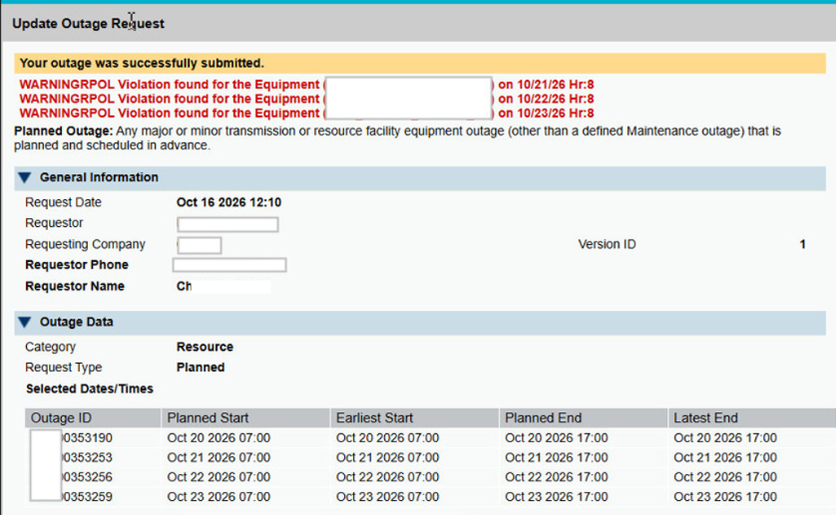
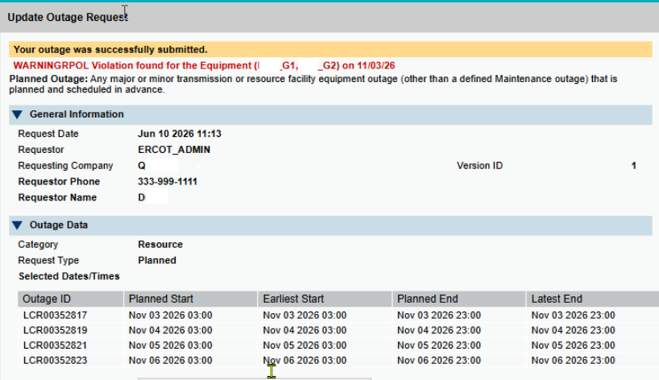
Outage Scheduler Submission Change
Fixing an issue in Outage Scheduler User Interface (OS UI) to ensure that RPOL violation warning message to be provided, consistently, for each day that is of RPOL violation if the submission has multiple days of RPOL violation.
  An example – the RPOL violation warning messages should be for all days of violation.
  Incomplete messages without the fix:

Slide 6
Questions/Comments?
Katherine.Li@ercot.com
Sreenivas.Badri@ercot.com

