Slide 1
Credit Exposure Update
Credit Finance Subgroup
ERCOT Public
​
October 21, 2026

Slide 2
Monthly Highlights: August 2026 – September 2026
Market-wide average Total Potential Exposure (TPE) decreased from $ 2.120 billion in August to $1.877 billion in September.
Forward adjustment factors on average decreased during the month
    Discretionary Collateral is defined as Secured Collateral in excess of TPE,CRR Locked ACL and DAM Exposure
  Average Discretionary Collateral decreased from $ 4.40 billion in August compared to $4.24 billion in September
No unusual collateral call activity

Slide 3
TPE and Forward Adjustment Factors: September 2025 – September 2026

Slide 4
TPE/Real-Time & Day-Ahead Daily Average Settlement Point Prices for HB_NORT:H September 2025 – September 2026

Slide 5
Available Credit by Type Compared to Total Potential Exposure (TPE):
September 2025 – September 2026
Numbers are as of month-end except for Max TPE

Slide 6
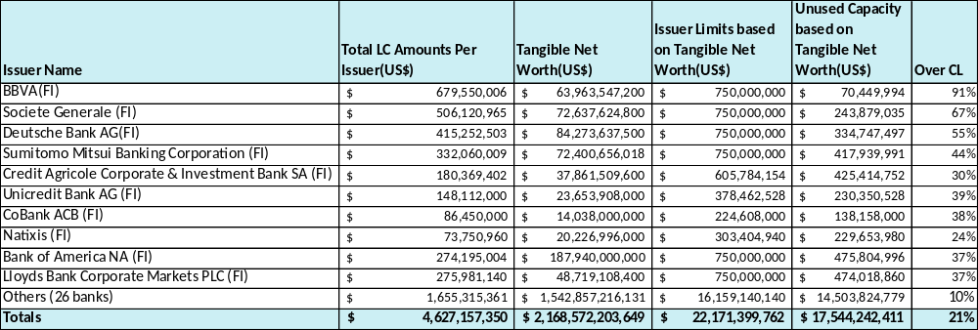
Issuer Credit Limits vs Total LC Amounts Per Issuer: September 2026
As of September 30, 2026
There are a total of 36 banks that have issued LCs.

Slide 7
Discretionary Collateral August 2026 – September 2026

Slide 8
Discretionary Collateral by Market Segment September 2024 – September 2026

Slide 9
TPE and Discretionary Collateral by Market Segment - September 2026
Load and Generation entities accounted for the largest portion of discretionary collateral

Slide 10
TPEA Coverage of Settlements August 2025 - August 2026
Invoice Exposure | Historical | Future
Invoice Exposure | 7 Days Back Net Invoice Amounts (Charges & Credits) | M1 Days (including current day) Forward Net Invoice Amounts (Charges & Credits); Excluding: 1) Securitization Invoices; 2) CRR Auction Invoices; and 3) Subchapter N Funds Distribution Invoice

Slide 11
TPEA Coverage of Settlements August 2025 - August 2026
Invoice Exposure | Historical | Future
Invoice Exposure | 7 Days Back Net Invoice Amounts (Charges & Credits) | M1 Days (including current day) Forward Net Invoice Amounts (Charges & Credits); Excluding: 1) Securitization Invoices; 2) CRR Auction Invoices; 3) Subchapter N Funds Distribution Invoice

Slide 12
TPEA Coverage of Settlements August 2025 - August 2026
Invoice Exposure | Historical | Future
Invoice Exposure | 7 Days Back Net Invoice Amounts (Charges & Credits) | M1 Days (including current day) Forward Net Invoice Amounts (Charges & Credits); Excluding: 1) Securitization Invoices; 2) CRR Auction Invoices; 3) Subchapter N Funds Distribution Invoice

Slide 13
TPEA Coverage of Settlements August 2025 - August 2026
Invoice Exposure | Historical | Future
Invoice Exposure | 7 Days Back Net Invoice Amounts (Charges & Credits) | M1 Days (including current day) Forward Net Invoice Amounts (Charges & Credits); Excluding: 1) Securitization Invoices; 2) CRR Auction Invoices; 3) Subchapter N Funds Distribution Invoice

Slide 14
TPEA Coverage of Settlements August 2025 - August 2026
Invoice Exposure | Historical | Future
Invoice Exposure | 7 Days Back Net Invoice Amounts (Charges & Credits) | M1 Days (including current day) Forward Net Invoice Amounts (Charges & Credits); Excluding: 1) Securitization Invoices; 2) CRR Auction Invoices; 3) Subchapter N Funds Distribution Invoice

Slide 15
TPEA Coverage of Settlements August 2025 - August 2026
Invoice Exposure | Historical | Future
Invoice Exposure | 7 Days Back Net Invoice Amounts (Charges & Credits) | M1 Days (including current day) Forward Net Invoice Amounts (Charges & Credits); Excluding: 1) Securitization Invoices; 2) CRR Auction Invoices; 3) Subchapter N Funds Distribution Invoice

Slide 16
Questions

