Slide 1
Batch 1+
Stakeholder workshop #3
October 15, 2026
Version 2
Format changes to slides 12-16 and 23-24
Slide 16 additional bullets for proposed next steps
Added one appendix slide (BYOG priority survey results from Workshop #2)

Slide 2

PUBLIC
On the agenda
1. Antitrust admonition
2. PUCT 58481 Discussion
3. Pre-Batch Portal Process Discussion (LIOO)
4. Other Batch details
5. Batch Large Load Reporting/Transparency
6. BYOG/PCLR Enhancement Discussion
7. Adjourn and wrap up
2

Slide 3
PUBLIC
On the agenda
1. Antitrust admonition
2. PUCT 58481 Discussion
3. Pre-Batch Portal Process Discussion (LIOO)
4. Other Batch details
5. Batch Large Load Reporting/Transparency
6. BYOG/PCLR Enhancement Discussion
7. Adjourn and wrap up
3

Slide 4
PUCT Project 58481: Process flow
Default process flow in 16 TAC §25.194
Interconnection study
ILLE sends request to TSP / DSP
ILLE and TSP / DSP enters into intermediate agreement*
Interconnecting TSP / DSP submit to ERCOT to initiate interconnection study
ERCOT initiates interconnection study
ERCOT provides updates on interconnection study
Interconnecting TSP / DSP, or ERCOT provides timely notification of transmission capacity allocated to the ILLE
Execute and fund the SLLIA¹ (including disclosure updates)
Post security, pay CIAC in cash, and agree to pay large load minimum billing demand
60 days
60 days
5 working days
5 working days
5 working days / update
ERCOT Batch study
*Intermediate agreement requirements:
TSP/DSP study fee ($100K)
ERCOT study fee (TBD)
Financial security for system upgrades ($50K/MW)
Disclosures, including site control, similar interconnection requests, site progress, phased energization schedules, water usage, state and local regulatory approvals, backup generation / onsite facilities, controllability, plans for power supply
Inform ILLE
Inform ILLE
Inform ILLE
Other major topics
This rule standardizes interconnection requests for all load types
If an ILLE does not hit milestones (e.g., energizing within time period), they will lose allocated capacity; refund terms have also been changed
All curtailment is outside of this rule
Competitively sensitive information is treated as protected
Every process step is subject to audit and verification

Slide 5
PUBLIC
On the agenda
1. Antitrust admonition
2. PUCT 58481 Discussion
3. Pre-Batch Portal Process Discussion (LIOO)
4. Other Batch details
5. Batch Large Load Reporting/Transparency
6. BYOG/PCLR Enhancement Discussion
7. Adjourn and wrap up
5

Slide 6

PUBLIC
Load Integration & Ongoing Operations (LIOO) Overview
LIOO is ERCOT's centralized application and data repository for Large Loads
A single location to request, collect, and maintain Large Load information
Improved visibility into interconnection status
Supports the Large Load lifecycle from interconnection through ongoing operations
ERCOT is still working to develop process sequence and hand-offs within the overall process¹
6
1. Will be discussed in later workshop

Slide 7

PUBLIC
Anticipated Release: December 2026
Initial Release – What to Expect
Read-Only Access: External Participants will initially have read-only access
Project Visibility: External Participants can view applicable project status through dashboards
Centralized Large Load Data: Centralized repository for Large Load project information
ERCOT Data Management: For the initial release, ERCOT will enter and maintain Large Load data
7

Slide 8
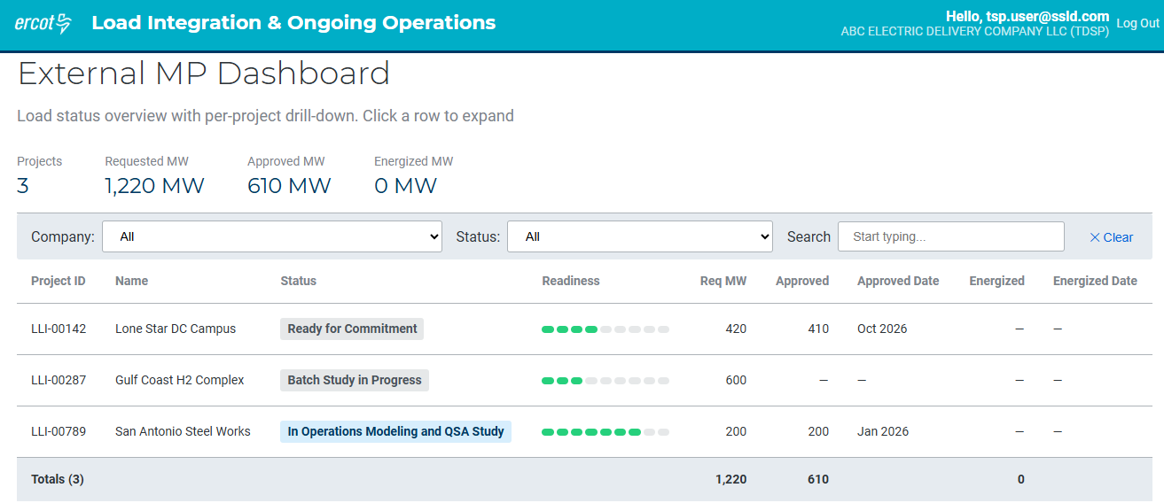
External Participant Dashboard (1/2)
Sample data generated for demonstration purposes only
The initial LIOO release will include an External Participant dashboard showing projects associated with the logged-in user
NOTE: This is a preliminary version. Field names and labels are subject to change as the design is further refined

Slide 9
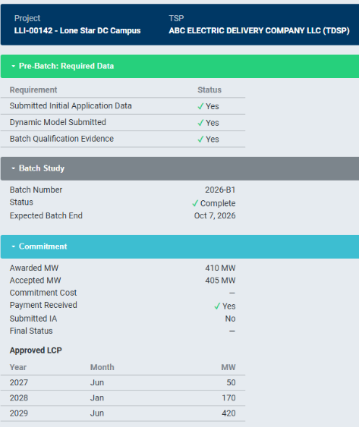
External Participant Dashboard (2/2)
Sample data generated for demonstration purposes only
Users will have the ability to drill down into a project to see additional details
NOTE: This is a preliminary version. Field names and labels are subject to change as the design is further refined

Slide 10
What Comes Next?
Initial Release
(Dec 2026)
Data entered and maintained by ERCOT
External Participants have read-only access
Pre-Batch 1 Release
TSPs and ILLEs will be able to enter and manage information directly in LIOO
Future Enhancements
Capabilities continue to evolve with Large Load processes and requirements
10

Slide 11
PUBLIC
On the agenda
1. Antitrust admonition
2. PUCT 58481 Discussion
3. Pre-Batch Portal Process Discussion (LIOO)
4. Other Batch details
5. Batch Large Load Reporting/Transparency
6. BYOG/PCLR Enhancement Discussion
7. Adjourn and wrap up
11

Slide 12
Batch processes: Batch re-study proposals
ERCOT considers stakeholder conceptual review substantially complete for these items. ERCOT will begin incorporating them into Revision Requests.
PUBLIC
Yes
No
No Opinion
xx
# of respondents
Q6-8: Do you agree with ERCOT’s proposed approach [to the following issues]? % of respondents
Q6: ILLEs with unfulfilled ramp: ERCOT is proposing that ILLEs with unfulfilled ramp may request re-study under their original Large Load Batch (LLB) tracking number
TSP
15
ILLE
11
Generators
25
Others
8
Total
59
Q7: Uncommitted large loads: ERCOT is proposing for large load projects that did not commit in prior Batch, that they may request inclusion in subsequent Batch studies, provided they (i) formally request it and (ii) pay a new study fee. The ILLE’s financial security, intermediate agreement, LL tracking number, and all portal information would carry forward to the new Batch study
TSP
15
ILLE
11
Generators
25
Others
8
Total
59
Q8: Large loads excluded from Batch Zero: ERCOT is proposing to allow large loads that received a tracking number, but were excluded from Batch Zero, to request inclusion in Batch One. ERCOT will waive the subsequent Batch fee if the interconnecting TSP/DSP attests that the ILLE has already paid at least $100k in study fees for the project. The ILLE must meet all other Batch One study requirements
TSP
15
ILLE
11
Generators
25
Others
8
Total
5%
59
Majority of respondents (73-76%) agree with ERCOT’s three proposed approaches to improve the Batch process
Source: CTP TSP survey, fielded 09/15–09/21 (n = 74 respondents; 15 blank responses)

Slide 13
Potential changes to large loads (1/2)
ERCOT considers stakeholder conceptual review substantially complete for these items. ERCOT will begin incorporating them into Revision Requests.
Preliminary
For ILLE changes to batch projects: ILLE must submit change request in the portal, with the following rules
Potential change
Treatment / restudy rule¹
1
In-service date (forward or backward)
  If earlier date, subject to restudy, while maintaining keep base load status for prior commitments.
  If later date, no restudy and will be reflected in next Batch / CTP study
2
Project MWs (increase or decrease)
  If increase in size, subject to restudy, while maintaining base load status for prior commitments
  If decrease, no restudy
3
Change LCP (ramp)
  If increase and/or earlier LCP ramp amount, subject to restudy, while maintaining base load status for prior commitments
  If decrease and/or later LCP ramp amount, no restudy but will be reflected in next Batch / CTP study
4
Change ownership
  Administrative change
5
Change POI
  Restudy in next Batch, unless ERCOT determines the new POI is electrically equivalent
6
Change type of load
  See "Change load characteristics (dynamics)"
1. Restudy detailed on slide 24

Slide 14
Potential changes to large loads (2/2)
ERCOT considers stakeholder conceptual review substantially complete for these items. ERCOT will begin incorporating them into Revision Requests.
Preliminary
For ILLE changes to batch projects: ILLE must submit change request in the portal, with the following rules
Potential change
Treatment / restudy rule¹
7
Change load characteristics (dynamics)²
  See next slide
8
Change DSP
  Administrative change
9
Change TSP
  Administrative change if no POI change; otherwise see “Change POI”
10
Split the project into multiple projects
  No restudy if electrically similar; otherwise restudy in next Batch
11
Change disclosure info
  Administrative change
12
Change co-location status
  No restudy if electrically similar; otherwise restudy in next Batch
13
Cancel
  Can cancel and be removed at any time, but there will be a deadline for reflecting that change in the current Batch / CTP study
1. Restudy detailed on slide 18
2. Including reactive consumption

Slide 15
Evaluation of Changing Load Characteristics (dynamics)
Preliminary
ERCOT considers stakeholder conceptual review substantially complete for these items. ERCOT will begin incorporating them into Revision Requests.
1. VRT/FRT Impact Check
2. Dynamics Impact Check
ERCOT checks the dynamic model to determine if there's an adverse impact on VRT or FRT performance
ERCOT checks the dynamic model to determine if there’s
a material impact to the dynamics
Evaluation Principle and Guidelines
  If the changes negatively impact dynamic performance, a restudy is needed
  If the changes are equal or better from
  a dynamic performance perspective,
  an assessment is needed without affecting the allocation
Start
Is there an
adverse impact on
VRT or FRT
performance?
Is there
a material impact to the dynamics?
No
Yes
Load does not need to be restudied in a subsequent batch, but it does need to be assessed in the next batch stability study, which does not affect its allocation but could impact its Initial Energization date
Yes
No
Load must be restudied in a subsequent batch
No restudy is needed
VRT = Voltage Ride Through
FRT = Frequency Ride Through

Slide 16
What does “Restudy in the next Batch” mean?
ERCOT considers stakeholder conceptual review substantially complete for these items. ERCOT will begin incorporating them into Revision Requests.
Preliminary
Unless otherwise noted, a restudy means:
The Large Load will forfeit any previously allocated MWs
The Large Load will enter the next Batch as a “studied load”
The Large Load must pay the Batch study fee and meet all other prerequisites for the Batch study, including any relevant deadlines

Slide 17
PUBLIC
On the agenda
1. Antitrust admonition
2. PUCT 58481 Discussion
3. Pre-Batch Portal Process Discussion (LIOO)
4. Other Batch details
5. Batch Large Load Reporting/Transparency
6. BYOG/PCLR Enhancement Discussion
7. Adjourn and wrap up
17

Slide 18
Batch reporting/transparency: Overview
Preliminary
NPRR 1267 as a starting point for Large Load transparency (approved June 2025, not implemented)
3.2.7 Large Load Interconnection Status Report
(1) For purposes of this section, a Large Load is inclusive of one or more Facilities at a single site with an aggregate peak Demand greater than or equal to 75 MW behind one or more common Points of Interconnection (POIs) or Service Delivery Points that is seeking interconnection on or after March 25, 2022. ERCOT may expand the criteria for including a Load as a Large Load, provided the defining criteria are clearly stated in the applicable report.
(2) ERCOT must publish a Large Load Interconnection status report each month to the ERCOT website that aggregates Large Load Interconnection requests across multiple dimensions with as much specificity as possible while maintaining the confidentiality of Customer data, including:
(a) Load Zone;
(b) TSP;
(c) Load type (as provided to the TSP, such as refinery, steel mill, data center, etc...);
(d) Calendar quarter and year in which the interconnecting TSP submitted the project to ERCOT;
(e) Requested energization quarter and year;
(f) Size range;
(g) Interconnection status (as defined by ERCOT to differentiate between operational, approved, under study, etc.);
(h) Co-location status.
18

Slide 19
Batch reporting/transparency: Overview
Preliminary
NPRR 1267 as a starting point for Large Load transparency (approved June 2025, not implemented)
3.2.7 Large Load Interconnection Status Report
(3) ERCOT shall take actions such as providing ranges of interconnection MW sizes, aggregate loads, and other similar actions to protect, anonymize, and otherwise safeguard confidential and competitively-sensitive Customer data from public disclosure. When aggregating Customer data, ERCOT should ensure that at least five Customers exist in a particular Load type subcategory prior to aggregation, to protect against accidental disclosure. ERCOT may leave a certain category blank or aggregated with other Load types to avoid disclosure.
ERCOT shall report to TAC or its designated subcommittee its methodology for developing the report defined in paragraph (2) above whenever that methodology changes, but at least every two years.
19

Slide 20
Batch reporting/transparency: Survey results
PUBLIC
Preliminary
Q34: NPRR1267 establishes a monthly aggregated Large Load report to improve transparency. The report includes the data elements listed below, with protections to prevent disclosure of confidential information when aggregation levels are not adequate to maintain anonymity. Please list any reporting elements you would like added or modified.
Data elements: Load zone, TSP, load type (as provided to the TSP), TSP submission to ERCOT quarter, requested energization quarter and year size range, interconnection status, co-location status
Data element
Example data element details
Ramp & energization performance detail (11)
  Requested ramp by quarter
  Actual MW energized vs. approved ramp schedule
  Energized MW vs. requested MW
  Average timeline from application to energization
Project configuration / technology classification (11)
  BYOG/WLPUN/PCLR election or designation
  Back up generation type (e.g., islanded generation, backup generation, WLPUN/BYOG)
  Generation resource type for co-located projects (solar, wind, BESS, gas)
Locational detail (9)
  County and/or city, including geographic coordinates
  Proposed or actual POI
Batch/study & agreement status detail (8)
  Batch or study cohort
  Intermediate Agreement and financial security status
  Commitment status following Batch study
  Standardized readiness milestones (e.g., site control, permits, construction status)
Data-center load-type sub-categorization (2)
  Data center type (e.g., AI training, AI inference, cloud, enterprise, crypto)
  Respondents flagged the need to protect confidentiality: Concerns include the ability to identify customers from broad data, lack of appropriate aggregation thresholds, and clarity on data that will not be published
Source: CTP TSP survey, fielded 09/15–09/21 (n = 74 respondents; 41 blank responses).

Slide 21
Existing GIS report provides a starting point to define Large Load reporting attributes
Yes
No
Conditional
Include equivalent in
LL report?
Include in
LL report?
GIS report attribute
GIS report attribute
1
INR
17
FIS Approved
2
Project Name
18
Economic Study Required
3
GIM Study Phase
19
IA Signed
# | GIS attribute | Include in Large Load report?
Project attributes
1 | INR | 🟡 Conditional
2 | Project Name | ❌ No
3 | GIM Study Phase | ✅ Yes
4 | Interconnecting Entity | ❌ No
5 | POI Location | 🟡 Conditional
6 | County | 🟡 Conditional
7 | CDR Reporting Zone | ✅ Yes
8 | Projected COD | ✅ Yes
9 | Fuel | 🟡 Conditional
10 | Technology | 🟡 Conditional
11 | Capacity (MW) | ✅ Yes
12 | Changes from Last Report | ✅ Yes
Project milestone dates
13 | Approval Date for Submission of Proof of Site Control | 🟡 Conditional
14 | Screening Study Started | 🟡 Conditional
15 | Screening Study Complete | 🟡 Conditional
16 | FIS Requested | 🟡 Conditional
17 | FIS Approved | ✅ Yes
18 | Economic Study Required | ❌ No
19 | IA Signed | ✅ Yes
20 | Financial Security and Notice to Proceed Provided | 🟡 Conditional
21 | Air Permit | 🟡 Conditional
22 | GHG Permit | 🟡 Conditional
23 | Water Availability | 🟡 Conditional
24 | Meets Planning Guide Section 6.9(1) Requirements for Inclusion in Planning Models | 🟡 Conditional
25 | Meets All Planning Guide Section 6.9 Requirements for Inclusion in Planning Models | 🟡 Conditional
26 | Meets Planning Guide QSA (Section 5.9) Prerequisites | ✅ Yes
27 | Construction Start | 🟡 Conditional
28 | Construction End | 🟡 Conditional
29 | Approved for Energization | ✅ Yes
30 | Approved for Synchronization | ❌ No
31 | Comment | ❌ No
20
Financial Security and Notice to Proceed Provided
4
Interconnecting Entity
5
POI Location
21
Air Permit
6
County
22
GHG Permit
7
CDR Reporting Zone
23
Water Availability
8
Projected COD
24
Meets Planning Guide Section 6.9(1) Requirements for Inclusion in Planning Models
9
Fuel
10
Technology
25
Meets All Planning Guide Section 6.9 Requirements for Inclusion in Planning Models
11
Capacity (MW)
26
Meets Planning Guide QSA (Section 5.9) Prerequisites
12
Changes from Last Report
13
Approval Date for Submission of Proof of Site Control
27
Construction Start
28
Construction End
14
Screening Study Started
29
Approved for Energization
15
Screening Study Complete
30
Approved for Synchronization
16
FIS Requested
Do we need any other attributes to add to the Large Load report?
Source: ERCOT Generator Interconnection Status (GIS) Report, “Project Details – Large Gen” tab

Slide 22
PUBLIC
On the agenda
1. Antitrust admonition
2. PUCT 58481 Discussion
3. Pre-Batch Portal Process Discussion (LIOO)
4. Other Batch details
5. Batch Large Load Reporting/Transparency
6. BYOG/PCLR Enhancement Discussion
7. Adjourn and wrap up
22

Slide 23
BYOG/PCLR enhancements: Under evaluation (1/2)
ERCOT is continuing to triage BYOG and PCLR enhancements, assessing technical feasibility and implementation complexity, and will share priorities as the evaluation progresses
Category
Enhancement
Description
Top 4 near-term priorities
Top 4 long-term priorities
WLPUN registration and lifecycle
1
WLPUN opt-out option during Commitment
Allow a Large Load with WLPUN to elect to be a standalone Large Load if the batch study results in full withdrawal capability for the load; i.e., cancel the GINR project without losing the load allocation
2
WLPUN exit plan
Define how a WLPUN can transition to different registration upon completion of energization of planned facilities (load, generation, and transmission upgrades as applicable)
3
WLPUN generation additions
Define how to add more generation to an existing/planned WLPUN site.
4
WLPUN on-ramp for existing Large Load
Define how to add generation to an existing/planned standalone Large Load so that it becomes a WLPUN
WLPUN enhancements
5
WLPUN Dynamic Limits
Define how WLPUN withdrawal limits could change from static to dynamic values in real-time
6
Large load self-supply outside of Batch
Allow a Large Load with generation to connect before going through the batch if the load ensures that it will not consume from the grid until after it goes through a batch process, i.e., use the GINR process
7
WLPUN with Settlement Only Generation
Allow a WLPUN to use Settlement Only generation
Alternative BYOG enhancements
8
Large Load island transition to grid-connected
Define process for islanded configurations to become grid-connected
9
BYOG at different location¹
Develop BYOG option for generation at a different location from the Large Load (if selected, provide comment on extent of "different location", such as one station away, or beyond)
10
Define/allow Self-Limiting Facility (SLF) PUN
Combine SLF and PUN concepts
11
Pursue BYOG option of Netted Network
Consider in the planning process how Netted Network concept discussed at Aug 21 LLWG would impact allocations if adopted in Operations.
1. This item resulted to be both a top 4 near- and long-term priority
Source: 1-ERCOT-CTP-stakeholder-workshop-2_09242026_v2

Slide 24
BYOG/PCLR enhancements: Under evaluation (2/2)
ERCOT is continuing to triage BYOG and PCLR enhancements, assessing technical feasibility and implementation complexity, and will share priorities as the evaluation progresses
Category
Enhancement
Description
Top 4 near-term priorities
Top 4 long-term priorities
Detailed next
Alternative BYOG enhancements (continued)
12
Allow Multiple POIs and/or Customer-owned Substations
n/a
13
Allow mix of resources at PUN
Allow a mix of different resource registration categories at a PUN, i.e., Generation Resources AND Settlement Only
14
Allow temporary generation
Allow temporary generation until the transmission is built to reliably serve the Large Load. Generation is planned from the beginning to be temporary without having to go through the RMR process
Battery enhancements
15
Define operational battery registration
Define battery registration for batteries that are only used for meeting operational requirements, e.g., voltage ride-through
16
Develop rules for market-operating operational batteries
Define rules for batteries that are added for operational requirements, and want to participate in the market
17
Rules for using an interconnected battery as part of PCLR
n/a
18
Alternative PCLR interconnection pathways¹
Explore alternative pathways for PCLRs to interconnect and operate independently of Batch timelines while maintaining ERCOT reliability requirements
Other stakeholders’ ideas
19
Alternative technologies to enable Large Load interconnection²
Evaluate the use of distributed energy resources and other alternative technologies to alleviate transmission constraints and enable additional Large Load capacity
20
Alternative approaches to transmission capacity allocation³
Explore alternative mechanisms for allocating transmission capacity to Large Loads, including market-based approaches and financial commitments
21
Enhanced coordination of generation and flexible loads⁴ (NPRR1348)
Explore mechanisms to coordinate separately metered generation and flexible load operations, including operational netting arrangements that maintain ERCOT visibility and dispatchability
1. Agentic Infrastructure — PCLR Market Design Initiatives | 2. PIQ Energy – Flexibility without Curtailment: Aggregate DER Dispatch to Support Additional Firm Large Load Service | 3. Vistra - An Open Season Batch Integration for Large Load Interconnection | 4. Global Capacity Alliance – FRONT-OF-THE-METER (FTM) NETTING
Source: 1-ERCOT-CTP-stakeholder-workshop-2_09242026_v2

Slide 25
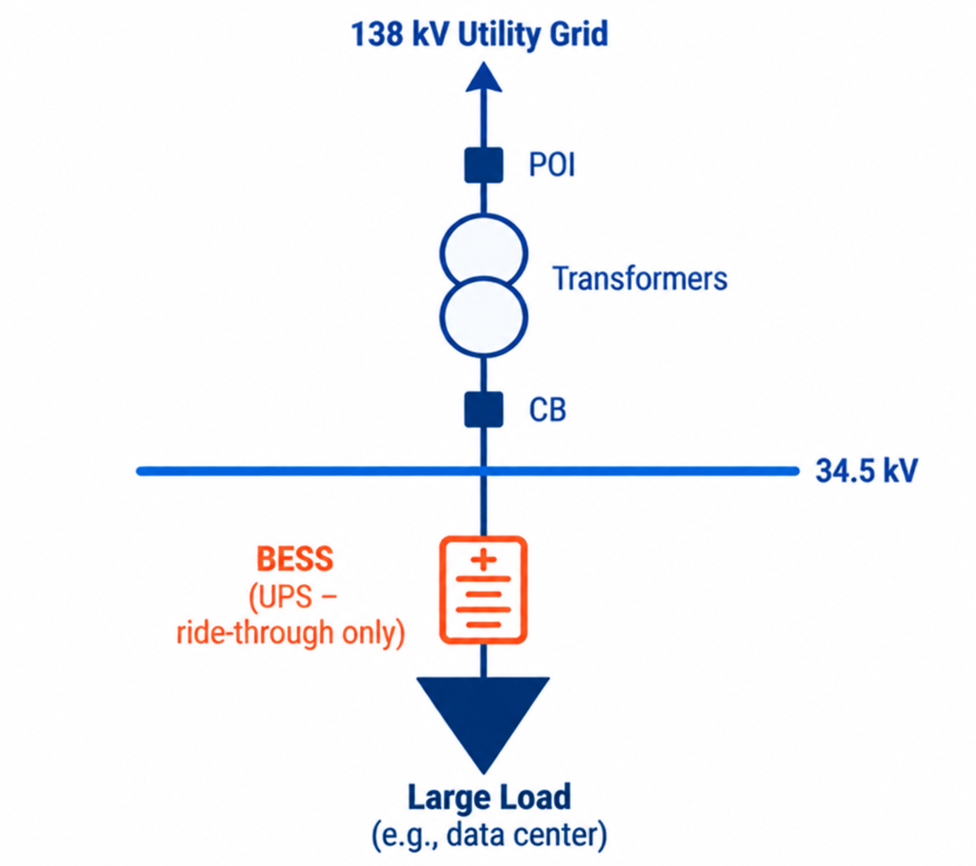
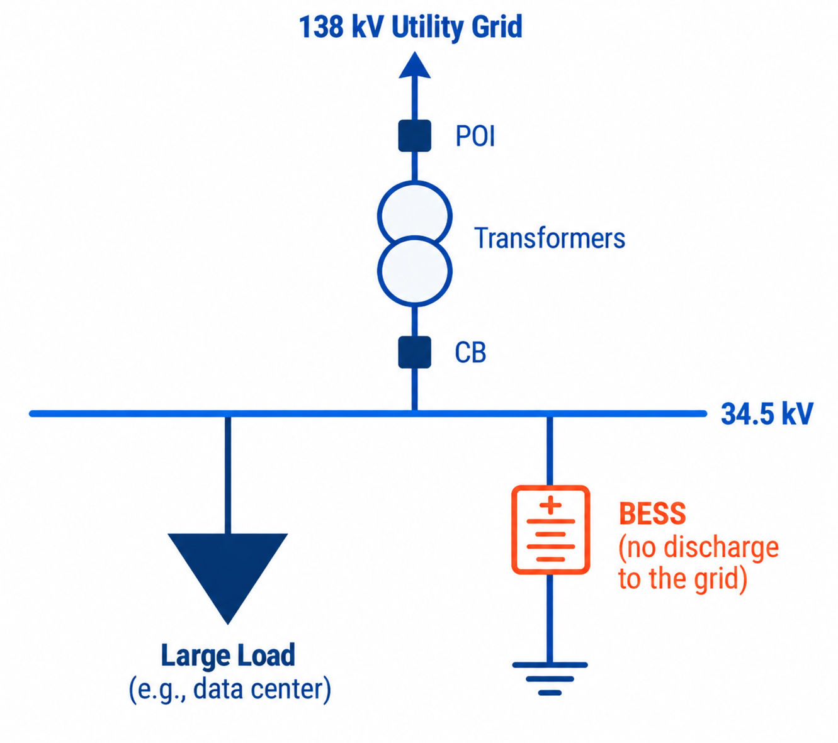
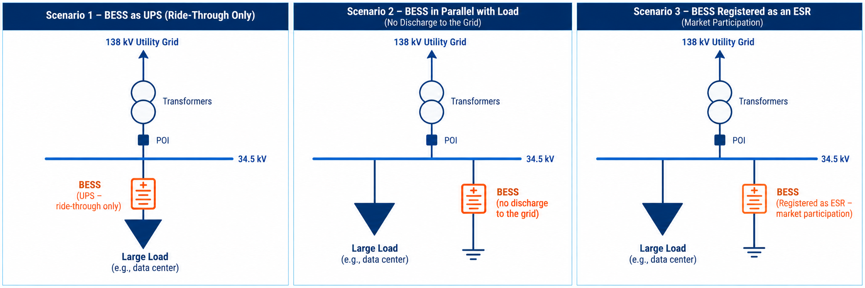
ERCOT is evaluating three BESS configurations to clarify interconn., modeling, and registration req's for Large Computational Loads
1
UPS (Ride-Through Only)
2
Parallel BESS w/o grid exports
3
Market-participating ESR
Configuration
BESS installed electrically between grid and Large Computational Load
BESS connected in parallel with the Large Computational Load
BESS connected in parallel with the Large Computational Load
Primary purpose
Provide ride-through during grid disturbances
Provide ride-through, demand response, or both
Provide ride-through while participating in ERCOT markets
Grid exports
Not permitted
Not permitted
Subject to ESR operating requirements
Interconnection study process
Batch
Batch and Generation Interconnection or Modification (GIM)
Batch and GIM as an ESR³
ERCOT modeling
Part of the Load
generator
ESR³
Registration
No additional registration
NSG¹ (when implemented⁴) or SOTSG²
ESR³
1. Non-Settled Generation | 2. Settlement Only Transmission Self-Generator | 3. Energy Storage Resource | 4. NPRR1317 and PGRR140

Slide 26
Deep-dive: UPS (Ride-Through Only)
1
BESS operating exclusively as UPS is modeled as part of the Large Load, without separate registration
Description and electrical configuration
Proposed ERCOT requirements
The BESS is installed electrically between the grid and the Large Computational Load, providing electrical decoupling and acting as an energy buffer
The configuration is designed to:
Protect the Large Computational Load from grid disturbances and support ride-through requirements
Maintain stable load behavior at the POI
Operate exclusively as a UPS, without exporting power to the grid
Interconnection study process
Batch process
Dynamic model
Model accurately representing the Large Load's dynamic characteristics at the POI, including the UPS/BESS. The applicable modeling and performance requirements are described in Planning Guide Section 6.2 and Nodal Operating Guide Sections 2.6 and 2.15 (e.g., LCL Ride-Through Requirements)
Stability studies
Stability study performed using the Large Load dynamic model
Planning studies
Studied as a Large Computational Load; Subsynchronous Oscillation (SSO) study required if applicable
NOM¹
BESS modeled as part of the Large Computational Load
Registration
No additional registration is required
1. Network Operations Model

Slide 27
Deep-dive: Parallel BESS w/o grid exports
2
BESS connected in parallel with a Large Computational Load requires separate generation modeling and registration, even without grid exports
Description and electrical configuration
Proposed ERCOT requirements
The BESS is connected in parallel with the Large Computational Load behind the same POI. The configuration supports two applications:
Ride-through: The battery supports the Large Computational Load during grid disturbances
Demand Response: The battery supplies energy to the co-located Large Computational Load, reducing net grid consumption when appropriate
The BESS is not designed to inject active power into the ERCOT grid
Interconnection study process
Batch (for Load) + Generation Interconnection or Modification (GIM) process, as Non-Settled Generation (NSG) when approved or Settlement Only Transmission Self-Generator (SOTSG)
Dynamic model
Dynamic models and data for the Large Load and BESS are separately needed and should accurately represent their dynamic characteristics at the POI. The applicable modeling/performance requirements are described in Planning Guide Section 6.2 and Nodal Operating Guide Sections 2.6, 2.14, and 2.15 (e.g., AGS-ESR Capability, LCL Ride-Through Requirements)
Stability studies
Stability study using both Large Load and BESS dynamic models, including associated control systems
Planning studies
SSO² study required, if applicable
NOM¹
BESS modeled as a generator
Registration
NSG when implemented or SOTSG; SOTSG registration is not available if a Generation Resource is co-located behind the same POI
1. Network Operations Model | 2. Subsynchronous Oscillation

Slide 28
Deep-dive: Market-participating ESR
3
The battery operates alongside the Large Computational Load while participating in ERCOT markets, subject to applicable modeling, ride-through, and available-capacity requirements
Description and electrical configuration
Proposed ERCOT requirements
The BESS is connected in parallel with the Large Computational Load and registered as an Energy Storage Resource (ESR).The configuration is designed to support both:
Ride-through: The battery provides support to the Large Computational Load during grid disturbances
Market participation: The battery participates in ERCOT markets as a registered ESR
The MW and State of Charge (SOC) capability made available to ERCOT markets must be derated
Interconnection study process
Batch (for Load) + Generation Interconnection or Modification (GIM) process as an ESR
Dynamic model
Dynamic data for the Large Computational Load and ESR are needed. The model should accurately represent their dynamic characteristics at the POI. The applicable modeling and performance requirements are described in Planning Guide Section 6.2 and Nodal Operating Guide Sections 2.6, 2.14, and 2.15
Stability studies
Stability study using both Large Load and ESR dynamic models, including associated control systems
Planning studies
Studied as a co-located ESR
NOM¹
BESS modeled as an ESR
Registration
ESR registration required; ESR cannot receive Wholesale Storage Load (WSL) treatment within a Private Use Network (PUN); market-available MW and SOC capability must be derated
1. Network Operations Model

Slide 29
PUBLIC
On the agenda
1. Antitrust admonition
2. PUCT 58481 Discussion
3. Pre-Batch Portal Process Discussion (LIOO)
4. Other Batch details
5. Batch Large Load Reporting/Transparency
6. BYOG/PCLR Enhancement Discussion
7. Adjourn and wrap up
29

Slide 30
Thank you – Discussion of next steps
Next Workshop in November
  Up for discussion- potentially after LLWG Nov 19 (same as today)
Revision Requests under consideration
  Batch 1+ Revision Request for on-ramp and commitments for Batch Study (Large Load submissions, eligibility, financial security, etc)
  Current related issues needing other Revision Requests:
    75MW-> 50MW transition of NERC definition
    Process for Large Load changes (ownership, load type, etc)

Slide 31
Batch processes: Priority BYOG enhancements (from Workshop #2)
PUBLIC
Others
Generators¹
ILLE
TSP
Q9: Select the four highest priority BYOG enhancements that you would like ERCOT to work on in the NEAR TERM, # of selections
24
2
21
18
17
16
15
15
15
1
1
13
13
12
12
11
1
9
10
7
1
2
1
3
2
2
1
2
2
2
1
1
1
1
2
1
1
1
1
1
2
2
2
2
Q10: Select the four highest priority BYOG enhancements that you would like ERCOT to work on in the LONGER TERM, # of selections
18
17
16
18
2
15
14
13
12
1
2
12
1
2
8
9
10
10
9
8
1
1
2
6
1
2
2
1
4
1
3
1
2
1
1
2
2
1
2
2
2
2
2
1
1
1
1
1
1
1
1
1
1
(6) Large load self-supply outside of Batch
(9) BYOG at different location
(2) WLPUN exit plan
(15) Define operational battery registration
(17) Develop rules for using an interconnected battery as part of PCLR
(14) Allow temporary generation
(5) WLPUN Dynamic Limits
(4) WLPUN on-ramp for existing Large Load
(16) Develop rules for market-operating operational batteries
(8) Large load island transition to grid-connected
(3) WLPUN generation additions
(12) Allow Multiple POIs and/or Customer-owned Substations
(11) Pursue BYOG option of Netted Network
(1) WLPUN opt-out option during Commitment
(10) Define and allow Self-Limiting Facility (SLF) Private Use Networks (PUN)
(13) Allow mix of resources at PUN
(7) WLPUN with Settlement Only Generation
No opinion
Survey identified clear differences between near-term and long-term enhancement priorities
Near-term: large load self-supply, BYOG at different locations, WLPUN exit plan, define operational battery registration
Long-term: BYOG at different locations, large load island transition to grid-connected, WLPUN generation additions, WLPUN dynamic limits
Source: CTP TSP survey, fielded 09/15–09/21 (n = 74 respondents; 3 blank responses).
1. Defined as Independent Generators (n=13) and Developers (n=20)

