Slide 1
EPE · ERCOT LARGE LOAD WORKING GROUP · OCTOBER 15, 2026
Simulating PCLR Dynamic Bid Capping in SCED
A multi-SCED method for evaluating large load curtailment risk under the Adjusted Bid Cap
Dr. Mohamed Ahmed
Vice President, Markets, Regulatory and Rates
Electric Power Engineers, LLC
Agenda item 5 · 11:00 a.m. CT · 30 minutes including Q&A
Notes:
Thank you Bob and Patrick for the slot. I am presenting a simulation method, not a position on any revision request. The goal is to get feedback from this group on how we are interpreting the bid-capping mechanism and on what outputs would be useful to developers, QSEs and ERCOT.

Slide 2
The question developers started asking in spring 2026
WHY WE ARE HERE
WHAT BATCH ZERO WILL TELL A LARGE LOAD
Why the old answer no longer works
A Low Power Consumption limit
Developers used to size curtailment risk by picking a bid price and running a market simulation: bid high, see how often price exceeds it.
Under dynamic bid capping the PCLR's bid is no longer its own. SCED replaces it, interval by interval, with a cap computed from binding constraints, shift factors and the system lambda.
So the risk is now a property of the location in the network and of the hour, not of the bid. Only a nodal simulation that reproduces ERCOT's capping logic can quantify it.
EPE built that simulation. This presentation shows how it works and what it returns.
The firm amount the system can serve reliably becomes the maximum LPC. Everything between the LPC and the requested Maximum Power Consumption is approved contingent on qualifying as a PCLR and following SCED base points.
WHAT IT WILL NOT TELL THEM
How often, how much, and because of what
How many hours per year the PCLR portion is curtailed, how many MWh that is, which transmission constraints cause it, what the price at the POI looks like while it happens, and how any of that changes once ERCOT applies the Adjusted Bid Cap in SCED.
Notes:
Since the Batch Zero workshops, the question from developers changed. They understand the PCLR; what they cannot work out is the curtailment risk between the LPC the batch study will give them and the MPC they want to run at, now that ERCOT will set their bid for them.

Slide 3
Four things in the next 30 minutes
DISCUSSION OUTLINE
PART 01
PART 02
PART 03
PART 04
The PCLR construct and the bid-price problem
ERCOT's dynamic bid capping
EPE's multi-SCED method
From the numbers to the map
Why neither a $5,000 bid nor a $100 bid tells a data center its curtailment risk.
The Adjusted Bid Cap mechanism as proposed in the Batch Zero workshops, and what the formula implies.
Two 8,760-hour SCED runs with an hourly capping step between them, and the quality control that makes the results interpretable.
GIS capabilities: constraints, shift factors and curtailment bus by bus, and tracking the upgrades that relieve them.
Notes:
Four parts plus the open questions. The method is in part three; the examples in part four are illustrative and anonymized.

Slide 4
PART 01
The PCLR construct and the bid-price problem
A load that wants all the energy the grid can reliably deliver does not have a bid price. The market model needs one anyway.
Notes:
Part one is background most of you know; two slides, then the problem statement.

Slide 5
The PCLR in one picture: a firm floor, a flexible range, SCED in between
PART 01 · THE CONSTRUCT
AS THE BATCH STUDY SEES IT
WHAT THE DEVELOPER HAS TO FINANCE AGAINST
1
Studied like firm load
PCLR range
curtailable
by SCED
MPC · Maximum Power Consumption (requested)
Steady state at the LPC, stability at full consumption; the reliable firm amount becomes the maximum LPC.
Curtailment exposure
2
Dispatched like a CLR
Above the LPC the load follows SCED base points. Its energy bid curve decides when it is curtailed relative to everything else.
Firm load
below LPC
LPC · Low Power Consumption (firm, from Batch Zero)
3
Bid-capped by SCED
Dynamic bid capping is added so the PCLR is dispatched rather than letting a constraint violate. The cap is computed by SCED, not chosen by the load.
4
Exposure = LPC to MPC
0 MW
The whole range is at risk unless the developer can quantify when and why it is curtailed.
Source: ERCOT Large Load Interconnection Batch Study Workshop #7, April 9, 2026, PCLR foundational concepts (design and language under review).
Notes:
Left: the load as the batch study sees it. The LPC is the firm floor; everything above it to the MPC is the PCLR range, dispatched by SCED like a CLR. Right: what the developer has to finance against.

Slide 6
A data center has no bid price, but the simulation needs one
PART 01 · THE BID-PRICE PROBLEM
Modeling choice | What it assumes | What it does to LMPs | What it does to curtailment | Verdict
Bid at the cap ($5,000/MWh) | Load is almost never willing to be curtailed | Sustained, unrealistically high LMPs at and around the POI whenever the load is marginal | Low, but only because the model paid any price to serve it | Realistic reliability, unrealistic prices
Bid low ($100/MWh) | Load is price-sensitive like any other | Believable LMPs | Systemic, repeated curtailment that no data center could operate under | Realistic prices, unrealistic reliability
Bid in between ($1,000/MWh) | A compromise with no physical meaning | Sensitive to the arbitrary choice | Sensitive to the arbitrary choice | The answer moves with the assumption
Dynamic bid cap (ERCOT PCLR) | SCED sets the bid from binding constraints, shift factors and system lambda | Bounded: the cap is tied to the constraint it relieves | Consistent with how ERCOT will actually dispatch the PCLR | The case to simulate
The point: the Adjusted Bid Cap is ERCOT's answer to the same problem the simulators had. It removes the arbitrary bid, but it moves the difficulty into the network: the cap now depends on which constraints bind, how much the load contributes to them, and what the system lambda is in that interval.
Notes:
This is the dilemma Tim's team ran into on every developer study. The high bid gives you believable curtailment but absurd prices; the low bid gives you believable prices and absurd curtailment. Neither is how a data center values reliability.

Slide 7
PART 02
ERCOT's dynamic bid capping, as proposed
The Adjusted Bid Cap: a trigger list from the previous SCED run, a shift-factor rule, and a formula anchored on the Step 1 system lambda.
Notes:
Part two restates the mechanism from Workshop 7 so that everyone is looking at the same formula before I show how we implement it.

Slide 8
The Adjusted Bid Cap in three steps, as presented by ERCOT
PART 02 · THE MECHANISM
1
SCED₋₁ · previous run
2
SCED current · before Step 2
3
SCED Step 2 · bid capped
Trigger list
Match
Cap
After each SCED run, list every transmission constraint whose shadow price is at or above 90% of its maximum shadow price (base case, contingency, IROL and generic constraints).
Compare the trigger list against all constraints active in the current run. Only the matches are evaluated for PCLR bid capping.
For each PCLR with a shift factor ≤ −0.02 on a matched constraint, cap its energy bid curve at the ABC before Step 2 executes. No standard market mitigation applies to energy bid curves.
ADJUSTED BID CAP FORMULA
ABC = Step 1 System Lambda − max( MaxShadowPrice × ShiftFactor ) − $0.01/MWh
Applied only where the PCLR shift factor is ≤ −0.02 · constraint must appear in the prior-run trigger list · shift factor is negative for a load that relieves the constraint, so the second term adds to lambda
Source: ERCOT Batch Study Workshop #7, April 9, 2026, slide 13, Provisional CLR dynamic bid capping process; Nodal Protocols Section 4.4.9.4.4 (proposed).
Notes:
Step one, after each SCED run, list the constraints whose shadow price is at or above 90 percent of its maximum. Step two, in the next run, match that list against the active constraints. Step three, for any PCLR with a shift factor of minus two percent or more negative on a matched constraint, cap its bid before Step 2 of the two-step SCED. The cap is the Step 1 system lambda minus the largest product of maximum shadow price and shift factor, minus a cent.

Slide 9
The cap is a property of the location and the hour, not of the load
PART 02 · WHAT THE FORMULA IMPLIES
THREE CONSEQUENCES FOR A DEVELOPER
1
Location-specific
The cap depends on the PCLR's shift factor on each triggered constraint. Two loads of the same size at different buses get different caps and different curtailment.
2
Interval-specific
The trigger list is rebuilt after every SCED run and the system lambda changes every interval. The cap is a time series, not a number.
3
Neighbor-dependent
Which constraints bind, and how hard, depends on every other PCLR, generator and storage resource on the same constraint. One load's cap moves when its neighbors energize.
Illustrative values chosen for arithmetic; the maximum shadow prices in use are ERCOT's published values by constraint type.
Notes:
A worked example with round numbers. The shift factor is negative because consuming at this bus relieves the constraint, so the cap sits above lambda by the product of the maximum shadow price and the shift factor. The cap can be a few hundred dollars one interval and the full bid the next.

Slide 10
None of the inputs to the cap are known until SCED has run
PART 02 · WHY THIS NEEDS A NODAL SIMULATION
INPUTS THE CAP NEEDS, AND WHERE THEY COME FROM
What EPE already had
Input to the ABC | Where it comes from | Available to a developer today?
Which constraints bind, and their shadow prices, every interval | The SCED solution for the full ERCOT network with the study-year topology and fleet | No; requires a nodal dispatch simulation
Whether each shadow price is at ≥ 90% of its maximum | ERCOT's maximum shadow price by constraint type, compared with the solved value | Thresholds yes; the solved values no
The PCLR's shift factor on each triggered constraint | Network sensitivities from the same case and topology | Only from a network model of the study year
The Step 1 system lambda | The first step of the two-step SCED, before bid caps are applied | No; it is a by-product of the run
What the other PCLRs are doing | Their own caps and dispatch in the same interval | No; circular without a simultaneous solve
A nodal SCUC/SCED market simulator of the full ERCOT network, calibrated against ERCOT prices and congestion.
Study-year cases built from the SSWG planning cases, with the generation and large-load pipeline placed at its buses.
Hour-by-hour shadow prices, shift factors and system lambda as standard outputs.
So, the task was: reproduce ERCOT's capping logic inside that simulator, hour by hour, and return the curtailment it implies.
Notes:
Everything on the left is an output of a security-constrained dispatch of the full network. A developer cannot compute the cap from a spreadsheet, and a zonal or hub-level price forecast does not carry constraint shadow prices or shift factors at all.

Slide 11
PART 03
EPE's multi-SCED method
Two 8,760-hour SCED runs with an hourly capping step between them. Stage 1 finds the caps; Stage 2 shows what they do.
Notes:
Part three is the method. Four slides: the overview, the two stages, the capping step in between, and the quality control.

Slide 12
Stage 1 finds the caps, the screening step applies the formula, Stage 2 shows what they do
PART 03 · OVERVIEW
STAGE 1
SCREENING
STAGE 2
OUTPUTS
8,760-hour SCED, PCLRs at $5,000/MWh
Hourly ABC calculation
8,760-hour SCED, PCLRs at capped bids
What the developer gets
Full ERCOT nodal network, study-year case, all large loads placed at their buses. Returns hourly LMPs, binding constraints with shadow prices, and shift factors.
For every hour: constraints at ≥ 90% of their maximum shadow price; PCLRs with shift factor ≤ −0.02 on them; ABC from the formula. Produces an hourly capped bid curve per PCLR.
Same case, same assumptions, bids replaced by the Stage 1 caps. Returns dispatch, curtailment and prices consistent with how ERCOT would dispatch the PCLRs.
Curtailment hours and MWh by month and hour of day; LMP at the POI and the hubs; basis; the constraints driving the caps and the curtailment; shift factors and limiting elements.
Frequency is not energy
Same case both stages
Repeatable
The screening step alone tells you how many hours the cap triggers. Only Stage 2 converts that into MW and MWh curtailed, because the capped bid changes the dispatch.
Topology, fleet, fuel, load and weather are identical in both runs, so every difference between Stage 1 and Stage 2 is the bid cap.
The whole chain runs as a scripted workflow, so a new study year, a new LPC or a new set of neighboring loads is a rerun, not a new study.
Notes:
Read left to right. Stage 1 is a full-year SCED with every PCLR bidding at the cap. The screening step goes through all 8,760 hours, finds the triggered constraints and the PCLRs with qualifying shift factors, and recomputes the bids. Stage 2 reruns the year with the capped bids. The outputs are what a developer actually needs: curtailment in MW and MWh, prices, and the constraints behind both.

Slide 13
Stage 1: the year as it would clear with every PCLR bidding at the cap
PART 03 · STAGE 1
MODEL SET-UP
STAGE 1 RETURNS, FOR EVERY HOUR
Element | How it is represented
Network | Full ERCOT nodal topology for the study year, built from the SSWG planning cases and ERCOT's approved transmission projects
Generation | Existing fleet plus the interconnection pipeline by expected in-service date; unit characteristics, fuel and outage assumptions
Large loads | Every known large load placed at its bus with its firm and flexible components; the studied project modeled with its LPC and MPC
PCLR bids | Flexible component bids at $5,000/MWh in Stage 1; firm component is fixed load
Hourly profiles | Load, wind and solar profiles for the weather year; storage with charge and discharge logic
Constraints | Base case and contingency limits monitored as in ERCOT operations; maximum shadow prices by constraint type
LMP at every bus, including the studied POI and the trading hubs
Every binding constraint with its shadow price and the contingency and monitored element behind it
Shift factor of the studied PCLR, and of every other PCLR, on each binding constraint
Step 1 system lambda
The dispatch of every PCLR: served, partially served or curtailed
The list of hours in which the $5,000 bid itself is marginal, which is where the LMP artefacts appear
Notes:
What is in the Stage 1 model and what comes out of it. The case assumptions are agreed with the client; the generation and load pipeline follows ERCOT's published queue and batch information.

Slide 14
Between the runs: the ABC applied hour by hour, PCLR by PCLR
PART 03 · THE SCREENING STEP
SCREENING TABLE · ONE PCLR, SAMPLE HOURS (ILLUSTRATIVE VALUES)
Hour | Triggered constraint (≥ 90% of max SP) | Max SP | Shift factor | Contribution | System λ | ABC | Bid used in Stage 2
Jan 14, HE 07 | 138 kV line A–B, contingency C1 | $5,000 | −0.061 | −$305 | $62 | $366.99 | $366.99
Jan 14, HE 08 | 138 kV line A–B, contingency C1 | $5,000 | −0.061 | −$305 | $58 | $362.99 | $362.99
Jan 14, HE 12 | none above threshold | — | — | — | $31 | not applied | $5,000
Jul 22, HE 17 | 345 kV line C–D, base case | $5,000 | −0.015 | SF > −0.02 | $89 | not applied | $5,000
Aug 03, HE 16 | 138 kV line A–B, C1 · autotransformer E, C2 | $5,000 | −0.061 / −0.034 | −$305 / −$170 | $74 | $244.99 | $244.99
Dec 19, HE 06 | GTC North–South | $5,000 | −0.044 | −$220 | $55 | $274.99 | $274.99
Lowest absolute contribution wins
Trigger list lags one run
Output: a bid time series
Where several constraints qualify in one hour, the protocol takes the lowest absolute value of the constraint contributions, as on Aug 03 above.
The list comes from the previous SCED run, so a constraint that first binds in an interval does not cap the PCLR until the next one. The screening step reproduces that lag.
The capped bid curve per PCLR for all 8,760 hours is itself a deliverable: it shows a developer exactly when its bid is taken away.
Notes:
A sample of the screening table for one PCLR. Hours where no constraint passes the threshold, or where the shift factor is above minus two percent, keep the original bid. Hours that qualify get the computed cap. The result is a full-year bid curve per PCLR that goes into Stage 2.

Slide 15
Stage 2: the same year with the caps in place, and what comes out
PART 03 · STAGE 2 AND OUTPUTS
CURTAILMENT
PRICES AND COST
CONSTRAINTS
Hours and MWh curtailed, by month and by hour of day
Longest consecutive curtailment, number of events
Curtailment at the studied POI versus other PCLRs on the same constraints
Change from Stage 1 to Stage 2: what the cap itself costs the load
Hourly, monthly and annual LMP at the POI
Hub prices and basis risk POI-to-hub
On-peak and off-peak forecasts
Energy cost of the served load, and the value of the curtailed energy
Which constraints set the cap, and how often
Which constraints cause the curtailment, which is not always the same list
Shift factor of the project on each
Limiting element and contingency for each, so the constraint can be matched to an upgrade
Why the outputs are different from a bid-price study: they stack the PCLRs in the order ERCOT's protocols would, they separate the constraints that cap from the constraints that curtail, and they tell the developer how much of the post-cap bid still lets the load be served.
Notes:
Stage 2 is identical to Stage 1 except for the bids. What it returns is organized around the two questions developers ask: how much curtailment, and what is driving it.

Slide 16
PART 04
From the numbers to the map
Curtailment has a location and congestion has a corridor. The same results, bus by bus, on the ERCOT map, with the upgrades that would relieve them.
Notes:
Two slides on the GIS side. The results of the multi-SCED runs are spatial, and developers trust them faster when they can see the constraint on the map next to their site.

Slide 17
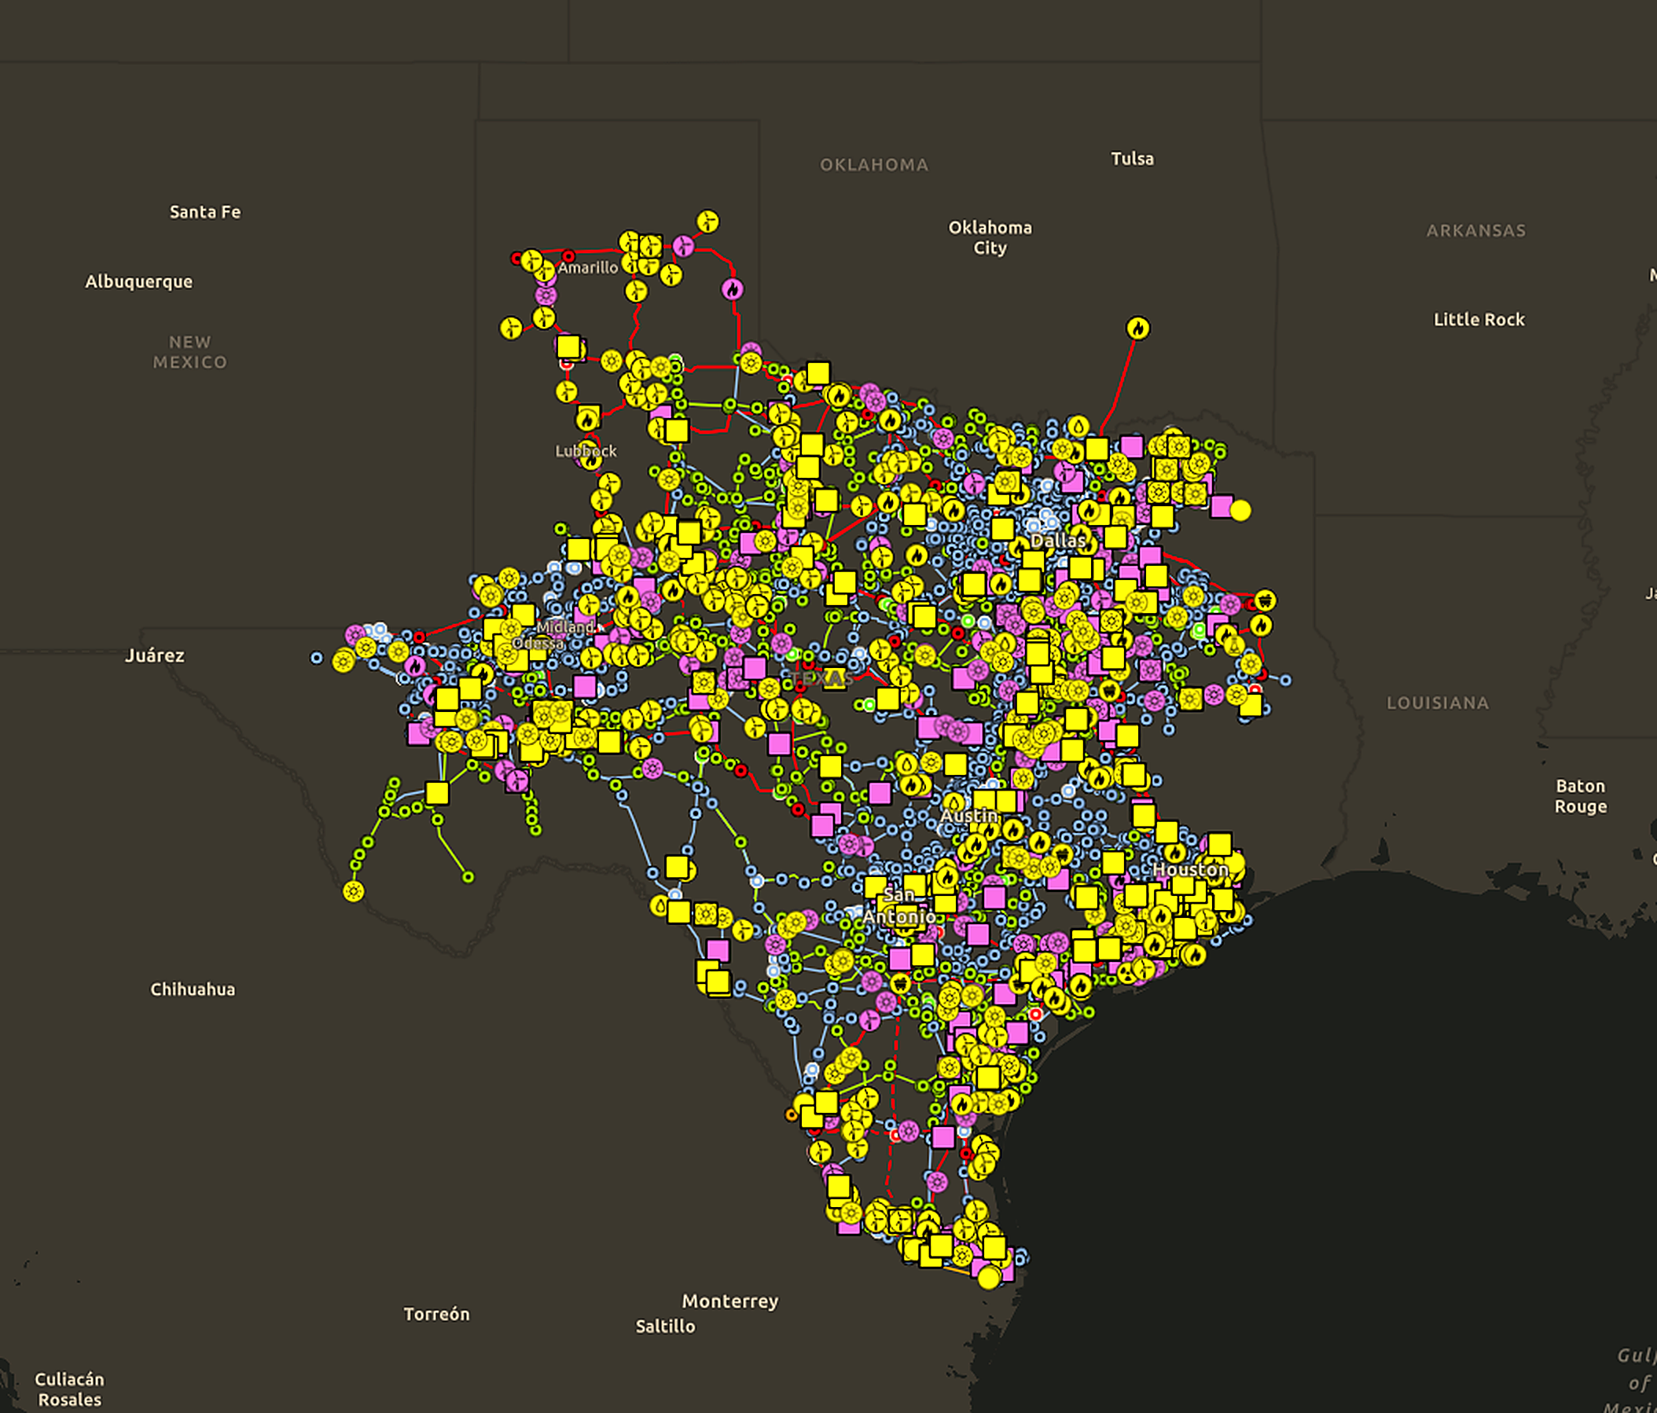
The whole footprint, with every project and constraint in place
PART 04 · GIS AND VISUALIZATION
One map, every layer
Existing and planned projects by fuel type, transmission by voltage, large loads from the batch process, study footprints and results, in one ArcGIS-based view.
Built on EPE's GIS group
The same team that builds the weather hazard surfaces and asset exposure overlays builds the study maps; one geodatabase serves both.
Why it matters for PCLRs
The constraints that cap and curtail a PCLR are physical elements with a location. Seeing them on the map, next to the site and the planned upgrades, is how a developer decides whether to wait, mitigate or move.
Screenshot: EPE platform, ERCOT network view; existing and planned generation by fuel, transmission by voltage.
Notes:
This is the live map in EPE's platform: every existing and planned generator by fuel type, the transmission network by voltage, and the study layers on top. A developer orients itself in seconds and sees which constraints sit between its bus and the rest of the system.

Slide 18
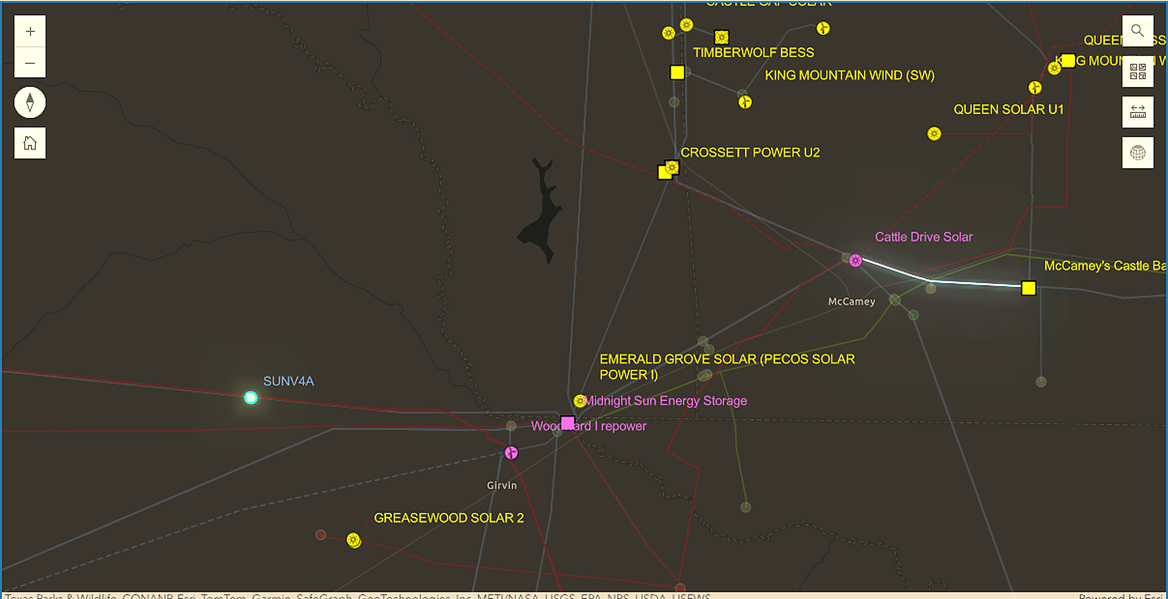
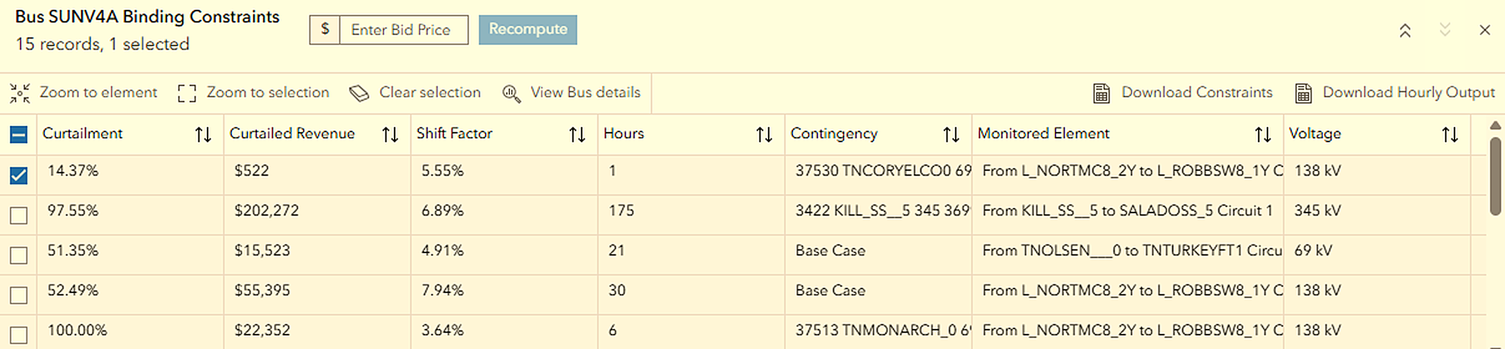
Binding constraints, shift factors and curtailment, bus by bus
PART 04 · GIS AND VISUALIZATION
Curtailment %: share of the project's energy lost to each constraint
Shift factor: how much of the project's consumption flows on the monitored element
Hours binding: how often the constraint binds across the 8,760 hours
Curtailed MWh: dollars at risk, by contingency and monitored element
Upgrade tracking
Each constraint is matched against RPG projects, the TPIT report and approved transmission plans, so the developer knows which upgrade relieves it and the expected year.
Screenshot: EPE curtailment module, ERCOT 2029 screening case, 200 MW project at bus SUNV4A; the same module applies to PCLR loads with the capped bid.
Notes:
Pick a bus, a project size and type, and the tool returns the binding constraints, their shift factors, how many hours they bind, and the curtailment and revenue at risk, with the monitored element and contingency for each. The same view works for a PCLR: enter the bid, or let the screening step enter the cap, and recompute. Then overlay the RPG projects and the TPIT report to see which upgrade relieves which row, and when.

Slide 19
What is still uncertain, and what would make the method more useful to everyone
OPEN ITEMS
UNCERTAINTIES WE CARRY TODAY
WHAT WOULD HELP
PCLR and bid-capping language is still under review and may change before filing; we implement what ERCOT communicated so far.
Which loads will be modeled as PCLRs in ERCOT's cases, and at what LPC, is not yet public; we use the batch declarations we can see.
The maximum shadow prices and the 90% threshold are taken as published; any change moves the trigger list.
Treatment of a paired resource under the cap is a design choice, not a settled rule; we report results for each choice.
From ERCOT
The PCLR list and LPC values once the batch results are final; confirmation of the threshold values and the trigger-list timing; any planned publication of the constraints that trigger caps.
From the working group
Feedback on whether our reading of the mechanism matches ERCOT's intent, and which outputs loads and QSEs would want standardized.
What EPE offers back
Once ERCOT publishes the PCLR models and parameters, we will rerun the method on the published set and bring the generalized, anonymized results back to this group.
Notes:
Honest list. The PCLR language is still under review, so some of what we implement today is our reading of the workshop material. The items on the right are what we would need from ERCOT, and what we would offer back.

Slide 20
Three things to take away
TAKEAWAYS
1
The cap moves the risk into the network
2
Two runs, not one
Under dynamic bid capping the PCLR's curtailment risk is set by shift factors, shadow prices and system lambda at its bus, interval by interval. It can only be quantified with a nodal simulation that reproduces the capping logic.
Stage 1 finds the caps; Stage 2 shows what they do. Trigger frequency alone overstates or understates the energy at risk; the second run converts hours into MWh.
3
The constraint list is the actionable output
Which elements cap the bid, which curtail the load, their shift factors and contingencies, mapped against planned upgrades. That is what lets a developer wait, mitigate or move.
Notes:
Four takeaways, then questions.

Slide 21
QUESTIONS AND DISCUSSION
Thank you
Dr. Mohamed Ahmed
Vice President, Markets, Regulatory and Rates
Electric Power Engineers, LLC · Austin, Texas
mahmed@epeconsulting.com · (512) 982-6353
Materials submitted to ERCOT for this meeting are public. Results shown are illustrative and anonymized; no client-specific data is included.
Notes:
Thank you. Happy to take questions now, and to follow up with anyone who wants to go deeper on the method.

