Slide 1
Project Update
Troy Anderson
ERCOT Portfolio Management
October 14, 2026
Outline:
Recent / Upcoming Project Highlights
2026 Release Targets
2027 Release Targets
Other Project Updates
Priority / Rank Recommendations
Technology Working Group (TWG)
Aging Revision Request Prioritization
Key Takeaways
Monthly project status update for ERCOT Portfolio Management presented to PRS
Covers 2026 release highlights, project updates, priority/rank recommendations, TWG update, and project planning

Slide 2
Project Update Agenda
Recent / Upcoming Project Highlights
2026 Release Targets
2027 Release Targets
Other Project Updates
Priority/Rank Recommendations for Revision Requests with Impacts
    NPRR1340 – Dispatchable Reliability Reserve Service Ancillary Service with Energy Storage Resource Participation
Technology Working Group (TWG)
  Next meeting is 10/22/2026
2026 Project Planning
Appendix
  Aging Revision Request Project Status – 2025
  Aging Revision Request Project Status – 2026
Location of Revision Request Project Information: http://www.ercot.com/services/projects
Notes:
Delete this slide before presenting

Slide 3
Recent / Upcoming Project Highlights
2026 October Release – 10/28/2026-10/29/2026 In Flight
  NPRR1198 – Congestion Mitigation Using Topology Reconfigurations
  NPRR1281 – Improvements to Alternate FFSS Resource Designation
      Used for the first time on Operating Day November 15th when the FFSS contract period begins
  NPRR1327 – As-Built for NPRR1281, Improvements to Alternate FFSS Resource Designation
2026 November Off-Cycle Release – 11/1/2026 In Flight
  NOGRR226 – Addition of Supplemental UFLS Stages
  NOGRR247(b) – Change UFLS Stages and Load Relief Amounts
2026 November Off-Cycle Release – 11/11/2026 In Flight
  SCR829 – API for the NDCRC Application
2026 December Release – 12/16/2026-12/17/2026 In Flight
  PGRR127 – Addition of Proposed Generation to the Planning Models
Note: Projected Go-Live dates are subject to change.
Please watch for market notices as the effective dates approach.

Slide 4
2026 Release Targets - Approved NPRRs / SCRs / Guide RRs
R1
R3
R5
January 1/28-1/29 | February 2/25-2/26 | March 3/25-3/26 | April 4/29-4/30 | May 5/27-5/28 | June 6/24-6/25
NPRR1234(c) PGRR131 NPRR1283 NPRR1285 NPRR1299 | NPRR1266 NPRR1277 | NPRR1287 Add’l Public Data Products in ERCOT Data Portal | CRR Historical Data Removal | NPRR1265 OBDRR055 | SCR820 PGRR145 NPRR1325
R2
R4
R6
ü
ü
ü
ü
ü
ü
ü
ü
ü
ü
4/24
1/1
ü
ü
3/1
ü
6/1
7/11
ü
ü
2/1
3/2
SCR820 TO/QSE Testing (see TWG meetings)
Cipher Security Upgrades (see TWG meetings)
RTC+B Stabilization
R7
R9
July 7/29-7/30 | August 8/26-8/27 | September 9/30-10/1 | October 10/28-10/29 | 11/1 | December 12/16-12/17
 | NPRR1290 NPRR1323 |  | NPRR1198 NPRR1281 NPRR1327 NOGRR258 PGRR113 | NOGRR226 NOGRR247b SCR829 | NPRR1201 PGRR127
R8
R10
R11
ü
ü
E
E
E
E
E
E
E
E
E
11/11
Go-live dates can differ from Protocol effective dates – Please refer to market notices for more details
APPENDIX
Red Text: New additions and target release changes
Strike-Through Text: Previous target release
(a), (b), etc.: Multiple phase release
Project Status Codes
NS = Not Started
I = Initiation
P = Planning
E = Execution
H = On Hold
NPRR1234(c) – RIOO changes for End-Use
Industry Classification to Loads
NOGRR247(b) – New / expanded UFLS stages
Release targets are subject to change

Slide 5
2027 Release Targets - Approved NPRRs / SCRs / Guide RRs
R1
R3
R5
January 1/27-1/28 | February 2/24-2/25 | March 3/24-3/25 | April 4/28-4/29 | May 5/26-5/27 | June 6/24-6/25
NPRR1188 NPRR1244 | NPRR936 NPRR1288 NPRR1201 |  | NPRR1004
R2
R4
R6
E
E
E
E
P
P
R7
R9
July 7/28-7/29 | August 8/25-8/26 | September 9/29-9/30 | October 10/27-10/28 |  | December 12/15-12/16
 |  |  |  |  | NPRR1328
R8
R10
R11
P
Go-live dates can differ from Protocol effective dates – Please refer to market notices for more details
APPENDIX
Red Text: New additions and target release changes
Strike-Through Text: Previous target release
(a), (b), etc.: Multiple phase release
Project Status Codes
NS = Not Started
I = Initiation
P = Planning
E = Execution
H = On Hold
Release targets are subject to change

Slide 6
Other Project Updates
NPRR1238 – Voluntary Registration of Loads with Curtailable Load Capabilities
  Part of Large Load Curtailment Manager project
  Initial implementation in June 2026, full scope by mid-2027 (including NPRR1238)
NPRR1309 – Board Priority - Dispatchable Reliability Reserve Service Ancillary Service (DRRS)
  PUCT approved on 7/9/2026
  Project started in July 2026
  Based on IA estimated duration, mid-2028 go-live is likely
NPRR826 – Mitigated Offer Caps for RMR Resources – and –
NPRR1342 – Mitigated Offer Caps for Contract for Capacity Resources
  Project starting this month
  Potential mid-2027 go-live
SCR805 – Provide Early Access to Certain 60-Day Reports to TSPs Upon Request
  ERCOT will be filing a new SCR to eliminate this system change

Slide 7
Priority / Rank Recommendations for Revision Requests with Impacts
Recommendations for…
Revision Request | Description | Priority | Rank | Comments
NPRR1340 | Dispatchable Reliability Reserve Service Ancillary Service with Energy Storage Resource Participation | 2026 | 440 | Preview of IA review at November PRS: $50k-$70k, 1-2 months Impacted System(s): MMS, S&B, EMS, CMM, Reporting Same Priority and Rank as NPRR1309 – if approved, will be added to scope of NPRR1309 project The 1-2 month duration can be incorporated into the NPRR1309 project with no impact to that project’s 20-30 month duration
NPRR1346 | Updates to Fuel Oil Price (FOP) | N/A | N/A | <$25k O&M – no project required
PPL Rank Information
Next 2026 Rank in Business Strategy = 4850 Next 2029 Rank in Business Strategy = 5300
Next 2027 Rank in Business Strategy = 4960 Next Rank in Regulatory = 470
Next 2028 Rank in Business Strategy = 5120

Slide 8
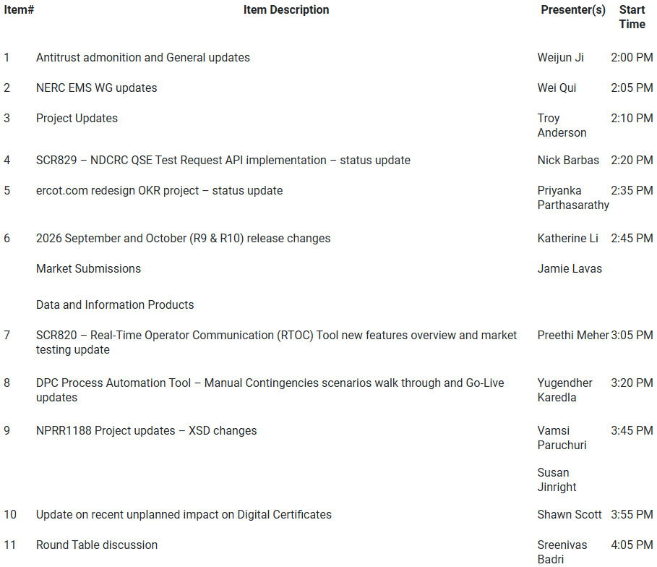
Technology Working Group (TWG) - 9/24/2026 Meeting
Next TWG scheduled for 10/22/2026

Slide 9
2026 Project Planning
ERCOT understands that Market Participants need lead time to implement changes in their systems for many Revision Requests
Approved Revision Request Project Starts – In progress in 2026
  NPRR826 – Mitigated Offer Caps for RMR Resources
  NPRR936 – CRR Account Holder Limits
  NPRR1004 – Load Distribution Factor Process Update
  NPRR1188 – Implement Nodal Dispatch and Energy Settlement for Controllable Load Resources
  NPRR1198 – Congestion Mitigation Using Topology Reconfigurations
  NPRR1201 – Limitations on Resettlement Timeline & Default Uplift Exposure Adj
  NPRR1238 – Voluntary Registration of Loads with Curtailable Load Capabilities
  NPRR1244 – Clarification of CLR Primary Frequency Response Responsibilities
  NPRR1277 – Revisions to EAL Formula
  NPRR1281 – Improvements to Alternate FFSS Resource Designation
  NPRR1288 – Remove Multiple Month Transactions in CRR Auctions
  NPRR1290 Ph 2 – Gap Resolutions and Clarifications for RTC+B + NPRR1323
  NPRR1309 – Board Priority - Dispatchable Reliability Reserve Service Ancillary Service (DRRS)
  NPRR1323 – Correction to Inadvertent Removal of Real-Time MCPC Capping for NPRR1290 Phase 2
  NPRR1328 – Establishment of Generation Firming Program
  SCR829 – API for the NDCRC Application
Green Text: Deemed “High Priority” at 2025 Prioritization Workshop
Blue Text: Deemed “High Priority” at 2026 Prioritization Workshop

Slide 10
Appendix
Aging Revision Request Project Status – 2025
Aging Revision Request Project Status – 2026

Slide 11
Aging Revision Request Project Status – 2025
10 Revision Request projects were deemed “High Priority” at August 2025 Prioritization Workshop
Status | High Priority Revision Request Projects | Additional Information
Complete | NPRR1234 – Interconnection Requirements for Large Loads and Modeling Standards for Loads >=25MW | System changes implemented in 3 phases Remaining gray box: Large Load Interconnection Study (LLIS) fee
 | NPRR1277 – Revisions to EAL Formula | Went live on 3/2/2026
In-Flight | NPRR1004 – Load Distribution Factor Process Update | April 2027 go-live target
 | NPRR1188 – Implement Nodal Dispatch and Energy Settlement for CLRs | January 2027 go-live target (w/NPR1244)
 | NPRR1198 – Congestion Mitigation Using Topology Reconfigurations | October 2026 go-live target
 | NPRR1238 – Registration of Loads with Curtailable Load Capabilities | Mid-2027 go-live target
 | NPRR1244 – Clarification of CLR Primary Frequency Response Responsibilities | January 2027 go-live target (w/NPR1188)
 | NPRR1281 – Improvements to Alternate FFSS Resource Designation | October 2026 go-live target
Not Started | NPRR1091 – Changes to Address Market Impacts of Additional Non-Spin Procurement | Expected to be part of Reliability Deployment Price Adder (RDPA) analysis
Workaround in Place | NPRR1216 – Implementation of Emergency Pricing Program | No action at this time
Key Takeaway: 10 High Priority RR projects tracked: 2 complete, 6 in-flight, 1 pending approval, 1 workaround

Slide 12
Aging Revision Request Project Status – 2026
11 Revision Request projects were deemed “Critical” or “High” at 2026 Prioritization discussion
Status | Revision Request | Additional Information
Complete | None
In-Flight | NPRR1004 – Load Distribution Factor Process Update | April 2027 go-live target
 | NPRR1309 – Board Priority - Dispatchable Reliability Reserve Service Ancillary Service | Project in Planning phase
 | NPRR1328 – Establishment of Generation Firming Program | Project in Planning phase
Not Started | NPRR826 – Mitigated Offer Caps for RMR Resources (with NPRR1342) | Project starting in October 2026
 | NPRR1171 – Requirements for DGRs and DESRs on Circuits Subject to Load Shedding | Bundle w/NPRR1213
 | NPRR1213 – Allow DGRs & DESRs on Circuits Subject to Load Shed to Provide ECRS | Bundle w/NPRR1171
 | NPRR1214 – Reliability Deployment Price Adder Fix to Provide Locational Price Signals, Reduce Uplift and Risk | Pending PUCT approval 2027 project
 | NPRR1264 – Creation of a New Energy Attribute Certificate Program | 2027 project
 | NPRR1296 – Residential Demand Response Program | Tabled at WMS and PRS
 | NPRR1307 – Revised Definition of Mitigation Plan | 2027 project
 | PGRR145 – Batch Zero Process for Large Load Interconnections (PCLR portion) | Early 2027 project start
Key Takeaway: 11 High Priority RR projects tracked: 0 complete, 3 in-flight, 8 not started

Slide 13
Questions/Comments?
Troy.Anderson@ercot.com

