Slide 1
ERCOT Reliability Monitor Program
Matthew Arth
Managing Asst. General Counsel, ERM Legal
October 13, 2026
Purpose
To familiarize Market Participants with ERCOT Reliability Monitor (ERM) function and role in supporting enforcement activities of the Public Utility Commission of Texas’ (PUCT) Division of Compliance and Enforcement (DICE)
Key Takeaway:
Market Participants will learn ERM’s governance framework, investigation process, and how to contact ERM
Notes:
Introduce myself and the ERM employees:
ERM Legal: myself, Holly Bohart, Kate Eguchi, Andy Gallo, and Torry Kesl
Operations & Planning Compliance (OPC): Chad Thompson and Colleen Frosch lead the OPC team of Conner Hare, Josh Hudson, Courtney Lopez, & Daniel Sanchez
Note that JB Lajzer is the Division Director of DICE and that several DICE staff are in attendance today
Thank you to Andy Gallo for drafting the initial version of this presentation
Thank you to Kate Eguchi for updating it

Slide 2
Agenda
Background
Distinction between ERCOT and ERM
ERM Investigation Process
ERM Responsibilities
Market Participant Obligations
More Information
Notes:
Background and history of ERM
Distinction between ERCOT traditional functions and ERM functions
ERM responsibilities according to Public Utility Commission of Texas (PUCT) rules
ERM Incident Review process
How to contact ERM

Slide 3




Enforcement Landscape in Texas
Key Takeaways: PUCT holds enforcement authority, which is prosecuted by DICE. ERM supports DICE to investigate state-level reliability requirements. Potential violations that come to ERCOT’s attention must be reported to ERM. TRE investigates federal-level NERC reliability requirements.
Notes:
Give background of who PUCT/DICE, ERCOT, ERM, and TRE are
Explain what state-level “reliability-related” means (related to grid operations and stability; not finance/market related)
Mention IMM for wholesale market monitoring side of violations (25.365 requires IMM to “detect and prevent market manipulation strategies and market power abuses”); similar to ERM, they monitor MPs and ERCOT for potential violations

Slide 4
History: Entities that Served as Reliability Monitor
2010 - November 16, 2020: PUCT contracted with Texas Reliability Entity (TRE) to perform the Reliability Monitor service. PUCT severed its contract with TRE in November 2020.
  TRE continues to perform federal reliability monitoring as the NERC regional entity
Between November 16, 2020 and November 2, 2022: PUCT Staff performed Reliability Monitor function
November 3, 2022: PUCT issued Order in Project 54248 directing ERCOT to serve as the Reliability Monitor
Notes:
ERCOT previously served as Reliability Monitor pre-2010
16 Tex. Admin. Code § 25.503(l) establishes criteria for selection of the entity to serve as the Reliability Monitor, including:
(1) Independence, objectivity, and the absence of potential conflicts of interest;
(2) Experience performing compliance monitoring of reliability-related laws;
(3) Familiarity with the ERCOT Region and understanding of reliability-related ERCOT protocols, procedures, and other operating standards;
(4) Ability to manage confidential information appropriately; and
(5) Cost effectiveness.

Slide 5
ERM Governance
16 Tex. Admin. Code § 25.503(k): PUCT rule establishing responsibilities of Reliability Monitor
Scope of Work: Responsibilities of ERM, including recordkeeping and reporting
Communications Plan: Specifies how ERM communicates with PUCT and Entity Investigated, records access and retention, and points of contact
Code of Conduct: Establishes tenets that each ERM employee agrees to be bound by, including maintaining information confidentiality and prohibiting conflicts of interest
Notes:
In addition to PUCT’s Nov. 2022 Order in Project 54248 requiring ERCOT to serve as the Reliability Monitor, the PUCT’s rule and these governance documents provide the legal framework for ERM
Jan. 2023: ERCOT (Andy, Chad. T, and Colleen) had drafted and filed Scope of Work, Codes of Conduct, and Communications Plan to govern
July 2026: ERM updated Communications Plan and Codes of Conduct
Communications Plan update reflects changes to org chart of ERM (now a Managing AGC role) and updates to points of contact
Will explain CoC more in a couple slides
16 Texas Administrative Code § 25.503: Oversight of Wholesale Market Participants
Establishes standards PUC will apply in monitoring activities of entities participating in wholesale electricity markets and enforcing PURA and ERCOT procedures related to wholesale markets
(f) Establishes Market Entity duties (includes MPs and ERCOT)
(g) Prohibits certain activities by Market Participants
(j) Establishes ERCOT’s role in enforcing operating standards, including (1) monitoring of material occurrences of non-compliance with ERCOT procedures, (2) promptly providing information to and respond to questions from ERM and PUCT, and (3) providing support and cooperation to ERM and PUCT to perform their functions
(k) Responsibilities of Reliability Monitor
(l) Selection of Reliability Monitor
(m) Funding of Reliability Monitor: from ERCOT’s fee

Slide 6
Role of the Reliability Monitor: 16 Texas Administrative Code § 25.503(k)
Assess Compliance
Monitor, investigate, and audit activities for compliance with reliability-related ERCOT Protocols, Other Binding Documents (OBDs), Public Utility Regulatory Act (PURA), and PUCT rules
Investigation Support
Investigate and report non-compliance to PUCT’s Division of Compliance and Enforcement (DICE) and provide support with subject matter advice, expertise, and assistance for oversight and enforcement activities
Enforcement Support
Provide advice, reports, and testimony related to analyses and findings to aid PUCT enforcement proceedings brought by DICE
Notes:
ERM does these three things, all while maintaining independence from ERCOT Inc. and MPs and maintaining confidentiality of investigations and EI information

Slide 7
Key Definitions
Entity Investigated (EI): Market Participant or ERCOT that is the subject
of an Incident Review
Incident Review (IR): Investigation performed by Reliability Monitor staff to assess compliance with a Reliability Requirement
Preliminary Assessment Report (PAR): report created by ERM providing results of its investigation, legal analysis of whether a potential violation of
a Reliability Requirement occurred, and associated evidence
Reliability Requirement: Reliability-related ERCOT Protocols, OBDs, PUCT rules (i.e., Title 16, Chapter 25 of Tex. Admin. Code), and PURA

Slide 8
ERM Code of Conduct
Prohibits ERM employees from sharing information related to investigations or results with non-disclosed entities
Must securely maintain records, including from non-ERM ERCOT employees
  Non-ERM ERCOT employees access to ERM SharePoint site only for individual matters
Prohibits concurrently providing service to a Market Participant if it might create a conflict of interest or appearance of impropriety
Prohibits having an interest (e.g., owning stocks) in an ERCOT member, Market Participant, or affiliate
Prohibits receipt of gifts
Requires any deviation from Code of Conduct to be reported to DICE
Notes:
Info sharing by ERM only allowed with:
Designated PUCT staff for performing ERM duties
Other ERM employees
The EI/MP or its affiliates for purpose of communications to conduct IR or monitor remedial actions
ERCOT (solely for purpose of improving System reliability)
Otherwise as required by law
Codes of Conduct updated (along with Communications Plan) July 2026 to now:
Explicitly allow information sharing among ERM employees (even those not working on a particular IR)
Allow ERM to share information with ERCOT “for the purpose of improving System reliability while maintaining, if applicable, the confidentiality of ERCOT Market Participant information”

Slide 9
Agenda
Market Participant Obligations
Distinction between ERCOT and ERM
ERM Investigation Process
ERM Responsibilities
Background
More Information
Notes:
We transition to a discussion of what the law requires of Market Participants

Slide 10
Market Participant Obligations
Public Utility Regulatory Act § 39.151(j)
Requires that a Market Participant:
  “shall observe all scheduling, operating, planning, reliability, and settlement policies, rules, guidelines, and procedures established by … ERCOT.
  Failure to … comply may result in revocation, suspension, or amendment of a certificate…or imposition of administrative penalty.”
Notes:
PURA is highest level Reliability Requirement
Protocols § 1.1(5) affirms that the Protocols and OBDs, taken together, constitute the “scheduling, operating, etc.” phrase used in PURA 39.151(j)
PURA Chapter 15, Subchapter B establishes PUCT’s enforcement jurisdiction and authority to impose administrative penalties

Slide 11
Market Participant Obligations – cont’d
16 Texas Administrative Code § 25.503(f):
(1) Know Protocols, Operating Guides, etc. and comply with them
(2) & (4) If you cannot comply, notify ERCOT immediately
(6) Bid energy and Ancillary Services from Resources available/capable of performing
(8) Provide accurate/factual info and do not submit false/misleading info or omit material
information in communications with ERCOT
(9) Report availability and maintenance of facilities, including outage scheduling and notify
ERCOT when capacity changes or resource limitations occur
(10) Timely comply with requests for information or data by ERCOT
(12) Cooperate with ERCOT subcommittees, staff, and PUCT to develop clear and
consistent Protocols
(13) Establish/document procedures instructing affected personnel how to implement ERCOT
procedures and establish clear lines of accountability
Notes:
Next level Reliability Requirements are the PUC Substantive Rules
Third level Reliability Requirements are ERCOT Protocols and OBDs
Standard Form Market Participant Agreement (Protocols § 22 Attachment A) § 5 states under Participant Obligations that the executing MP “shall comply with, and be bound by, all Protocols”

Slide 12
Agenda
Distinction between ERCOT and ERM
Market Participant Obligations
ERM Process
ERM Responsibilities
Background
More Information
Notes:
Now we’re going to briefly discuss the differences between ERCOT Inc. and the ERM

Slide 13
Distinction Between ERCOT Inc. and the Reliability Monitor
ERCOT
16 TAC § 25.503(j)
Monitors material occurrences of non-compliance with the ERCOT procedures (i.e., that have potential to impede ERCOT operations or represent risk to system reliability)
Reliability Monitor
16 TAC § 25.503(k)
Evaluates performance by ERCOT and/or Market Participants against compliance metrics, reports on performance, and supports Commission enforcement activities
Key Takeaway: ERCOT monitors incidents and performance failures; ERM supports the enforcement of those incidents or performance failures.
Notes:
PUC rule 25.503(j) establishes ERCOT’s role in enforcing operating standards
While (k) establishes Reliability Monitor’s responsibilities
[focus on distinction that ERM supports enforcement—discussion of what ERM actually does is in a few slides]

Slide 14
Distinction: Role of ERCOT
Under 16 TAC § 25.503(j), ERCOT must:
    Monitor material occurrences of non-compliance with Reliability Requirements
    Keep records of such events
    Support ERM and PUCT in performing their duties
Examples of such occurrences:
    Failure to follow Dispatch Instructions
    Failure to meet Ancillary Service obligations
    Failure to maintain Current Operating Plans
Key Takeaway: ERCOT’s traditional role has not changed.
Notes:
25.503(j) establishes ERCOT’s role in enforcing operating standards

Slide 15
Distinction: Role of ERM
Under 16 TAC § 25.503(k), ERM must, under the direction and supervision of the PUCT’s DICE:
  Monitor, investigate, audit, and report on ERCOT and Market Participant performance with Reliability Requirements
  Provide subject matter expertise, advice, and assist DICE in oversight and enforcement activities
Key Takeaway: ERM performs research and analyses to support enforcement; only DICE has authority to bring an enforcement action and seek enforcement penalties

Slide 16
ERCOT Employees Performing ERM Activities
ERM function resides in ERCOT’s Legal and Compliance departments:
  Compliance: Operations & Planning Compliance (OPC) SMEs are separate from rest of Compliance. Performs Incident Reviews and analyses
  Legal: ERM attorneys are separate from rest of Legal. Coordinates with DICE and EIs, performs legal review of IRs, and makes filings with PUCT
In support of ERM responsibilities, non-ERM ERCOT employees must:
  Act independently and maintain confidentiality of data and information
  Sign the Code of Conduct specific to that IR
  Access to ERM SharePoint site for that IR only
Key Takeaway: ERCOT employees performing the ERM activities act independently and respect the heightened confidentiality requirements
Notes:
Operations & Planning Compliance (OPC)

Slide 17
ERM Core Tenet
Independence
Must be objective
Use independent judgment free of undue influence
* To ensure independence from other ERCOT activities and to maintain confidentiality:
  Market Participants should not copy any ERCOT employee (including their ERCOT Account Manager) when responding to ERM correspondence or information requests

Slide 18
What about NERC?
North American Electric Reliability Corporation (NERC) Reliability and Critical Infrastructure Protection Standards are federal standards
  TRE monitors compliance with those Standards in Texas
If a given incident potentially impacts compliance with both NERC Standards and Texas Reliability Requirements, then both TRE and ERM may independently investigate that incident

Slide 19
Agenda
Distinction between ERCOT and ERM
Market Participant Obligations
ERM Process
ERM Responsibilities
Background
More Information
Notes:
Now we’re going to talk about what ERM’s responsibilities are

Slide 20
ERM Responsibilities: Monitoring and Investigation
Monitor ERCOT and Market Participant compliance with Reliability Requirements:
  Routinely monitor for ERCOT Protocols § 8 Performance Monitoring (previously performed by ERCOT Compliance)
  Review ERCOT event analysis reports (e.g., weather events, system disturbances, etc.)
  Produce quarterly performance metrics reports to DICE
Investigate ERCOT and Market Participant compliance with Reliability Requirements
  Perform Incident Reviews
  Draft Incident Review reports (i.e., PARs) and submit to DICE
Notes:
Reminder here that this is ONLY Reliability Requirements.

Slide 21
ERM Responsibilities: Quarterly Reporting
Quarterly Reporting to PUC
  Post public report required by PUC that includes:
    Number of IRs opened and referred to DICE
    Monitoring of reliability-related changes to PUC rules and ERCOT Protocols and OBD; can make recommendations to promote improved reliability
    Reminder of routine compliance monitoring areas
    An assessment of the overall reliability of the ERCOT grid, highlighting areas of concern and identifying possible remedial actions
    Status of compliance audits
  Issue a confidential report to DICE on Protocols § 8 performance metrics
  Refer SIRPs
Notes:
Quarterly Reports:
New IRs include ERM-designated priority level of Critical, High, Medium, Low, or Streamlined (SIRP)
Referred IRs include category information (e.g., Generation Resource Energy Deployment Performance (GREDP), CLR Energy Deployment Performance (CLREDP), Primary Frequency Response (PFR) performance, and Outage Scheduler updates)
Tracking of reliability-related Revision Requests

Slide 22
ERM Responsibilities: Enforcement Support
Assist DICE with oversight and enforcement activities
  Respond to DICE staff questions regarding Incident Reviews
  Support DICE during enforcement activities as requested
    Testimony, exhibit generation, advice/counsel, etc.
Key Takeaway: ERM provides “start to end” support to PUC and DICE staff

Slide 23
Agenda
Distinction between ERCOT and ERM
Market Participant Obligations
ERM Investigation Process
ERM Responsibilities
Background
More Information
Notes:
Now we’re going to talk about how ERM processes work

Slide 24
ERM Assessment Process
Applies to ERCOT and Market Participants
  Only issues related to state-level Reliability Requirements
Incident Reviews can be initiated by:
  Direct notification by a Market Participant, DICE, or ERCOT employee
  Internal routine compliance monitoring
ERM triages incidents of potential non-compliance
  If the incident impacts a Reliability Requirement, then ERM opens an IR
  If not state-level reliability-related, then ERM refers incident to ERCOT Legal for additional process determination
Notes:
Reliability Monitor reviews issues related to state-level Reliability Requirements
Explain that non-reliability issues (e.g., financial/market issues) are not investigated by ERM:
ERCOT Legal either (1) self-reports to PUC if ERCOT’s violation or (2) works with MP Registration or other ERCOT Department to get MP to correct
(2) in some instances notify TRE or IMM if by Market Participant

Slide 25
ERM Investigation Process: Overview
If reliability-related, ERM performs Incident Review
Applies to ERCOT and MPs
ERM may request assistance from ERCOT SMEs
Review data, send RFIs, conduct interviews, etc.
Determine if violation occurred
If yes, refer PAR to DICE for enforcement decision

Slide 26
ERM Investigation Process: Step-by-step
Reliability Related?
Perform research, issue RFIs, review evidence
Compliance Event Occurs
Notify DICE and EI
Yes
No
Preliminary Assessment: Violation?
Need more info
End and document outcome
Refer to DICE and inform EI
Present Findings to Mgt
Yes
No
Compliance Deviation?
Yes
No

Slide 27
Agenda
Distinction between ERCOT and ERM
Market Participant Obligations
ERM Responsibilities
Background
More Information
ERM Investigation Process

Slide 28
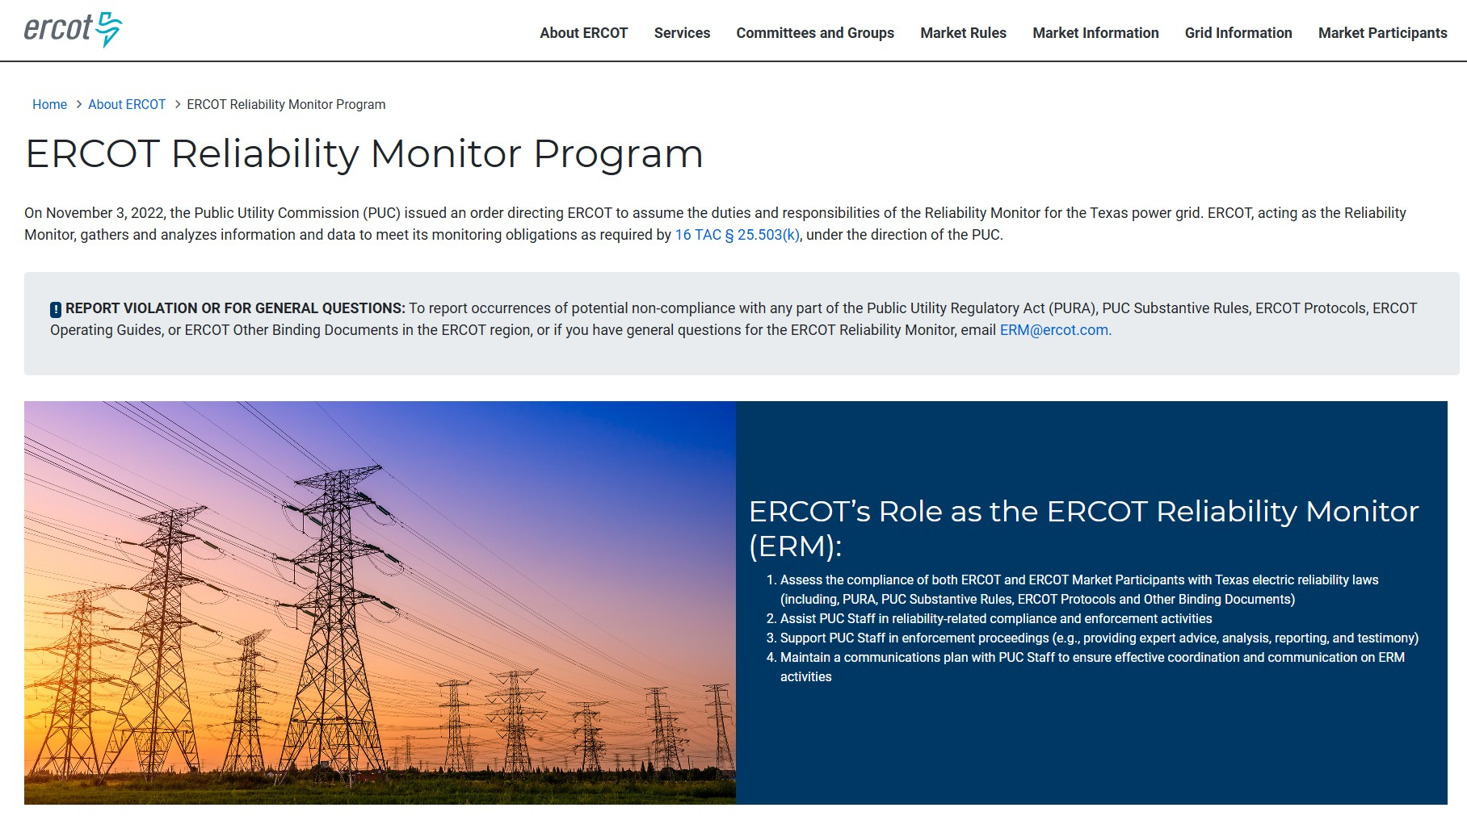
ERM Webpage
Key Takeaway: Refreshed webpage summarizes ERM role, types of Incident Reviews and status of current investigations, and links to additional information: www.ercot.com/about/reliability-monitor

Slide 29
Contacting ERM
Email ERM@ercot.com with:
  Referrals of potential violations of reliability-related state requirements
  Self-report potential Reliability Requirement violations
  Questions related to ERCOT’s role as the Reliability Monitor
Notes:
Encourage MPs to self-report; explain DICE’s posture that getting entities into compliance is the goal

Slide 30
Submitted Questions
Does ERM follow certain criteria when deciding whether to open an investigation versus handling an issue through an RFI process?
What are the most common triggers that lead to an ERM investigation? Are they different for Generation Resources, Load Resources, or QSEs?
At what point, if any, does an ERM investigation transition into a formal compliance or enforcement matter, and what factors influence that decision?
What should stakeholders expect regarding investigation timelines, status updates, confidentiality protections, and final disposition of findings?
How does the ERM distinguish between an operational error, a compliance violation, and a systemic process issue?
How does the ERM evaluate root-cause analyses submitted by Market Participants, and what characteristics make a response more effective and credible?
How are corrective actions assessed, and what evidence demonstrates that a mitigation or software fix has been effective?

Slide 31
Additional questions?

Slide 32
Appendix 1
Use Case # 1 – Potential Market Participant Violation
Use Case # 2 – Reliability Monitor Audit
Use Case # 3 – Potential ERCOT Violation
Use Case # 4 – Potential Market Participant Violation
Use Case # 5 – Potential Market Participant Violation
Use Case Examples

Slide 33
Use Case #1 – Potential MP Violation
Issue: Winter Storm Elliott – Event Analysis
ERCOT
  Operations performs event analysis (e.g., weatherization issues)
  During or after event analysis, it appears MP did not properly weatherize their equipment
  ERCOT reports incident to ERM
  Reliability-related? (confidential report)
Yes - not properly weatherizing affects reliability
  ERM conducts Incident Review
Reliability Monitor
  Draft report
  If violation, refer to DICE (confidential report)

Slide 34
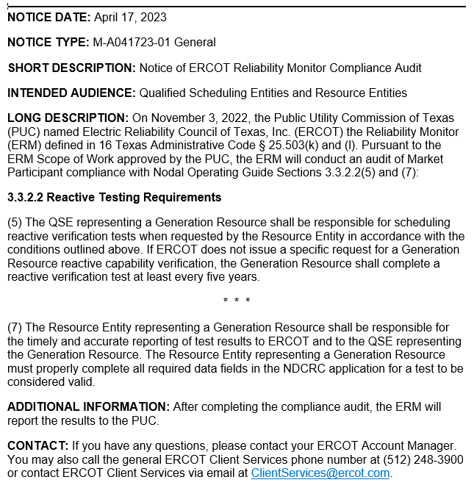
Use Case # 2 - Audit
Compliance with NOG § 3.3.2.2 (Reactive Testing)
ERM performs risk-based analysis to identify Reliability Requirement to audit
Identifies NOG § 3.3.2.2(5) & (7)
Issues Market Notice
Gathers data
Analyzes data
Drafts report and sends to DICE

Slide 35
Use Case # 3 – Potential ERCOT Violation
Issue: ERCOT does not conduct ERS Resource testing under the required timeline
ERCOT
ERCOT does not timely conduct ERS Resource testing
ERCOT employee reports issue to manager
Manager reports matter to ERM
  Reliability-related?
Yes - ERS supports grid stability and resilience
ERM conduct Incident Review
Reliability Monitor
  Draft report
  If violation, refer to DICE (confidential report)

Slide 36
Use Case #4 – Potential MP Violation
Issue: MP does not update Backup Authorized Rep. (BAR) contact info
ERCOT
ERCOT sends email to MP’s BAR
Email bounces
ERCOT learns BAR left company
ERCOT reports MP to ERM@ercot.com
  Reliability-related? (confidential report)
No - does not affect system stability or resilience
Reliability Monitor
ERM refers to ERCOT Legal for further action

Slide 37
Use Case #5 – Potential MP Violation
Issue: Failure to operate Automatic Voltage Regulator (AVR)
ERCOT
Operations identifies Resource being On-Line without AVR in service (required by Protocols § 13.5.2)
Operations refers incident to ERM
  Reliability-related?
Yes - operating without AVR in service affects system reliability
ERM conducts Incident Review
Reliability Monitor
  Draft report
  If violation, refer to DICE (confidential report)

