Slide 1

TDTMS Update
Leadership 2026:
Chair - Sheri Wiegand, Vistra
Co-Vice Chairs – Monica Jones, CNP
Rob Bevill, TNMP
RMS
October 13th, 2026

Slide 2
TDTMS
TDTMS Met on September 21st
IT Report & SLAs
2027 SLAs
Market Data Transparency SLAs – now owned by Jamie Lavas’ team
Which working group will have purview? TWG or TDTMS?
Digital Certificate Issue 9/9
Discussed at TWG 9/24 – cert revocation list refresh issue thus not allowing users access – issued cleared by 2:00 PM

Slide 3
TDTMS
ERCOT IT Projects
Client Services – Market Participant Service Portal (MPSP) – as described as part of the “blob” of access strategy for market participants with the goal of “one stop shopping” for stakeholders: ERCOT data/access, MPSP: Service Now, Batch Zero, etc with a single sign on.
Once this project completes, this will drive future projects such as the MarkeTrak and FlighTrak alternative platform.
New Listserv Platform – Shawn Scott will be the ERCOT owner for the new Listserv platform under Jamie Lavas. Updates will likely be presented during TWG meetings.
“Data Dump” for MT Analysis – two options: posting public report to Retail Operations page on ercot.com or SCR (emil)
Access Management / Digital Certificates
MIS - API & UI
FlighTrak replacement
MarkeTrak replacement

Slide 4
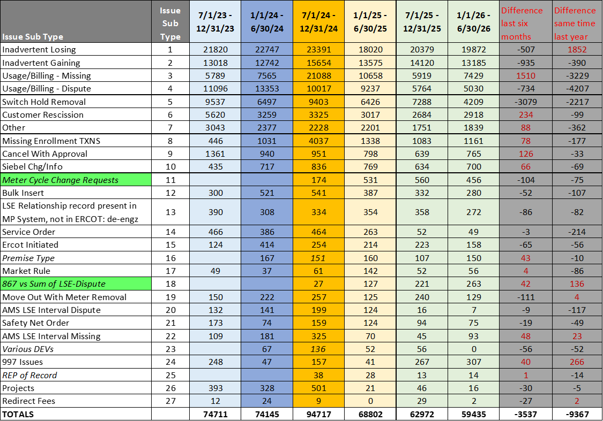
MarkeTrak Subtype Volumes – 2026(1)
Observations:
IAG/IAL/Rescission now make up a little over 60% of MTs submitted, although volumes have decreased ~4% from the first half of the year
Total issues volume decreased to 59, 435, the lowest across the six half-year periods
Switch Hold Removal remains seasonal – higher volumes first half of the year lower the second half
Usage & Billing – Missing saw an increase of ~1500 cases
Customer Rescissions saw an 8.7% increase from second half of 2025
Meter Cycle Change Requests continue to see solid use although decreasing 18.5% from the second half of 2025
Cancel w/Approval MTs saw a slight increase over second half of 2025, yet still within range over last six periods reviewed.

Slide 5
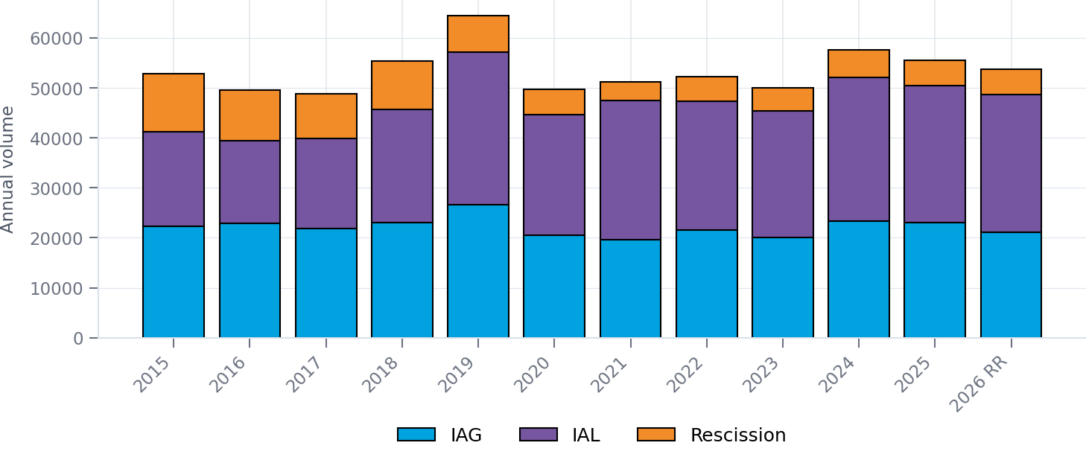
IGL TRAINING | ERCOT MARKET TRENDS
IAG / IAL / Rescission volumes remain elevated
Annual volumes, with 2026 projected from January–May actuals
2026 ACTUAL THROUGH MAY
2026 EOY RUN RATE
VS. 2025
LARGEST CATEGORY
22,369
53,686
−3.3%
IAL
8,826 IAG | 11,455 IAL | 2,088 RES
Annualized from five months of actual volume
Run rate compared with 55,492 annual cases
51% of 2026 actual volume
2026 READOUT
The annualized 2026 total is tracking slightly below 2025, while IAL remains the largest source of volume.
2026 uses Jan–May actuals and an EOY run rate of 53,685.6.
Source: IGL Training graph worksheet_updated_20260915.xlsx
Vistra
1

Slide 6
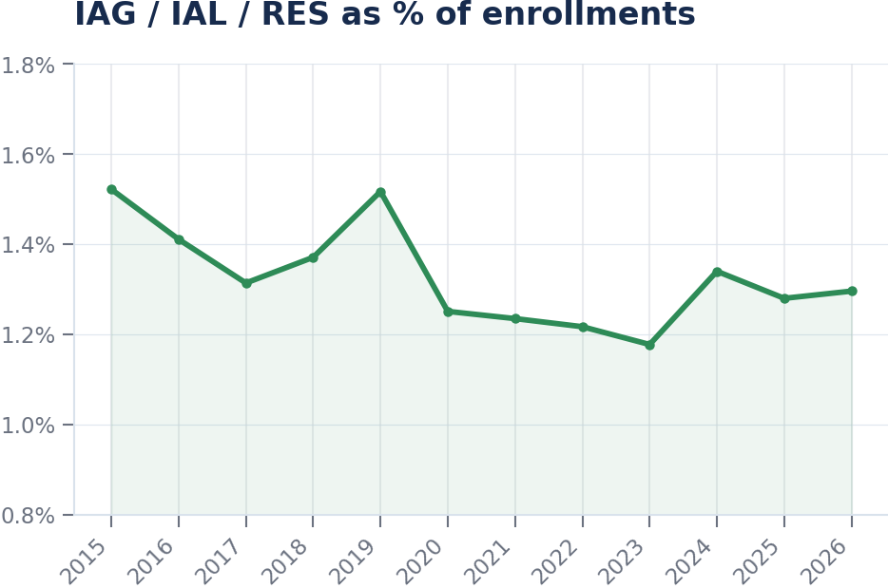
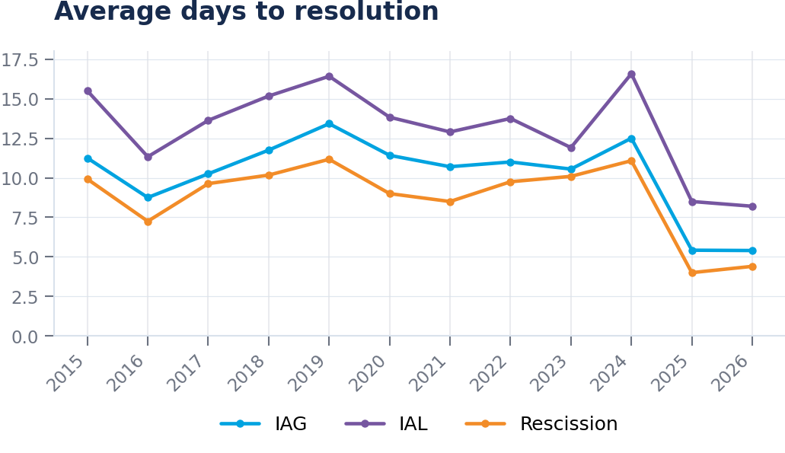
IGL TRAINING | ERCOT MARKET TRENDS
Resolution speed gains are holding as incidence stays near 1.3%
Annual averages show a sustained step-change beginning in 2025
2026 IAG RESOLUTION
2026 IAL RESOLUTION
2026 RES RESOLUTION
2026 % OF ENROLLMENTS
5.4 days
8.2 days
4.4 days
1.29%
Essentially flat to 2025
Improved from 8.5 days in 2025
Up 0.4 day from 2025
Jan–May YTD incidence
Key takeaway
2026 resolution times remain roughly half of 2024 levels, while the share of enrollments is stable versus 2025.
Source: IGL Training graph worksheet_updated_20260915.xlsx
Vistra
2

Slide 7
TDTMS
Next Meeting – October 26th, 2026 @ 1:30 PM [WebEx Only]
ERCOT Updates
IT Report
MT performance issues
2027 SLAs
Projects
Client Services – Market Participant Service Portal
Digital Certificates / Access Management update
Listserv Platform
MarkeTrak Enhancements list – updates
Discuss IAG suggested drop-down
Other ideas
Client Services update on IAG support
MT Deep Dive – review Rescission results of 2025(2)
MT Deep Dive – leveraging AI update
“data repository” options
Review of 2026 goals - checkpoint

