Slide 1
ERCOT Information Technology Report
Vikram Gupta
Manager, Retail & Metering Application Services
ERCOT Public October 2026

Slide 2
Incident Report Highlights
Service Availability & Maintenance
  Retail Market IT systems met all SLA targets
  9/13 – Site Failover
Retail Incidents
  9/11 – Digital Certificate Vendor Issue
Completed & Upcoming Retail Activities
  No major releases for September

Slide 3
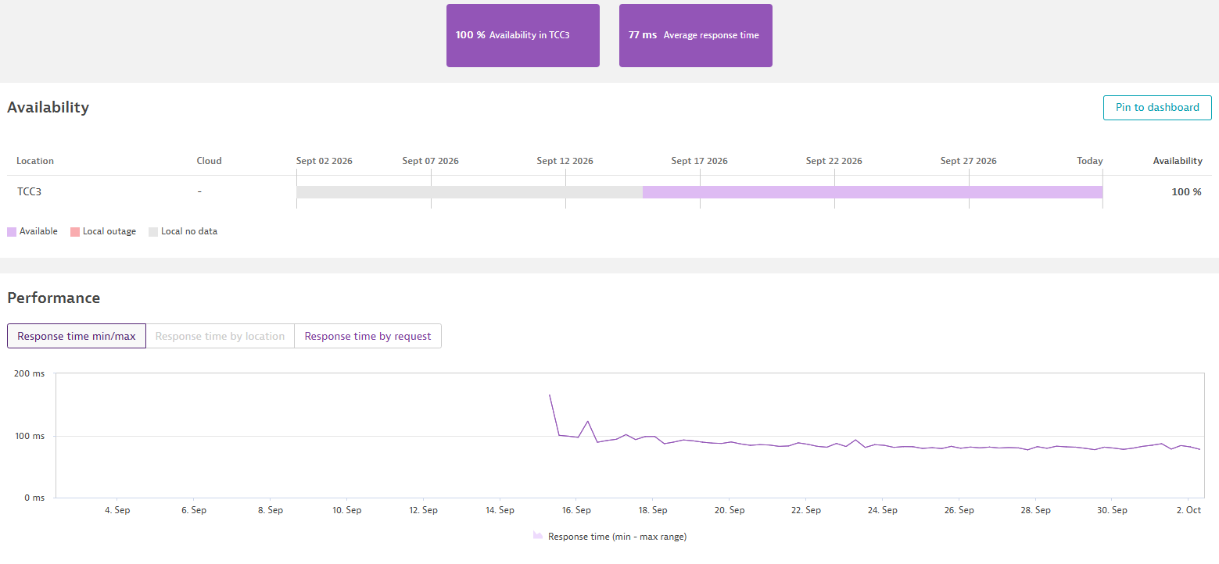
MarkeTrak UI Availability

Slide 4
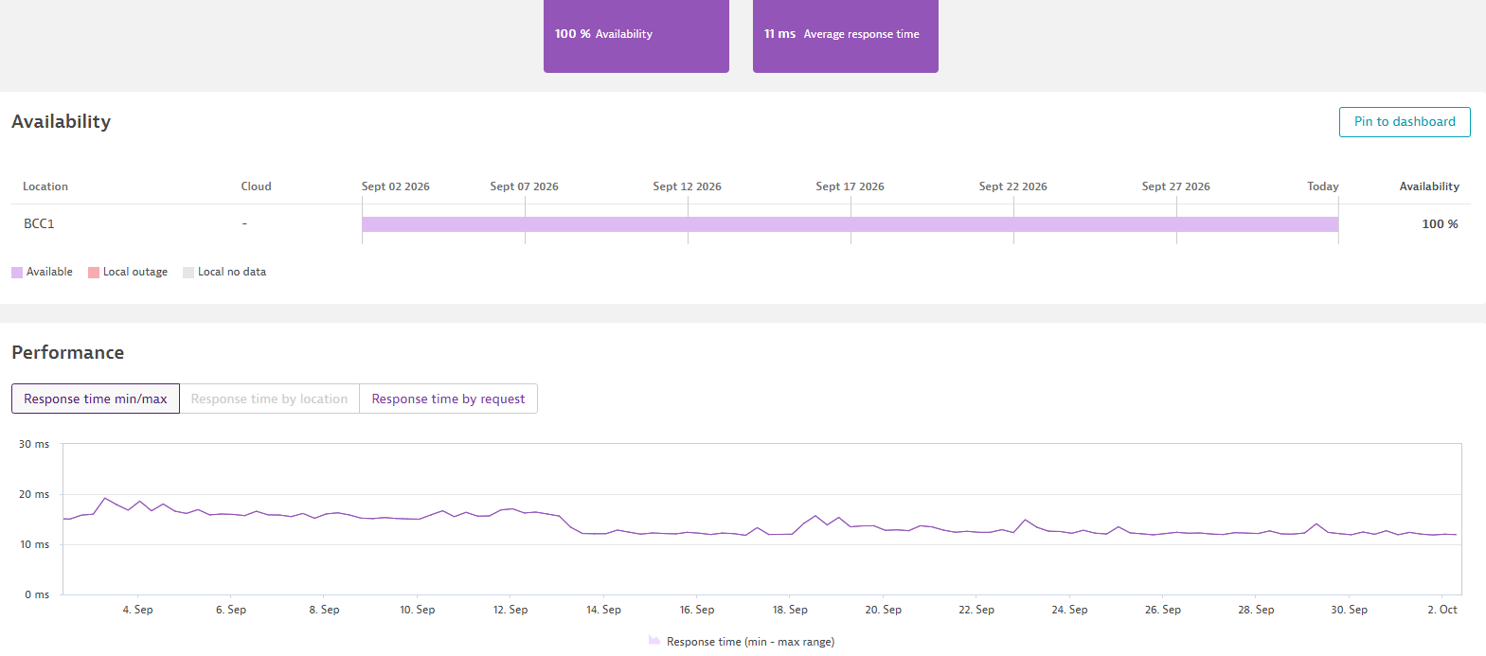
MarkeTrak API Application Availability

Slide 5
MarkeTrak API Performance
MarkeTrak API
Sept 2026 | Response Time (seconds) |  | SLO (seconds)
 | Monthly Average | 12 Month Average
QueryDetail | 0.27 | 0.35 | 2
QueryList | 0.65 | 1.34 | 10
Update | 0.40 | 0.43 | 10

Slide 6
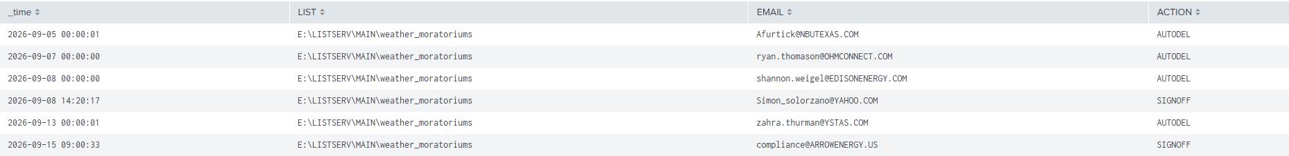
Weather Moratorium Removals

Slide 7
Discussion Items
Project Updates 2027 SLA Documents

