Slide 1
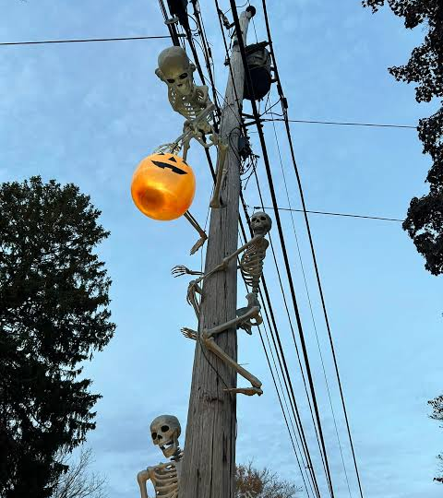
TEXAS SET/LP
Working Group
Update
RMS 10/13/2026
Texas SET LP Meeting Notes 09.22.26.docx
Notes:
Source: Texas SET LP Meeting Notes 09.22.26.docx
Texas SET / Load Profiling meeting held September 22, 2026. Presenter not assigned. Imagery is generated ink-wash contextual artwork, not a real ERCOT asset.

Slide 2
Flight 1026 Update
19
7
New CRs testing
Existing CRs testing
Source wording:
“15 DUNS+ 4 CRs”
6 service provider changes
1 bank change
Meeting update: no issues reported; flight progressing.
Texas SET LP Meeting Notes 09.22.26.docx
02
Notes:
Source: Texas SET LP Meeting Notes 09.22.26.docx
Heading: ERCOT Flight Updates; embedded Flight 1026
All updates reflect the September 22, 2026 source meeting; no RMS meeting date is assumed.

Slide 3
TX SET Implementation Guide Change Control
n.0X
n.0
n.X
ADMINISTRATIVE
e.g. 4.0A, 4.0B
• Spelling errors and language clean-up
• No impact to systems
• No market testing required
INCREMENTAL RELEASE
e.g. 5.0, 6.0
• System impacts to market-facing systems
• Requires market testing
• All guides share this version
SUPPLEMENTAL RELEASE
e.g. 5.1, 5.2, 6.1
• System impacts, no market testing
• Only changed guides are reissued
• Sits under the full version
All variants roll up to one overarching version — testing and certification are always on the full incremental version (5.0, 6.0).
Only the guides that actually change are reissued, so revisions move faster and PUC filings stay concise.
03

Slide 4
2026 Annual Validation Complete
All TDSPs meet the completion threshold prior to Sept 30^{th*}
Status snapshot: September 21, 2026
TDSP | Net subject to change | Updated | Remaining | Completion
AEP | 12,546 | 12,543 | 3 | 100.0%
CNP | 13,626 | 13,582 | 44 | 99.7%
NUECES | 102 | 102 | 0 | 100.0%
ONCOR | 18,063 | 18,063 | 0 | 100.0%
TNMP | 1,941 | 1,941 | 0 | 100.0%
LP&L | 977 | 977 | 0 | 100.0%
*99% completion threshold per Load Profiling Guide 11.2.1(2)(a)(vi)
Texas SET LP Meeting Notes 09.22.26.docx
04
Notes:
Source: Texas SET LP Meeting Notes 09.22.26.docx
Heading: ERCOT 2026 Annual Validation Updates; embedded Profile Validation Status as of 21-Sep-26
All updates reflect the September 22, 2026 source meeting; no RMS meeting date is assumed.

Slide 5
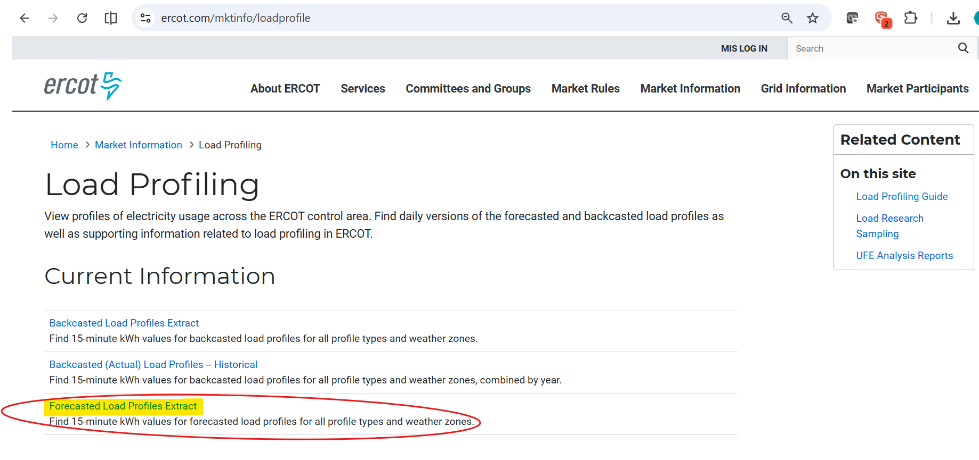
Forecasted Load Profiles Extract
FORECAST MODEL • PROPOSAL
Forecasted Load Profiles Extract:
Currently, ERCOT provides 15 minute kWh values for forecasted load profiles for all profile types and weather zones on a 3 day outlook.
Posted daily to the highlighted reference link
Suggested Changes
To help normalize forecasting volatility of 15 minute data, ERCOT has suggested changing to hourly forecast
Potential market impacts from 15min vs hourly data
REPs: Need 15-minute interval detail for accurate forecasting
TDSPs: 15-minute interval data supports estimation routines in the event actual LSE data is unavailable from meter
05
Texas SET LP Meeting Notes 09.22.26.docx
Notes:
Source: Texas SET LP Meeting Notes 09.22.26.docx
Heading: ERCOT RES HI/LO WR Load Profiles & Daily Profiles Forecast Discussion; embedded Current vs Proposed Models.
Proposed daily profiles forecast model is intended to streamline processes, provide timelier data, and consider EVs, rooftop solar, and data centers. It is a proposal, not an approved implementation. EV charging support remains in progress (Not there yet). Main concern is removal of 15-minute interval detail.

Slide 6
PUCT Project 58000 [possible 12CP billing]
TEXAS SET/LP ON HOLD — pending PUCT action
December PUCT meeting
Notice discussed advised a December vote.
No precise vote date was given.
December 14 SET/LP
Scheduled to respond to PUCT action; may be canceled
if no approval is received.
Texas SET LP Meeting Notes 09.22.26.docx
06
Notes:
Source: Texas SET LP Meeting Notes 09.22.26.docx
Heading: Project 58000 (12CP Updates)
All updates reflect the September 22, 2026 source meeting; no RMS meeting date is assumed.

Slide 7
Meetings
Month | TX SETLP
October | 10/27 New October dates
November | 11/17
December | 12/14 — new date Conditional on PUCT approval
Texas SET LP Meeting Notes 09.22.26.docx
07
Notes:
Source: Texas SET LP Meeting Notes 09.22.26.docx
Heading: 2026 Meeting Dates; Next Texas SET LP Meeting
All updates reflect the September 22, 2026 source meeting; no RMS meeting date is assumed.

