Slide 1
SB6 Large Load Curtailment
Operations Workshop #1
Outline for Workshop
Background: Large Load Curtailment under SB6
Refresher on Energy Emergency Alert (EEA) and where SB6 curtailment fits
Deeper Dive into PURA § 37.0561(e) Operational Implications
Potential Registration, Visibility, and Compliance Requirements
Other Considerations
Wrap Up and Next Steps
Today’s Goal
  Build a shared understanding of the operational challenges in implementing SB6 Large Load curtailment and frame the questions for the workshops ahead.

Slide 2
Background
Large Load Curtailment Under SB6

Slide 3
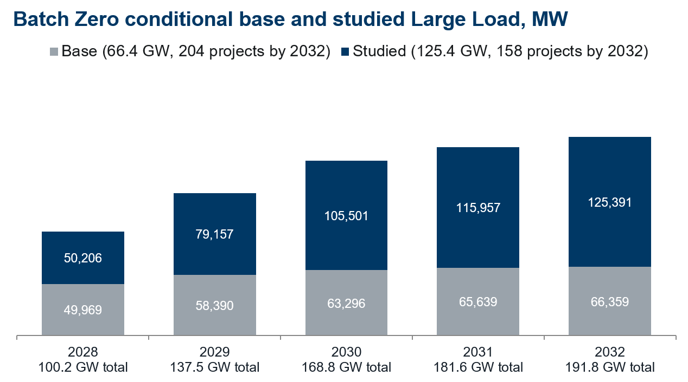
ERCOT is seeing rapid growth in prospective Large Loads
A significant number of new Large Loads are pursuing interconnection in the ERCOT Region. As these loads are added, generation supply may not always keep pace with the system demand. Foreseeing this risk, the Legislature gave ERCOT new authority in SB6 to direct the curtailment of certain Large Loads to protect grid reliability.
About the chart
Conditional Batch Zero classification, provided to interconnecting TSPs on September 3, 2026. Figures may change through the dispute and verification processes.
Base: Large Loads meeting a base-load eligibility path (subject to verification).
Studied: Large Loads on a studied-load path, subject to PGRR 145 verification.
Excludes 302.2 GW (373 projects) excluded from Batch Zero.
Source: Board update on Batch Zero

Slide 4
ERCOT load-reduction mechanisms before and after SB6
Existing
Controllable Load Resources (CLRs) registered as Resources, submit RT offers and are curtailed by SCED based on their offers.
Voluntary Early Curtailment Loads (VECLs) created by NPRR1238; curtailed with 30-minute notice when operating margin falls below 3,100 MW.
Emergency Response Service from Loads provide response within 10min or 30min; deployed in Energy Emergency Alert (EEA) Level 1.
Non-Controllable Load Resources (NCLRs) provide RRS/ECRS, responding within 10 minutes when deployed in an emergency (EEA Level 2) or when frequency is low and Non-Spin, responding within 30 minutes under offline Non-Spin deployment rules
Firm load shed: all other loads including Large Load that is not subject to SB6 actions below; shed by the TSP/utility under its load-shed plan.
SB6 Added
Net-Metered Curtailable Load (PURA § 39.169) Large Load in a net-metering arrangement with an existing Generation Resource or Energy Storage Resource; subject to curtailment conditions directed by PUCT.
Backup-Supported Curtailable Load (PURA § 37.0561(e)) Large Load subject to curtailment because it is capable of being served by on-site backup generation sufficient to serve at least 50 percent of the total demand of the facility that includes the Large Load.
Large Load Demand Management Service (PURA § 39.170) SB6-directed; under development; paid service curtailed with 24-hour notice to avoid risk of EEA.

Slide 5
Workshop Focus and Scope
This workshop is the first in what will likely be a series of workshops related to ERCOT-directed curtailment of Large Load under SB6.
These workshops will cover:
  Operational considerations for implementing the curtailment of Backup-Supported Curtailable Load (BSCL)
  Related operational topics for Net-Metered Curtailable Loads (NMCLs) and Voluntary Early Curtailment Loads (VECLs)
These workshops are not intended to cover:
  Controllable Load Resources (CLRs)
  Emergency Response Service (ERS)
  Non-Controllable Load Resources (NCLRs)
  The Large Load Demand Management Service (LLDMS)
  Firm load shed
Workshop Series Goal: Develop Large Load curtailment framework details that maintain reliability, align with the general principles of SB6, and support the Revision Requests needed to implement the resulting design.

Slide 6
The two SB6 curtailable Large Load categories
Net-Metered Curtailable Load (NMCL)
PURA § 39.169
Definition: A Large Load that participates in a net metering arrangement with an existing Generation Resource or Energy Storage Resource and that is subject to a curtailment condition adopted by the PUCT in an order issued pursuant to PURA § 39.169.
The statute requires the Commission to approve project-specific conditions. To date, the Commission has approved three net metering arrangements — all with substantially similar conditions, under which:
Curtailment can be instructed in anticipation of, or during, an emergency
The instruction goes to the QSE
The load must fully curtail within 30 minutes and make the co-located Resource’s HSL available to ERCOT for dispatch
Pricing Impact: NMCL load reduction and co-located generation increase must be accounted for when calculating price adjustments for reliability deployments.
Backup-Supported Curtailable Load (BSCL)
PURA § 37.0561(e)
Definition: A Large Load subject to an ERCOT curtailment instruction under PURA § 37.0561(e) because it can be served by on-site backup generation sufficient to serve at least 50% of the facility's total demand.
The statute specifies ERCOT may direct the utility to require the BSCL to curtail after all available market services, except frequency-responsive services, are deployed.
Pricing Impact: A deployment under this section is included as firm load shed when calculating price adjustments for reliability deployments.
Key Takeaway: NMCL conditions approved to date allow instruction before an emergency, route the instruction through the QSE, and specify the time within which the load must fully curtail. For BSCL, the statute establishes a different sequence and instruction path, raising the operational questions to be examined in this workshop.

Slide 7
Refresher on EEA and where SB6 curtailment fits

Slide 8
Refresher on Current Energy Emergency Alert Levels
How ERCOT responds as operating margin tightens
While ERCOT may communicate with the market ahead of expected tight conditions, sometimes days in advance, EEA levels themselves are based on actual system conditions: ERCOT declares an EEA when real-time operating margin* falls below set thresholds.
Operating Principles: Use market processes to the fullest extent. Implement levels in sequence to the extent possible. Shed firm load only when necessary to balance load with available generation. Terminate** EEA levels in reverse order (Level 3, then Level 2, then Level 1), where practicable.
* For simplicity, this presentation uses "operating margin" as a common term for headroom or reserves on the system broadly, rather than as a precise metric. The specific metric used for implementation will be addressed separately. ** EEA ends once any shed firm load has been restored, system frequency is stable, operating margin has returned to pre-EEA levels, and market processes are restored.
EEA Level 1
Operating Margin below 2,500 MW
Take actions to increase operating margin
Bring available generation online
Deploy Emergency Response Service
Operating Margin
EEA1
EEA2
EEA3
EEA Level 2
Operating Margin below 2,000 MW
Deploy remaining demand response
Load Resources
Utility load management programs
2,500 MW
2,000 MW
EEA Level 3
Operating Margin below 1,500 MW
May order firm load shed
Directed through the TOs to restore operating margin
1,500 MW
Time
Each EEA level is declared as operating margin falls below its threshold and is not expected to recover.

Slide 9
EEA Levels With SB6: A Simple Mapping
If ERCOT could be certain that operating margins would always decline slowly and that there would always be sufficient time to take load off the system carefully, SB6 curtailment actions could theoretically be mapped to the existing EEA levels: NMCL no later than EEA Level 1, and BSCL at EEA Level 2.
However, operating margin will not always decline slowly, and curtailment takes time.
EEA Level 1
Operating Margin below 2,500 MW
Net-Metered Curtailable Load
PURA § 39.169
No later than
Basis: Commission-approved conditions allow curtailment in anticipation of an emergency; NERC EOP-011-4 (Attachment 1); all Generation Resources are in use at EEA Level 1*.
EEA Level 2
Operating Margin below 2,000 MW
Could align with
Backup-Supported Curtailable Load
PURA § 37.0561(e)
Basis: PURA § 37.0561(e); after all available market services are deployed, only frequency-responsive services remain
EEA Level 3
Operating Margin below 1,500 MW
*ERCOT's position in Docket 58872.

Slide 10
Why the simple EEA mapping may not work in all conditions
Three factors affect how quickly Large Load can be curtailed:
    Time to act: It takes time for ERCOT to issue curtailment instructions to the Customer and for that Customer to act to curtail the load.
    Coordination: As the number and size of Large Loads grow, ERCOT may need to issue more instructions across more facilities and to direct different levels of reduction (full or partial curtailment), requiring greater coordination among the different forms of SB6 curtailment and with other emergency actions.
    Frequency stability: Curtailing too much load at once risks high system frequency. To maintain reliability, ERCOT may need to instruct curtailment in smaller tranches, which adds to the time it takes to curtail larger volumes of load.
Key Takeaway: EEA levels are declared once operating margin has already fallen. Waiting for operating margin to reach the applicable EEA threshold, as in the simple mapping, may not leave enough time to fully utilize all SB6-authorized curtailment before firm load shed is needed to maintain frequency or NERC contingency reserves.

Slide 11
Deeper Dive into PURA § 37.0561(e) Operational Implications

Slide 12
Deeper Dive on PURA § 37.0561(e) for BSCL
PURA § 37.0561(e) After the independent organization deploys all available market services, except for frequency responsive services, the independent organization may direct the applicable electric utility or municipally owned utility to require the large load customer to either deploy the customer's on-site backup generating facilities or curtail load.
This provision imposes two key conditions for curtailment:
  ERCOT may instruct curtailment only after all market services are deployed except frequency-responsive services.
  ERCOT instructs the utility (TDSP), which coordinates with the customer.
One of the key goals of the PURA § 37.0561(e) curtailment language was to ensure that Large Load additions do not increase firm load shed risk for residential and other customers. The next few slides address what these two conditions mean for that goal.

Slide 13
Limitations of routing BSCL instructions through the utility
Added coordination: Under § 37.0561(e), the utility must relay every BSCL curtailment. As noted earlier, routing through the utility adds a step in getting the instruction to the Large Load, which can lengthen the curtailment response time or shorten the time the Large Load has to act.
More complex coordination as BSCLs grow: That coordination becomes more complicated with more sites, and sites with larger consumption. When SB6 was adopted, curtailing whole sites may have been a reasonable expectation. With the individual Large Load sizes now being proposed, meeting a system-level MW curtailment target will increasingly mean partial, block-level curtailment across many Large Loads, and rotating which Large Loads or blocks are called across multiple curtailment events. The more detailed the instructions, the greater the risk of miscommunication as they are relayed.
Notifying both is not problem-free either: Even if ERCOT also notifies the Customer directly, the utility is still required to instruct the Customer under PURA § 37.0561(e). This may create miscommunication (ERCOT vs. utility), and delays as the Customer waits for the utility's instruction.
Key Takeaway: Under PURA § 37.0561(e), the utility's coordination role adds time and complexity that grow with the number and size of BSCLs, and notifying the Customer in addition to the utility introduces issues of its own.

Slide 14
Curtailment response time determines how early ERCOT must act
The longer it takes load to be curtailed, the further in advance ERCOT must issue instructions to avoid a deeper EEA.
In this presentation, “curtailment response time” is the time from when ERCOT issues a curtailment instruction until the full amount of the requested MW reduction is delivered.
SB6 BSCL: PURA § 37.0561(e) provides that when curtailing BSCL, ERCOT must direct the utility, which then coordinates with the Large Load. This added coordination is part of the curtailment response time and can affect how much load is curtailed, and how quickly.
Firm load shed: Under Nodal Operating Guide Section 4.5.3(7), SCADA-controlled load is expected to be interrupted within 30 minutes after receipt of the instruction, and other load within 60 minutes.*
The latest ERCOT can issue an instruction is the time the curtailment must be in place, minus the curtailment response time.
\
* While not the focus of this workshop, a faster firm load response would also reduce how far ahead ERCOT must act.
Key Takeaway: Every added minute of curtailment response time is a minute earlier that ERCOT must issue the curtailment instruction. The curtailment response time for BSCL should therefore be the shortest practicable period from ERCOT's instruction until the requested MW reduction is reliably delivered.

Slide 15
Illustrative example: Impact of BSCL instruction timing and visibility
The following slides compare two highly simplified BSCL instruction sequences under the same assumed system conditions.* The example holds curtailment response time the same in both cases and compares the impact of changing when instructions begin and whether ERCOT has visibility into each Large Load.
How to read the charts
The top chart shows operating margin and the EEA thresholds. The bottom chart shows how much of each SB6 Large Load category would be curtailed, and whether firm load shed becomes necessary.
What is held identical in both cases:
Operating conditions and net load.
Available NMCL and BSCL MW quantity.
Emergency tools (ERS, NCLRs) and emergency thresholds (EEA1 / EEA2 / EEA3)
30-minute curtailment response time for each instructed NMCL and BSCL block
NMCL is curtailed when the near-term forecast indicates operating margin will fall below 2,500 MW in both cases
*Illustrative, highly simplified example. It is not an actual event, an ERCOT forecast, or a study result. Its only purpose is to show how the manner in which Large Load is instructed can change the outcome. Actual outcomes will depend on operating conditions in real time.

Slide 16
Illustrative example: Impact of BSCL instruction timing and visibility
What differs for BSCLs: when instructions begin and what is visible to ERCOT
Real-time threshold-based, without visibility
  Instructed once operating margin is already low (below 2,000 MW), consistent with the timing in PURA § 37.0561(e).
  Uniform site-level data and real-time telemetry are not available to ERCOT. ERCOT lacks visibility into each Large Load’s curtailment capability and delivered response. So ERCOT instructs based on what the system needs and waits to see what is delivered, which may differ from the instructed amount.
  Because the delivered amount is uncertain and too much load curtailing at once could create frequency risk, successive instructions are spaced farther apart.
Near-term forecast-informed, with visibility
  Instruction when the near-term forecast indicates operating margin will fall below 2,000 MW, earlier than under PURA § 37.0561(e).
  Site-level capability data and real-time telemetry is available to ERCOT. This enables ERCOT to size each instruction based on Large Load’s curtailment capability and confirm the real-time response that it delivered.
  Because the instructed MW are bounded and actual delivery is visible in real time, successive instructions are issued closer together.

Slide 17
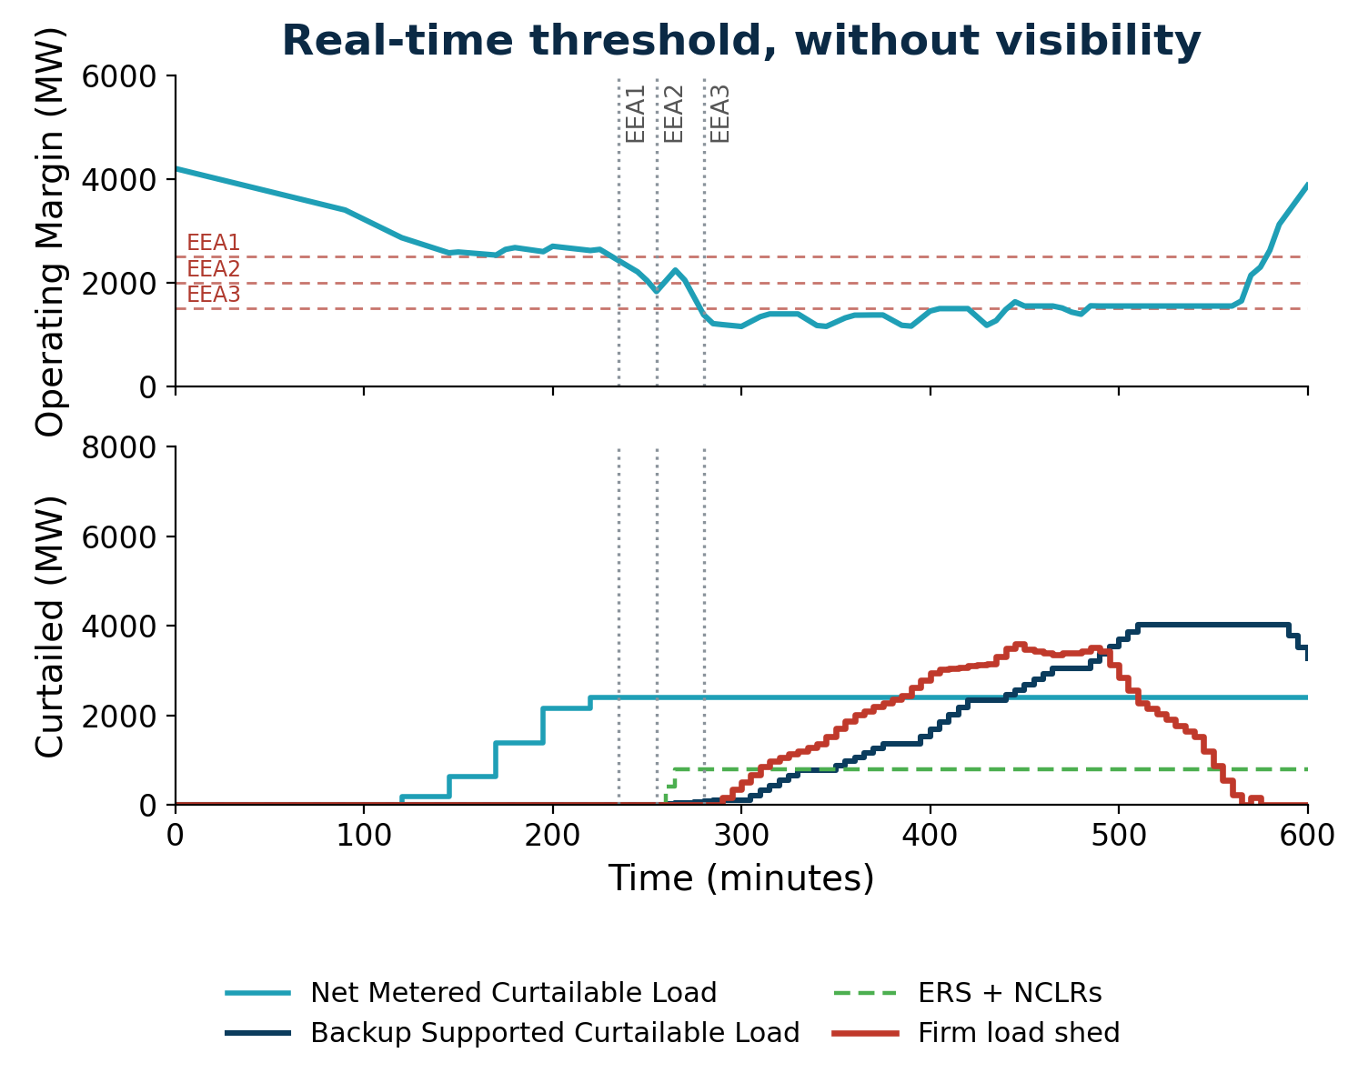
Real-time threshold, without visibility: BSCL instructed once operating margin is already low
Minutes 120–220: NMCL is curtailed in blocks based on a forecast of operating margin, reaching its full available amount.
Minute 235: Operating margin falls below the EEA1 threshold.
Minute 255: Operating margin falls below the EEA2 threshold. BSCL is first instructed through the utility, and NCLRs are instructed.
Minutes 255–480: BSCL is instructed in blocks and its response builds gradually.
Minute 265: NCLRs respond.
Minute 280: Operating margin reaches EEA3 level, and firm load shed is instructed.
Minute 290: Initial firm load shed response* begins before BSCL curtailment has built up.
Minute 570: Firm load fully restored.
*Illustrative, highly simplified example. Actual outcomes will depend on operating conditions in real time. The example assumes initial firm load shed begins 10 minutes after instruction and continues to build over the applicable response window.

Slide 18
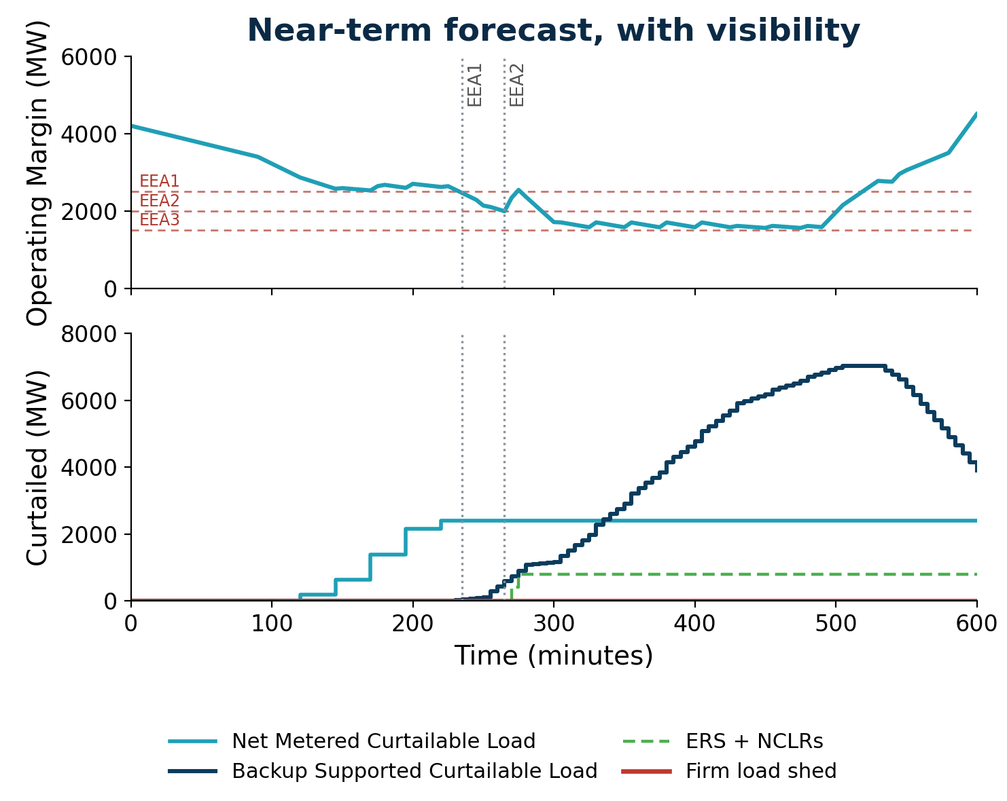
Near-term forecast, with visibility: BSCL instructed using a forecast of operating margin
Minutes 120–220: NMCL is curtailed in blocks when the near-term forecast indicates operating margin will fall below 2,500 MW, reaching its full available amount.
Minute 225: BSCL is first instructed to the Customer, when the near-term forecast indicates operating margin will fall below 2,000 MW.
Minutes 225–475: BSCL is instructed in blocks and its response builds steadily.
Minute 235: Operating margin falls below the EEA1 threshold.
Minute 265: Operating margin briefly reaches the EEA2 threshold, and NCLRs are instructed.
Minute 275: NCLRs respond.
Minutes 275–500: Operating margin holds between EEA2 and EEA3 levels. No firm load shed is instructed.
Minute 535: BSCL curtailment recall begins.
*Illustrative, highly simplified example. Actual outcomes will depend on operating conditions in real time

Slide 19
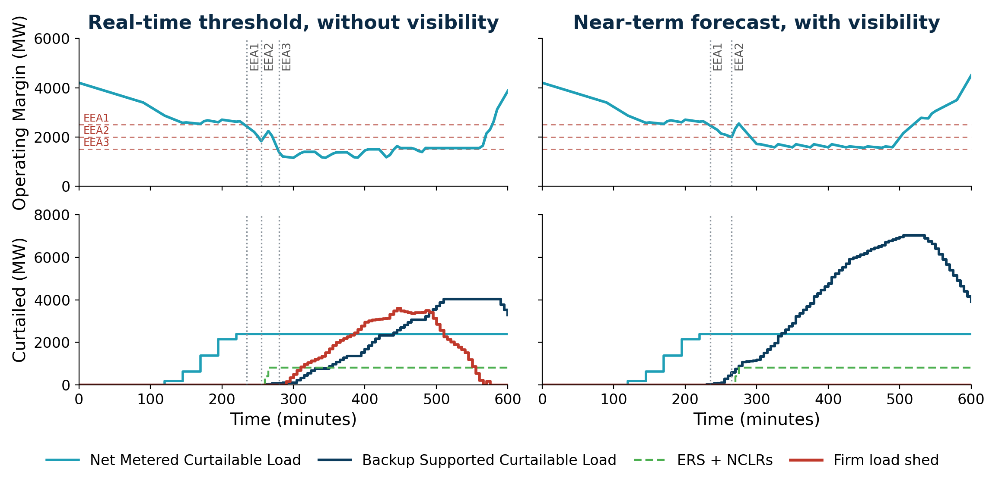
Illustrative comparison: When and how BSCL is instructed changes the outcome
Under the same assumed system conditions, the real-time threshold case reaches EEA3 and firm load shed, while the near-term forecast case remains above the EEA3 threshold.

Slide 20
Why the real-time threshold-based case reached firm load shed
In the real-time threshold case, without visibility:
The clock started late. ERCOT began instructing BSCL only when operating margin was already low, leaving little time for aggregate BSCL curtailment to build before EEA3.
Successive instructions were spaced farther apart. Without visibility into each Large Load, the delivered amount was uncertain, so instructions were spaced out to limit the frequency risk of too much load curtailing at once.
Aggregate BSCL curtailment built too slowly. The requested curtailment did not occur quickly enough to keep operating margin above the EEA3 threshold, so firm load was shed while BSCLs were still responding.
In the near-term forecast case, with visibility, ERCOT began issuing instructions earlier and successive instructions were issued closer together. Ultimately, aggregate BSCL curtailment came sooner, built steadily, and was in place when it was needed.
Key Takeaway: In this illustrative comparison, an earlier start, together with the visibility that allowed instructions to be issued closer together, reduced exposure to firm load shed. Later slides separate the two: what visibility alone can achieve, and what depends on timing.

Slide 21
PURA § 37.0561(e) Operational implications of “when” and “who”
Timing Risk
Waiting for the statutory trigger may leave less time than the curtailment response time requires, so the requested curtailment may not be in place before firm load shed is needed.
When
ERCOT may direct BSCL curtailment after all available market services, other than frequency-responsive services, have been deployed.
Who
ERCOT then directs the utility, which coordinates with the Large Load.
Instruction-Path Risk
The utility-directed path requires utility-to-load coordination. Too much load curtailing at once, such as from a full-site breaker opening, could create frequency risk.
Key Takeaway: Under the requirements of PURA § 37.0561(e), the timing condition may leave too little time for BSCL curtailment to build, and the utility-directed path may not deliver curtailment precisely enough to avoid too much load curtailing at once. Both risks grow as BSCL volume and size of individual sites grow.

Slide 22
Three operational requirements for any BSCL curtailment implementation
To reduce exposure to firm load shed and high-frequency risk, any implementation of PURA § 37.0561(e) needs to satisfy three operational requirements:
Instruct in time
Instruction sequence begins early enough for aggregate BSCL curtailment to build before firm load shed is needed.
INSTRUCTION TIMING
Shortest practicable curtailment response time
The instruction path supports the shortest practicable period from ERCOT’s instruction until the requested MW reduction is delivered reliably. A longer response time will require instructions to begin earlier.
RESPONSE TIME
RESPONSE PRECISION
Deliver and verify the requested MW
Each instruction carries a clear obligation to deliver the requested curtailment, with visibility to monitor and confirm the site-specific response, so aggregate curtailment builds in controlled increments while limiting over-curtailment and high-frequency risk.
Key Takeaway: Together, these requirements define the needed operating outcome: begin the instruction sequence in time, minimize the end-to-end response period, and make delivery of the requested MW binding, visible, and verifiable.

Slide 23
Potential
Registration, Visibility, and Compliance Requirements

Slide 24
Need for Registration, Visibility, and Compliance Requirements
Meeting the requirements on slide 22 depends on ERCOT knowing each BSCL’s and NMCL’s location, curtailment capability, and real-time consumption, and on each being obligated to respond within a set curtailment response time. Protocol revisions, drafted consistent with PURA § 37.0561(e), would need to include:
1
2
3
Large Load registration & visibility
Provides the information ERCOT needs, including each Large Load's location, curtailment capability (i.e., number of block and sizes), and real-time consumption, and sets responsibilities for providing modeling data and real-time visibility.
A binding obligation to act
Each curtailment instruction obligates the BSCL and NMCL to respond, backed by a defined backstop.
A clear curtailment response time
There is a clear response time to meet whenever instructions are issued.
Key Takeaway: These would address the response time and response precision requirements for any BSCL curtailment implementation. They do not change when ERCOT may act under PURA § 37.0561(e), or who ERCOT directs.

Slide 25
Roles and responsibilities under these requirements
Under these potential Protocol revisions, each Large Load would be added to ERCOT's model, with defined roles for who provides site data, who provides real-time telemetry, and, where applicable, who acts on curtailment instructions.
*Require TSP/DSP to provide telemetry for Large Loads that are not required to have a QSE and are not co-located with a Generation Resource or ESR. **Applicable to BSCLs interconnecting after June 20, 2025
Large Load
Large Load Entity
Owner
Site data and obligations
Including:
Location in the network model
Maximum consumption (MW, MVAR)
Backup generation capability
Curtailment capability (full or partial)
Interconnecting TSP/DSP with control of site breaker
Real-time consumption*
For VECLs, BSCLs** and NMCLs
QSE
Operator
Telemetry, 24x7 communication, and entity with obligation for curtailment
Large Load: added to ERCOT's operations model, so ERCOT can see where it is and account for its effect on the system.
Large Load Entity: the entity that owns the facility and provides modeling information about the site to ERCOT.
QSE: provides real-time telemetry ERCOT requires for the site, such as MW and MVAr, 24×7 communication and entity with obligation for curtailment. For NMCLs same as the co-located Generation Resource or ESR’s QSE.
Key Takeaway: With these roles defined, ERCOT could size each curtailment instruction to a curtailable Large Load's capability and confirm the response, rather than wait to see what is delivered. The next slide shows what that changes in the illustrative example.

Slide 26
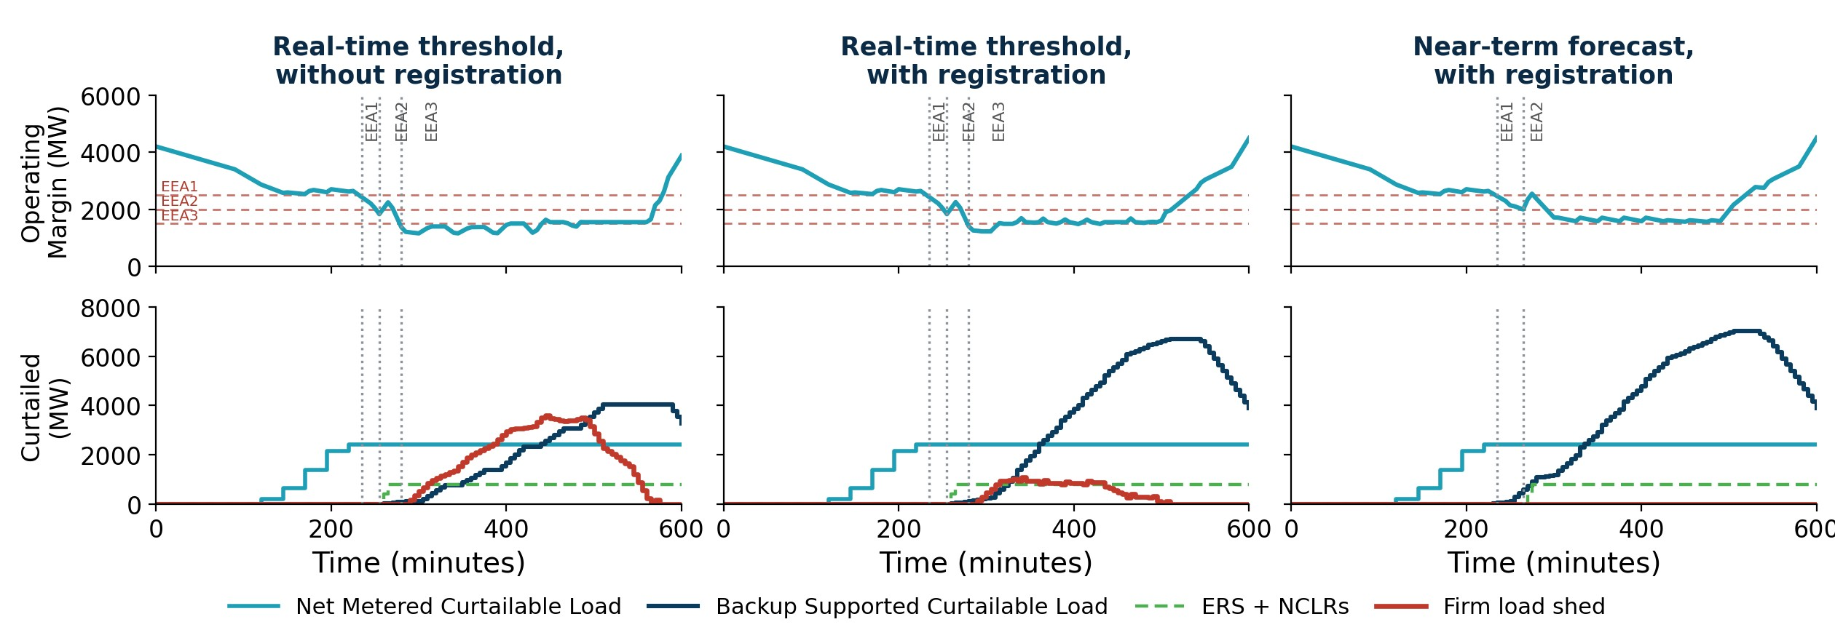
Illustrative example: isolating what registration impacts
The near-term forecast-informed case introduced earlier assumes site-level curtailment capability and real-time telemetry are available to ERCOT. Here, "with registration" represents the Protocol revisions on slide 24 that would provide those capabilities. The middle case gives the real-time threshold case those same capabilities, keeping its timing, and its routing through the utility, unchanged.
Key Takeaway: Registration and related requirements allow ERCOT to size, monitor, verify, and pace BSCL curtailment more precisely. They do not change when ERCOT may begin; in the middle case, firm load shed still occurs because the statutory timing condition remains unchanged.

Slide 27
Even with these Protocol revisions, two issues remain under SB6
The timing condition: Even with registration, BSCL instructions can begin only once the statutory trigger is met. In the illustrative example, that alone still led to firm load shed.
The instruction path: Registration gives ERCOT the information to issue load-specific instructions, but PURA § 37.0561(e) still routes them through the utility, so the issues on slide 13 remain: the added relay step may reduce the time the Customer has to respond, and as BSCLs grow, more complex instructions increase the risk of delay and miscommunication.
Key Takeaway: Protocol changes can address response time and precision, but the timing condition and the utility instruction path may inhibit ERCOT’s ability to use BSCL curtailment to avoid EEA 3 load shed.

Slide 28
NERC is balloting standards for computational loads
Separately from SB6, stakeholders may already be aware that NERC is developing reliability standards under Project 2026-02 that apply directly to owners and operators of Computational Load Sites. They are noted here because they may apply to many of the same Large Loads.
Threshold: 50 MW or more, served at 100 kV or above. ERCOT’s current Large Load threshold is 75 MW.
Construct: the Balancing Authority interacts directly with the customer through two new registration types, Computational Load Owner (CLO) and Computational Load Operator (CLOP).
Three Standards: CLO-001 (interconnection, studies, modeling data); CLO-002 (operational data and communications); CLO-003 (protection coordination and disturbance monitoring).
Status: the Draft 1 ballot passed (Aug–Sep 2026). A final ballot is expected in October 2026, and NERC Board approval and filing with FERC is expected by December 2026. FERC approval is still required, and the earliest expected enforceable date for CLO-001 is July 1, 2027, while the earliest expected enforceable date for CLO-002 is April 1, 2028. ERCOT voted for the standards but against the implementation plans because the timelines are too compressed.
Key Takeaway: If FERC approves these, ERCOT will need Protocol revisions to meet these NERC requirements.

Slide 29
Implications of proposed NERC Project 2026-02 requirements
If FERC approves these standards, Computational Load Sites would also be required to have a Computational Load Operator (CLOP) responsible for telemetry and communications. ERCOT’s Protocol revisions could align with this by extending the QSE requirement on slide 25 to large computational loads (LCLs).
*Require TSP/DSP to provide telemetry for Large Load who are not required to have a QSE and are not co-located with a Generation Resource or ESR. **Applicable to BSCLs interconnecting after June 20, 2025
Large Load
Large Load Entity
Owner
Site data and obligations
Including:
Location in the network model
Maximum consumption (MW, MVAR)
Backup generation capability
Curtailment capability (full or partial)
Interconnecting TSP/DSP with control of site breaker
Real-time consumption*
For VECLs, BSCLs** and NMCLs
QSE
Operator
Telemetry, 24x7 communication, and entity with obligation for curtailment
NEW
+ LCLs
Greyed elements are unchanged from slide 25.
Large Load: added to ERCOT's operations model, so ERCOT can see where it is and account for its effect on the system.
Large Load Entity: the entity that owns the facility and provides modeling information about the site to ERCOT.
QSE: provides real-time telemetry ERCOT requires for the site, such as MW and MVAr, 24×7 communication and entity with obligation for curtailment. For NMCLs same as the co-located Generation Resource or ESR’s QSE.
Key Takeaway: Extending the QSE requirement to all LCLs above 50 MW would let one set of Protocol revisions meet both SB6 curtailment needs and NERC's proposed requirements.

Slide 30
Other Considerations

Slide 31
Other considerations: design elements ahead
As ERCOT continues developing an approach to implement SB6 for NMCL and BSCL, several design elements will need stakeholder input. These are not for detailed discussion today; future workshops are expected to take them up. They include:
The forward-looking margin that would trigger curtailment
Curtailment response times, and how curtailment blocks are defined and instructed
The order in which Large Loads are curtailed, within an event and across events
Recall and restoration
Notice ahead of curtailment
Two topics are worth raising today because while they are not in SB6's language, they follow from the same reasoning:
VECL forward-looking trigger
Accounting for BSCL and NMCL curtailment in TO load-shed obligations
Key Takeaway: Most design elements will be taken up in future workshops. Two related topics are shared now so stakeholders can begin considering them.

Slide 32
Topic 1: VECL forward-looking trigger
Why it's raised now: VECLs are not part of SB6, but the need to account for curtailment response time before operating margin reaches the applicable threshold applies equally to VECLs. The Commission-approved conditions for NMCL already allow curtailment before an emergency.
Question: Should VECLs be deployable when near term forecasts indicate operating margin will fall below 3,100 MW, not only once they have fallen below it?
ERCOT's current thinking: Yes. NPRR1238 intended VECLs to be curtailed early, ahead of emergency conditions. With NMCL instructed before an emergency under its approved conditions, VECLs could come off after NMCL if they wait for Real-Time operating margin to fall. Aligning the VECL trigger preserves NPRR1238’s intent and keeps VECLs first in the sequence, ahead of NMCL.
Input sought: Feedback on aligning the VECL trigger with the forward-looking approach proposed for the other categories.

Slide 33
Topic 2: SB6 loads and TSP load-shed obligation
Why it's raised now: SB6 does not address TSP load-shed obligation but loads curtailed under SB6 are expected to come off ahead of EEA3.
Question: Should Large Loads subject to SB6 curtailment be assumed to have been curtailed prior to EEA3, and therefore not included in TSP firm-load-shed obligation?
ERCOT's current thinking:
  For NMCL: Yes. Under the conditions the Commission has approved, NMCL can be curtailed before an emergency, so it is expected to be off before EEA3. The Commission has already ordered net metering loads subject to curtailment conditions to be removed from TSP load-shed obligations (Dockets 58881 and 59220), with the methodology to be addressed in ERCOT's rules.
  For BSCL: It depends. Whether BSCL can be assumed curtailed before EEA3 depends on resolving the timing and instruction-path issues described earlier (the three operational requirements), so that BSCL is reliably curtailed before EEA3.
Input sought: Stakeholder feedback is requested on this topic.

Slide 34
Wrap Up and Next Steps

Slide 35
Summary and Next Steps
Summary
As BSCL volume and site size grow, the statutory timing condition may leave too little time to build sufficient curtailment before firm load shed is needed.
Registration, visibility, and compliance requirements would improve precision, and accountability, but do not change the fact that the timing condition and the utility instruction path may inhibit ERCOT’s ability to use BSCL curtailment to avoid EEA 3 load shed.
If approved, proposed NERC reliability standards in Project 2026-02 are expected to mandate that ERCOT establish telemetry and communication requirements for computational loads 50 MW and above.
Next steps
ERCOT requests feedback on potential Protocol revisions described in Slides 24 through 29, and on the two related topics on Slides 32 and 33 by end of day October 23, 2026.
A follow-up workshop will be scheduled in early November.
ERCOT will consider stakeholder feedback before finalizing the Revision Requests.

