Slide 1
Probabilistic CDR Concept
Pete Warnken
ERCOT Resource Adequacy Department
Supply Analysis Working Group
October 2, 2026

Slide 2
Probabilistic CDR Report Elements
Planning Reserve Margins based on Perfect Capacity (PCAP)
Reliability Standard compliance visualizations
Reliability metric heat maps
Revised Capacity, Demand and Reserves tables

Slide 3
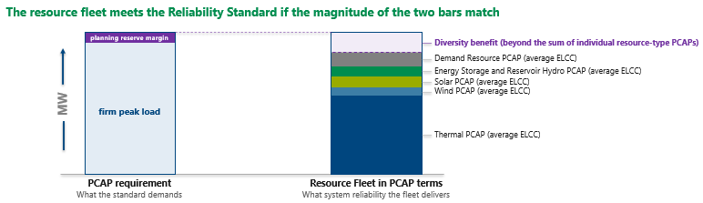
Perfect Capacity (PCAP) Planning Reserve Margin Concept
PCAP Planning Reserve Margin = (PCAP reliability standard requirement ÷ firm peak load) − 1
Perfect capacity has 100% availability for a simulation year. The PCAP requirement is how much of it the system needs to just meet the reliability standard, determined by running the probabilistic reliability model. The PCAP reserve margin represents the amount of PCAP needed to cover weather diversity and Large Loads. Meeting the reliability standard implies that the fleet-wide Effective Load Carrying Capability (ELCC)—which accounts for resource availability when most needed—at least matches the PCAP requirement as shown below.

Slide 4
Reserve Margin Basis Comparison
Basis | What the resource numerator represents | What changes the PRM numerator
PCAP | Perfect capacity the system needs to just meet the Reliability Standard. | Load level and shape, weather risk, load shedding/operating reserve conventions, fleet turnover, Demand Resource dynamics
UCAP hybrid (Current ERCOT CDR) | The amount of installed “Unforced Capacity” expected to be available after applying certain availability derates. For the current CDR: thermal units derated to reflect seasonal sustained capability renewables and storage ELCCs Demand Resources at credited levels Unplanned thermal unit outage derates are NOT reflected in the reserve margin | All the above, plus all technology-specific ELCC values

Slide 5
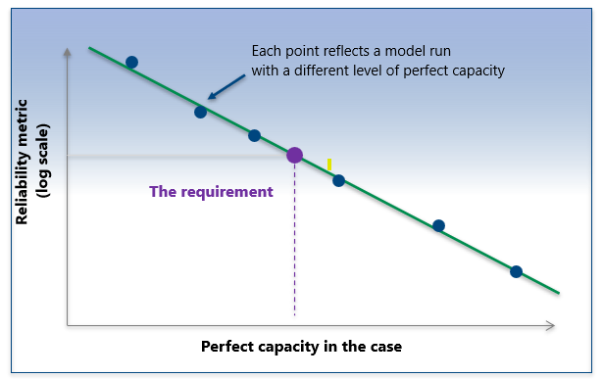
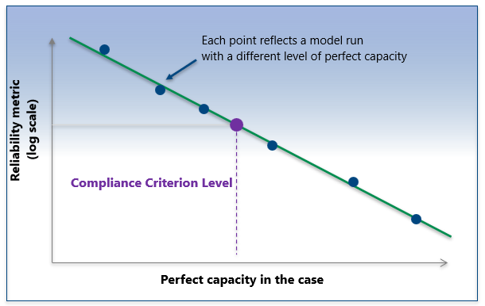
PCAP Planning Reserve Margin Derivation
Derivation Steps:
Iteratively run SERVM by adding and removing 250-MW perfect gas combustion turbine (CT) blocks; each PCAP run is referred to as a “case.” Each case has a resultant outcome for the three reliability measures: maximum duration, maximum magnitude, and frequency (each accounting for the accompanying exceedance tolerance).
  Cases are run for each of the five CDR forecast years.
  Obtain multiple cases that fall above and below the compliance criteria for the reliability measures.
  Fit a curve for each of the three reliability measures by year ( 5 years x 3 criteria = 15 curves ).
  For a given year, the case point that comes closest to, but doesn’t exceed, the compliance criterion levels for all three fitted curves determines the PCAP requirement.
  Divide the annual PCAP requirements by the firm peak loads to derive the annual PCAP planning reserve margins.

Slide 6
Advantages of the PCAP approach
Simplicity. The numerator implies no resource availability characteristics such as ELCCs. ELCCs determine if a resource portfolio meets the PCAP requirement according to separate resource accounting (slide #3).
Technology Agnostic. The PCAP requirement is influenced by changes to the existing resource mix, but there is no reliability bias for certain technologies since all resource types are assigned ELCCs reflecting their availability characteristics.
Less Volatility. The CDR’s hybrid UCAP-based reserve margin varies in response to load, resource portfolio, and ELCC changes over time, whereas the PCAP reserve margin avoids the influence of ELCC changes over time, resulting in a more stable PRM forecast.
Reliability Standard Consistency. Deriving the CDR’s PCAP requirements is identical to the modeling process for determining if the reliability standard is being met (although modeling assumptions will vary); the probabilistic CDR thus becomes an interim reliability scorecard between triennial reliability assessments.

Slide 7
Considerations
Frequency of CDR reports. Advocating for a single mid-year report release, supported by a dynamic dashboard for detailed CDR data with periodic updates (ultimately monthly).
Reporting seasonal PCAP requirements and reserve margins along with annual values. This is desirable but would add to the modeling complexity and workload; this level of reporting could be phased in.
Reporting PCAP PRMs using median versus “official” firm load forecasts.
  Historical hourly weather-year load forecast shapes in SERVM are scaled to forecasted median (“50/50”) values; therefore, PCAP reporting should be based on the median system load forecasts.
  However, ERCOT’s long-term load forecast uses an historical weather-year for calendar mapping to best represent the expected median forecasts. An issue is that differences in coincident diversity between the historical weather years means that the official forecasts can be above or below the actual median values used for SERVM modeling.
  If the median and official forecast values are significantly different, a solution is to show the required PCAP requirement alongside both load forecasts and their corresponding margins. This comparison would be located in an appendix to reduce confusion regarding which forecast basis is used for reliability reporting.
Comparability issues with respect to reserve margin reporting by other Assessment Areas for NERC’s annual Long Term Reliability Assessments (LTRAs).
  PCAP reserve margins can be translated into NERC LTRA-equivalent values if necessary.

Slide 8
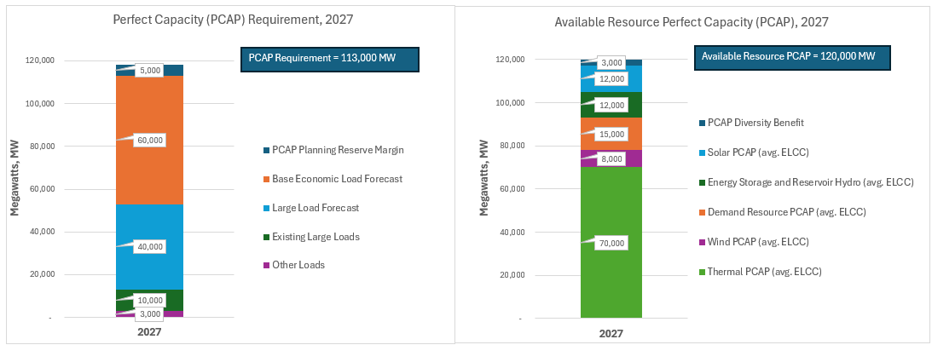
Reliability Standard Compliance Visuals
The CDR report would have, for each of the five forecast years, two side-by-side stacked bar charts comparing the PCAP requirement and available resource PCAP.
The 2027 example below shows that the ERCOT Region is expected to be compliant with the reliability standard (all three metrics) since available resource PCAP exceeds the requirement by 7,000 MW.
Additional side-by-side charts would reflect alternative scenarios.
MOCK DATA

Slide 9
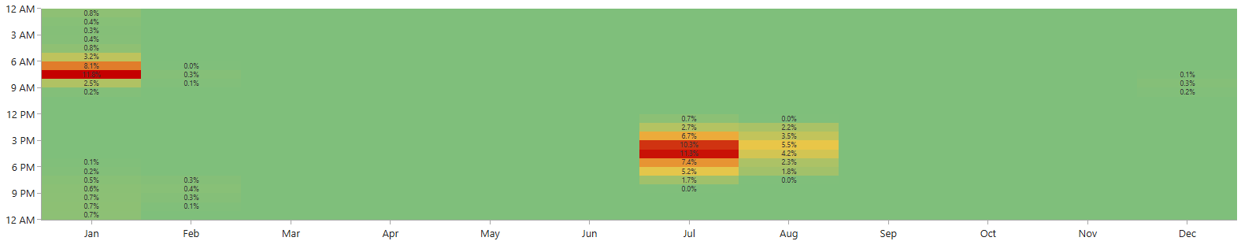
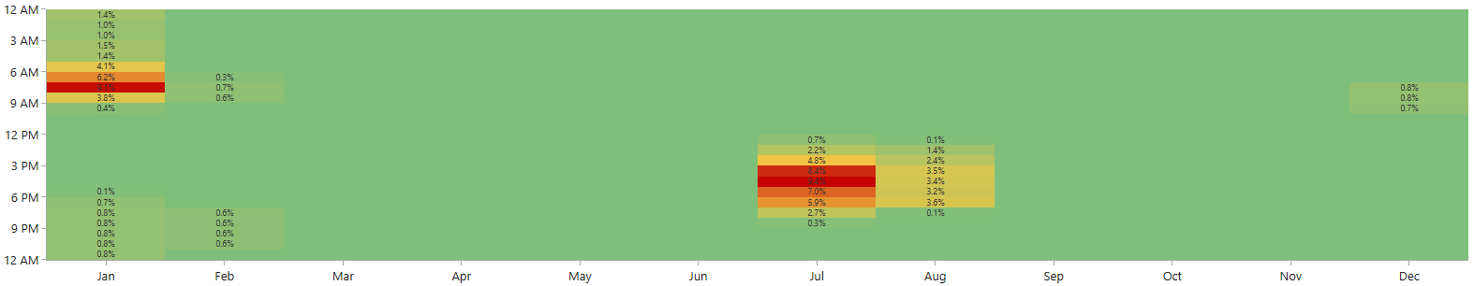
Reliability Metric Heat Maps –Year 2027 (Test Data Samples)
Each heat map cell represents the probability-weighted average value for the metric for the month-hour combination across all simulation trials.
Heat Map - Expected Unserved Energy (EUE)
SAMPLE DATA
Heat Map – Loss-of-Load Hours
SAMPLE DATA

Slide 10
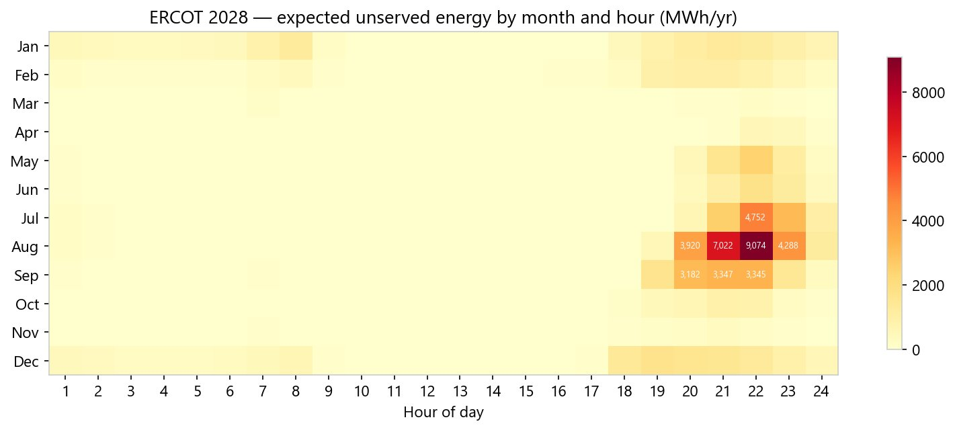
Reliability Metric Heat Maps –Year 2028 (NERC Result)
This custom heat map reports average EUE amounts for the hour-month combinations in MWh; it represents actual modeled results for the 2026 NERC Probabilistic Assessment.

Slide 11
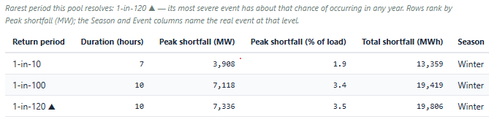
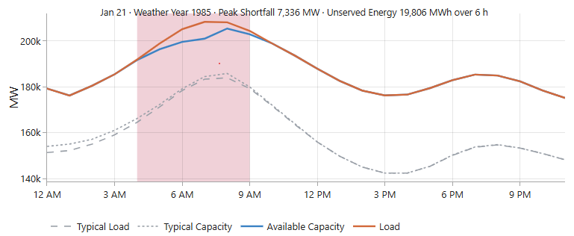
Event Profile –Year 2027 (Sample Data)
Loss-of-Load Event Return Profile
Worst Event, Hourly Profile

Slide 12
How will ELCCs be Developed?
Average ELCCs will be calculated for each CDR forecast year, season, and resource type as before—however, risk-period ELCCs would not be estimated as these aren’t necessary for determining PCAP requirements or available resource PCAPs.
The CDR report would continue to list ELCC percentages.
ELCCs for energy storage would only be reported based on design duration ranges for resources in the CDR (e.g., a 12-hour battery storage ELCC would only be reported if one or more ESRs had a design duration of this length).
ERCOT would continue to conduct a separate ELCC study that includes marginal ELCCs; frequency is yet to be determined.

Slide 13
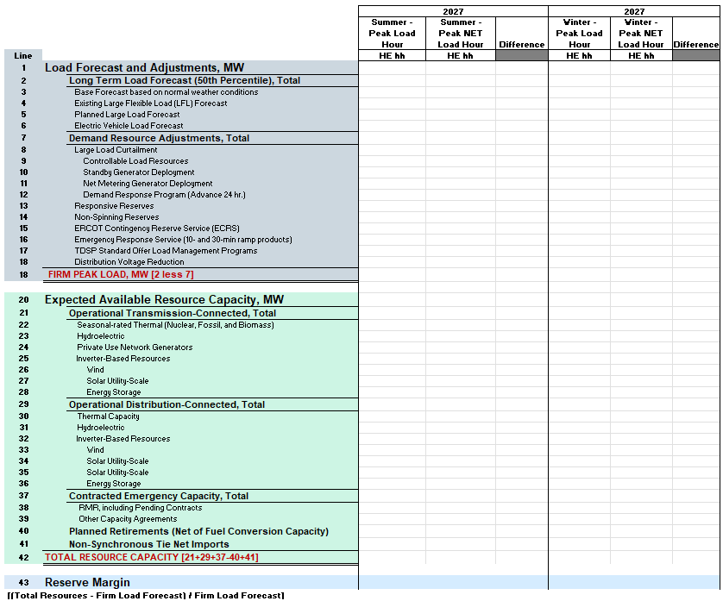
Opportunity to Overhaul the “Seasonal Summary” Table
The example at right expands line items to include Large Load and Distributed Generator data; regional renewable details are removed.
Not including spring and fall columns since monthly probabilistic reporting details should be sufficient.
The CDR report would continue to have the ‘Unit Details’ table.

Slide 14
Thank you!
Pete.Warnken@ercot.com

