Slide 1



2026 ERCOT CONE Study
DRAFT
Prepared By
  The Brattle Group
  Sam Newell
  Andrew W. Thompson
  Nathan Felmus
  Andrew Boettcher
  Sargent & Lundy
  Joshua Junge
  Danny Harrington
Prepared For
  ERCOT
October 2, 2026

Slide 2
Notice
This report was prepared by The Brattle Group and Sargent & Lundy for the Electric Reliability Council of Texas Inc. (ERCOT). It is intended to be read and used as a whole and not in parts. The report reflects the analyses and opinions of the authors and does not necessarily reflect those of The Brattle Group’s clients or other consultants.
Copyright © 2026 The Brattle Group, Inc.

Slide 3
Table of Contents
1
Executive Summary
2
Introduction
3
2024 Prevailing ERCOT CONE Estimate
4
Current Situation for Building a Gas-Fired Plant
5
2026 Overnight Capital Costs for Frame CT
6
2026 Installed Capital Costs for Frame CT
7
2026 Level-Real CONE Accounting for Scarcity
8
Indicative Long-Term Equilibrium CONE
9
Appendix

Slide 4
Table of Contents
1
Executive Summary
2
Introduction
3
2024 Prevailing ERCOT CONE Estimate
4
Current Situation for Building a Gas-Fired Plant
5
2026 Overnight Capital Costs for Frame CT
6
2026 Installed Capital Costs for Frame CT
7
2026 Level-Real CONE Accounting for Scarcity
8
Indicative Long-Term Equilibrium CONE
9
Appendix

Slide 5
2026 ERCOT Cost of New Entry (CONE) Study
Executive Summary
Context: Texas is experiencing record load growth amid industry-wide scarcities of equipment and labor for building generation, leading to high costs and long lead times for new plants
Problem Statement: ERCOT asked Brattle with Sargent & Lundy to conduct a streamlined analysis of CT CONE
  ERCOT and the PUCT plan to use this study for planning purposes and as an input to the 2026 Reliability Assessment
  The study will inform ERCOT and the PUCT in assessing whether ERCOT’s market design can set prices high enough to attract sufficient capacity to meet reliability criteria on a near-term and/or on a long-run basis after scarcities resolve.
  “CONE” is a common metric that expresses the levelized cost of new generation, typically estimated as:
    Overnight Capital Cost (OCC) × Capital Charge Rate (CCR) + Levelized Annual Fixed O&M (FOM)
    OCC can be estimated from bottom-up analysis of the equipment, labor, materials, and other costs to build a plant.
    CCR is the portion of capital recovery required in year-1, given the economic life of the asset, the cost of capital, and the assumed revenue recovery trajectory
  PUCT staff asked us to estimate “level-real CONE” under current conditions and long-run conditions
Interpretation: see next slide for market relevance of Current CONE, Long-Term Equilibrium CONE,
and levelization methods

Slide 6
2026 ERCOT Cost of New Entry (CONE) Study – Essential Concepts for Interpretation
Executive Summary
Basic concepts: In restructured markets, merchant investors will enter if they expect to recover their capital and fixed costs over the life of the plant plus a reasonable return on investment through net revenues in the wholesale market.
  They expect revenues in the first year to equal CONE at minimum, where CONE is calculated with a net revenue trajectory that is can be expected to be supported by anticipated market fundamentals.
  That trajectory could be “level-real” in a static environment with constant technology and resource costs, such that an entrant today can continue to earn net revenues that rise in nominal terms at the rate of inflation over the life of the plant.
  Yet if technology will improve or supply chains will ease, future entrants will compete down prices and erode revenue recovery for today’s entrants. That necessitates assuming a front-loaded revenue recovery, corresponding to “level-nominal” or even higher when calculating “CONE” as a reservation price for a merchant investor to enter the market.
Current conditions: With scarcity of equipment and skilled construction labor, the OCC is very high, but the reservation price for entry is even more extraordinarily high. That is because the prospect of current high prices normalizing means merchant investors would require extra front-loaded revenue recovery and thus high CCR, with 1st-year revenue requirements much higher than the (already elevated) current level-real or level-nominal CONE.
Long-term conditions: ERCOT/PUCT may not want to design the market around acute short-term conditions, especially if long lead-times limit how quickly entry could be stimulated by higher prices. Hence their request to also estimate CONE for future long-run equilibrium conditions. For that purpose, we provide some indicative benchmarks:
  LT OCC, using equipment and labor/EPC costs per kW as in 2018 & 2022 (adjusted for inflation), with qualifiers re uncertainties;
  Level-Real LT CONE corresponding to the PUCT’s request, and a higher Level-Nominal LT CONE that may more representative of investors’ reservation prices for entering if they anticipate technology advancement;
  Timing of equilibrium: it is difficult to predict when the market may moderate to “equilibrium,” but current turbine reservations suggest after 2032.

Slide 7
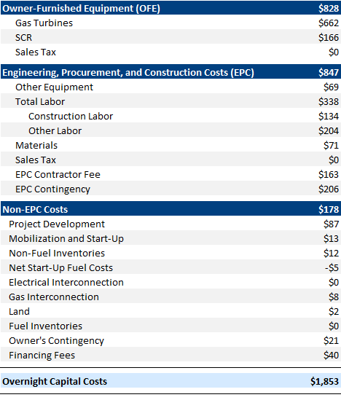
Costs to build new gas-fired plants are substantially higher than in 2024 when the last ERCOT CONE Study was done, due to supply chain constraints driven by large load demand for electricity.
Executive Summary
  Scarcity of turbines, other equipment, and labor/EPC has made building new gas plants costlier than ever, and with longer lead times
  Current best estimates of bottom-up costs to build a Frame CT today are $1,853/kW overnight capital costs and $2,368/kW installed capital costs (including capital carrying costs during construction). This incorporates OEM equipment quotes, labor rates, and other project costs from S&L database as of July 2026 for a 444 MW plant in Harris County, TX.
  These capital cost estimates are aligned with contemporary estimates from publicly announced CT projects (see Appendix for more details).
  In real terms, 2026 frame CT overnight capital costs are more than double the 2024 ERCOT CONE Study, and 46% higher than the 2025 PJM CONE Study completed a year ago, with higher turbine costs accounting for almost half of that increase, followed by EPC (1/3) then labor (1/4).
  Consistent with other CONE studies, we define the development timeline as beginning from the Financial Investment Decision (FID) which assumes that major equipment has already been ordered, the site has already been permitted, and interconnection is approved. Construction then is 50 months for a 2030 COD. Turbine costs are $662/kW based on current quotes from OEMs.
  However, if a developer actually placed order now with the latest turbine backlog, the project would take at least another 15 months, with COD in 2032 or later.
  This translates to $290/kW-year Level-real CT CONE for 2030 entry
  Assumes 9.71% merchant ATWACC and 20-year life, and a capital charge rate of 12.9%, when applied to $1,853/kW overnight cost results in a Year 1 level-real capital recovery of $242/kW-year
  Levelized FOM is $48/kW-year, which is additive to result in a level-real CONE of $290/kW-year.
  The 2025 PJM CONE CT (Online June 2028) had a very similar capital charge rate of 12.8%; applied to a lower $1,247/kW overnight cost which led to a level-real capital recovery of $160/kW-year. Levelized FOM was $21/kW-year, resulting in a level-real CONE of $181/kW-year for 2028 entry.
  Overnight Capital Cost for a 444 MW Frame CT (2026$/kW)

Slide 8
2026 ERCOT Cost of New Entry (CONE) Study
Executive Summary
2026 Level-real CONE and Long-term (LT) Equilibrium CONE Benchmarks
  Current Level-real CT CONE understates the net revenues an investor would need to enter for 2030-32 and likely overstates future entry prices.
  Level-real CONE assumes future revenues increase at the rate of inflation.
  This understates short-term revenues investors would require to enter now if current high prices are expected to eventually revert back to lower equilibrium levels.
    For example, investors’ current reservation prices might be closer to $593/kW-year if they expect 5 years of high prices followed by reversion to an equilibrium level at $149/kW-year.
    This is sensitive to assumptions, and there is little empirical basis for knowing investors’ actual range of expectations, other than revealed preference from commercial activity.
  On the other hand, current CONE likely overstates the net revenues investors will need to enter in the future if equipment and labor costs revert to lower long-term equilibrium levels. We think about possible long-term cost and timing as follows:
    Long-term (LT) CONE: One indicative benchmark of LT level-real CONE is $126/kW-year, derived by substituting today’s equipment and labor costs (and EPC costs as percentages of other capital costs), with those from 2018 (pre-COVID) and 2022 (pre-large load demand), taken from our 2018 and 2022 PJM CONE studies (but both using a construction timeline from the 2022 study); and with adjustments for Texas.
    Alternatively, a level-nominal LT CONE is $149/kW-year (see discussion on slide 5).
    Timing: beyond 2032 at least as indicated by the current turbine backlog and CT development timelines. Equilibrium conditions could take several years beyond that.
    Qualifiers: Lots of uncertainty around timing and level of future costs. LT equilibrium CONE could be lower depending on technology progress, economies of scale, lower cost of capital. LT equilibrium CONE could be higher if 2018 and 2022 prices were below LT equilibrium, if materials costs continue to rise, and if critical supply chains remain concentrated and limit production capacity.
  The $126/kW-year LT level-real CONE is based on 2018/21-vintage costs while the $140/kW-year existing level-real CONE is a 2026$ number that was based on 2023-vintage costs that were higher.
Current Level-real CT CONE for 2030 entry
Indicative level-nominal LT CONE
ERCOT Existing Value*
Indicative level-real LT CONE
* ERCOT Existing Value from the Commission's decision based on 2024 CONE Study Level-real CT sensitivity for 2026 entry see PUCT Open Meeting Minutes, July 25, 2024 Item 19 at 3. Shown as unescalated $140/kW-yr, constant in nominal dollars per ERCOT practice. Other Sources: Brattle CONE analysis

Slide 9
Table of Contents
1
Executive Summary
2
Introduction
3
2024 Prevailing ERCOT CONE Estimate
4
Current Situation for Building a Gas-Fired Plant
5
2026 Overnight Capital Costs for Frame CT
6
2026 Installed Capital Costs for Frame CT
7
2026 Level-Real CONE Accounting for Scarcity
8
Indicative Long-Term Equilibrium CONE
9
Appendix

Slide 10
Introduction
introduction
ERCOT requested an updated Cost of New Entry (CONE) study for planning purposes.
  Per ERCOT’s request, this study is a streamlined update to the CONE estimate rather than an in-depth bottom-up estimate:
  The streamlined CONE approach uses the same reference technology as the recent 2025 PJM CONE Study (a large-frame combustion turbine, “CT”) and the same reference location as the 2024 ERCOT CONE Report (Harris County) with several ERCOT-specific adjustments including: assessing a CT that is not a dual fuel plant and instead has a firm gas supply contract, adjusting capital cost and labor rates for Texas, and applying an after-tax weighted average cost of capital (“ATWACC”) reflecting tax rates in ERCOT. Based on recent ERCOT interconnection request analysis, Harris County continues to be a reasonable reference location, but future CONE studies would need to consider other areas such as the North and South CDR Zones.
  We understand the PUCT and ERCOT may use this CONE study to inform modeling for long-term reliability planning purposes. Additionally, the PUCT/ERCOT have requested a CONE estimate that could be an indicator of long-run equilibrium market conditions.
  Therefore, in this study we present estimates of both current CONE based on prevailing costs and labor rates as well as indicators of what a long-term equilibrium CONE could be based on capital costs and labor rates prior to when scarcity and premium prices materialized.

Slide 11
Key Considerations
introduction
There were several key considerations while undertaking this 2026 CONE Study
Rapid Demand Growth
Recently, demand for electricity has increased substantially across the U.S., driven primarily by data centers. BNEF estimates that 20% of the U.S. data center pipeline is in ERCOT. While ERCOT is still determining the amount of data center and other large loads to include in its next long-term load forecast, the amount remains substantial. However, there is significant uncertainty around how much of this new load will materialize.
Tight Labor and EPC Market
EPC contractors are managing substantial workloads and are pricing projects to reflect higher skilled labor rates and the opportunity cost of taking on more work given the limited capacity they have available. Meanwhile, there is acute scarcity for skilled EPC and construction labor and bottlenecks to expanding the labor pool due to the time needed for training.
Scarcity of Gas Turbines and Other Equipment
Substantial equipment backlogs and resulting protracted wait times for new gas turbines have created a significant supply/demand imbalance. The three largest gas turbine manufacturers (GE, Siemens, and Mitsubishi) have a combined order backlog of 246 GW as of Q2 2026 compared to an annual production capacity of roughly 60 GW. As a result, gas-fired plants that begin development today would not come online until 2032 or later.
Tight Supply Conditions
Consequently, many regions in the U.S. are facing premium prices for new generation due to scarcity and rapid demand growth that outpaces the rate that new generation can be built. In the near term, supply chain constraints for gas turbines and other major equipment majorly restrict the deployment of new generation capacity.

Slide 12
Table of Contents
1
Executive Summary
2
Introduction
3
2024 Prevailing ERCOT CONE Estimate
4
Current Situation for Building a Gas-Fired Plant
5
2026 Overnight Capital Costs for Frame CT
6
2026 Installed Capital Costs for Frame CT
7
2026 Level-Real CONE Accounting for Scarcity
8
Indicative Long-Term Equilibrium CONE
9
Appendix

Slide 13
2024 Prevailing CONE in ERCOT
2024 Prevailing ERCOT CONE Estimate
Costs of gas-fired generation have increased sharply, along with longer lead-times
Issue: The prevailing ERCOT CONE value is $140/kW-year and was based on a sensitivity analysis from the previous 2024 ERCOT CONE Study with underlying cost estimates from 2023, which do not reflect current costs.
  The 2024 ERCOT CONE Study estimated a CONE of $293/kW-year for an aeroderivative CT and $263/kW-year for a solar + battery storage hybrid resource (both in 2026$) based on technologies that were dispatchable, economically viable, and were being developed in ERCOT at that time.
  PUCT Commission Staff recommended a CONE value of $162/kW-year (in 2026$) based on a sensitivity analysis from the 2024 ERCOT CONE Study that assessed an indicative level-nominal CONE estimate for a frame CT based on cost estimates from December 2023.
  The PUCT decided on the final CONE value of $140/kW-year by adjusting the indicative level-nominal frame CT sensitivity to a level-real levelization approach. A level-real levelization assumes that revenues constantly increase at the rate of inflation while a level-nominal approach assumes that revenues are constant over the lifetime of the plant.
Overnight capital costs for frame CTs have more than doubled in real terms since the 2024 ERCOT CONE Study and merchant investors’ reservation price for entry is likely even more extraordinarily high. That is because the prospect of wholesale prices eventually normalizing means merchant investors would require extra front-loaded revenue recovery, with 1st-year revenue requirements much higher than the (already elevated) current level-real or level-nominal CONE.
However, ERCOT/PUCT may not want to design the market around acute short-term conditions (especially if long lead-times limit how quickly entry could be stimulated by higher prices) and instead opt to center market design around long-term equilibrium conditions.
Sources and Notes: For Aero and PV+BESS CONE, see Newell, et al., ERCOT CONE for 2026, June 10, 2024 at 34-35. For frame CT sensitivity, see Newell, et al., ERCOT CONE for 2026, June 10, 2024 at 46-47. For Staff's $162/kW-year recommendation, see PUCT Project No. 54584, Item 69, Staff's Update on CONE , July 3, 2024 at 2. For the Commission's $140/kW-year decision, see PUCT Open Meeting Minutes, July 25, 2024 Item 19 at 3.

Slide 14
Table of Contents
1
Executive Summary
2
Introduction
3
2024 Prevailing ERCOT CONE Estimate
4
Current Situation for Building a Gas-Fired Plant
5
2026 Overnight Capital Costs for Frame CT
6
2026 Installed Capital Costs for Frame CT
7
2026 Level-Real CONE Accounting for Scarcity
8
Indicative Long-Term Equilibrium CONE
9
Appendix

Slide 15
Current Conditions for Gas-fired CT Generation Development
Current Situation for Building a Gas-Fired Plant
A gas-fired CT ordered today would not come online until 2032 or later due to a substantial backlog of gas turbines, supply chain constraints on transformers and switchgear, and scarcity of skilled labor. This has increased prices and development timelines for new generation nationwide; it is highly uncertain when these scarcity conditions will resolve.
  Large load (mostly data center) electricity demand has caused a substantial backlog of orders for new gas turbines (246 GW in Q2 2026), which cannot be resolved quickly with the current annual production limit of gas turbines (60 GW) or even projected increases by 2030 (~80 GW).
  U.S. utilities and ISOs anticipate an extended period of large-load-driven demand growth, while broader electrification efforts, the coal-to-gas transition, and firm capacity needs all point to a sustained supply crunch for gas turbines.
  Meanwhile, there is acute scarcity for skilled EPC and construction labor and a bottleneck due to the time needed to train new workers.
  Additionally, recent proposed restrictions from the Trump Administration on sourcing bulk-power equipment from certain countries may further constrain options for new generation.
Historical Gas Turbine Orders and Annual Production Limit (GW)
Q2 2026 Order Backlog:
246 GW Total
Mitsubishi: 35 GW
Siemens: 95 GW
GE Vernova: 116 GW
Projected Increase to Annual Production Limit
Global Gas Turbine Orders
2026 Annual Production Limit
(GE, Siemens, and Mitsubishi)
Sources and Notes: Brattle analysis of Nat Bullard, Decarbonization: Parameters, Dollars and Sense, Electrons Photons Molecules, January 15, 2026; POWER Magazine, “We're Writing a New Chapter”: Mitsubishi Power CEO Bill Newsom on AI, Gas Turbines, and the Path to Decarbonization, July 9, 2025; Wood Mackenzie, Gas turbine prices soar 195% as market faces supply-demand crisis, April 1, 2026; Bloomberg, Siemens Energy, Mitsubishi Struggle to Keep Up With AI-Driven Demand For Gas Turbines, October 2, 2025; Power Magazine, Gas Turbine Boom Tests Supply Chains as OEMs Race to Expand , September 1, 2026; Siemen’s Energy, 2025 Capital Market Day, November, 2025; Siemen’s Energy, Q3 Analyst Presentation, August 5, 2026; MHI, Mitsubishi Heavy Industries, Ltd. 2024 Medium-Term Business Plan Progress Briefing, May 27, 2026; MHI, Q&A Summary, October 5, 2025; MHI, Q1 FY2026 Financial Results , August 4, 2026; GE Vernova, GE Vernova Q&A, May 28, 2025; GE Vernova, GE Vernova Second Quarter 2026 Financial Results, July 22, 2026.

Slide 16
Lead Times for Gas Turbines & High-Voltage Transformer Are Longest
Current Situation for Building a Gas-Fired Plant
The large-frame gas turbine market is in a supply crunch: OEM backlogs show deliveries for H- and F- class CTs pushing into 2032 and beyond¹, with record turbine orders and substantial reservation fees required.
  In ERCOT, equipment procurement constraints have already impacted projects (e.g. Texas Energy Fund applicants withdrawing gas due to inability to meet required timeline milestones).
  The bottleneck for transformers is also affecting new builds for all utility-scale technologies: large power transformer U.S. average lead times are now ~80–210 weeks which have doubled since 2021.²
  Battery storage remains the fastest-to-market option for new capacity: ERCOT utility-scale storage deployments set records in 2024–25³ and installed costs continue to decline despite policy/tariff announcements, but recent federal policy could impede future deployment.⁴
New Generation Development Timelines as of Q4 2025
Project Development
Notice to Proceed-to-Delivery
Delivery-to-COD
Sources and Notes: 1. Gas turbine delivery timelines based on OEM advertisement and S&L recent project data.
2. Transformer delivery timelines based on Q3 and Q4 2025 vendor quotes and OEM presentations.
3. Modo Energy, ERCOT Buildout Report: Battery capacity crosses 12 GW in Q3 2025, October 16, 2025. 4. Executive Order 14421: Declaring a National Emergency To Secure the United States Bulk-Power System, August 26, 2026.
Sources and Notes: 1: Sargent & Lundy database of Q3 and Q4 2025 OEM quotes and vendor presentations; 2: Wood Mackenzie, Supply shortages and an inflexible market give rise to high power transformer lead times, April 2, 2024; 3: Energy Storage News, Global energy storage deployments on track for record year in 2025, BNEF says, October 21, 2025; 4: Executive Order 14420, Declaring a National Emergency to Secure the United States Bulk-Power System – The White House, August 26, 2026; 5: IRS Notice 2026-15, Guidance to Apply Interim Safe Harbors for Purposes of Determining a Taxpayer’s Material Assistance from a Prohibited Foreign Entity; Other Prohibited Foreign Entity Guidance, February 12, 2026.

Slide 17
Table of Contents
1
Executive Summary
2
Introduction
3
2024 Prevailing ERCOT CONE Estimate
4
Current Situation for Building a Gas-Fired Plant
5
2026 Overnight Capital Costs for Frame CT
6
2026 Installed Capital Costs for Frame CT
7
2026 Level-Real CONE Accounting for Scarcity
8
Indicative Long-Term Equilibrium CONE
9
Appendix

Slide 18
2026 Overnight Capital Costs for Frame CT
CT Overnight Costs Have Increased Substantially in Recent Years
Overnight costs have more than doubled in the past three years resulting from a combination of gas turbine and other major equipment backlogs and scarce labor. The overnight capital costs for an H-frame CT have increased to $1,853/kW in 2026$.
The 2024 ERCOT CONE Study did not develop a bottom-up cost analysis for a frame CT but did provide a sensitivity analysis which estimated an indicative CONE for a frame CT of $162/kW in 2026$. The PUCT decided to adopt a $140/kW-year CONE based on a level-real adjustment to the indicative frame CT sensitivity, which reflected overnight costs of $918/kW in 2026$ based on cost estimates from December 2023.
More recently, the 2025 PJM CONE Study developed a bottom-up CONE estimate for a frame CT with an online date of June 2028, which captured some of the recent scarcity premiums and rapid cost increases. The 2025 PJM CT had overnight costs of $1,267/kW in 2026$ based on cost estimates for turbines from August 2025 and labor/other costs from January 2025.
The 2026 ERCOT CONE Study results, however, show that costs have increased substantially (even from the 2025 PJM CONE Study approx. 1.5 years ago). Overnight costs have increased by 102% in real terms from $918/kW in December 2023 to $1,853/kW in July 2026 in 2026$, driven almost entirely by scarcity pricing for turbines, major equipment, and labor.
Frame CT Overnight Capital Costs (2026$/kW)
Sources and Notes: All costs escalated to July 2026$ using CPI.
2024 ERCOT: Newell et.al., ERCOT CONE For 2026 (June 10, 2024) at 46.
2025 PJM CT (Rest of RTO): Affidavit of Dr. Samuel A. Newell, Dr. Andrew W. Thompson, Dr. Bin Zhou, and Joshua C. Junge Regarding Updates to PJM’s CONE and Net Energy and Ancillary Service Offset Parameters for Delivery Years 2028/29 Through 2031/32, before the Federal Energy Regulatory Commission, Docket No. ER26-455, Attachment E.
2026 ERCOT: Results from current 2026 ERCOT CONE Study herein.

Slide 19
Estimated ERCOT Overnight Costs Are In Line With Contemporary Public Estimates
2026 Overnight Capital Costs for Frame CT
We estimate current overnight capital costs for a frame CT in ERCOT are $1,853/kW in 2026$, which is in line with other public cost estimates for recent plants.
  The Lone Star CT project by Entergy Texas was announced in 2024 with estimated overnight costs of $1,589/kW (in 2026$) and is currently under construction with a scheduled COD of 2028.
  The Chesterfield CT project by Dominion Energy in Virginia was announced in 2025 with estimated overnight costs of $1,619/kW (in 2026$) and is currently under development with construction scheduled to begin in 2026 and a scheduled COD of 2029.
  The North Valmy CT project by NV Energy in Nevada was announced in 2024 with most recently (as of 2026 IRP) estimated overnight costs of $1,881/kW (in 2026$) and is currently in the planning stages with a scheduled COD of 2028.
Frame CT Benchmark Overnight Capital Costs (2026$/kW)
Sources and Notes:
All costs escalated to July 2026 dollars at the CPI.
Gridlab, The New Reality of Power Generation (September 2025).
Lone Star: Direct Testimony of Carlos Ruiz, before the Public Utility Commission of Texas, Control No. 56693 (June 2024) at 28. Overnight cost estimate includes total generation project cost less AFUDC, plus interconnection costs.
Chesterfield: Direct Testimony of Shawn Kelly, before the Virginia Commerce Commission, Case No. PUR-2025-00037 (July 2025) at 4.
North Valmy: NV Energy, Integrated Resource Plan Vol. 8 (May 2026) at 12.

Slide 20
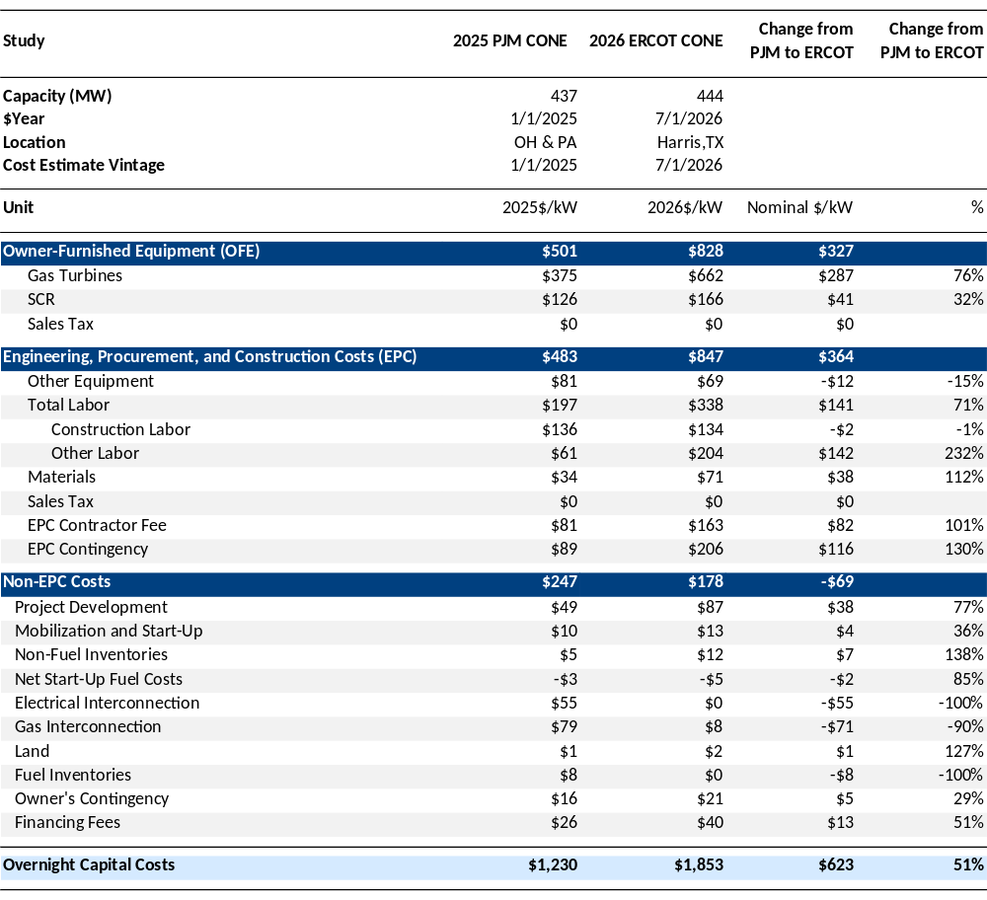
Turbine and Labor Shortages Have Increased Overnight Costs
2026 Overnight Capital Costs for Frame CT
Current $1,853/kW frame CT overnight capital costs are primarily driven by increases in turbine equipment costs, labor costs, and the price premiums required by EPCs.
Since the 2025 PJM CONE Study was completed 1.5 years ago, overnight capital costs for an H-class frame CT have increased by $623/kW or 51% in nominal terms, driven by:
  Owner-Furnished Equipment (OFE): Gas turbines alone are now above $660/kW due to ongoing supply scarcity seen nationwide.
  Labor: Labor costs are up more than 70% due to higher labor compensation from tighter labor pool, contractors pricing in opportunity costs to manage labor limitations, and additional workers or overtime needed to complete the same scope to contain timelines during construction where possible.
  EPC Fee & Contingency, Owner’s Contingency: EPC contractor fees have increased from 10% of OFE + EPC costs to 12.5%, and EPC contingency increased from 10% to 14% of all other OFE+EPC costs (incl. contractor fee); owner’s contingency has increased from 8% to 18% of other owner’s costs (excl. emission reduction credits) due to the greater scope of associated risk owners are facing by securing long-lead time equipment which previously was procured by EPCs.
Frame CT Overnight Capital Cost Components (Nominal)
Sources and Notes: 2025 PJM OFE costs are based on updated OEM quotes from August 2025.

Slide 21
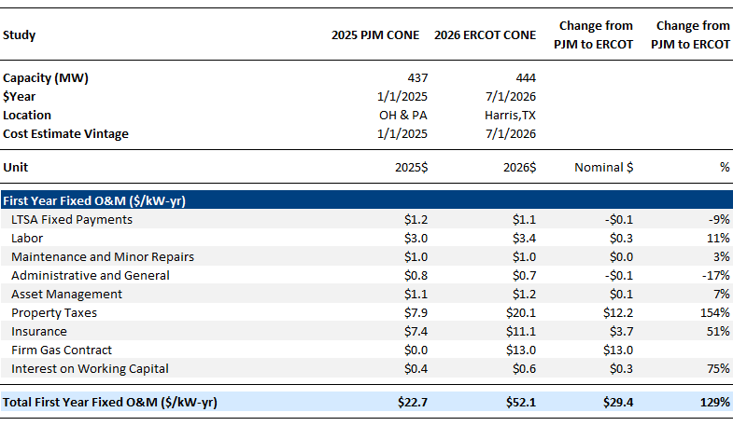
Increases in Overnight Capital Costs Also Drive FOM Increases
2026 Overnight Capital Costs for Frame CT
First year Fixed O&M costs for the reference CT are approximately $52/kW-yr in October 2030$, driven by differences in property tax rates and increases in percentage-based costs. Additionally, the ERCOT reference CT has a firm gas supply contract instead of being a dual-fuel unit like in PJM.
Between the 2025 PJM CONE and 2026 ERCOT CONE studies, Total First Year FOM costs have increased $29/kW-yr or 129% in nominal terms, driven by:
  Firm Gas Contract: In the 2025 PJM CONE study, the CT technology was dual fuel, resulting in higher capital costs (initial fuel inventories) but lower FOM costs. The 2026 ERCOT CONE study instead assumes the unit signs Firm Gas Supply Contract reflected as an FOM cost.
  Property Taxes: Property taxes are calculated as a percentage of the assessed value of the plant and therefore have increased along with overnight capital costs. Additionally, the Harris County, TX location in the current 2026 ERCOT CONE study assesses property taxes differently than OH or PA from the 2025 PJM CONE study.
  Other Percentage-Based Costs: Insurance and Interest on Working Capital are also calculated as percentages of overnight capital costs, so these have increased as well.
Frame CT Fixed Operations and Maintenance Cost Components (Nominal)

Slide 22
Table of Contents
1
Executive Summary
2
Introduction
3
2024 Prevailing ERCOT CONE Estimate
4
Current Situation for Building a Gas-Fired Plant
5
2026 Overnight Capital Costs for Frame CT
6
2026 Installed Capital Costs for Frame CT
7
2026 Level-Real CONE Accounting for Scarcity
8
Indicative Long-Term Equilibrium CONE
9
Appendix

Slide 23
Installed Capital Costs
2026 Installed Capital Costs for Frame CT
We estimate installed capital costs, which include capital carrying costs during construction, to be $2,368/kW for a frame CT in ERCOT in 2026.
The capital drawdown schedule is estimated by S&L based on observations from actual CT projects reflecting how overnight capital costs are incurred over time. It is used to calculate capital carrying costs during development/construction to arrive at a complete installed cost.
Installed cost is calculated by applying the capital drawdown schedule to nominal overnight costs and then calculating the present value of the monthly cash flows as of the online date using the after-tax cost of capital (ATWACC) as the discount rate. We assumed an ATWACC of 9.71% which reflects the core financial assumptions from the 2025 PJM CONE Study adjusted for ERCOT tax conditions.
The development timeline has increased to 50 months (6 months more than in 2025 PJM) and is now more backloaded since developers need to reserve turbines much earlier before construction kicks off. Consistent with past CONE studies, we define the development timeline to be from financial investment decision (FID) until the commercial operation date (COD). We assume an approximately 15-month period of development for permitting and other activities before FID, the costs of which are capitalized.
Capital Drawdown Schedules for Frame CT
Sources and Notes:
PJM 2025: Newell et. al., Brattle 2025 CONE Report for PJM, April 9, 2025, Appendix A1.

Slide 24
Table of Contents
1
Executive Summary
2
Introduction
3
2024 Prevailing ERCOT CONE Estimate
4
Current Situation for Building a Gas-Fired Plant
5
2026 Overnight Capital Costs for Frame CT
6
2026 Installed Capital Costs for Frame CT
7
2026 Level-Real CONE Accounting for Scarcity
8
Indicative Long-Term Equilibrium CONE
9
Appendix

Slide 25
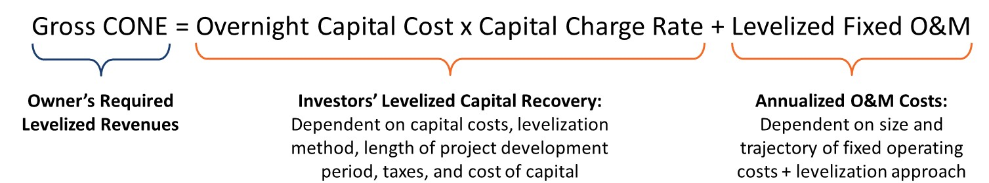
CONE Calculation Overview
2026 Level-real CONE Accounting for Scarcity
Capital Charge Rate (CCR) is an output from the CONE model which expresses the fraction of overnight capital cost that investors would need to recover in the first year of operation to be willing to finance a new plant.
CCR thus depends on:
  Investors’ long-term view of economics (trajectory of net revenues and economic lifetime of the plant)
  ATWACC available to merchant investors
  Depreciation schedules for capital
  Income tax
  Tax credits (if applicable)

Slide 26
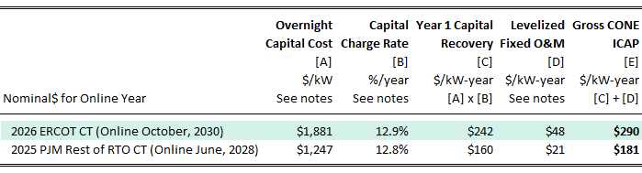
2026 Level-Real CONE Estimate for a Frame CT
2026 Level-real CONE Accounting for Scarcity
The estimated 2026 Level-real CONE for a frame CT in ERCOT is $290/kW-year, representing updated costs and the PUCT-prescribed level-real revenue trajectory. A level-real CONE calculation assumes that revenues increase at the rate of inflation over the plant’s assumed economic life (20 years).
However, a level-real CONE is unlikely to reflect the revenues required to enable new entry in today’s market. Current scarcity for turbines causing cost premiums for equipment, long development timelines, and uncertainty imply that investors would likely need a more front-loaded revenue recovery and thus a higher CONE to be incentivized to enter (see additional analysis in Appendix). However, ERCOT/PUCT may not want to design the market around acute short-term conditions and have also requested an estimate of CONE for future long-run equilibrium conditions.
2026 Level-Real CONE

Slide 27
Table of Contents
1
Executive Summary
2
Introduction
3
2024 Prevailing ERCOT CONE Estimate
4
Current Situation for Building a Gas-Fired Plant
5
2026 Overnight Capital Costs for Frame CT
6
2026 Installed Capital Costs for Frame CT
7
2026 Level-Real CONE Accounting for Scarcity
8
Indicative Long-Term Equilibrium CONE
9
Appendix

Slide 28
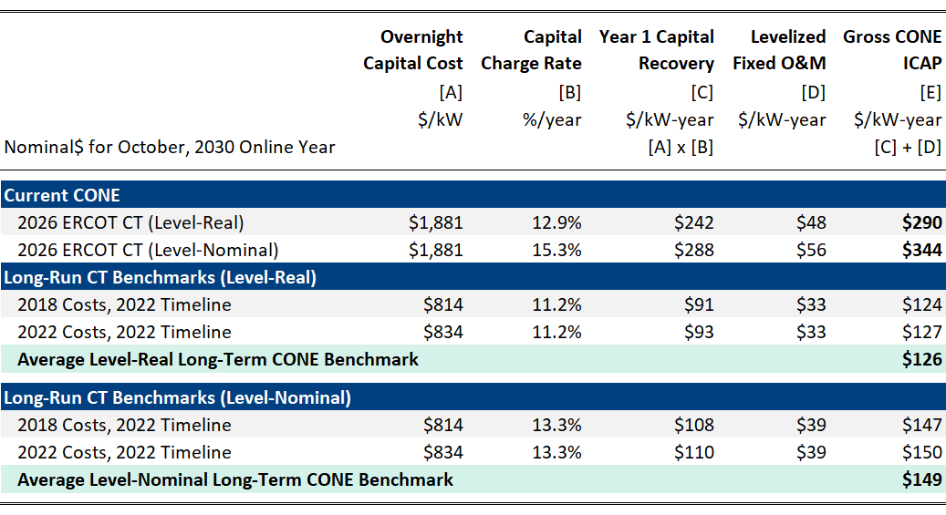
Indicative Long-term Equilibrium CONE Benchmarks
Indicative Long-term equilibrium cone
It is unclear when scarcity conditions will ease for costs and revenue expectations to revert to long-term equilibriums, but unlikely to be before 2032 based on the current turbine backlog.
We assess indicative benchmarks of what a long-term equilibrium level-real CONE ($126/kW-year) and a long-term equilibrium level-nominal CONE ($149/kW-year) could be based on the following approach:
  Substitute today’s equipment and labor costs on a per kW basis and percentage-based EPC and non-EPC cost percentages with those from 2018 (pre-COVID) and 2022 (pre-large load demand) taken from our 2018 and 2022 PJM CONE studies; use current 2026 costs for remaining cost line items (e.g. electrical interconnection, net start-up, land, etc.)
  Make adjustments for Texas: adjust OCC using the ratio of locational overnight capital cost factors between Scranton, PA and Houston, TX.
  Take 20-month FID-to-COD timeline from 2022 PJM CONE Study
  Use current 9.71% ATWACC merchant cost of capital for ERCOT.
Observations:
  LT equilibrium CONE could be lower depending on technology progress, economies of scale, or a lower cost of capital.
  LT equilibrium CONE could be higher if 2018 and 2022 prices were below LT equilibrium, if materials costs continue to rise, and if critical supply chains remain concentrated and limit production capacity.
Estimated Current CONE and Long-term Equilibrium CONE Benchmarks
Sources and Notes: 2018 and 2022 overnight costs inflated to July 2026 dollars using CPI from their original dollar-year vintages (01/2017 and 01/2021, respectively).
For locational adjustment, see EIA, Capital Cost and Performance Characteristics for Utility-Scale Electric Power Generating Technologies, January 2024.
For 2018 PJM CONE Study, see Affidavit of Samuel A. Newell, John M. Hagerty and Sang H. Gang (Attachment G), before the Federal Energy Regulatory Commission, Docket No. ER19-105-000, December 12, 2018.
For 2022 PJM CONE Study, see Affidavit of Samuel A. Newell, John M. Hagerty, and Sang H. Gang (Attachment D), before the Federal Energy Regulatory Commission, Docket No. ER22-2984-000, December 1, 2022.
For 2024 ERCOT CONE Study, see Newell et al, ERCOT CONE for 2026, June 10, 2024.

Slide 29
Table of Contents
1
Executive Summary
2
Introduction
3
2024 Prevailing ERCOT CONE Estimate
4
Current Situation for Building a Gas-Fired Plant
5
2026 Overnight Capital Costs for Frame CT
6
2026 Installed Capital Costs for Frame CT
7
2026 Level-Real CONE Accounting for Scarcity
8
Indicative Long-Term Equilibrium CONE
9
Appendix

Slide 30
CONE Depends On Assumed Revenue Trajectory Over Lifetime (i.e. “Levelization” Approach)
Appendix
CONE is the levelized revenues an investor would require in the first year to recover capital and fixed O&M costs over the lifetime of a new build plant based on their expectation of future revenues.
  Level-real CONE: An investor could accept a lower price today if they believed that nominal revenues would continue to increase at the rate of inflation (i.e. would remain level in real terms).
  Level-nominal CONE: An investor may need to front-load more of their recovery in earlier years if they instead believed that nominal revenues would be constant (i.e. decreasing in real terms at the rate of inflation).
  5-year Reservation Price: If instead an investor expected current tight supply conditions to normalize once supply chains are expanded, such that premium scarcity prices would eventually revert back toward a long-run equilibrium, they would need an even more front-loaded revenue recovery than level-nominal. We present an example of 5-years of scarcity prices that later revert back to a long-run equilibrium.
A levelization approach that reflects short-term scarcity conditions will more accurately reflect the true revenues required for new generation to enter the market today. If chosen such that CONE is too low, there is material risk the market signal will be insufficient to attract new entry, which would extend scarcity conditions.
Assumed Revenue Trajectories Embedded in CONE Estimates
(nominal terms)
5-year Reservation Price: likely extra-elevated reservation price needed to enter if short-run prices are at temporary premium
Level-real revenue trajectory
Level-nominal CONE
Price (Nominal$/kW-year)
Level-nominal revenue trajectory
Level-real CONE
Revenue trajectory if return to equilibrium prices after 5-years of scarcity prices
Year of Asset Life

Slide 31
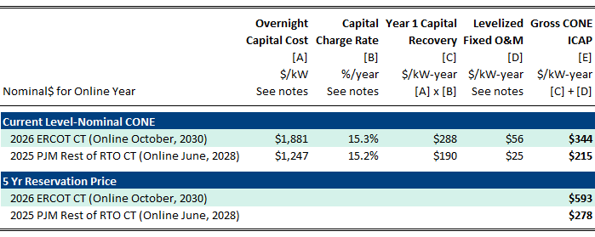
2026 CONE Under Acute Tight Supply Conditions (Level-Nominal and 5-yr Reservation Price)
Appendix
The 2026 level-nominal CONE for a frame CT in ERCOT is $344/kW-year, representing updated costs and development timelines and assumes that annual revenues are constant over the economic life of the plant (20 years).
However, if an investor expects that near-term scarcity conditions will subside and that revenues would revert back to lower long-term equilibrium levels, they would need an even more front-loaded recovery than level-nominal implies. An estimate of a 5-year Reservation Price is $593/kW-year, which reflects a revenue trajectory of five years of scarcity prices that revert to a long-run equilibrium for the 15-year remainder of the economic life.
2026 Level-Nominal CONE and 5-year Reservation Price

Slide 32
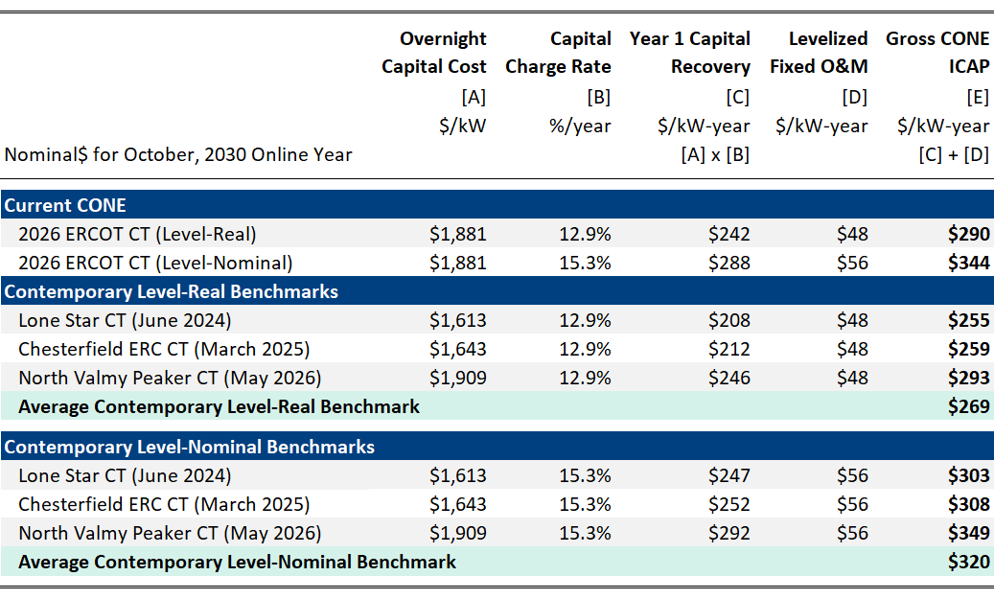
Contemporary CONE Benchmarks
Appendix
2026 ERCOT level-real and level-nominal CONE estimates are line with CONE values derived from overnight costs for recent publicly announced CT projects.
As shown on slide 18:
  The Lone Star CT project by Entergy Texas estimated overnight costs of $1,589/kW (in 2026$).
  The Chesterfield CT project by Dominion Energy in Virginia estimated overnight costs of $1,619/kW (in 2026$).
  The North Valmy CT project by NV Energy in Nevada estimated overnight costs of $1,881/kW (in 2026$).
Translating the overnight capital costs from these public CT plant benchmarks into CONE values with the current development timeline, cost of capital, and levelized fixed O&M costs results shows good agreement with our 2026 CONE estimates.
Estimated CONE and Contemporary Overnight Cost Benchmarks
Sources and Notes:
Overnight costs in 2026$ escalated to 2030$ based on ratio of 2030$ to 2026$ overnight costs in current ERCOT CONE model.
Gridlab, The New Reality of Power Generation (September 2025).
For Lone Star, see Direct Testimony of Carlos Ruiz, before the Public Utility Commission of Texas, Control No. 56693 (June 2024) at 28. Includes total generation project cost less AFUDC, plus interconnection costs.
For Chesterfield, see Direct Testimony of Shawn Kelly, before the Virginia Commerce Commission, Case No. PUR-2025-00037 (July 2025) at 4.
For North Valmy, see NV Energy, Integrated Resource Plan Vol. 8 (May 2026) at 12.

Slide 33
Summary of Alternative CONE Estimates
Appendix
2026 ERCOT CONE AND LONG-RUN EQUILIBRIUM BENCHMARKS
2026 ERCOT CONE estimates follow the trend of rising costs and exceed recent CONE estimates for CTs calculated in 2024 and 2025, while indicative LT benchmarks of CONE could be on the order of $150/kW-year.
  The $290/kW-year 2026 level-real CONE assumes that revenues are in constant in real terms (i.e. rising at the rate of inflation). This likely understates short-term revenues investors would require to enter now given scarcity conditions.
  The $344/kW-year 2026 Level-nominal CONE assumes that revenues are constant in nominal terms (i.e. decreasing at the rate of inflation) which reasonably aligns well with how long-term costs evolve with technology progress and economies of scale enabling future entrants to compete down prices.
  However, if investors expect current high prices to eventually revert back to lower long-term equilibrium levels, a 2026 Reservation Price might be closer to $593/kW-year assuming five years of scarcity prices followed by prices reverting to a LT equilibrium.
  On the other hand, current CONE estimates likely overstate the levelized cost and reservation prices investors may need to enter in the future if equipment and labor costs revert to lower long-term equilibrium levels. These could be on the order of $126/kW-year to $149/kW-year, however there is substantial uncertainty regarding future costs (see discussion on slide 27).
CT Reservation Price for 2030 entry if expecting 5 years of high revenues before the market normalizes to long-run equilibrium
Range of Contemporary Cost Estimates Reflecting Scarcity
Current Level-Nominal CT CONE for 2030 entry
Current Level-Real CT CONE for 2030 entry
2025 PJM Level-Nominal CT CONE for 2028 entry
Indicative level-nominal LT CONE
ERCOT Existing Value*
Indicative level-real LT CONE
* ERCOT Existing Value from the Commission's decision based on 2024 Study’s Level-real CT CONE for 2026 entry see PUCT Open Meeting Minutes, July 25, 2024 Item 19 at 3. Shown as unescalated $140/kW-yr, constant in nominal dollars per ERCOT practice.
Other Sources: Brattle CONE analysis

