Slide 1
PDCWG Report to ROS
Chair: Paul Messmann
Vice Chair: Open (ERCOT Interim)
ROS
October 1st 2026

Slide 2
Report Overview & Notes
Report Overview
  Meeting Minutes
    Texas RE Report
    Frequency Control & Regulation Reports
    Analysis of Disturbances
  NPRR1340 Discussion
  Frequency Control Report

Slide 3
NPRR1340 Discussion
There were no issues with the proposed language and no additional comments.

Slide 4
Frequency Control Report

Slide 5
CPS1 Performance
Current 12-Month Rolling Average: 184.02%
Notes:
12 month rolling average CPS1 score is 184.02 which is continuing the increasing trend of CPS1 scores.

Slide 6
RMS1 Performance of ERCOT Frequency
Notes:
A Granular look at the last 15 years of RMS1 by month.
2026 Monthly August RMS1 Statistics
Mean: 10.94 mHz
Min: 09.98 mHz
Max 12.06 mHz

Slide 7
Frequency Profile Analysis
Notes:
Comparison of frequency profile between August 2025 and August 2026.

Slide 8
Time Error Corrections
Notes:
No time error corrections in the month of August

Slide 9
ERCOT Total Energy
Notes:
52,687,127 MWh

Slide 10
ERCOT Total Energy from Wind Generation
Notes:
9,625,740 MWH

Slide 11
ERCOT % Energy from Wind Generation
Notes:
18.27% of total energy was provided by wind generation

Slide 12
ERCOT Total Energy from Solar Generation
Notes:
9,700,383 MWh

Slide 13
ERCOT % Energy from Solar Generation
Notes:
18.41% of total energy was provided by solar generation

Slide 14
ERCOT Daily Minimum System Inertia
Notes:
Minimum Inertia in August 2026 = 261,312 MW*s
Historical Overall Minimum was 109,029 MW*s on 3/22/2021
August Data:
Mean: 308,618 MW*s
Max: 339,562 MW*s on August 27th
Min: 261,312 MW*s on August 13th

Slide 15
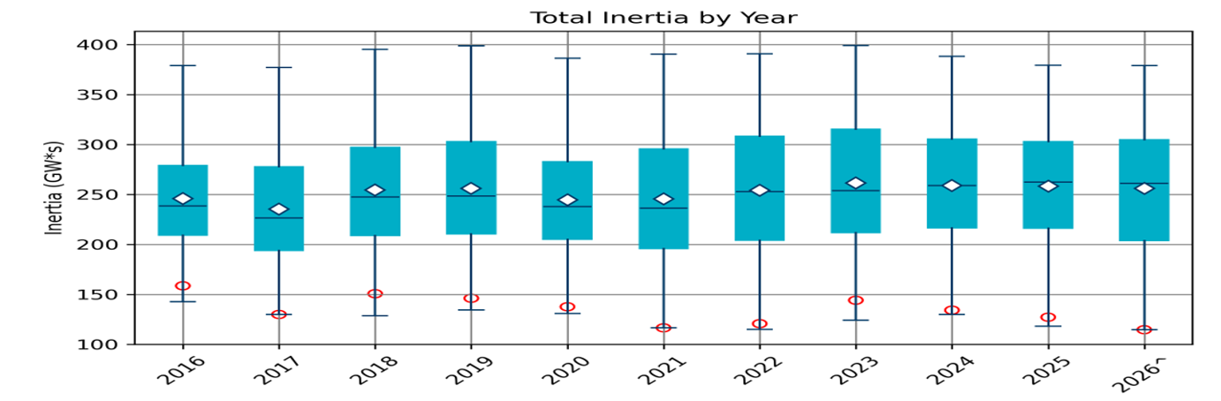
Total Inertia 2016-2026
Date and Time | 2016 4/10 2:00 AM | 2017 10/27 4:00 AM | 2018 11/03 3:30 AM | 2019 3/27 1:00 AM | 2020 05/01 2:00 AM | 2021 03/22 1:00 AM | 2022 03/21 2:00 AM | 2023 04/18 3:00 AM | 2024 03/29 4:00 AM | 2025 03/18 12:00 PM | 2026* 03/14 12:00 PM
Min synch. Inertia (GW*s) | 143 | 130 | 128.8 | 134.5 | 131.1 | 116.6 | 115.0 | 124.3 | 129.9 | 118.3 | 114.7
System load at minimum synch. Inertia (MW) | 27,831 | 28,425 | 28,397 | 29,883 | 30,679 | 31,767 | 33,784 | 35,578 | 37,039 | 49,130 | 48,013
Non-synch. Gen. in % of System Load | 47 | 54 | 53 | 50 | 57 | 66 | 65 | 61 | 68 | 74 | 81
FFR Award | N/A | N/A | N/A | N/A | 0 | 0 | 0 | 0 | 134 | 298 | 430
Critical Inertia (GW*s) | 100 | 100 | 100 | 100 | 100 | 100 | 100 | 100 | 93 | 92 | 87
Red circles denote inertia at max IRR penetration (= IRR Gen/Total Gen)
Notes:
Summary of ERCOT inertia for the previous 10 years. Lowest inertia this year was on March 14th.
For each box, the central mark (red line) is the median, the edges of the box (in blue) are the 25th and 75th percentiles, the whiskers correspond to +/- 2.7 sigma (i.e., represent 99.3% coverage, assuming the data are normally distributed. The corresponding lowest inertia in each year is given in the table.
The circle on each boxplot is showing inertia during time when highest portion of load was served by wind/solar generation in that year.

Slide 16
Questions?

