Slide 1
Large Load VRT IROL Mitigation Plans
Patrick Gravois
Principal Operations Engineer
ROS
October 1, 2026
Outline:
Reliability Concern Recap
IROL Groups for 2026 Q4
Current Consumption Levels
Status of Mitigation Plans and Load Share Calcs
Next Steps
Key Takeaways
ERCOT Operations has developed 3 Mitigation Plans for identified Large Load IROL groups based on 2026 Q4 QSA results. LL consumption has not yet reached a level in which Mitigation Plans are active.

Slide 2
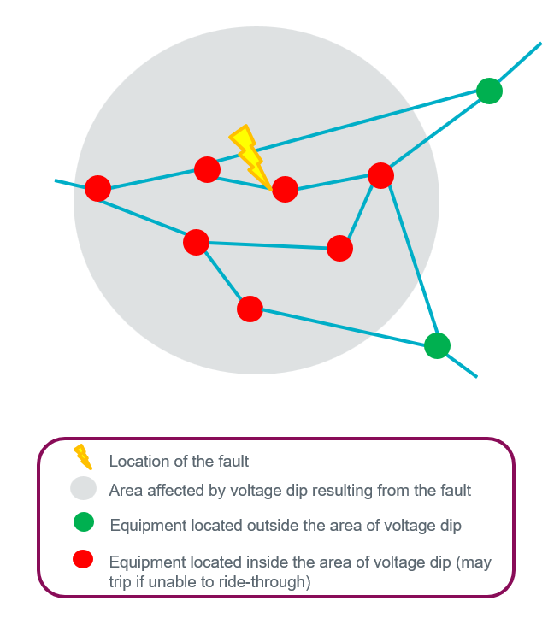
Reliability Concern of Large Load Ride-Through
Reliability Concern
System fault occurs and Large Computational Loads w/o ride-through capability trip or transfer load to backup generation
This large amount of customer-initiated load reduction causes high system frequency and overvoltage conditions
Frequency Limit
ERCOT identified that 3,200 MW of Load loss results in frequency overshoot to 60.4 HZ under certain system conditions.
System frequency of 60.4 Hz leads to potential cascading outages and frequency instability
Quarterly Stability Assessment (QSA)
ERCOT performs VRT assessment for Large Loads in each QSA
Assessment identifies trip groups in which a single voltage disturbance may cause >3,200 MW of Load loss from LLs
IROLs and Mitigation Plans developed for identified LL trip groups

Slide 3
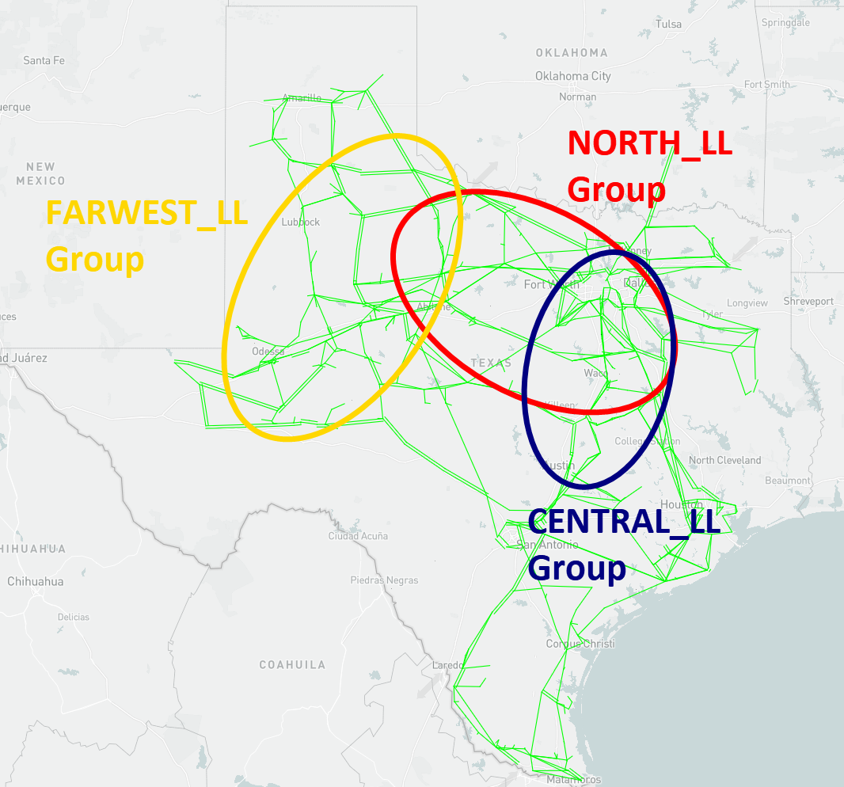
Approved Capacity and Locations of IROL Groups
IROL Group | Total Approved Capacity (MW)
NORTH_LL | 5,465
CENTRAL_LL | 5,240
FARWEST_LL | 4,198
IROL groups based on results of QSA LL VRT assessment
  22 GW of approved LL in study case
ERCOT confirmed approved capacity of affected loads with TSPs and QSEs
Significant overlap in NORTH_LL and CENTRAL_LL groups
Previous WESTTX_LL group not needed for Q4 2026
  Some LCLs provided updated models w/ VRT capability
  Approved capacity of affected loads now <3,200 MW

Slide 4
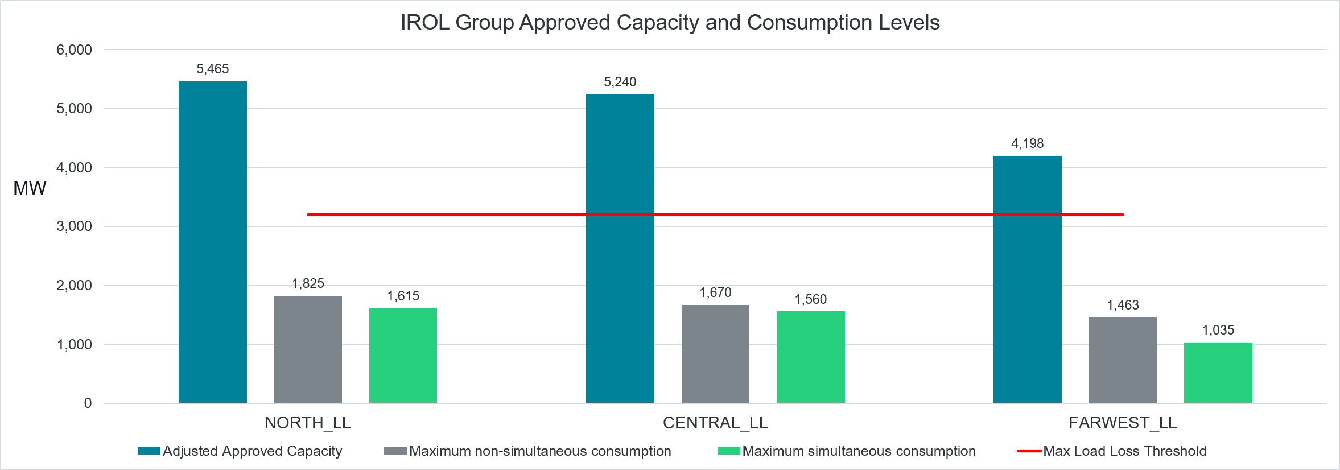
Current Consumption Levels
ERCOT is monitoring simultaneous consumption level of each IROL group in EMS
IROL Group | NORTH_LL | CENTRAL_LL | FARWEST_LL
Approved Capacity | 5,465 | 5,240 | 4,198
Maximum non-simultaneous consumption | 1,825 | 1,670 | 1,463
Maximum simultaneous consumption | 1,615 | 1,560 | 1,035
Chart above has been updated from chart shown at 9/14 BOD meeting

Slide 5
Load Share Calculations for TSPs/QSEs
Based on TSP feedback, load share ratios for TSPs/QSEs based on actual consumption instead of Approved Capacity
  Several LCLs are energized with large Approved Capacity, but consuming <5 MW
  Energized LCLs far behind ramp schedules provided in LCPs
ERCOT determined maximum consumption for each LCL in IROL groups over last 3 months
  Used telemetry when available; state estimated values when telemetry is suspect
  If consumption is less than 5 MW; assumed to be construction load only and not used in load share calculations
Mitigation Plans assign a “Not To Exceed” MW limit to each TSP/QSE based on the load share calculation
Since these are IROLs and the 3,200 MW limit may not be exceeded, even temporarily, ERCOT will control IROLs to 85% of limit, or 2,720 MW
  Not To Exceed Limits based on 2,720 MW limit

Slide 6
LL IROL Mitigation Plan Example
Table 1
Transmission Operator (TO) or QSE | Station Name | Station ID | Load Name | Max Consumption Last 3 months | Approved MWs
TO1 | Station 1 | ST1 | LD_1, LD_2, LD_3 | 120 | 200
TO1 | Station 2 | ST2 | LLD1, LLD2 | 240 | 400
TO2 | Station 3 | ST3 | XFMR1, XFMR2 | 150 | 300
TO2 | Station 4 | ST4 | LDLXFMR1, LDLXFMR2 | 40 | 120
TO2 | Station 5 | ST5 | Load1, Load2, Load3, Load4 | 200 | 450
TO3 | Station 6 | ST6 | LDXFMR3, LDXFMR4 | <5 | 250
TO3 | Station 7 | ST7 | XFMR3 | 400 | 800
QSE1 | Station 8 | ST8 | LCL1, LCL2, LCL3 | 350 | 1000
 |  | Total MW |  | 1,500 | 3,520
Table 2
TO/QSE | TO1 | TO2 | TO3 | QSE1 | Total LL MW | Discounted Region Limit
Total Approved MW of Affected Loads | 600 | 870 | 1,050 | 1,000 | 3,520
Maximum Consumption (non-simultaneous) | 360 | 390 | 400 | 350 | 1,500
Percent of Total Combined Maximum Consumption | 24.0% | 26.0% | 26.7% | 23.3% | 100%
Not to Exceed MW Limit Based on Maximum Consumption | 653 | 707 | 726 | 634 |  | 3,200*0.85 =2,720
Not to Exceed MW Limit Based on Maximum Consumption (Adjusted) | 600 | 725 | 745 | 650 |  | 2,720

Slide 7
Status of Mitigation Plans
ERCOT has provided draft Mitigation Plans to TSPs and has received feedback
Revised MPs were sent out
Mitigation Plans sent to TSPs list all LLs in IROL groups, but cannot be shared publicly
TSPs should notify all LLs listed in Mitigation Plans
ERCOT meeting with affected QSEs for LLs co-located with Generation Resources
ERCOT will be providing the following telemetry to monitor IROL groups and maintain limits
Discounted IROL limit based on ERCOT control room reliability margin (ex. 2,720 MW when set to 85%)
Individual “Not to Exceed Limit” to each TSP/QSE
Real-time aggregate consumption of all LLs in IROL group
TSP/QSE individual real-time consumption of their affected loads
Mitigation Plans will be activated through ERCOT instruction
Affected LLs may continue to ramp up until Mitigation Plan becomes active
ERCOT will activate a MP once aggregate consumption of an IROL group reaches ~2,500 MW
Once active, TSPs/QSEs must maintain their load at or below the “Not To Exceed” limit
ERCOT will take action as necessary to maintain consumption of each IROL below 3,200 MW limit

Slide 8
Next Steps
ERCOT to meet with affected QSEs (LLs co-located with Generation Resources)
  QSEs will not have access to full Mitigation Plans
  May need to draft redacted MPs to provide to QSEs
  Most individual QSEs have just one LL in MPs
Create telemetry points and update MPs with ICCP telemetry names
Develop Operator Procedures
Update SOL Methodology
Continue to monitor simultaneous consumption levels and activate MPs when/if needed

Slide 9
Questions/Comments?
Patrick.Gravois@ercot.com

