Slide 1
RUC Ancillary Service Deployment Factors (ASDFs) for Fall
Balancing Operations Planning Staff
WMWG
September 25, 2026

Slide 2
Summary of Fall ASDFs
ERCOT will continue applying the winter/spring/summer ASDF methodology to determine fall ASDFs. This includes:
  Regulation Up and Regulation Down based on 75th percentile of the historical deployment of each service in the last two years, rounded to the nearest 5%. (Next Slide)
  RRS-PFR and RRS-FFR set to zero for all hours.
  Non-Spin based on 90th percentile value of the historical deployment of the service in the last year, rounded to the nearest 5%.
  ECRS from Non-Spin ASDFs scaled down by 75%.

Slide 3
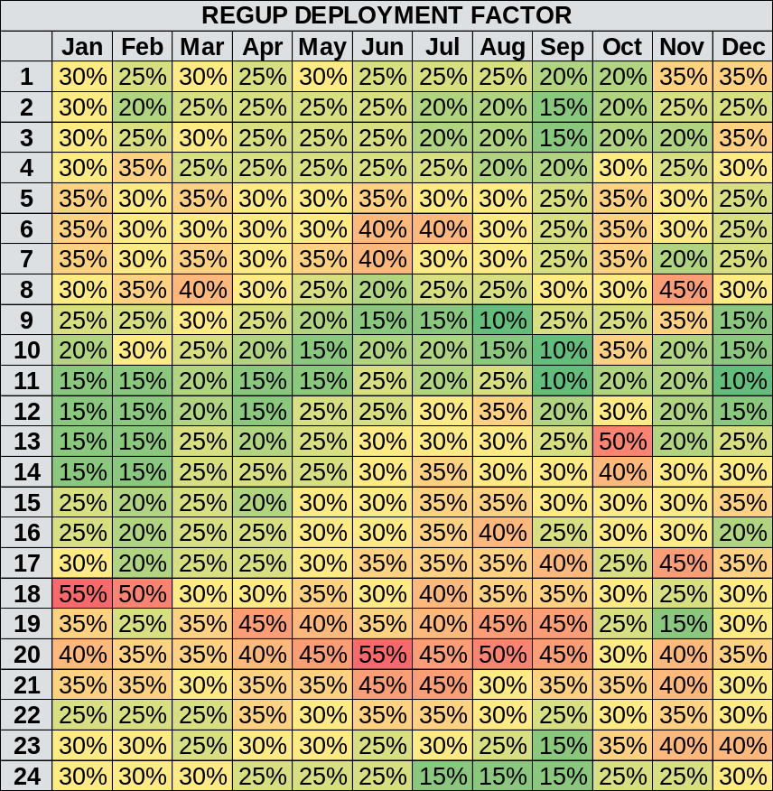
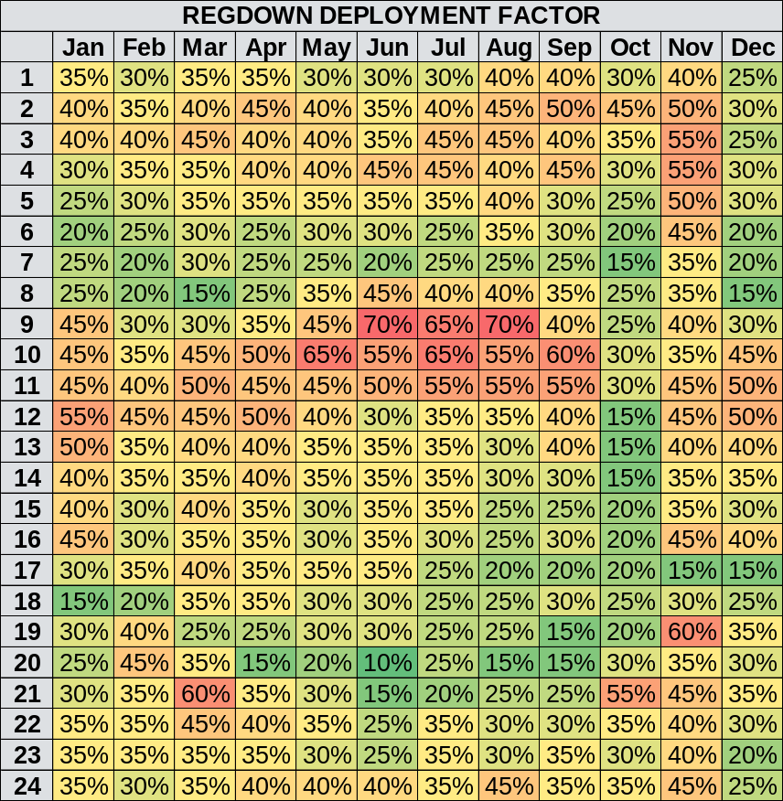
AS Deployment Factors For Regulation Service

Slide 4
Appendix

Slide 5
Reference Material
Link to prior discussion on RUC Deployment Factors at RTCBTF on November 13, 2025:
  RTCBTF 20251112 - RUC AS Deployment Factors REVISED
Link to Spring RUC Deployment Factors at RTCBTF on February 18, 2026:
  RTCBTF 20260218 RUC AS Deployment Factors

Slide 6
Deployment Factor Recap
ERCOT relies on RUC studies to assess if sufficient capacity and energy is online and available in every hour to serve load, manage congestion and procure reserves.
  RUC studies use selected forecast for load, wind, solar and every ESR’s COP submitted hour-beginning SOC (HBSOC) information and assigns base points and AS awards* to resources.
  While RUC has a set of constraints that focus on Hour Beginning State of Change (HBSOC), minimum SOC, and maximum SOC within an individual hour, it also has an additional constraint to evaluate how uncertainties may impact the hour-to-hour change in HBSOC.
  This additional constraint utilizes an AS Deployment Factor (ASDF) when considering how much of the hour-to-hour change in HBSOC will be impacted by deployment of awarded AS.
For Go-Live/Winter 2025-2026, ERCOT established (More details in Appendix):
  Regulation Up and Regulation Down ASDFs based on 75th percentile of the historical deployment of each service in the last two years, rounded to the nearest 5%.
  RRS-PFR and RRS-FFR ASDFs set to zero for all hours.
  Non-Spin ASDFs (and ECRS ASDFs) based on historical Non-Spin energy deployed in 2024-2025 Winter
*Note that “AS awards” and “usage of energy” are referring to the perspective of the RUC optimization and not binding AS awards and energy deployment to the Resource’s QSE, e.g., through the Real-Time Market.

Slide 7
Recap: AS Deployment Factors For Regulation Service
Regulation deployment data for 2024 and 2025 shows (1) year over year growth in average, (2) seasonal variations (higher averages in Summer) and (3) time of day variations (linked to sunrise and sunset).
ERCOT has derived DFs for Regulation Up and Regulation Down based on 75th percentile of the historical deployment of each service in the last two years, rounded to the nearest 5%. This approach learns from historic usage that is closer to average values while accounting for increases in intra-hour uncertainties that may materialize due to growth in installed capacity.

Slide 8
Recap of Analysis for Non-Spin Deployment Factor
ERCOT estimated Non-Spin energy deployed by identifying a Resource’s operating range that is for its online Non-Spin Responsibility and then compared Resource’ Base Point relative to this range to identify actual Non-Spin deployment. These MW deployment estimations were then used to estimate Non-Spin energy deployed in each 5-min interval.
Example
HSL
= 300 MW
Ex3.
BP = 270 MW
Non-Spin Deployed = 250 – 170 = 80 MW
Non-Spin Energy Deployed = 80 * 5/60 MWh = 6.667 MWh
ECRS Responsibility
= 50 MW
250 MW
Non-Spin Responsibility = 80 MW
Ex2. BP = 200 MW
Non-Spin Deployed = 200 – 170 = 30 MW
Non-Spin Energy Deployed = 30 * 5/60 MWh = 2.5 MWh
170 MW
Ex1. BP = 130 MW
Non-Spin Deployed = 0
Non-Spin Energy Deployed = 0 MWh
LSL
= 100 MW

Slide 9
Winter ASDFs for ECRS and Non-Spin

Slide 10
Spring ASDFs for ECRS and Non-Spin

Slide 11
Summer ASDFs for ECRS and Non-Spin

