Slide 1
Outline
  Refresher on DPC Automation concept
  Contingency DPC submission- Clarifications
  Timelines
This effort provides new tool to Market Participants to facilitate DPC submission process for Temporary DPCs.
Downstream Production Changes (DPC)- Process Automation
Yugendher Karedla / Yong Ma
Sep 24, 2026

Slide 2
Downstream Production Changes (DPC)
Downstream Production Change (DPC) is a standard process that makes changes to the Network Model in production in between the weekly model loads without having to load a new model (database load).
This process is managed by the multiple teams at ERCOT (Network Modeling, GMS, Shift Engineers, Operations etc.).
DPC process helps update the network model in both Energy and Market Management systems (EMS and MMS) incorporating the changes submitted by the transmission operators that are critical to maintaining the reliability of the system.
The DPC process allows ERCOT to make specific data modifications in real-time including:
  Static Line / Transformers Ratings
  Dynamic Line Ratings
  Line / Transformer Impedance
  Contingency Definition updates
  Enabling and Disabling of Contingencies
  GTC updates
  RAP and RAS changes
GTC and RAP/RAS definition updates related DPCs are submitted by ERCOT Operations team.

Slide 3
Downstream Production Changes (DPC)
DPC process is intended to make model changes in production between weekly model loads as necessary, not for model changes that can follow normal NOCMR timelines.
Current High level DPC Process
MP
(Submits Model changes for DPC)
NMMS
Review Model and Create DPC
Jira Process
1. Review and Approve by Operations team
2. Track DPC implementation in EMS/MMS systems across multiple models
EMS/MMS
DPC process demands significant collaboration efforts between several departments within ERCOT and market participants. It requires significant amount of manual effort to create, validate, track and implement DPCs in multiple environments across multiple weekly model loads.
The manual nature of DPC tasks often leads to inefficiencies, delays, and increased resource loading across several departments within ERCOT. This multifaceted process demands extensive time and resources to ensure accuracy and efficiency.

Slide 4
Summary of feedback received from TOs
  TSP initiates new DPC submission
    when an operational line or transformer ratings / Impedances that gets published from their engineering team, is different from ERCOT Model ratings / Impedances.
    Based on rating comparisons done every month at TSP side & if they see discrepancy with ERCOT Model ratings.
  Current DPC NOMCR submission process involves
    Submitting DPC NOMCRs into ERCOT modeling system
    Send out email to notify ERCOT network modeling group
    Attach a DPC request form and reason for DPC with NOMCR
    After DPC is processed into ERCOT system, update TSPs EMS model to reflect the change.
  Current DPC CAMR submission process involves
    For equipment outages / reclosures, submit a DPC CAMR to enable Manual contingencies within 3 business days of effective date.
    If a new CTG is needed to reflect new configuration, attach an excel sheet with proposed CTG definition in CAMR.
    Submit a separate DPC CAMR within 3 business days of configuration returning to Normal.
    When active CTGs are found to be incorrect, CAMR DPC submitted to disable or edit incorrect CTGs.

Slide 5
Distinction between Permanent and Temporary DPC type updates
  Permanent DPC types
    DPC updates that will be done in Production , but they also will need to go into Network Model
    These DPC updates will continue to be applied in Production for few more model loads, before they are included within NMMS CIM XML file.
    All DPC types are eligible for Permanent DPCs.
    Continue to follow the current process of submitting Permanent DPC NOMCRs into ERCOT modeling system.
  Temporary DPC types
    DPC updates that does not need to go into Network Model.
    DPC updates that requests ERCOT control room to make a temporary update to model data due to a field outage / field work, that can last for up to 2 weeks.
    Below are the 2 major Temporary DPC types that ERCOT receives from MPs
      Static Line / Transformers Ratings
      Enabling and Disabling of Contingencies
    New DPC UI Tool is developed to provide ability for MPs to quickly submit temporary DPCs, with effective dates to ERCOT production system.
  A new DPC Dashboard will be developed that provides full list of DPCs (both permanent and temporary DPCs) with their status (planned / Implemented) with a historian for past DPCs implemented.

Slide 6
New DPC Tool – High Level Implementation Details
  New displays and dash boards will be added in current Outage Scheduler UI (OS UI) to allow Market Participants to submit Temporary DPCs with start and end times.
  Currently QSEs with resources and TOs have the access to OS UI through ERCOT MIS website
  A new role will be created to TOs to access these displays using OS UI.
  ERCOT Operations will review and approve Temporary DPCs.
  Upon approval, Temporary DPCs get implemented in ERCOT real-time systems (EMS/MMS) automatically and provides status back to DPC tool.
  Thereafter, DPCs get implemented automatically in EMS/MMS systems during every week model load until end time of DPCs.
  This new DPC tool will provide visibility to Market Participants on DPC implementation status in ERCOT EMS/MMS systems. Dashboards will be developed to meet this requirement along with ability to sorting and filtering capabilities

Slide 7
New DPC Tool – High Level Implementation Details
  If a Temporary DPC submitted through DPC UI, is not yet implemented, TOs will have an option to Withdraw the DPC from their DPC Dashboard, using “Withdraw” status option.
  Once a Temporary DPC is approved at ERCOT and is Implemented in EMS / MMS Applications, TOs will not be able to “Withdraw” their submitted DPC. If this scenario arises, TOs can submit another new Temporary DPC to revert the implemented DPC TOs have to update the planned end date which eventually would close the DPC by reverting the updates with aligning to the model.
  ERCOT is pursuing an option to provide ability for TOs to associate Temporary DPC to an Outage. This will be an optional attribute (not mandatory), which allows more visibility to ERCOT, as we see several instances of Contingency status update DPCs tied to an Outage condition.
  TOs DPC dashboard will continue to show status updates on the submitted DPCs (both Permanent and Temporary DPCs), as ERCOT goes through DPC implementation and confirmation steps.

Slide 8
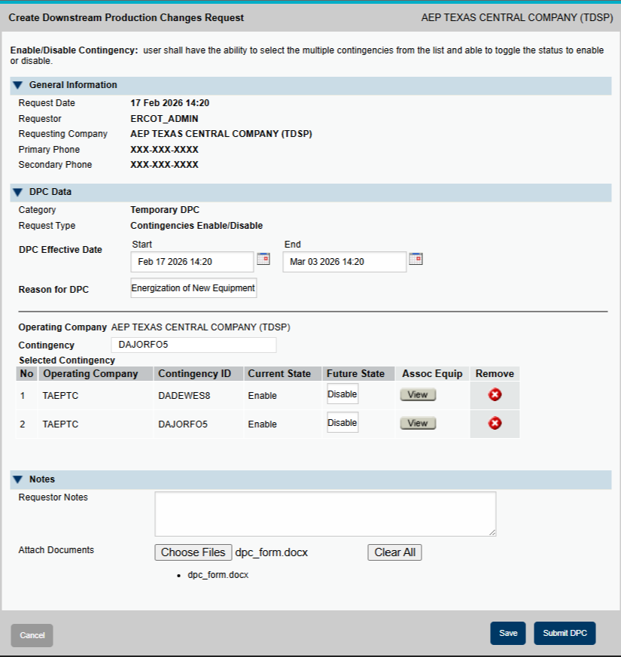
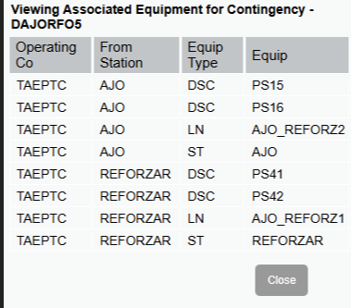
Submitting Temporary DPCs – Contingency Status Changes
For Contingency Status Change DPCs this includes:
  Planned start/end, nature of work, operating company
  Notes, attachments
  Individual contingencies and future state
    Associated equipment for each contingency can also be viewed
  On submit, a summary of the changes will be presented along with a prompt to confirm

Slide 9
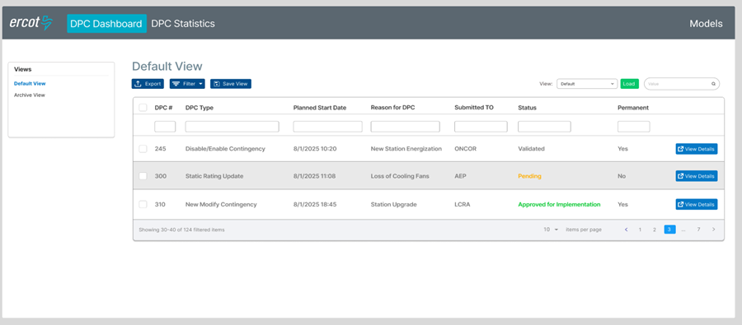
DPC Dashboard- Default View
Displays DPCs pending approval or implementation with general info and link to view full details
Users can apply filters and personalize the view then save and reload it
Other views include the Archive (completed or rejected DPCs).

Slide 10
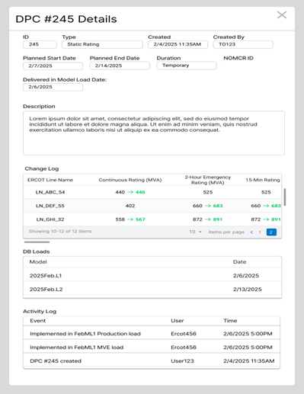
DPC Details Popup
A DPC’s details can be viewed in the DPC Details popup
  This includes:
    General Information: description, type, creation date, duration, etc.
    Change Log: the list of all changes applied in this DPC
    DB Loads: the DB Loads the DPC is applied in
    Activity Log: key dates and events relating to the DPC (created on, implemented on, etc.)

Slide 11
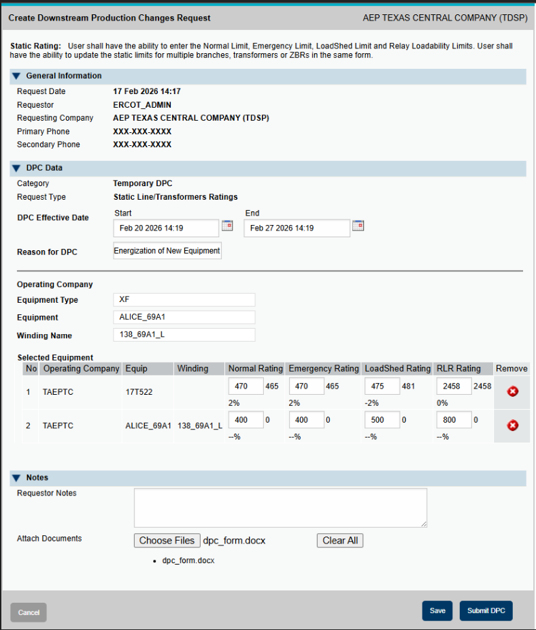
Submitting Temporary DPCs- Static Rating
Static Rating update DPCs form includes:
  Planned start/end, nature of work, operating company
  Notes, attachments
  Can review each specific device ratings and update.
  On submit, a summary of the changes will be presented along with a prompt to confirm
  Note – If a line/XF is dynamically rated, those lines/XFs will be automatically excluded from the drop down list for temporary DPCs, as this UI is only for Static rating updates.

Slide 12
Handling Schedule Changes for Temporary DPCs
Withdrawal Option
  TOs can withdraw a DPC while it is “Submitted” Status , but NOT after it gets to “Approved for Implementation” status.
  Use case for Withdraw option is when TOs like to edit effective start/end dates or content of DPC, before it is approved for implementation at ERCOT. If Withdraw option is available, new DPC is not needed to make these modifications.
Effective End Date Modification- Applicable to implemented DPC.
  On Implemented status, TOs can modify the effective end date:
    Modify Effective end date to earlier date: Ends the DPC sooner.
    Modify Effective end date to later date: Extends the DPC duration.
  Note- effective end date needs to be greater than current date/time and cannot be 21 days from date of submission for Temporary DPCs.
No conflicting/duplicate DPCs for same elements:
  After DPC is implemented in production (Implemented Status, not Closed Status), if TOs want to change the DPC again, then a new DPC needs to be submitted for the same equipment. So, the procedure is to update the effective end date to current date/time and ensure the current DPC is in Closed Status (from DPC Dashboard). After DPC associated with a specific equipment is closed, TOs can submit a new DPC for same equipment with new start/end times.
Closed Status
  Once the effective end date is reached, the DPC automatically transitions to Closed status.
  Transition to Closed status - It would trigger EMS/Market applications to revert back to Model value/state in production.
  After DPC transitions to closed status, no further changes are allowed, and it will be archived for historical reference.

Slide 13
DPC notifications from ERCOT CR
One address per organization — you manage the members
Suggested format
ercotdpcnotifications@[yourdomain]
ercotdpcnotifications@lcra.org
ercotdpcnotifications@oncor.com
ercotdpcnotifications@aep.com
ERCOT configures once
TO manages recipients
One address per org — no changes needed when your team membership changes
Add or remove team members from the alias without any ERCOT involvement
Instant staff changes
No personal emails at ERCOT
New hires added, departing members removed — all within your own systems
Individual addresses are never stored on the ERCOT side
NOTIFICATIONS SENT TO THIS ALIAS
✕
Rejected
⏰
Temporary DPC expiring
DPC rejected by ERCOT; rejection reason included in the notification
Sent XX days/hrs before expiration (6hrs??);

Slide 14
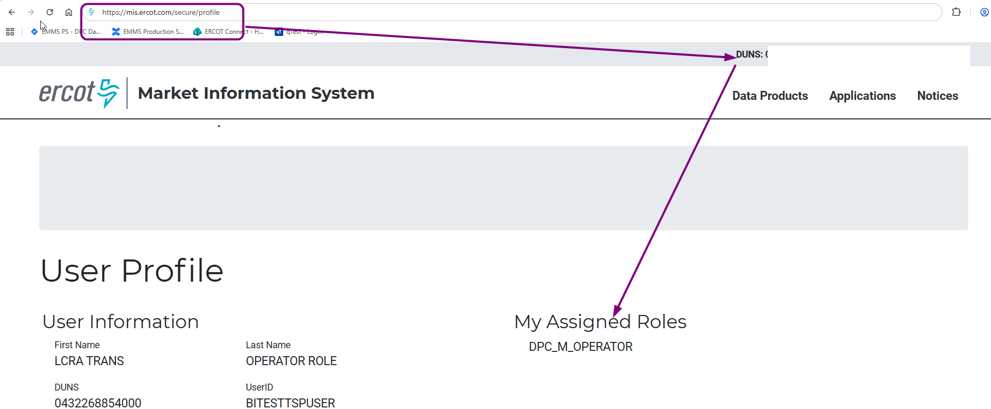
DPC Dashboard Access
Access control
  Application access will be granted via digital certificates
  New roles must be added to the certificate for authorization
    Operator (DPC_M_OPERATOR)
    ReadOnly (DPC_M_VIEW)
    Effective for MOTE from 07/13/2026
    Effective for PROD from 08/28/2026
  How do I know if I have role in my certificate
  This is for PROD - https://mis.ercot.com/secure/profile
  Link will be available from current OSUI page (This feature will be available from September)

Slide 15
New DPC Tool – High Level Implementation Details
  DPC Tool support following DPC Types
    Update Static Line / Transformers Ratings
    Enabling and Disabling of Contingencies
  DPC Tool Data Flows:
NMMS Mage
(Network Model)
Permanent DPCs
DPC
Importer
OS UI
MPs
DPC Tool
ERCOT Review & Approval (DPC Dashboard)
EMS/MMS
Temporary DPCs
MPs DPC dashboard (All DPCs)

Slide 16
Contingency DPC updates:
NMMS MAGE vs DPC Submission Form— decision table-Updates
Category | Definition change needed? | NOMCR to NMMS MAGE? | Status set in submission in NMMS MAGE | Separate Temporary DPC? DPC Submission Form from Dashboard
Permanent | Always to NMMS MAGE | Yes | Set directly to desired (enabled/disabled) state | No
Temporary — no definition change | No | No | No | Yes — sole submission
Temporary — modifying existing | Yes | Yes | Retain previous status | Yes Just add a comment in temporary submission form- “Implement NOMCR# before this”
Temporary — brand-new | Yes (by definition) | Yes | Disabled (default) | Yes Just add a comment in temporary submission form- “Implement NOMCR# before this”

Slide 17
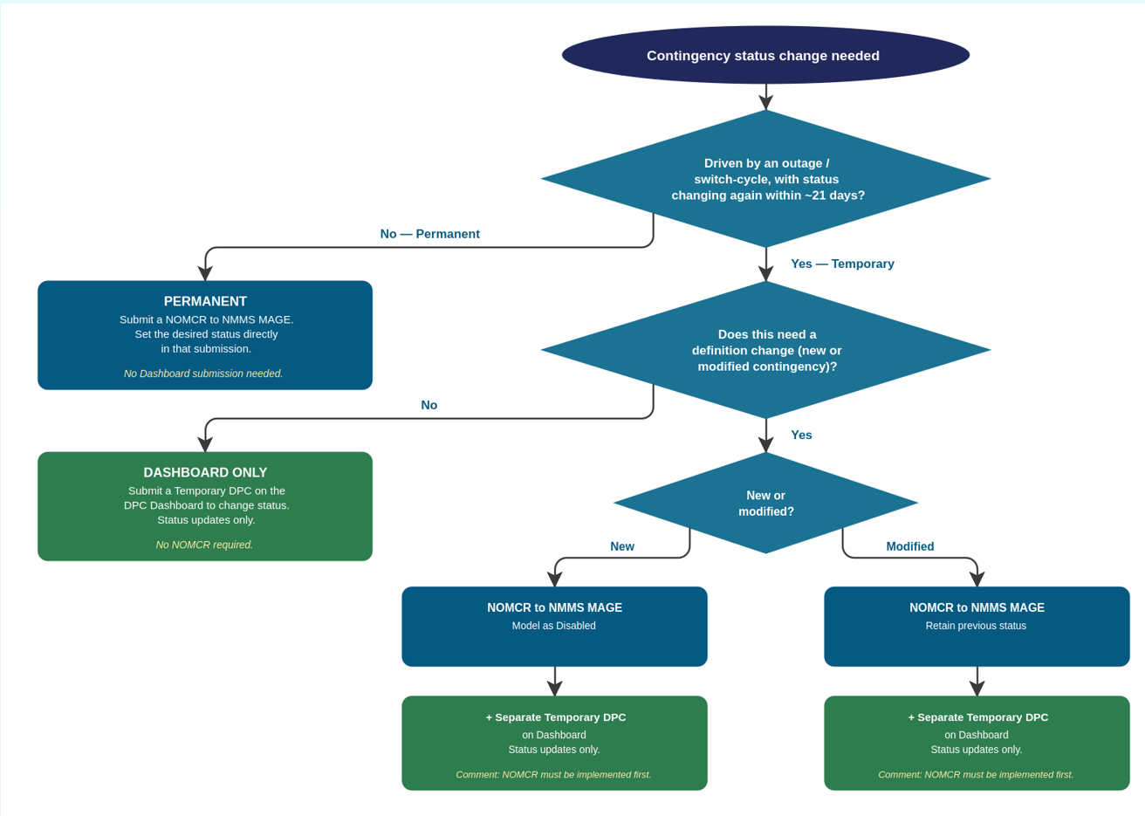
The same logic, as a decision tree - Updates

Slide 18
Temporary DPC Submissions – Parallel Period & Switchover - Updates
Parallel Submission Period
Transition Temporary DPC submission to DPC UI
◦ September 2nd — first weeks of parallel submissions are complete. Two areas of feedback so far:
2 Temporary DPCs submitted — both went through the full lifecycle without issues, apart from one observation: special characters in submission-form comments aren't handled correctly yet — fix targeted for the next patch
Some ambiguity on manual contingency submissions — NMMS MAGE vs. the new DPC Tool submission forms. An updated User Guide will be published, and the decision tree will be socialized at TWG and NDSWG. Still open for feedback/insights — reach out to our support email
◦ October 21, 2026 —
From this date, Temporary DPCs will be submitted only through the new DPC submission forms
NMMS MAGE will no longer be used for Temporary DPC submissions

Slide 19
Market Notices and Support- Updates
M-A082626-01 DPC Dashboard: Parallel Submissions for Temporary DPCs through DPC Dashboard to begin
ercotdpcsupport@ercot.com for any clarifications

Slide 20
Questions/Comments?
ercotdpcsupport@ercot.com

