Slide 1
NERC EMSWG Update
ERCOT TWG
Wei Qiu
Lead Engineer, Event Analysis, NERC
September 18, 2026

Slide 2
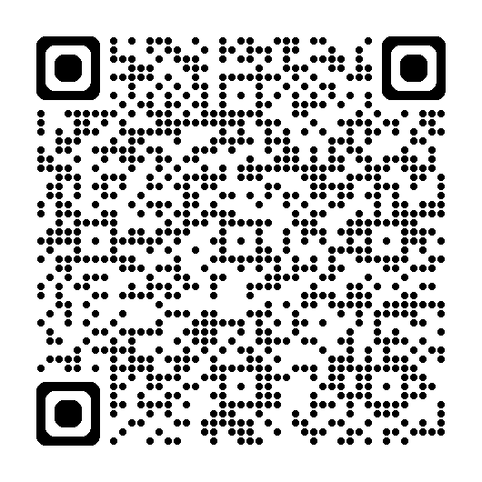
2026 Monitoring and Situational Awareness Technical Conference
Location: ComEd, in Chicago, IL
Date: Tue. 10/6 - Wed. 10/7
Conference Announcement Monitoring and Situational Awareness Technical Conference October 6, 2026 | 8:00 a.m. – 5:00 p.m. Central October 7, 2026 | 8:00 a.m. – 12:00 p.m. Central Conference Registration ComEd Chase Tower, 10 S. Dearborn Street Chicago, IL, 60603 The NERC Energy Management System Working Group will hold its 14th Annual Monitoring and Situational Awareness Technical Conference at ComEd in Chicago, IL, on October 6-7, 2026. This year's conference theme is "Reassuring Modeling: From Legacy Errors to Verified Performance." The event will bring together professionals to explore emerging technologies, innovative solutions, and workforce strategies that are shaping the future of the energy industry. Click here for: The 2025 conference Agenda and Presentations. Additionally, don't miss the co-located Bulk Electric System Operating Agility Workshop which will take place from October 7-8 at the same location. Join us for two great events in one week! Space is limited so be sure to register early! For more information or assistance, please contact Stephanie Lawerence via email.
RELIABILITY | RESILIENCE | SECURITY |  | www.nerc.com
POWERING TODAY. PROTECTING TOMORROW.

Slide 3
Agenda
EMS overview - NERC
Panel Discussion
  FERC 881 - Manitoba Hydro, ITC, ComEd, and RC West
  EMS vendor – GE Vernova, Hitachi Energy, OSI, and Siemens
Situational Awareness Tool – SPP
Modeling Validation – BC Hydro
Sub synchronous oscillation – Dominion and ERCOT
AI
  Weather AI -ANL
  State Estimation through Dynamic System AI - PNNL
Human Factors in an Age of Accelerating Complexity - Resilient Grid

