Slide 1
2026 September & October (R9 & R10) Releases – Market & Outage Scheduler Changes
Katherine Li
September 24, 2026
Outline:
2026 September (R9) Release
2026 October (R10) Release
Key Takeaways
  No Market or Outage Scheduler submission changes in July (R9) release.
  One Market and two Outage Scheduler submission changes planned in October (R10) release.

Slide 2
2026 September/October (R9/R10) Releases
2026 September (R9) Release will be deployed into Production on 10/01/2026.
  September (R9) release does not have any Market or Outage Scheduler submission changes that may impact Market Participants.
2026 October (R10) Release will be deployed into Production on 10/29/2026.
  One market submission validation message enhancement for Current Day Plan (COP) Ancillary Service (AS) Capability validation is currently planned.
      to be able to show two decimal points of the amount of megawatts (MW) in response message.
  One Outage Scheduler submission change is currently planned.
      enhance the Resource Planned Outage Limit (RPOL) violation warning messages

Slide 3

2026 October (R10) Release – Market Submission Validation Change
One market submission validation message enhancement for COP AS capability - to be able to handle two decimal points of MW in COP validation message.
  An example: a COP submission of Reg-Down (REGDN) capability
      the submitted COP REGDN capability: 195.8 MW
      the resource’s qualified MW for REGDN: 195.78 MW
      once submitted, currently the following message is be provided:
      with the change in R10, the message will be improved to indicate clearly the reason for “Validation of the COP failed” - the submitted MW (195.8) is greater than the resource’s qualified MW (195.78) of REGDN.

Slide 4
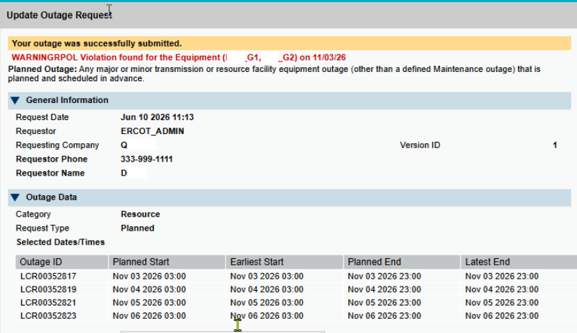
2026 October (R10) Release – Outage Scheduler Submission Change
Fixing an issue in Outage Scheduler User Interface (OS UI) to ensure that RPOL violation warning message to be provided, consistently, for each day that is of RPOL violation if the submission has multiple days of RPOL violation.
  An example – the RPOL violation warning messages should be for all four days.

Slide 5
Questions/Comments?
Katherine.Li@ercot.com
Sreenivas.Badri@ercot.com

