Slide 1
Modernizing Market Participant Interactions
September 21, 2026
Market Participant Service Portal
Identity & Access Management
ONE MARKET PARTICIPANT
EXPERIENCE
Key Takeaways
ERCOT is modernizing Market Participant service delivery through two connected efforts
  Market Participant Service Portal (MPSP)
  Future Ready Identity and Access Management (IAM)

Slide 2
Agenda
1. Antitrust Admonition
2. Agenda Review
3. Welcome and Opening Remarks
4. Current State and Future Vision
5. Future Ready Identity IAM Program
6. MPSP Phase 1 and the Road Ahead
7. Questions ERCOT has been Hearing
8. Open Questions and Answers
9. Summary and Next Steps
10. Adjourn

Slide 3
Antitrust Admonition
To avoid raising concerns about antitrust liability, participants in ERCOT activities should refrain from proposing any action or measure that would exceed ERCOT’s authority under federal or state law. For additional information, stakeholders should consult the Statement of Position on Antitrust Issues for Members of ERCOT Committees, Subcommittees, and Working Groups, which is posted on the ERCOT website.1
1 The document is available at http://www.ercot.com/about/governance/index.html

Slide 4
Current State and Future Vision
Modernizing Market Participant Interactions
September 21, 2026
Outline:
Where We Are Today And The Future Vision
Modernizing Market Participant Services
Modernizing Secure Access
Market Participant engagement
Key Takeaways
ERCOT is modernizing Market Participant interactions through two connected efforts: IAM and MPSP
The future experience combines stronger authentication with more structured, automated and transparent interactions
Today begins a continuing engagement with Market Participants

Slide 5
Market Participant Interactions – Today vs. Future
The vision: more secure access and a more integrated way to interact with ERCOT
TODAY
FUTURE (MODERNIZED EXPERIENCE)
BENEFITS FOR
MARKET PARTICIPANTS
Multiple channels. Manual processes.
One secure access. One integrated experience.
Operational
applications
IDENTITY & ACCESS MANAGEMENT (IAM) with MFA
Stronger security
with MFA
✓
MIS
ERCOT ↔ Market Participants
ERCOT ↔ Public
Digital Certificates
for secure access
B2C
One secure identity
for all access.
Market Information
System
B2B
Secure access to the MIS
(including current applications) and the MPSP
Secure access to
the Public Portal
⚙
Simplified experience
E-mail +
Phone Calls
Individual
Interactions
with ERCOT
MARKET INFORMATION SYSTEM (MIS)
One sign-on.
One place.
(Client Services,
Service Desk,
Form Submissions, etc...)
MIS OPERATIONAL APPLICATIONS
MARKET PARTICIPANT
SERVICE PORTAL (MPSP)
(Manual Processes)
↗
Automated Workflows
▦
▥
$
↔
▰
?
⇄
✓
Less manual effort.
Faster outcomes.
Individual
Interactions
with ERCOT
Grid
Operations
Market Operations
Commercial Operations
Retail
Transaction
Processing
Data
Extracts Reports
Client Services Service Desk
Submit Forms
Automated
workflows
Tracking &
visibility
Public Portal
Current MIS applications MPs use today
Replaces manual e-mail and phone processes
◎
Self-Service
Transparency
Public &
Market Participants
(Client Services,
Service Desk,
Form Submissions, etc...)
Real-time status
and tracking.
PUBLIC PORTAL – Only for public use
?
▤
⚒
!
Questions &
issues
Submit
Requests
Service Desk
(IT & Technical)
Stay
Informed
A more secure IAM and a Market Information System (MIS) that includes operational applications and a service portal
B2B = Business to Business (Market Participants)
B2C = Business to Customer (Public)

Slide 6
MPSP Phase 1: Modernizing Market Participant Services
A selected set of high-value interactions establishes the service-management foundation
1
Client Services
Service Desk
2
Protocol forms
NCI / LSIPA
3
Request for Information
Notices to MPs
Weatherization
PHASE 1 EXPERIENCE
Authenticated access • automated workflows • acknowledgements •
status & history
✓
+
+
→
Today
Manual channels
MPSP
Phase 1
Additional Protocol forms
Road Ahead
More workflows

Slide 7
Engagement continues beyond today
ERCOT will bring Market Participants along through ongoing communication, hands-on participation, and readiness support as IAM and MPSP are introduced.
Stakeholder engagement
Testing, Workshops & Training
Ongoing
Workshops + stakeholder meetings
Updates, questions and input
Input shapes future phases
Testing builds readiness
HOW WE WILL ENGAGE
Inform → Listen → Test → Learn → Prepare
Market Notices • demos • user testing • feedback • training/readiness
Documentation and support will accompany the change — IAM and MPSP user guides

Slide 8
Up Next: Future-Ready IAM Program
A closer look at the new identity platform, MFA, implementation approach, and how IAM connects to MPSP.

Slide 9
Identity and Access management (IAM) - Modernizing Secure Access
IAM and MPSP work together: IAM modernizes secure access; MPSP modernizes service interactions and workflows.
Today
Digital Certificates for MIS Access
E-mail + Manual Processes
Future
Username/password + MFA
Integrated Service Experience
(Access to MIS Applications and Services)
Stronger security
Modern, standards-based authentication and adaptable controls
Simpler access
Reduce certificate handling and move toward a consistent sign-in experience
Automated workflows
Replace manual e-mail routing with structured, trackable interactions
More transparency
Acknowledgements, status, history and clearer visibility for MPs
WHY MODERNIZE?
A more secure, simpler and more transparent experience for Market Participants — without reliance on certificates, e-mail and manual processing.

Slide 10
IAM Timeline
The IAM Program will have the Stakeholder Login Portal go-live in October 2026 with PowerGADS as the first application. A phased approach to integrating remaining applications and portals will follow. MPSP is planned for integration with the Stakeholder Login Portal around February 2027.
Sept 2026
Early Testers + User Acceptance Testing*
Oct-Dec 2027
User Acceptance Testing – MPSP**
NPRR 1306 Effective Date***
2027 - 2028
Discontinuation of old technology, moving into Ping as the official and only authentication method
2027
Testing and go-lives for applications integrating into Ping
Sep 2026
Early Testers Kick Off
Oct 2026
Future Ready
Stakeholder Portal & PowerGads
Go-Live
Feb 2027
MPSP**
Go-Live
Apr/May 2027
MIS
Go-Live
Registration and login to Ping Dev
Apps included, not limited to:
NMMS – MOD
MMS – OS UI
CRR
MarkeTrak
Grid Geo
Key Takeaway:
The delivery approach for the IAM Program is in iterative waves, which consist of planned advanced notices (communications), testing and education with the stakeholder roles relevant to the applications and changes coming.
User Acceptance Testing for all impacted roles before the October Stakeholder Portal go-live
User Acceptance Testing for all impacted roles (e.g.: USAs, ARs/BARs) before MPSP** go-live
*User Acceptance Testing will consist of applications as they are tagged to a Wave, testers will vary based on impacted roles
**MPSP = Market Participant Service Portal
***NPRR 1306 - Removal of Digital Certificate References for Market Participants with ERCOT MIS Access
10

Slide 11
B2B Plan
As applications and portals are on-boarded into the new solution, the existing authentication methods will remain in place. Once all applications are behind the new Stakeholder Login Portal and fully functional, only then will the “old” methods be disabled/discontinued.
Client certificates with SAML token (i.e. current Weatherization portal)
Auth0 MFA via SSL proxy per individual application, i.e. RIOO, GINR, REC, FlighTrak
Custom MFA (Client Certificate + password) GridGeo
Digital Certificates
NEW B2B TOOLING
Share Wave Plan
2027: Begin waves to transition applications to new B2B tooling
We are here
PowerGADS and Ping Go-Live (Oct 2026)
First use of new B2B tooling
2027/2028
Full adoption of new B2B tooling
Key Takeaway: The PowerGADS is the only application that will implement the new B2B tooling (Ping) in 2026.

Slide 12
M-D073126-01 Request to review and update MPIM User Email fields for IAM Modernization
NOTICE DATE: July 31, 2026
NOTICE TYPE: M-D073126-01 General
SHORT DESCRIPTION: Request to review and update MPIM User Email fields for IAM Modernization
INTENDED AUDIENCE: Market Participant User Security Administrators (USAs) and Backup User Security Administrators (BUSAs)
DAYS AFFECTED: September 30, 2026
LONG DESCRIPTION: ERCOT is modernizing its identity and access management (IAM) through the Future Ready Identity Program. This effort was the subject of NPRR 1306: Removal of Digital Certificate References for Market Participants with ERCOT MIS Access, which will become effective on Aug 1, 2026. As part of this effort, ERCOT will transition to an email-based identity model and remove the future need for digital certificates.
To prepare for this transition, USAs and BUSAs must review Market Participant Identity Manager (MPIM) user records and confirm that each user account has a unique, individual user email address by August 31st, 2026.
To access MPIM, authenticate with your digital certificate by logging in to the Market Information System (MIS).
REQUIRED STEPS: Review user records in MPIM and update the User Email and Certificate Email fields, as needed, to ensure the following:
What:
  Market Notice sent to USAs and BUSAs on July 31 asking for a 1:1 mapping of users to user email addresses
  Did not include API guidance at this time – will share that at a future date
Why:
  In the future-state, each user will have their own login
  User accounts will be migrated to the new system to help eliminate the new registration requirement

Slide 13
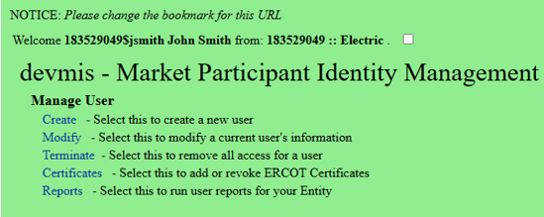
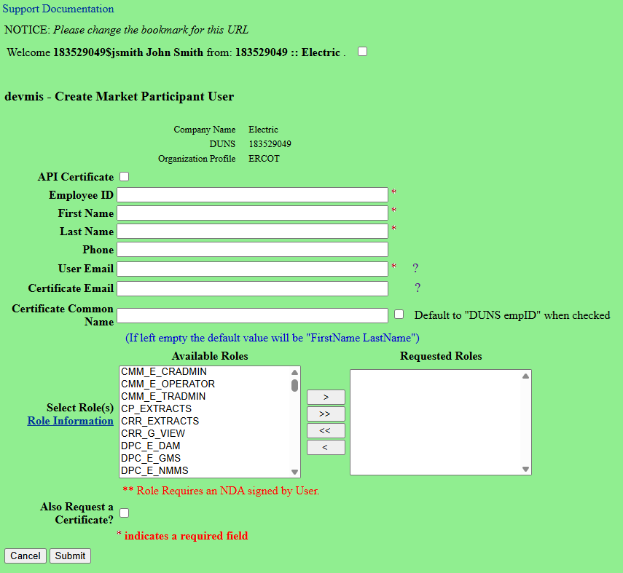
How Stakeholders Register (1/3)
Current State
1. MIDM Admin initiates MP user creation
2. MIDM Admin submits details
Draft – for illustrative purposes only; to be finalized

Slide 14
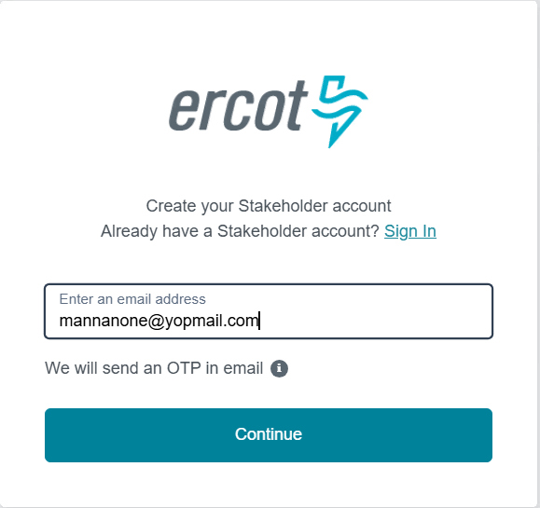
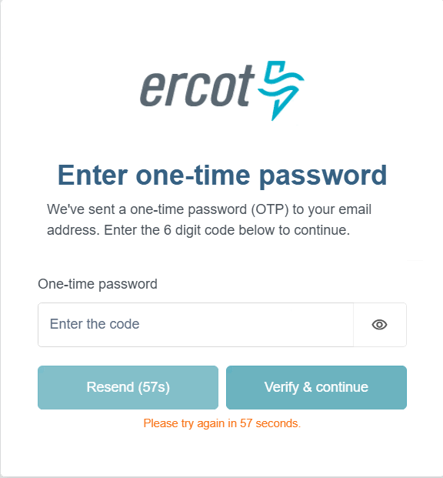
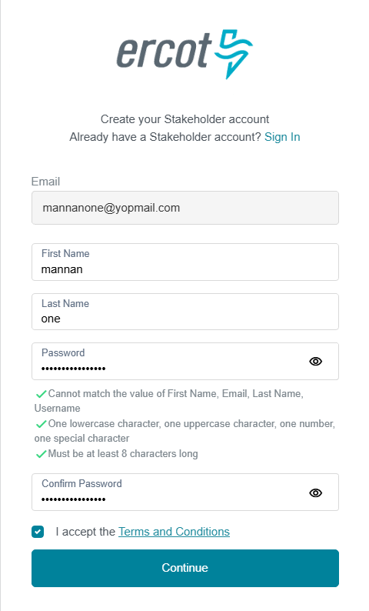
How Stakeholders Register (2/3)
Future State
1. User Registration
2. Verify Email
3. Submit details
Draft – for illustrative purposes only; to be finalized

Slide 15
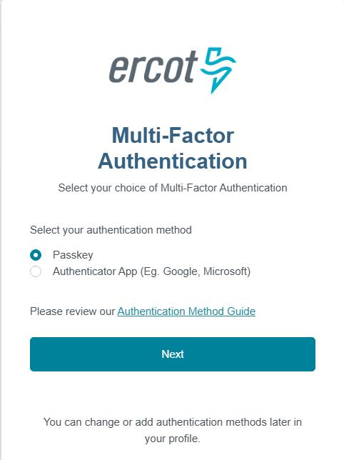
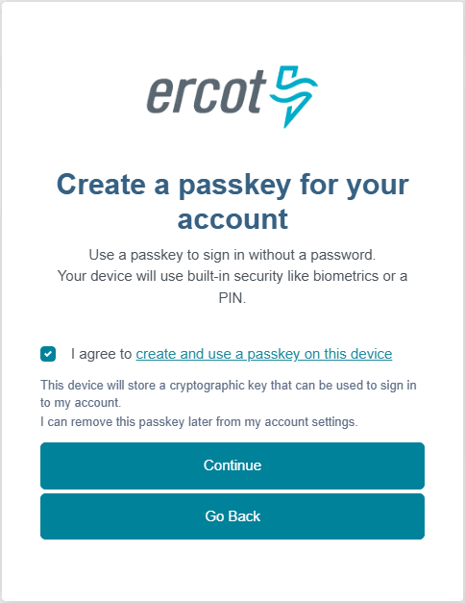
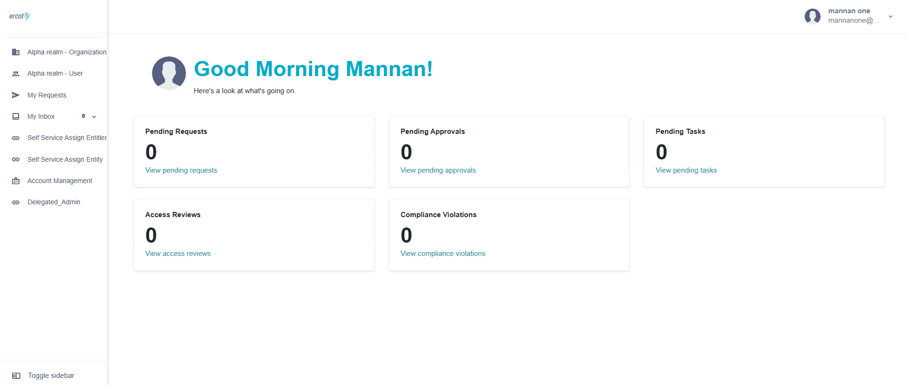
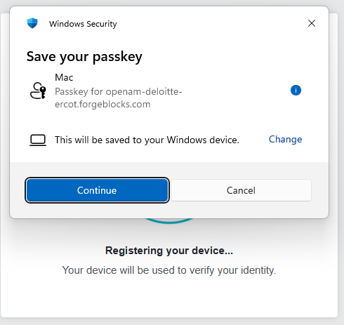
How Stakeholders Register (3/3)
Future State (cont.)
4. Select MFA
5. Setup MFA
5. Access Portal
Draft – for illustrative purposes only; to be finalized

Slide 16
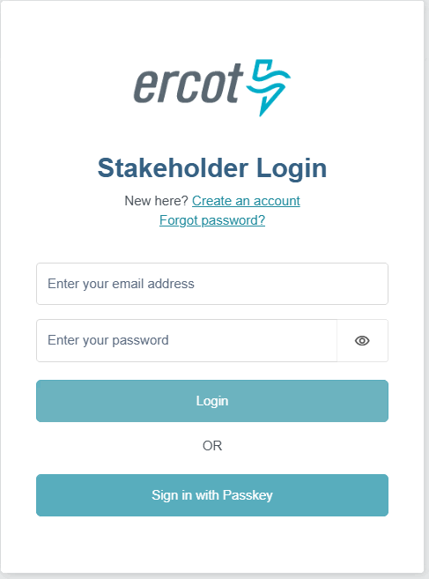
How Stakeholders Authenticate
Current State
Future State
1. Sign in by uploading certificate sent by Admin
1. Sign in securely with MFA or enjoy a frictionless passwordless login experience
Draft – for illustrative purposes only; to be finalized

Slide 17
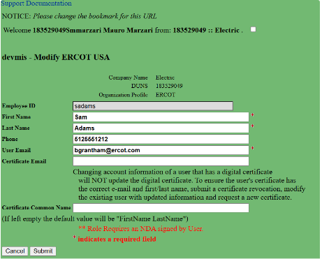
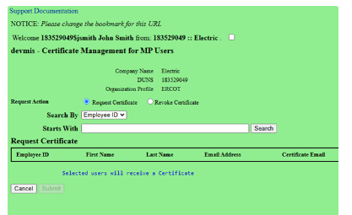
How Stakeholders are Managed – Current state
Current State
MIDM Admin manages MP profile
MIDM Admin manages USA certificates
MIDM Admin manages MP users' certificates
Draft – for illustrative purposes only; to be finalized

Slide 18
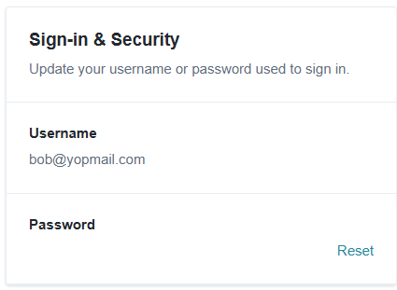
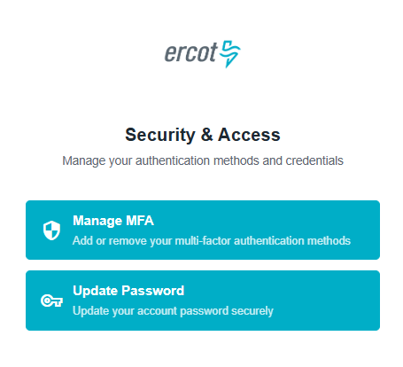
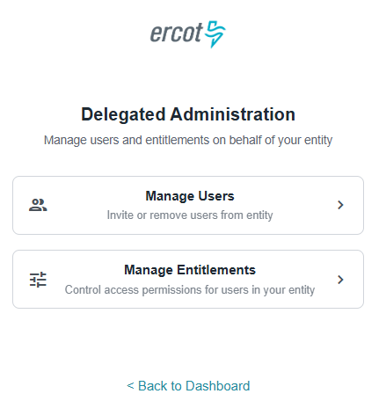
How Stakeholders are Managed – Future State
Future State
Self Service Profile Management
Self Service MFA and Password Management
USAs manage their users and entitlements
Draft – for illustrative purposes only; to be finalized

Slide 19
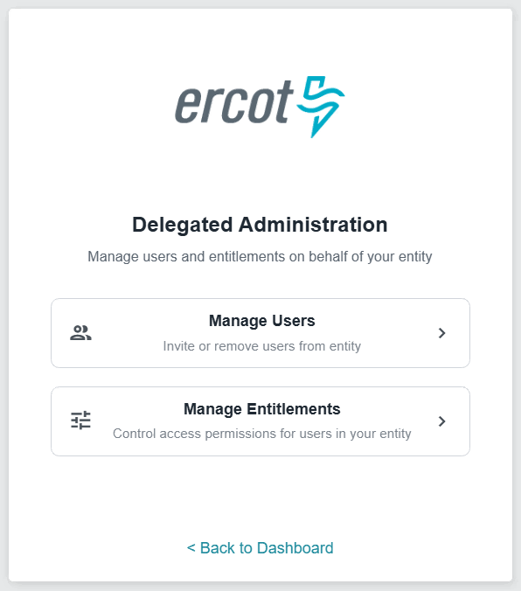
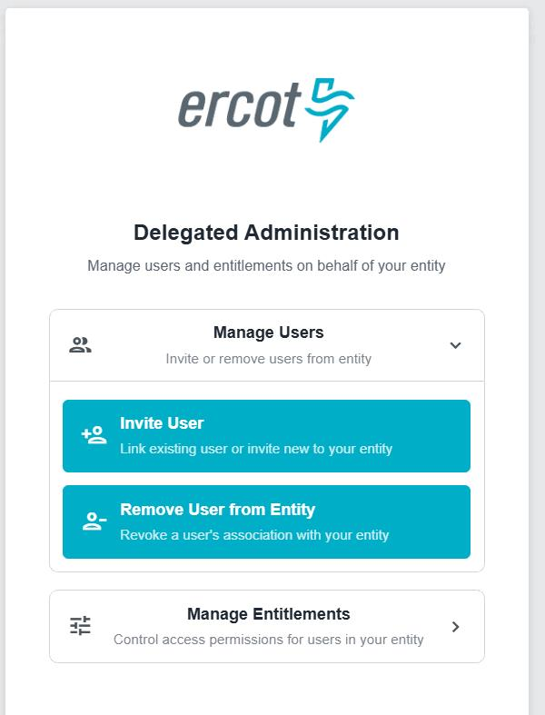
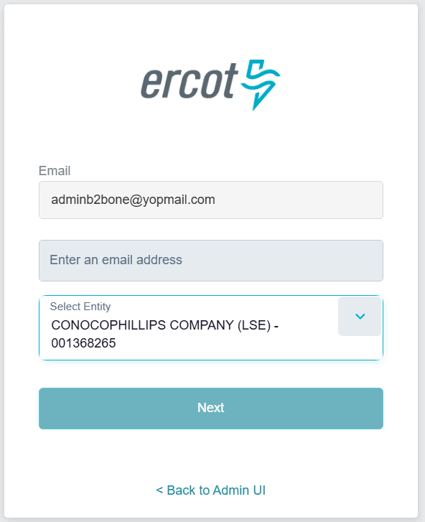
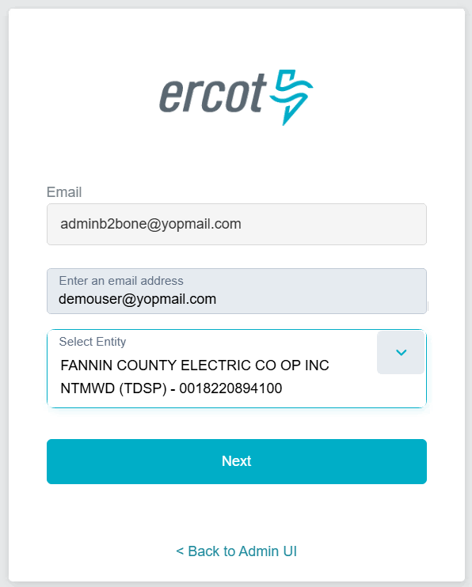
How USAs Manage Users
Future State
Invite new or existing users(1/2)
1. Delegated Administration
2. Manage Users
3. Invite User
4. Provide user mail & entity
Draft – for illustrative purposes only; to be finalized

Slide 20
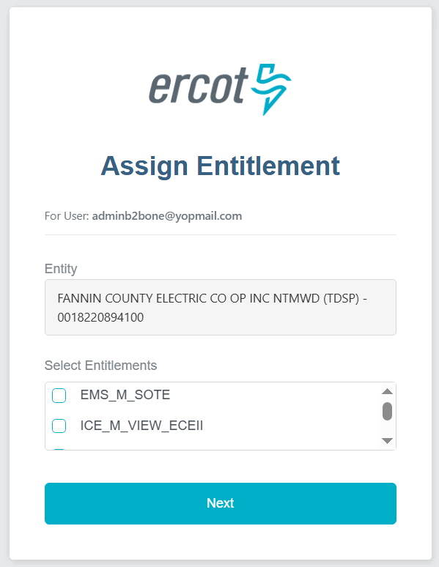
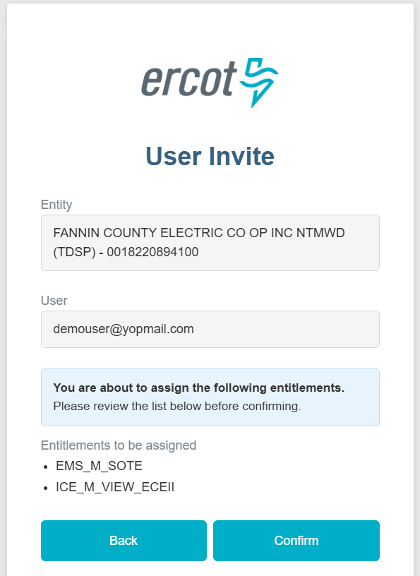
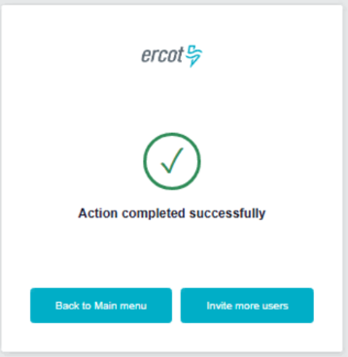
How USAs Manage Users
Future State
Invite new or existing users(2/2)
5. Select Entitlement
6. Confirm entity & entitlements
7. Success
Draft – for illustrative purposes only; to be finalized

Slide 21
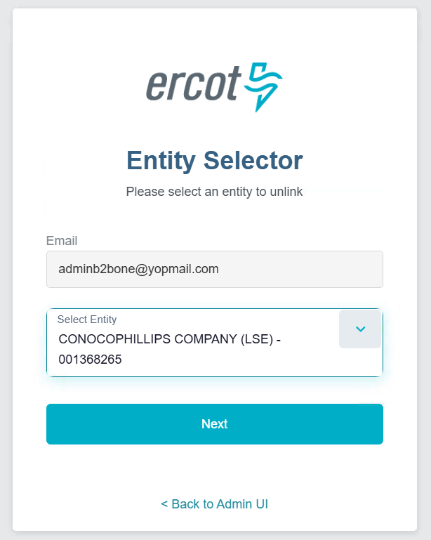
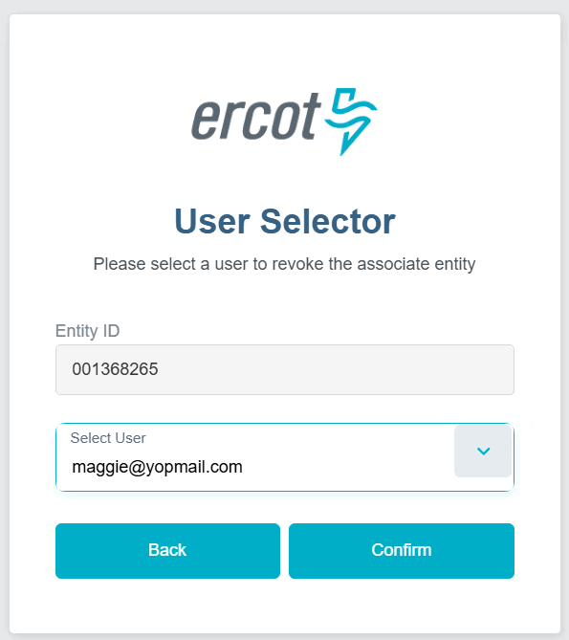
How USAs Manage Users
Future State
Unlink users from entity(1/2)
1. Delegated Administration
2. Manage Users
3. Remove User from Entity (Select Entity)
4. Select User
Draft – for illustrative purposes only; to be finalized

Slide 22
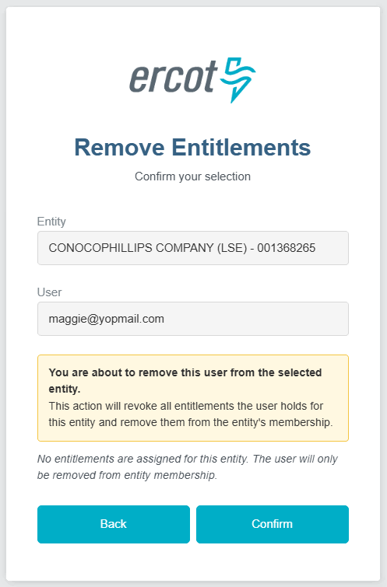
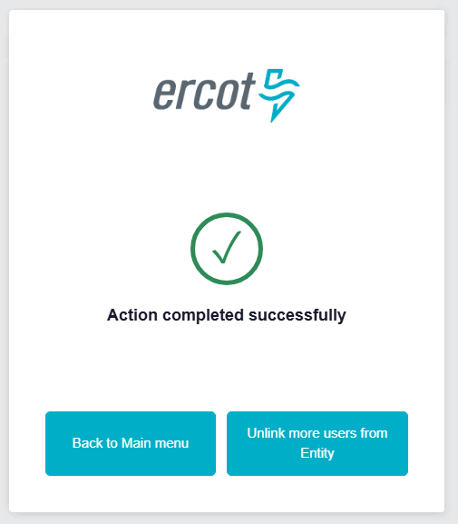
How USAs Manage Users
Future State
Unlink users from entity(2/2)
5. Confirm selection
6. Success
Draft – for illustrative purposes only; to be finalized

Slide 23
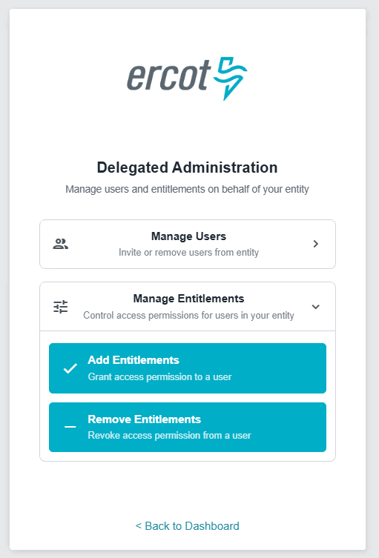
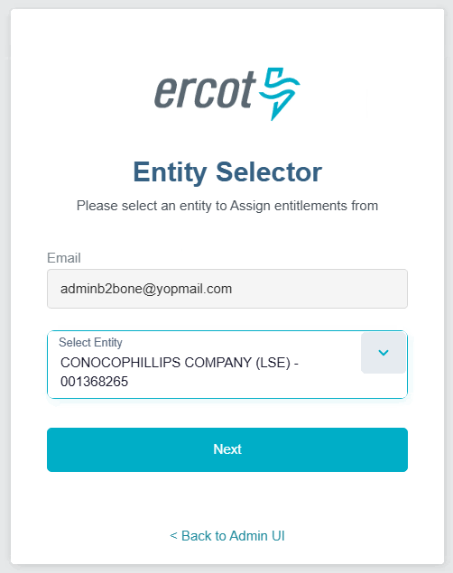
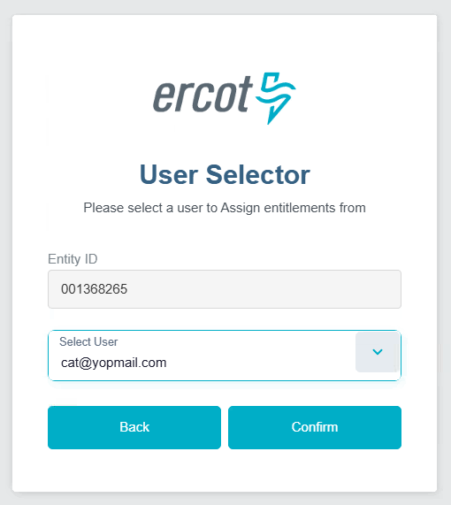
How USAs Manage Users
Future State
Assign Entitlements (1/2)
1. Delegated Administration
2. Manage Entitlements
3. Add Entitlements(Select Entity)
4. Select User
Draft – for illustrative purposes only; to be finalized

Slide 24
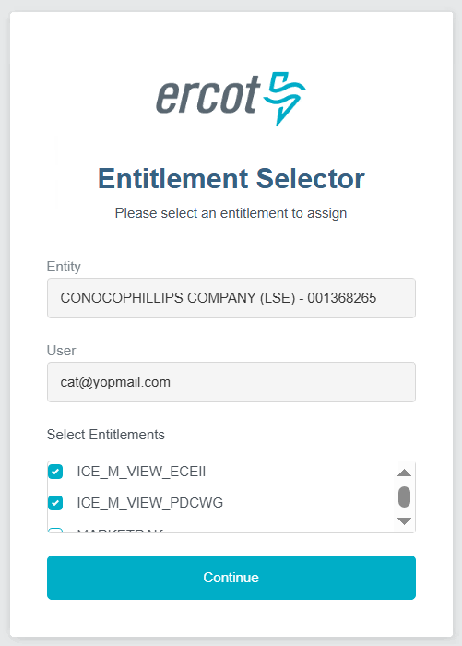
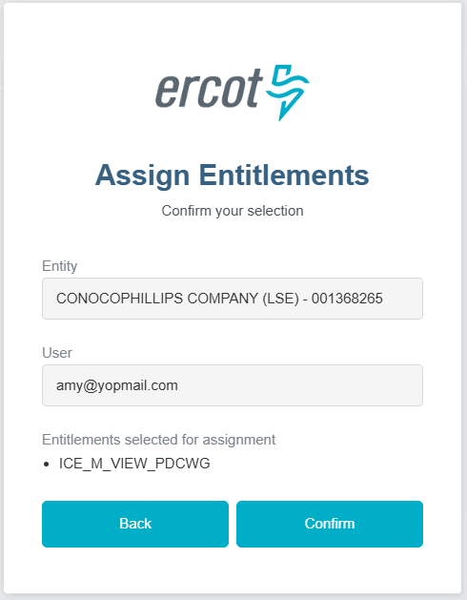
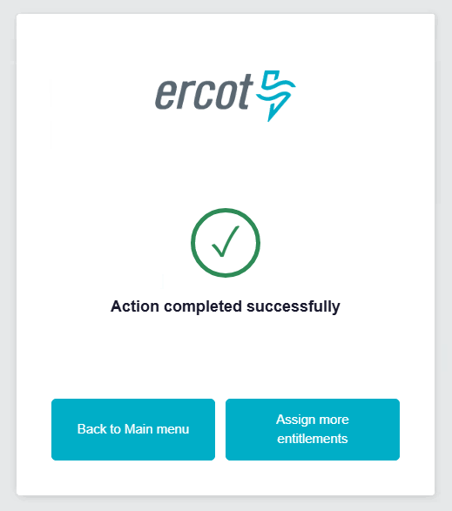
How USAs Manage Users
Future State
Assign Entitlements (2/2)
6. Select Entitlements
5. Confirm selection
6. Success
Draft – for illustrative purposes only; to be finalized

Slide 25
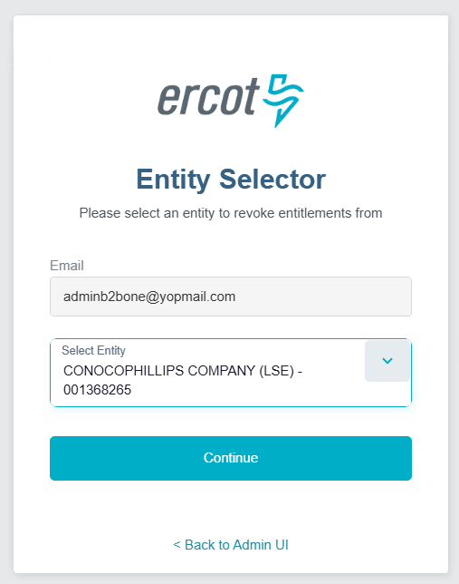
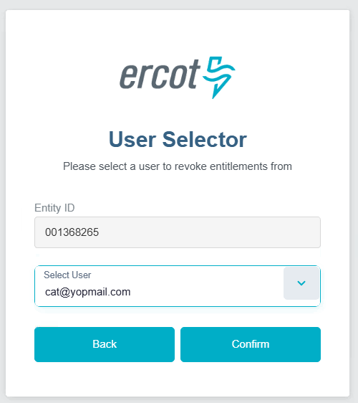
How USAs Manage Users
Future State
Remove Entitlements (1/2)
1. Delegated Administration
2. Manage Entitlements
3. Remove Entitlements(Select Entity)
4. Select User
Draft – for illustrative purposes only; to be finalized

Slide 26
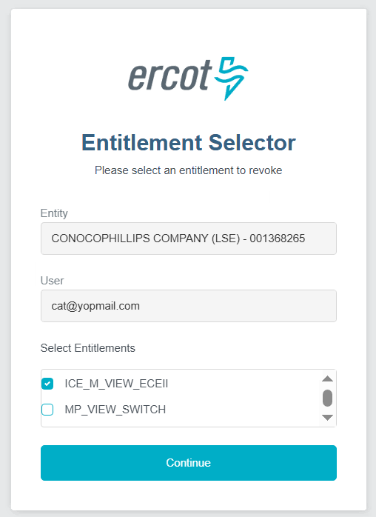
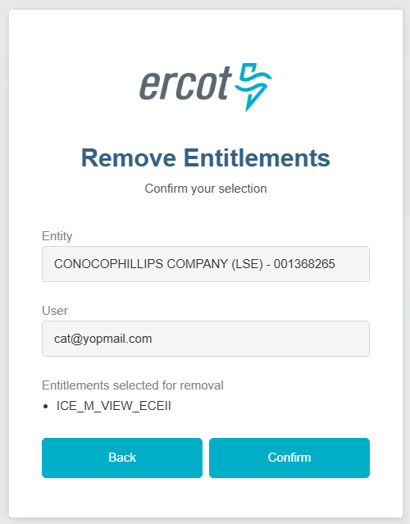
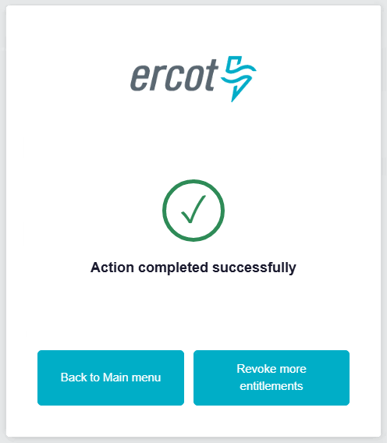
How USAs Manage Users
Future State
Remove Entitlements (2/2)
6. Select Entitlements
5. Confirm selection
6. Success
Draft – for illustrative purposes only; to be finalized

Slide 27
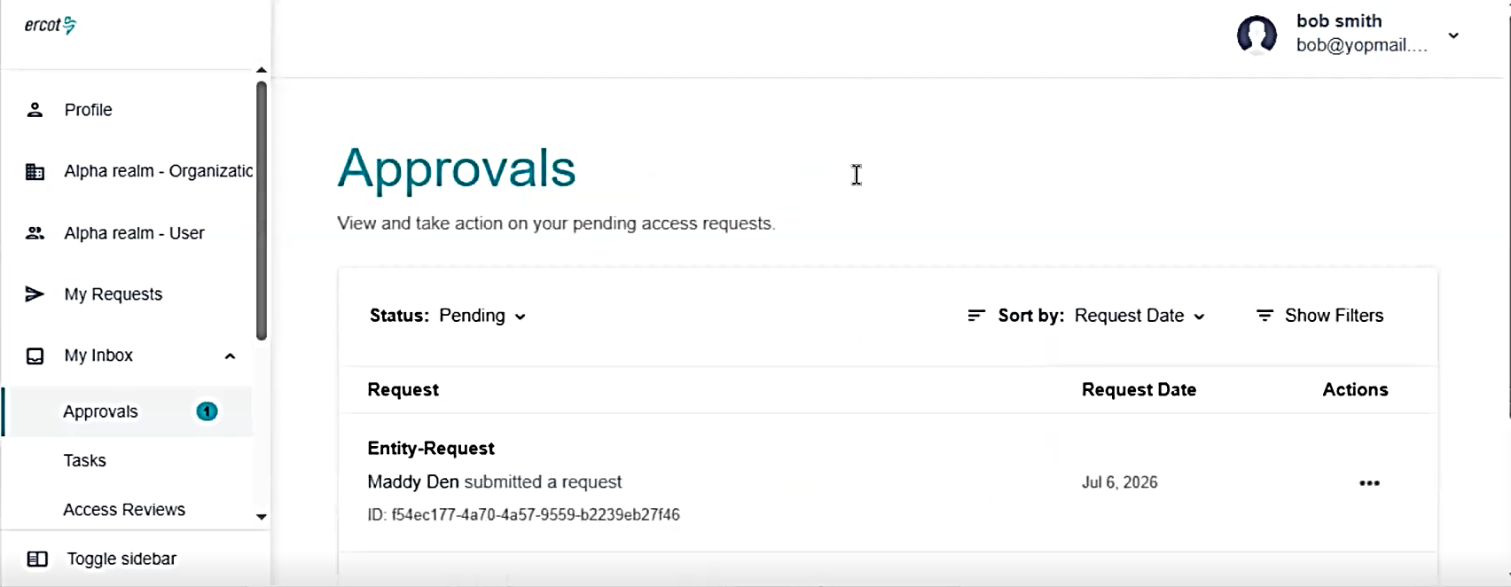
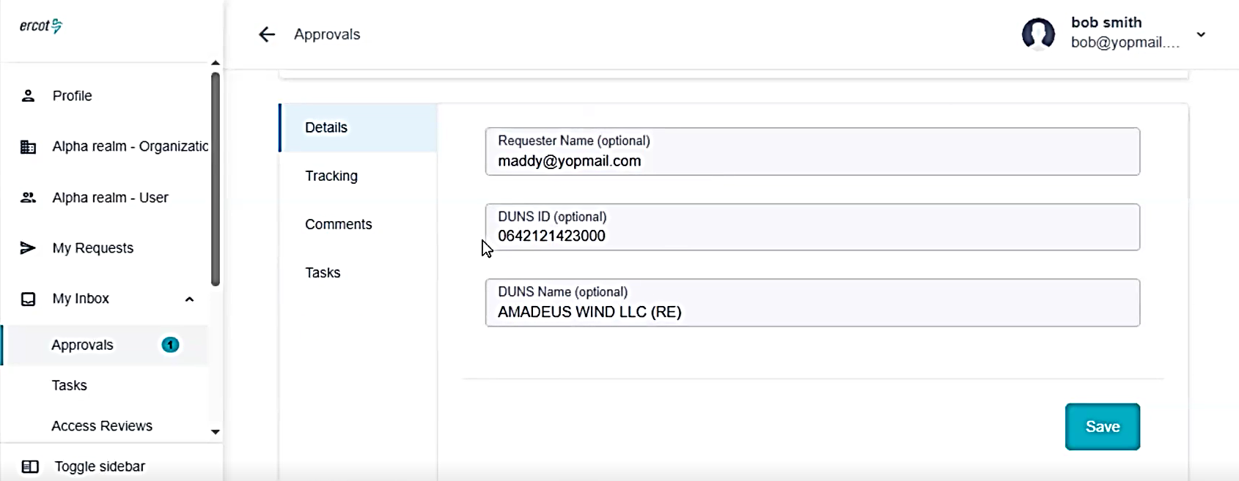
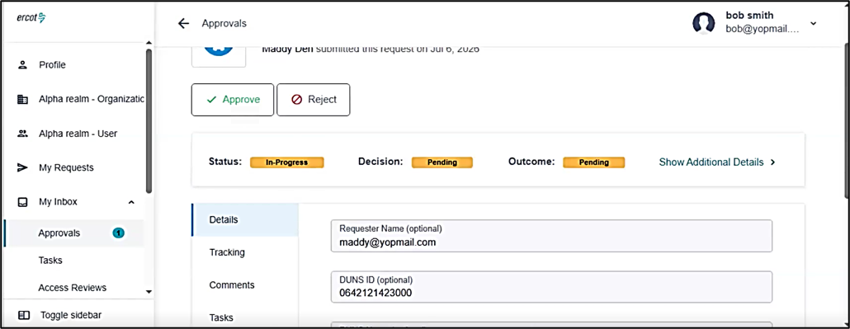
Entity Management Updates
This is a preview of the new platform User Security Administrators (USAs) and Back-Up User Security Administrators (BUSAs) will use to manage entities in the new Stakeholder Login Portal. A full training will be coming for this topic.

Slide 28
Market Participant Service Portal (MPSP)
Phase 1 and the Road Ahead
September 21, 2026
Outline:
• How Phase 1 fits the future vision
• Phase 1 service-management use cases
• NCI and LSIPA walk-through
• Road ahead and future phases
• Readiness and questions
Key Takeaways
MPSP establishes an authenticated ERCOT ↔ MP service-management experience
Phase 1 includes Client Services, Service Desk, RFIs, Notices, NCI/LSIPA and Weatherization access transition
Future phases expand Protocol forms and workflows
ERCOT will engage MPs through notices, testing, workshops, user guides and feedback
Use cases walk-through · Preview of future phases
Key Takeaways
• MPSP establishes an authenticated ERCOT ↔ MP service-management experience
• Phase 1 includes Client Services, Service Desk, RFIs, Notices, NCI/LSIPA and Weatherization access transition
• Future phases expand Protocol forms and workflows
• ERCOT will engage MPs through notices, testing, workshops, user guides and feedback
Amy Loera
Manager, Regulatory Processes & Registration · ERCOT Legal

Slide 29
Building on the Current State and Future Vision
From manual interactions to structured, trackable service management
TODAY
E-mail, phone calls & attachments
Manual routing across ERCOT teams
Limited status and history
Manual re-keying of information
MPSP PHASE 1
Secure access + MP service management
Structured intake
Routing & workflow
Acknowledgements
Status & history
RESULT
Requests routed correctly
Receipt acknowledged
Trackable status
Current registered contacts
Better transparency
MPSP turns the future vision into specific, trackable ERCOT ↔ Market Participant interactions.

Slide 30
The Foundation We Will Build On
IAM establishes trusted identity; MPSP applies it to Market Participant business interactions
1
2
3
4
5
6
1
2
3
4
5
6
User account
Individual identity
MFA / IAM
Secure sign-in
MP association
Linked to one or more MPs
USA approval
Associate Users & Grant Entitlements
Role-based capability
AR • BAR • USA • MP user
MPSP
Guided interactions
Registered Contacts
ARs/BARs authenticate as individuals
Protocol-defined functions become entitlements
Example: NCI submission and MP records
User Security Administrators
Associate users with MPs
Grant or approve entitlements
Manage access similar to today’s role model
Market Participant Users
Create accounts
Request MP association
Request entitlements from USAs
IAM enables the MPSP to identify the user, MP relationship and the approved entitlements

Slide 31
Phase 1 - Service Management Use Cases
Five use-case areas — one service-management foundation
Client Services
Questions • issues • assistance
Route to assigned Account Manager
Service Desk
IT & technical issues
Triage and route to ERCOT IT
RFIs
ERCOT requests information
Send • remind • track • report
Notices
Structured MP communications
Create • approve • schedule • send
Protocol Forms
NCI + LSIPA
Authenticated submission + workflow
Weatherization
Existing MIS weatherization and inspection functions transition from Digital Certificates to username/password + MFA.
The common experience:
Acknowledgement • Routing • Status • History • Reporting

Slide 32
MP → ERCOT: Getting Help
Client Services and Service Desk become structured, trackable interactions
CLIENT SERVICES
Questions • Issues • Concerns • Assistance
SERVICE DESK
Technical or information-technology issues
Submit
MP enters request in MPSP
Route
Assigned Account Manager
Work
Interact with ERCOT + self-help
Track
Acknowledgement • status • history
Submit
MP initiates issue
Triage
Service Desk classifies
Route
Appropriate ERCOT IT team
Resolve
Track through closure
Instead of needing to know whom to e-mail, MPs tell ERCOT what they need — MPSP routes and tracks the request.

Slide 33
ERCOT → MP: Structured Communications
RFIs and Notices use current MP Registration contacts and managed workflows
MP REGISTRATION INTEGRATION
Current entities • MP types • Authorized Representatives • registered contacts
REQUESTS FOR INFORMATION
ERCOT initiates and manages the response lifecycle.
Draft → Review → Approve → Select audience →
Send → Respond → Remind → Track & report
MP value: clear requests, acknowledgement, reminders and less e-mail follow-up.
NOTICES
Ad hoc and recurring Market Participant communications.
Create → Review → Approve → Schedule →
Select audience → Send
Audience: one MP • multiple MPs • MP type • all MPs
MPSP improves not only how MPs contact ERCOT, but also how ERCOT communicates with MPs.

Slide 34
Protocol Forms: More Than Electronic Submission
NCI and LSIPA demonstrate authenticated submission plus ERCOT workflow processing
Authenticate
Select form
Guided entry
Submit
ERCOT workflow
Status / history
FORM E
NOTICE OF CHANGE OF INFORMATION (NCI)
ARs/BARs review current registered contacts
Entity-level or registration-specific changes
Submission routes to Legal, then MP Registration processing
Representative deep dive: full lifecycle
FORM S
LSIPA CEGE/CEGS ATTESTATION
Entity-level obligation across registrations
AR initiates and routes to entity officer
DocuSign supports electronic execution
Secure handling: ECEII
The change is not just “forms online” — it is authenticated submission plus managed ERCOT workflow.

Slide 35
What an NCI covers
The everyday changes Market Participants make
1
2
3
Contact updates
Company information
Entity or registration level
AR and Backup AR email addresses, plus other registered contacts — Compliance, 24×7, Credit, and more.
Legal name, mailing and physical address, and other registered entity details.
Apply a change across the whole entity, or to a single registration.
EXAMPLE WE'LL FOLLOW
A Market Participant has a new Backup Authorized Representative. The Authorized Representative submits the change — a routine contact update we'll take through the portal on the next slide.
Notes:
Keep the NCI concrete. An NCI handles the everyday changes MPs actually make: contact updates (AR and Backup AR email, and other registered contacts like Compliance, 24x7, Credit), company information (legal name, address), applied at the entity or registration level. Anchor on the AR-email example — a routine contact change — and carry it into the journey on the next slide.

Slide 36
NCI: Follow the Entire Journey
From authenticated intake to ERCOT processing and status/history
MARKET PARTICIPANT EXPERIENCE
ERCOT WORKFLOW AFTER SUBMIT
Authenticate
See current records
Select entity / registration
Enter change
Submit NCI
Legal review
Approval
Registration processing
Status / history
WHAT CHANGES
MPSP connects the authenticated Market Participant experience to the ERCOT workflow —
and provides status and history across the process.
NCI example: MPSP manages the workflow associated with a Protocol form from intake through ERCOT processing

Slide 37
Phase 1 → The Road Ahead
Establish the capability, then expand end-to-end workflow automation
PHASE 1 — ESTABLISH
Service interactions
Client Services • Service Desk
Communications
RFIs • Notices
Initial Protocol workflows
NCI • LSIPA
NEXT — EXPAND
Additional Protocol-required forms
Secure submission
Acknowledgement
Legal / business-team routing
Review & processing
Status & completion
ROAD AHEAD — SCALE
More MP interactions
Less e-mail
More workflow automation
More transparency
Historical records
Better MP experience
To prepare:
Confirm USA engagement • Keep AR/BAR contacts current (individual emails, not shared) •
Watch for Market Notices • Participate in testing and workshops

Slide 38
Up Next:
Questions and Answers

Slide 39
FAQs

Slide 40
FAQs
PRESENTATION CATEGORY/BUSINESS AREA | Question | Answer
MPSP ICE BREAKER | What is MPSP? How does it help me? | The Market Participant Service Portal (MPSP) is a new secure MIS application for managing Market Participant services. Initial use cases include contacting Client Services and the Service Desk, submitting forms, receiving Notices and Requests for Information (RFIs), and accessing frequently asked questions and answers.

Slide 41
FAQs
PRESENTATION CATEGORY/BUSINESS AREA | Question | Answer
IAM | What are associations and entitlements? | Associations identify requests as submitted on behalf of a Market Participant. Entitlements provide access to SECURE or CERTIFIED areas of the MIS — similar to roles on Digital Certificates. Both are granted or removed by USAs. Associations alone do not grant entitlements.
IAM | Do I still need to use my Digital Certificate, or is it going away? | Yes — Digital Certificates remain required for current MIS applications. The MPSP will use the new IAM system (expected Q1 2027). Weatherization is targeted to follow in Q2 2027. ERCOT will communicate the transition plan for remaining MIS applications through stakeholder forums and Market Notices.
IAM | Who creates user accounts in the new IAM system? | User accounts may be created by users or USAs. ERCOT will also create accounts for ARs and USAs from registration information, and for existing Digital Certificate holders based on the email address on Digital Certificates. ERCOT-created accounts must be activated by users. The ERCOT IAM User Guide will provide full details.

Slide 42
FAQs
PRESENTATION CATEGORY/BUSINESS AREA | Question | Answer
IAM | Who will manage my access to MPSP and other MIS applications in the new IAM system? | Your Market Participant's User Security Administrator (USA) manages all user access to MIS applications including the MPSP — just as USAs manage Digital Certificate access today — except for AR-specific functions, which ERCOT manages directly.
IAM | How are ARs and USAs authorized to perform their duties in the new IAM system? | The new IAM system integrates with ERCOT's MP registration system. ARs and USAs are authenticated using their registration contact information, and the IAM system manages their access to the portions of the MPSP required to perform their protocol duties.
IAM | Can I be associated with more than one Market Participant? | Yes. A user may be associated with and granted entitlements for one or more Market Participant registrations or Market Participant entities. User association or access to the MIS SECURE or CERTIFIED AREA is based on each user’s associations and entitlements.

Slide 43
FAQs
PRESENTATION CATEGORY/BUSINESS AREA | Question | Answer
GUIDES_MPSP_IAM | Where do I find guides, reference materials and implementation details on the MPSP and the new IAM system? | ERCOT will publish an MPSP User Guide and an IAM User Guide. Watch for Market Notices and workshop materials on the ERCOT website for additional details.
MPSP_CS_Service_Desk | How do I reach Client Services or the Service Desk once the MPSP is available? | Submit Client Services or Service Desk requests through the MPSP. Requests from associated users are automatically routed to your Account Manager. Existing phone and email channels remain available, with follow-up conducted through the MPSP.
MPSP_GENERAL | Will I still be able to do everything I currently do on the Public Portal? | Yes. The MPSP will include applicable Public Portal services. Users will have an account on either the Public Portal or the MPSP — not both — so request types such as public information requests will also be available within the MPSP.

Slide 44
FAQs
PRESENTATION CATEGORY/BUSINESS AREA | Question | Answer
MPSP_LEGAL | Will all Market Participant forms and manual processes eventually move to MPSP? | ERCOT intends to progressively move most MP forms and manual processes into the MPSP. Timing and scope will be communicated as functionality is implemented.
MPSP_LEGAL | What should I expect when a form I usually email becomes available in MPSP? | Email submission is retired for each form when it goes live on the MPSP. ERCOT will confirm cutover timing by Market Notice, including guidance for submissions already in progress.
MPSP_LEGAL | Will the MPSP allow ARs to designate users that can originate protocol-required forms for submission with AR approval? | Not at initial go-live. The NCI and LSIPA forms must be submitted by ARs or Backup ARs. This may be revisited in a future phase.

Slide 45
FAQs
PRESENTATION CATEGORY/BUSINESS AREA | Question | Answer
MPSP_LEGAL | Will the MPSP allow MPs to designate users that can view, track and export historical submissions? | Not at initial go-live. This may be revisited in a future phase.
MPSP_General | Will there be testing and training before the MPSP goes live? | Yes. Watch for Market Notices with details on additional workshops, Market Participant testing, and training opportunities.

Slide 46
Questions/Comments?

