Slide 1
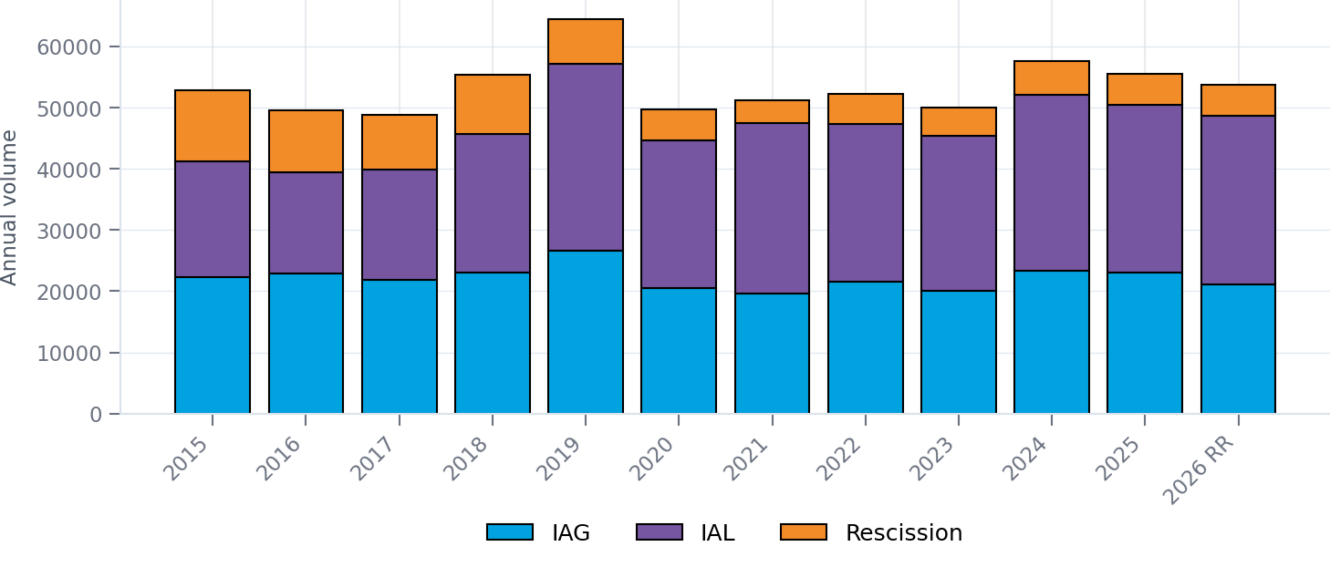
IGL TRAINING | ERCOT MARKET TRENDS
IAG / IAL / Rescission volumes remain elevated
Annual volumes, with 2026 projected from January–May actuals
2026 ACTUAL THROUGH MAY
2026 EOY RUN RATE
VS. 2025
LARGEST CATEGORY
22,369
53,686
−3.3%
IAL
8,826 IAG | 11,455 IAL | 2,088 RES
Annualized from five months of actual volume
Run rate compared with 55,492 annual cases
51% of 2026 actual volume
2026 READOUT
The annualized 2026 total is tracking slightly below 2025, while IAL remains the largest source of volume.
2026 uses Jan–May actuals and an EOY run rate of 53,685.6.
Source: IGL Training graph worksheet_updated_20260915.xlsx
Vistra
1

Slide 2
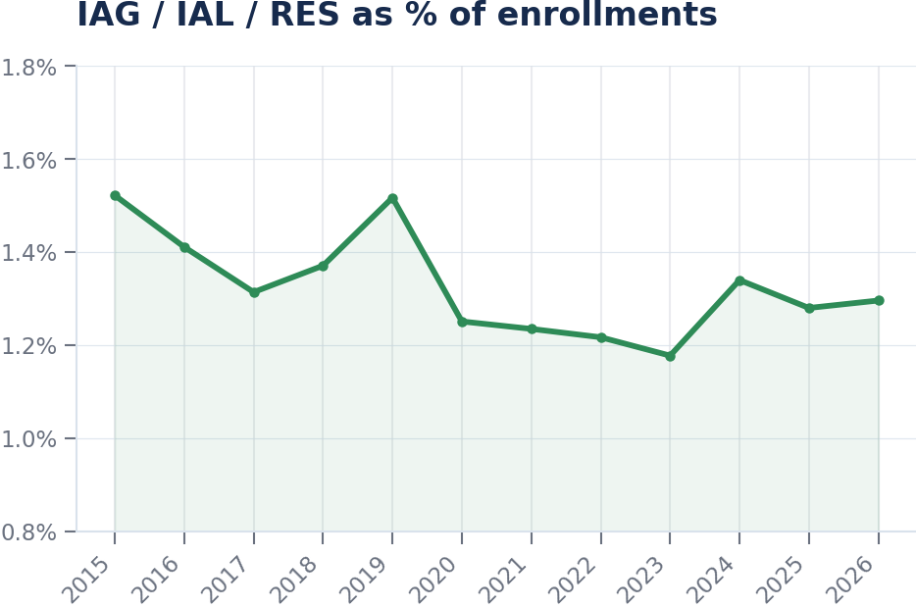
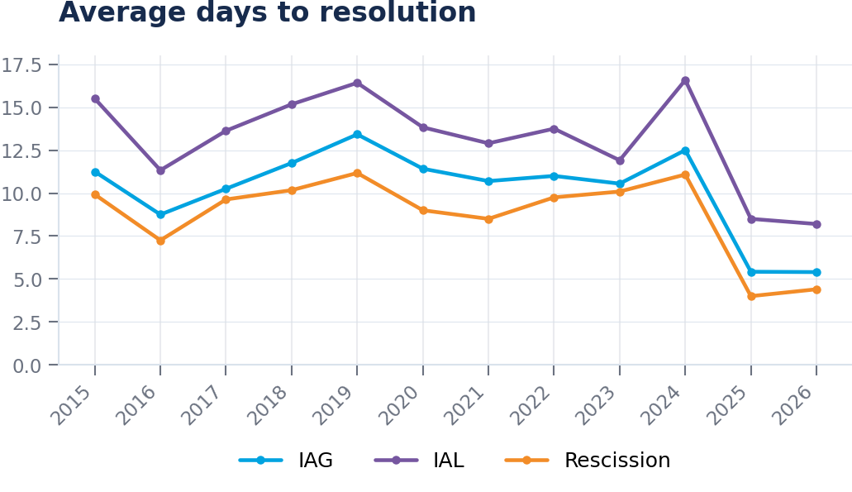
IGL TRAINING | ERCOT MARKET TRENDS
Resolution speed gains are holding as incidence stays near 1.3%
Annual averages show a sustained step-change beginning in 2025
2026 IAG RESOLUTION
2026 IAL RESOLUTION
2026 RES RESOLUTION
2026 % OF ENROLLMENTS
5.4 days
8.2 days
4.4 days
1.29%
Essentially flat to 2025
Improved from 8.5 days in 2025
Up 0.4 day from 2025
Jan–May YTD incidence
Key takeaway
2026 resolution times remain roughly half of 2024 levels, while the share of enrollments is stable versus 2025.
Source: IGL Training graph worksheet_updated_20260915.xlsx
Vistra
2

