Slide 1
Credit Exposure Update
Credit Finance Subgroup
ERCOT Public
​
September 23, 2026

Slide 2
Monthly Highlights: July 2026 – August 2026
Market-wide average Total Potential Exposure (TPE) slightly decreased from $ 2.184 billion in July to $2.120 billion in August.
Forward adjustment factors on average decreased during the month
    Discretionary Collateral is defined as Secured Collateral in excess of TPE,CRR Locked ACL and DAM Exposure
  Average Discretionary Collateral slightly increased from $ 4.32 billion in July compared to $4.40 billion in August
No unusual collateral call activity

Slide 3
TPE and Forward Adjustment Factors: August 2025 – August 2026

Slide 4
TPE/Real-Time & Day-Ahead Daily Average Settlement Point Prices for HB_NORT:H August 2025 – August 2026

Slide 5
Available Credit by Type Compared to Total Potential Exposure (TPE):
August 2025 – August 2026
Numbers are as of month-end except for Max TPE

Slide 6
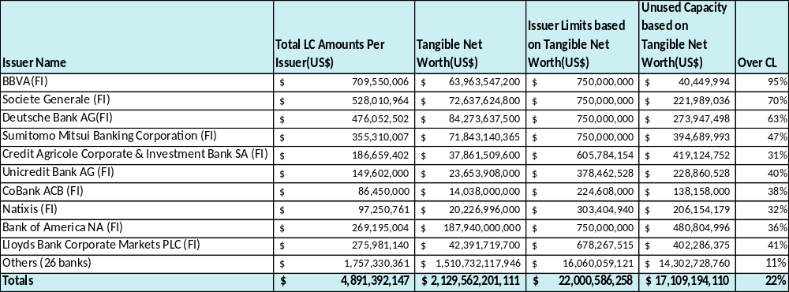
Issuer Credit Limits vs Total LC Amounts Per Issuer: August 2026
As of August 31, 2026
There are a total of 36 banks that have issued LCs.

Slide 7
Discretionary Collateral July 2026 – August 2026

Slide 8
Discretionary Collateral by Market Segment August 2024 – August 2026

Slide 9
TPE and Discretionary Collateral by Market Segment - August 2026
Load and Generation entities accounted for the largest portion of discretionary collateral

Slide 10
TPEA Coverage of Settlements July 2025 - July 2026
Invoice Exposure | Historical | Future
Invoice Exposure | 7 Days Back Net Invoice Amounts (Charges & Credits) | M1 Days (including current day) Forward Net Invoice Amounts (Charges & Credits); Excluding: 1) Securitization Invoices; 2) CRR Auction Invoices; and 3) Subchapter N Funds Distribution Invoice

Slide 11
TPEA Coverage of Settlements July 2025 - July 2026
Invoice Exposure | Historical | Future
Invoice Exposure | 7 Days Back Net Invoice Amounts (Charges & Credits) | M1 Days (including current day) Forward Net Invoice Amounts (Charges & Credits); Excluding: 1) Securitization Invoices; 2) CRR Auction Invoices; 3) Subchapter N Funds Distribution Invoice

Slide 12
TPEA Coverage of Settlements July 2025 - July 2026
Invoice Exposure | Historical | Future
Invoice Exposure | 7 Days Back Net Invoice Amounts (Charges & Credits) | M1 Days (including current day) Forward Net Invoice Amounts (Charges & Credits); Excluding: 1) Securitization Invoices; 2) CRR Auction Invoices; 3) Subchapter N Funds Distribution Invoice

Slide 13
TPEA Coverage of Settlements July 2025 - July 2026
Invoice Exposure | Historical | Future
Invoice Exposure | 7 Days Back Net Invoice Amounts (Charges & Credits) | M1 Days (including current day) Forward Net Invoice Amounts (Charges & Credits); Excluding: 1) Securitization Invoices; 2) CRR Auction Invoices; 3) Subchapter N Funds Distribution Invoice

Slide 14
TPEA Coverage of Settlements July 2025 - July 2026
Invoice Exposure | Historical | Future
Invoice Exposure | 7 Days Back Net Invoice Amounts (Charges & Credits) | M1 Days (including current day) Forward Net Invoice Amounts (Charges & Credits); Excluding: 1) Securitization Invoices; 2) CRR Auction Invoices; 3) Subchapter N Funds Distribution Invoice

Slide 15
TPEA Coverage of Settlements July 2025 - July 2026
Invoice Exposure | Historical | Future
Invoice Exposure | 7 Days Back Net Invoice Amounts (Charges & Credits) | M1 Days (including current day) Forward Net Invoice Amounts (Charges & Credits); Excluding: 1) Securitization Invoices; 2) CRR Auction Invoices; 3) Subchapter N Funds Distribution Invoice

Slide 16
Questions

