Slide 1
Updates and Revisions to Sec. 16.11 Financial Security for Counter-Parties
Credit Finance Sub Group (CFSG)
September 23, 2026

Slide 2
Key Changes – TPE Terms
Change TPEA & TPES acronyms/terms to be more descriptive of exposure being measured
Current Protocols
“TPEA”: Total Potential Exposure Any
“TPES”: Total Potential Exposure Secured
Proposed
“TPEE”: Total Potential Exposure for Energy
“TPEC”: Total Potential Exposure for CRR

Slide 3
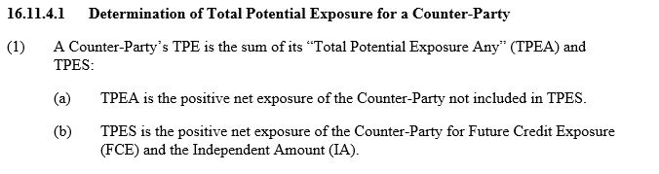
Key Changes – TPE
Current Protocols
Proposed
TPE = TPEE + TPEC + IA + PUL
Where:
TPE = Total Potential Exposure
TPEE = Total Potential Exposure for Energy
TPEC = Total Potential Exposure for CRR

Slide 4
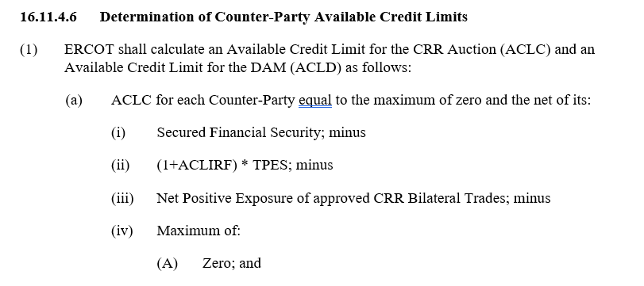
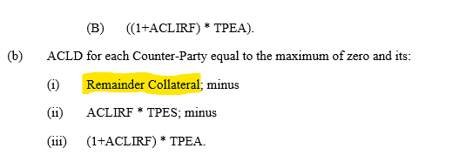
Key Changes - ACL
Current Protocols
Proposed
16.11.4.6 Determination of Counter-Party Available Credit Limits
ERCOT shall calculate an Available Credit Limit for the CRR Auction (ACLC) and an Available Credit Limit for the DAM (ACLD) as follows:
ACLC = Max [(Financial Security – (TPE * (1+ACLIRF)) – CRR Bilateral Trades Exposure), 0]
ACLD = Max (ACLC – CRRALA, 0)
CRRALA CRR Auction Locked Amount

Slide 5
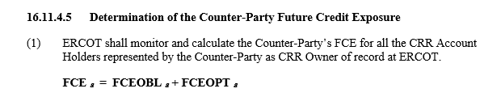
Key Changes - FCE
Current Protocols
Proposed
16.11.4.5 Determination of the Counter-Party Future Credit Exposure
ERCOT shall monitor and calculate the Counter-Party’s FCE for all the CRR Account Holders represented by the Counter-Party as CRR Owner of record at ERCOT.
FCE _{a} = FCEOBL _{a} + FCEOPT _{a} + CRRBTE _{a}
Where CRRBTE = Max (0, CRRBTE)
CRRBTE CRR Bilateral Trade Exposure

Slide 6
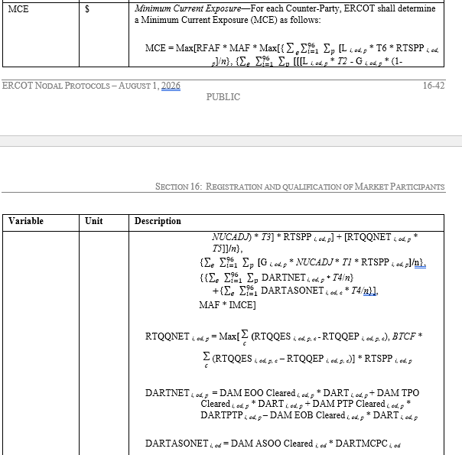
Key Changes - MCE
Current Protocols
Proposed
MCE = Max[ RFAF × MAF × Max[TermA, TermB, TermC, TermD, MAF × IMCE ] ]
Where:
Term A = [L i, od, p * T6 * RTSPP i, od, p]/n}
Term B = [[[L i, od, p * T2 - G i, od, p * (1-NUCADJ) * T3] * RTSPP i, od, p] + [RTQQNET i, od, p * T5]]/n}
Term C = [G i, od, p * NUCADJ * T1 * RTSPP i, od, p]/n}
Term D = {{∑_e^ ▒ ∑_(i=1)^96▒ ∑_p^ ▒ DARTNET i, od, p * T4/n} +{∑_e^ ▒ ∑_(i=1)^96▒ DARTASONET i, od, c * T4/n}]

Slide 7

Key Changes - IEL
Current Protocols
Proposed
IEL = Max [(DEL * Max [0.2, RTEFL] * RTAEP * (M1 + M2)], IMCE]
* New Counter-parties that intend to serve load are assessed very minimal amounts of IEL that fall below the $22,500 IMCE. In some instances, these CPs start day 1 not representing any Load Serving Entity essentially become trade-only CPs but have not posted collateral equivalent to IMCE.

Slide 8
Cash Collateral
Include the following in Sec. 16.11.3 (1)(c) Alternative Means of Satisfying ERCOT Creditworthiness Requirements
Cash Collateral must be paid to ERCOT in U.S. Dollars (USDs) by Electronic Funds Transfer (EFT) in immediately available or good funds (i.e., not subject to reversal). EFTs must be with U.S. banks only.
Cash Collateral deposits must include the Counter-Party’s Duns Number in the payment remarks.

Slide 9
Questions

