Slide 1

Front-of-the-meter (FTM) Netting
ERCOT NPRR Primer (v.2)
Sept 17, ‘26 Large Load Working Group meeting
Presented by Jesse Gossett
Executive Director, GCA
Founder and CEO, V-Wire Inc.
This presentation and the associated Nodal Protocol Revision Request (NPRR) draft to be submitted are sponsored by the Global Capacity Alliance (GCA)—an emerging industry coalition—to establish an open, resource-agnostic market standard.
Notes:
Introduction: V-Wire and the GCA are working with leading market architects like Arushi Frank from Luminary and others, to bring a targeted, ERCOT-specific implementation pathway to what is becoming a nationally recognized solution for speed-to-power while ensuring reliable grid growth.

Slide 2
MythBusters!
MYTH vs. REALITY
As Brattle’s report highlights, a gross curtailment obligation produces unnecessary interruptions by curtailing load even when supporting generation is fully available to offset it. Brattle recommends a net curtailment obligation where only load not covered by the paired generation is curtailed.
Currently, SCED evaluates co-located assets independently, resulting in a gross obligation. FTM-Netting is the ERCOT-native mechanism that allows SCED to enforce a net obligation.
MYTH: This is a novel ERCOT experiment.
REALITY: FTM-Netting is the mechanism, designed for ERCOT, to adopt the net curtailment framework Brattle has identified as the optimal solution for large load interconnection. Aurora found that a 4-hour FTM-netted BESS can reduce PCLR curtailment hours by 83% on average across the modeled sites while providing the predictability needed for bankability.
MYTH: FTM-Netting asks SCED to enforce private, bilateral contracts.
REALITY: SCED is optimizing real-time nodal physics.
QSEs already manage operational envelopes upstream of SCED. FTM-Netting gives SCED the accurate physical boundary of the node, preventing SCED from evaluating a netted site as a gross site.
Brattle concludes that 5-minute SCED is the best operational layer for these pairings.
MYTH: This isn’t fair for everyone else on the grid.
REALITY: We want new large loads to bring new generation with them. Motivating PCLRs to bring new paired assets to ERCOT is a positive sum outcome. For operations reliability and grid fairness, SCED should ramp generators and batteries paired with loads first, not ask 200% of the pairing for 100% of the impact.
Notes:
This NPRR asks ERCOT to allow new loads to manage their curtailment risk with a co-located, FTM new resource. No changes to SCED. QSEs can functionally do this today. The core of the NPRR is simply allowing for this netting to happen. New generation in SCED + speed to power inside of ERCOT.

Slide 3
Our Shared Challenge:
Speed-to-Power
The Demand Shock: The ERCOT grid is facing hundreds of GW of load requests that standard, multi-year transmission planning cycles cannot natively accommodate.
The Capital Readiness: Private capital is not just bringing load; developers are ready to fully fund and build net-new dispatchable generation to support it.
Our shared goal is to find a pathway for new load and generation to be built, at pace, integrated and visible to SCED within the ERCOT grid.

Slide 4
The NPRR In A Nutshell:
Enabling Netting
The Core Function: This proposed rule change asks ERCOT to allow for QSE-managed dynamic representation of assets in SCED to enable a netted pair without requiring any changes to SCED.
The Protocol Link: FTM-Netting uses existing telemetry to logically link two co-located, independently connected assets, netting their local congestion impact so they can safely connect ahead of long-term transmission upgrades.
The Grid-Tied Alignment: FTM-Netting will enable developers to Bring Your Own Generation (BYOG) directly into the ERCOT system. It gives the load the curtailment mitigation required for bankability, while giving ERCOT the grid-connected visibility they require.

Slide 5
The Bankability Gap:
Volume vs. Volatility
Pricing Volume: Developers can underwrite a known budget of curtailed MWh. A predictable volume of downtime can be modeled.
The Physics of 5-Minute Dispatch: Compute infrastructure cannot safely drop 100+ MW in a 5-minute SCED window. Effective ramping requires a longer, predictable runway.
The Premium on Predictability: The industry is currently buying speed-to-power off-grid or in isolated Private Use Networks. They are not doing this to save on energy costs—they are doing it purely to buy predictability.
The Question: Can we offer early energization (speed) and operational predictability inside the ERCOT grid?
5

Slide 6
Early Energization Option: PCLR
Provisional Controllable Load Resource (PCLR)
What it is: Allows early energization above a firm floor by agreeing to be curtailable through ERCOT’s 5-minute Security-Constrained Economic Dispatch (SCED).
The Challenge: A "naked" PCLR exposes loads to unpredictable curtailment.
Uptime vs. Predictability:
  Uptime: A reduction in uptime is a loss of revenue.
  Predictability: An unpredictable number of volatile curtailment events on 5-minute intervals will be challenging to finance.
PCLR is the only way to energize early within the grid. But there is no way to bring your own generation to support your load.

Slide 7
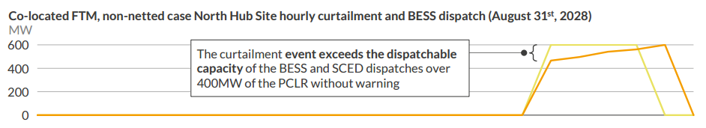
BYOG: PCLR with an FTM resource
(not netted)
Standard Co-Located Front-of-the-Meter (FTM)
What it is: Building load and dispatchable generation (e.g., BESS or gas) FTM at the same location on separate revenue meters.
The Challenge (The "Attributability Gap"): Without a protocol mechanism to link them, SCED treats them as independent assets with a gross curtailment obligation, dispatching the generator to help the grid while also curtailing the load—socializing the relief and leaving the load exposed.
Aurora Energy Research: Curtailment Mitigation for PCLRs: Modelling the Effects of Front-of-Meter Netting, Sept. 2026, slide 12

Slide 8
FTM-Netting: Speed-to-Power And Net-New Generation
The Objective: Large loads require speed-to-power, and developers want to build this infrastructure integrated within the ERCOT grid.
The Constraint: PCLR provides speed, but there is no bankable way for a load to BYOG to mitigate curtailment risk.
New Generation Is Coming: GWs of new generation will be built, paid for by new load that needs speed-to-power.
The Solution:
FTM-Netting provides the missing protocol link that allows new generation to support new load while waiting for grid upgrades.
Bankable for the developer, grid-integrated within SCED.
The Offer: We are bringing SCED new generation.

Slide 9
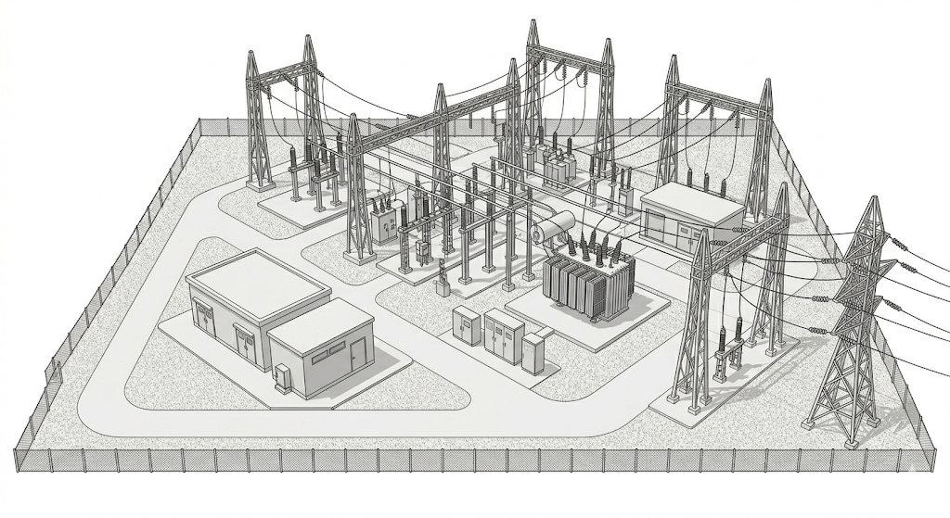
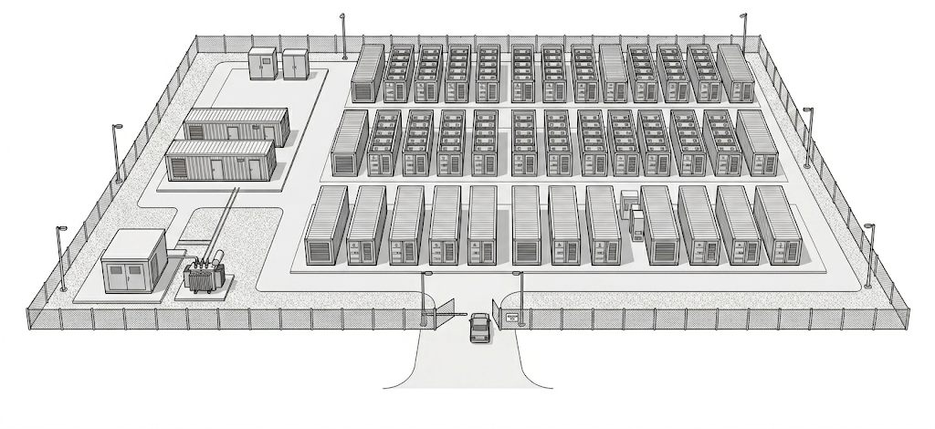

Illustrative FTM-Netting:
The Set-up
Grid Sub
POI
100MW
100MW Consumption
POI
BESS (or gas) 100MW & 100MW PCLR
PCLR Low Power Consumption (LPC) set to 0MW
PCLR is fully exposed to curtailment
BESS (or Gas)
Curtailable Load
Notes:
EPS – ercot-polled settlement

Slide 10
Illustrative FTM-Netting:
Step 1 – The Bid
Grid Sub
POI
100MW Bid
100MW Consumption
POI
Qualified Scheduling Entity (QSE) bids BESS (or gas)
100MW of resource is equivalently offsetting potential congestion impacts from PCLR
QSE dynamically raises LPC of PCLR to 100MW
BESS (or Gas)
Curtailable Load
Notes:
EPS – ercot-polled settlement

Slide 11
Illustrative FTM-Netting:
Step 2 – The Shield
Grid Sub
POI
100MW Inject
100MW Consumption
POI
ATTRIBUTION
SCED needs 100MW of relief, calls the resource
SCED needs more relief while the resource is actively injecting 100MW.
The PCLR does not show up as available for curtailment, SCED sources elsewhere.
Node netted to 0MW
BESS (or Gas)
Curtailable Load
Notes:
EPS – ercot-polled settlement

Slide 12
Illustrative FTM-Netting:
Step 3 – The Yield
Grid Sub
POI
100MW Inject
100MW Consumption
POI
Resource runs low on charge or fuel
OR
System Scarcity Event
OR
Resource trips offline / derates
QSE lowers LPC to firm floor, re-exposing PCLR to SCED dispatch
(note timing of each varies as discussed later)
BESS (or Gas)
Curtailable Load
Notes:
EPS – ercot-polled settlement

Slide 13
FTM-Netting:
The Payoff
Grid Sub
POI
100MW Inject
100MW Consumption
POI
The privately-financed co-located asset’s relief is directly attributable to the PCLR
The PCLR secures financed predictability—SCED only curtails the net physical shortfall, reducing volume and, crucially, buying predictability with residual curtailment coming after hour+ warnings.
BESS (or Gas)
Curtailable Load
Notes:
EPS – ercot-polled settlement

Slide 14
How It Works:
Physical & Dispatch Mechanism
Feature | Mechanism
Telemetry Shield | FTM-Netting enables the Qualified Scheduling Entity (QSE) to dynamically raise the PCLR’s telemetered Low Power Consumption (LPC) limit to match the real-time offset capacity of the paired resource. This effectively shields the load from Security-Constrained Economic Dispatch (SCED) curtailment while the offsetting capacity is actively offered.
Net-Zero Nodal Math | Because the load and the mitigating asset share a Resource Node, the paired generation's injection acts as an equivalent offset to the PCLR’s impact on localized transmission constraints. SCED deploys the equivalent physical counter-flow from the paired asset as necessary during normal operations.
Economic Equivalency | To clear the merit order equivalently to the shielded load, the paired resource is automatically mitigated via the same Adjusted Bid Cap (ABC) methodology or Mitigated Offer Cap (if gas) as the PCLR. This ensures native SCED compliance and prioritizes the paired resource for local congestion relief without causing market power or price distortion.
Respecting SCED | FTM-Netting requires no changes to SCED. The QSE manages the netted operational envelope upstream via LPC telemetry, allowing SCED to enforce net curtailment obligations vs. gross.

Slide 15
How It Integrates:
Reliability Guardrails
Feature | Mechanism
The Scarcity Yield | During system-wide emergencies (EEA Level 1+), the QSE must drop the telemetry shield within 60 seconds and without intentional delay. This deterministic release ensures both the flexible load and the newly built generation are fully returned to SCED when grid reserves are most threatened.
Day-Ahead (DRUC) Alignment | Current Operating Plan (COP) reporting is bifurcated by technology to prevent ERCOT’s Day-Ahead Reliability Unit Commitment (DRUC) engine from double-counting the paired assets. BESS: The QSE zeros out the reserved High Sustained Limit (HSL) and Target State of Charge (SOC) in the COP while the PCLR shows up as fully dispatchable due to State of Charge (SoC) limitations of the BESS. Gas: The generator submits an On-Line COP while the PCLR reports as unavailable via a raised LPC.
Status Protection: Base Point Grace Period | If the paired resource trips offline (Forced Outage or physical derate), the QSE immediately lowers the LPC shield. Base Point deviations incurred within this ramp window are exempt from compliance evaluation, removing the risk of PCLR-status revocation during an unexpected generator trip.

Slide 16
How It Settles:
“IT-Lite” Implementation
Feature | Mechanism
Post-Day Settlement | FTM-Netting avoids conditional netting logic in the real-time SCED algorithm. ERCOT natively verifies compliance using the telemetry, meter data, and offer curves it already collects, mirroring the existing Telemetry Validation methodology currently applied to Controllable Load Resources (CLRs).
Five-Point Settlement Check | To waive uninstructed deviation charges, the following are verified for every 15-minute Settlement Interval: Volumetric Equivalency: Available FTM Offset Capacity = load's Offset LPC MW. Offer Sufficiency: Verify a valid Energy Offer Curve (or Bid/Offer Curve). Ancillary Service (AS) Independence: High Sustained Limit (HSL) minus AS responsibility must cover offset. Latency Compliance: Ensure Scarcity Yield occurred within the mandated 60 seconds. Nodal Price Alignment: Divergence of Real-Time Locational Marginal Prices requires unshielding.

Slide 17
Senate Bill 6 and Political Alignment
Statutory Alignment: Advancing the Goals of SB 6
Provable Additionality: FTM-Netting enforces a "12-Month Rule," requiring the paired generation to achieve its Commercial Operations Date no more than 12 months before the PCLR's synchronization, driving net-new generation to the ERCOT grid.
The Scarcity Yield (Exceeding SB 6): SB 6 dictates that non-firm large loads must remain curtailable to protect system reserves. FTM-Netting goes further: during an EEA Level 1+, the load drops, and the privately financed generation is immediately yielded to SCED. It transforms a passive load reduction into an active, dispatchable grid asset when Texas needs it most.
Phantom Load Protection: By utilizing the PCLR mechanism to energize ahead of multi-year transmission buildouts, FTM-Netting eliminates the "phantom load" flight risk targeted by the legislature. Developers stay engaged and physically connected to the macro-grid.

Slide 18
Stakeholder Alignment:
Building On the Grid
Net-New Generation - Fully Financed, Natively Integrated:
BESS: Acts as a localized counter-flow to net out the PCLR’s congestion impact during normal operations and guarantees an unencumbered injection of capacity into the macro-grid scarcity.
Dispatchable Gas: Shields the load from curtailment while also operating like any standard price-responsive generator—injecting continuous energy, providing physical rotational inertia, and delivering 24/7 macro-level scarcity support.
Protecting TSP Revenue: The FTM arrangement puts the load on an un-netted revenue meter, paying 100% of transmission costs, keeping utilities whole.
Preserving WSL Integrity: By remaining FTM across distinct EPS meters, paired batteries preserve Wholesale Storage Load (WSL) tax exemption.
PURA Compliance: Both assets interact independently across the ERCOT utility boundary, avoiding PURA "retail wheeling" and joint-ownership legal friction.
18

Slide 19
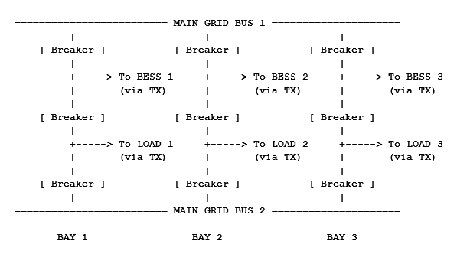
Interconnection Architecture:
Dual PoI & Queue Preservation
Queue Preservation (Non-Material Modification): Requesting the TSP to construct two terminal bays off a shared bus bar should not constitute a "Material Modification," because the GPS site location, voltage, and MW rating don’t change.
Post-Study Engineering (FIS & Batch 0 Alignment): The specific physical layout of the dual-POI breaker bays is finalized directly with the TSP during the detailed engineering phases of both processes—specifically, during the generator's Full Interconnection Study (FIS) and the TSP reliability upgrade assessments within the load’s Batch 0 study process. This allows the TSP to build a coordinated, shared-bus switchyard.
Topological Equivalence (Shift Factor Neutrality): Because both terminal bays drop from the same TSP switchyard bus bar, ERCOT's Network Operations Model (NOM) maps them to the identical Electrical Bus, ensuring their shift-factor vectors are identical.
19

Slide 20
FTM-Netting is a Positive-Sum Bridge
Concern: A paired resource can look like it is being reserved for one load rather than made fully available to the system.
Market Reality: Without a grid-integrated path, assets will still get built – private capital moves BTM into a WLPUN or fully off-grid. ERCOT loses new generation, dispatch, and scarcity rights.
The Positive Sum Bargain: The load gets a bankable path to speed-to-power. ERCOT gets new front-of-meter capacity that is visible, metered, and responds during emergencies.
Firming Asset | What the Load Gets (The Shield) | What ERCOT Gets (The Yield)
Battery / ESR | A predictable buffer against 5-minute SCED curtailments | A front-of-meter asset that yields 100% capacity during EEA 1+, while the un-netted load pays its full transmission tariff.
Gas / dispatchable gen | Durable, 24/7 firming support without a state-of-charge limitation | Daily market energy, rotational inertia, local reliability, and scarcity release

Slide 21
Next Steps: NPRR Submission
A Pre-Vetted Foundation: This framework has been diligently pressure-tested privately across the industry, incorporating feedback from load and generation developers, banks, insurers, technical engineers, QSEs and reliability experts.
Formal Submission: We will be formally submitting the FTM-Netting NPRR to enter the official ERCOT stakeholder process.
Public Engagement: We welcome the rigorous, public evaluation that the ERCOT process provides. We look forward to engaging with this working group, System Operations, and Market Design as the revision moves through the process.
21

Slide 22
Thank you
Jesse Gossett jesse@globalcapacityalliance.org www.globalcapacityalliance.org

Slide 23
FTM-Netting: A Positive-Sum Framework for Texas 1 of 2
For Regulators & Grid Operators (ERCOT & the IMM)
Guarantees Scarcity Yield (SB 6 Alignment): At EEA 1 or higher, the telemetry offset automatically terminates. The PCLR returns to its Baseline LPC, making its native curtailment capability available to the grid while the paired Resource remains separately available for dispatch.
Net-New Generation for SCED: Loads requiring continuous uptime are incentivized to build firming generation entirely off-grid or BTM. FTM-Netting provides the commercial mechanism to keep that privately funded generation inside the ERCOT market as separately metered, SCED-dispatched Resources, permanently expanding the grid's dispatchable footprint.
Delivers Unblended Nodal Visibility: FTM-Netting gives ERCOT independent visibility into both the true gross load and the paired generation, expanding operational visibility for the macro grid. This empowers operators to accurately model the system and avoids "phantom" N-1 contingency risks of blended resources operating behind a master meter.
Aligning with NPRR1188: ERCOT rules will require CLRs to be metered separately. FTM-Netting complies with this unbundled metering reality, using QSE telemetry to solve the resulting "attributability gap" without violating existing protocol.
For Load & Technology (Hyperscalers, QSEs, & Developers)
Speed-to-Power Within the Grid: PCLR is the only option for early energization within the grid. FTM-Netting converts open-ended, uninsurable SCED curtailment exposure of a PCLR into a defined, predictable obligation. Bounding this risk allows projects to be contracted, insured, and financed.
Unlocks Early Transmission Headroom: Provides a pathway for continuous-compute "Base Load" projects to energize years ahead of transmission upgrades without creating unstudied grid risk.
23

Slide 24
FTM-Netting: A Positive-Sum Framework for Texas 2 of 2
For Generation & Storage (Gas & BESS Developers)
Aligns Reliability Needs with Merchant Economics: FTM-Netting gives loads a commercial reason to finance co-located batteries and generation. Developers secure a bankable capacity revenue stream for the telemetry shield while retaining the ability to capture wholesale market upside.
Keeps Private Capital in the ERCOT Market: Incentivizes developers to build net-new generation directly into SCED as separately metered ERCOT Resources, rather than isolating capacity behind the meter or in off-grid islands.
For Wires & Ratepayers (TSPs & Consumers)
Protects 4CP & WSL Tariff Integrity: By rejecting single-POI blended meters and keeping settlement entirely separate, FTM-Netting guarantees TSPs collect their full 4CP tariffs on gross consumption and preserves strict Wholesale Storage Load compliance.
Reduces Phantom-Load Forecasting Risk: Earlier PCLR operation gives TSPs verifiable, observable demand on the system while they build out the longer-term transmission upgrades, drastically reducing stranded-investment exposure.
24

Slide 25
The Commercial Product
FTM-Netting agreement
Bi-Lateral Contract between Load and Resource:
Tolling capacity while upgrades are built
Investable, insurable curtailment protection
Load → QSE → Resource | insurance-wrapped
POI
POI
Real-time telemetry management
QSE + Bank Underwrites
Fixed Toll ($/kW-mo)
Premium Toll ($/kW-mo)
Parametric & E&O Insurance Wrap
BESS (or Gas)
25
Curtailable Load
Notes:
EPS – ercot-polled settlement

Slide 26
Aligning Capital for Texas Reliability
Turning Private Risk Management into Public Grid Assets
 | Path A: Off-Grid | Path B: Grid-Integrated FTM-Netting
Private Capital Deployed | $500M+ CAPEX / 100MW | $20M / year Toll for 5 years (100MW BESS)
Effective Power Cost | $100-160 / MWh locked in 20 years | $55 – 70 / MWh grid mix
Operational Predictability | Unproven at scale (pipeline outages, plant reliability, etc.) | Grid-level + predictable occasional downtime
ERCOT Grid Resilience | 0 MW contributing to Grid ecosystem | Fully integrated into wider Grid ecosystem
The Desire for Grid Integration: Developers are ready to spend billions of dollars to build gas and battery capacity in Texas. Load operators want to be grid-connected.
The Capital Flight: Without predictability, private capital seeks off-grid or BTM configurations—putting GW in the ground that ERCOT cannot see or dispatch during a system emergency.
The Shared Solution: FTM-Netting bridges this gap. It gives operators the predictability they need while capturing new privately funded generation for the ERCOT grid for system reliability.

Slide 27
FAQ
Question: Why not just net the two assets natively in SCED through a master meter, or behind a Private Use Network?
The Answer: Operational netting is what FTM-Netting does but managed at the physical envelope of the assets, by the QSE. The QSE nets the load's withdrawal against the paired resource's available injection using telemetry each interval.
  Re-Writing SCED: Creating a "netted node" inside SCED (allowing a blended single meter for operations) will require a core IT rewrite. The SCED objective function would have to be re-coded to simultaneously co-optimize a load’s bid curve and a generator’s offer curve as a single, shifting constraint entity. FTM-Netting avoids touching the SCED solver entirely by letting the QSE manage the net-envelope upstream via telemetry.
  ERCOT requires separation for flexible load (NPRR1188): ERCOT forbids CLRs from being operationally metered jointly with generation. There are valid technical reasons for this: Separate telemetry from the load and the generator provides accurate Primary Frequency Response and voltage support monitoring. Blurring them behind a master meter creates a blind spot in operations.
  Taxation and Tariffs: A master meter breaks project economics. To legally preserve WSL tax exemptions for batteries and accurately calculate 4CP transmission tariffs for the load, the PUCT and TSPs require sub-metering.
  Commercial Financing & Retail Wheeling: Load and gen are rarely under common ownership. Using a PUN master meter triggers common-ownership issues and raises retail wheeling challenges if power is being sold privately.
  Splitting Resource IDs creates the Attributability Gap: To provide ERCOT with visibility through telemetry, the site must be split into distinct Resource IDs with separate sub-meters. But the moment you do that, you re-create the attributability gap and the generator / load pairing loses bankability.
27

Slide 28
FAQ
Question: How does FTM-Netting interact with coordinated load/gen Planning Studies, and what happens if the planned generation fails to energize?
The Answer: Coordinated studies and FTM-Netting are highly complementary. A coordinated planning study can establishe the safe baseline for a paired site, while FTM-Netting provides the dynamic, operational tether that ensures those planning assumptions are strictly enforced in real-time SCED dispatch. Because FTM-Netting relies on live telemetry rather than a static planning status, ERCOT assumes zero reliability risk if the planned generation is delayed or fails to achieve commercial operation.
Here is the technical breakdown of how the two concepts interlock to protect grid reliability:
Manages Risk of Failure of Gen During Operations: If the supporting generation is delayed, goes bankrupt, or fails to reach COD, the load receives zero offset, defaulting to a standard, unprotected PCLR. SCED relies on standard curtailment Base Points to manage local thermal limits. The commercial risk of "failure to build" is isolated to the developer.
From Static Snapshot to Real-Time Enforcement: A coordinated study accurately demonstrates that a paired net-flow profile stays within limits, based on the assumption that the generator is available. However, a study cannot manage daily operational realities like forced outages or maintenance. FTM-Netting translates the study's premise into a live SCED parameter, verifying the net-flow capability every 5-minute interval.
The Attribution Problem Embodied in Planning: Even in a coordinated study, a generator's relief value at a given constraint is not exclusive to one load; other projects sitting behind the same constraint interact with that same relief. Allocating 100% of a generator's capacity as a single load's firm MW concentrates a system-wide benefit onto a single interconnection request. This mirrors the same gross-vs-net challenge FTM-Netting solves in real-time dispatch. In a planning model, any allocated credit is naturally bounded by the load's proportional share of the generator's contribution to that constraint. And the share dynamically changes as the queue evolves. FTM-Netting resolves this attribution gap each interval at the node. Coordinated planning is essential for an accurate long-term build-out but dynamic netting is required to ensure reliability is maintained in operations.
Managing the G-1 Contingency: ERCOT’s planning standards require protection against N-1/G-1 contingencies. That risk requires an operational layer that responds on the exact same timescale as the contingency. Under FTM-Netting, the moment the paired resource stops injecting, the LPC shield drops, and the PCLR immediately reverts to its studied, curtailable floor.
28

Slide 29
FAQ
Question: Does FTM-Netting encourage capacity withholding or let private contracts override SCED?
The Answer: FTM-Netting allows the load and generator to accurately reflect their combined impact at the node, netting to zero (above firm load allocations). This is managed at the QSE layer, as an input to SCED based on the physical envelope of the assets.
Here is the breakdown of why this protects the market:
It Solves Withholding via Market Visibility: PUN / BTM / off-grid capacity isn't dispatchable or grid integrated. FTM natively integrates both assets.
Scarcity Release: For system-wide scarcity events, both assets are returned to native SCED dispatch, resulting in a positive-sum addition to ERCOT when reserves are low.
No Distortion Risk: The pairing does not distort congestion because the FTM-Netted assets occupy the same Resource Node. Mathematically, one megawatt of load curtailed is electrically identical to one megawatt of generation injected at the node.
29

Slide 30
FAQ
Question: What happens to local voltage and reactive power limits when the shield drops and SCED takes over?
The Answer: FTM-Netting provides ERCOT with superior voltage control and reactive power (VAR) support compared to the alternatives. Because the assets remain FTM, ERCOT retains full dynamic modeling and continuous voltage support, even during a rapid SCED transition.
Here is why local voltage remains stable:
Voltage Support: The resource remains synchronized with its AVR in service, providing VSS as require.
Inverter-Based Resource (IBR) Capabilities: In some of these pairings, the mitigating resource will be an ESR. Modern smart inverters can inject or absorb reactive power independently of active power. VAR support continues while MWs are ramping.
Full EMS Visibility & Dynamic Modeling: In a PUN, ERCOT’s Energy Management System (EMS) doesn’t see the internal reactive capabilities of the individual assets. Under FTM-Netting, ERCOT’s Network Operations Model fully incorporates their reactive capabilities and dynamic stability limits into the real-time state estimator.
Preserving Last Resort: SB 6 requires new large loads to be equipped for direct curtailment during firm load shed. FTM-Netting adds a graduated step in front of this. Because the load is telemetered and SCED-dispatchable, ERCOT can walk it down on base points through SCED.
What happens when the generator trips? If the paired resource trips rather than being dispatched down, its reactive support is lost and the shield drops and the load ramps down via SCED. This is the current studied case. ERCOT's Batch Zero framework screens PCLRs at full requested load in the steady-state study and at full consumption in the stability screening study. A trip returns the site to the studied case and FTM-Netting keeps everything in SCED.
30

