Slide 1
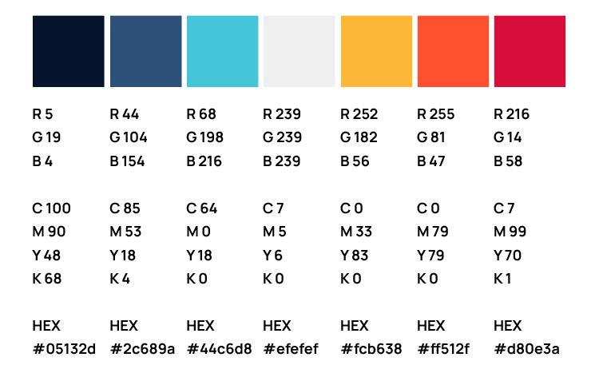


ERCOT IBRWG Industry Updates
Julia Matevosyan, Associate Director and Chief Engineer, ESIG (ERCOT IBRWG chair)
September 18, 2026
ERCOT IBRWG Meeting
Energy Systems Integration Group 2026

Slide 2
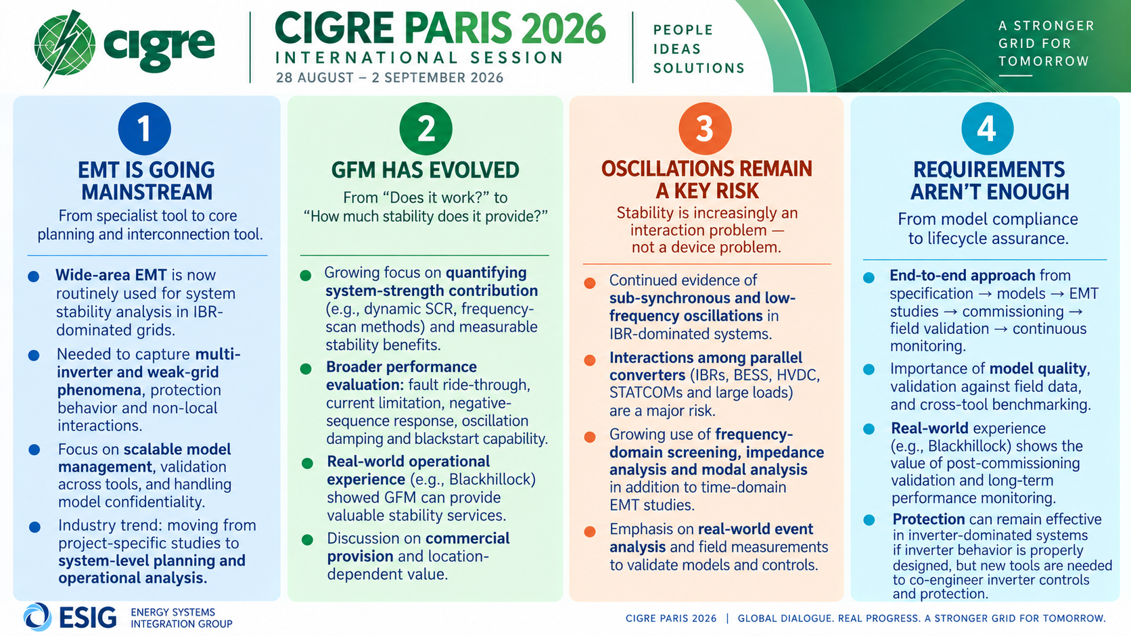

Slide 3


i2X Studies, Tools, and Interconnection Consistency and Harmonization
Automation and Data Harmonization
i2X STITCH| 08/18/2026
A DOE initiative supported by the Office of Critical Minerals and Energy Innovation (CMEI)

Slide 4

Key Goals and Outcomes from i2X STITCH
To advance interconnection study practices across U.S. regions by identifying opportunities for harmonization, standardization, and automation to improve the speed, transparency, and reliability of generation and storage interconnections.
The Forum will convene the industry stakeholders and synthesize insights from meetings into a technical whitepaper that defines actionable pathways for consistent and efficient interconnection study processes nationwide.
The presentation portion of these meetings will be recorded and posted, and presentation slides will be shared.
Regional study processes, challenges and gaps, recommended practices and harmonization opportunities will be summarized in the whitepaper, published by the end of the meeting series, in February 2027
Notes:
[DOE]

Slide 5
i2X STITCH August 18th Automation and Data Harmonization – Agenda
Meeting Introduction: Julia Matevosyan, ESIG
Automating MISO Interconnection Studies with SUGAR: David Bromberg, Pearl Street Technologies and Alyssa Hickey, MISO
Streamlining PJM Interconnection Processing with Tapestry: AJ Lambert, PJM and Cat Wong, Tapestry
Automating Interconnection Decision-Making with Nira: Jenny Erwin, Senior Director, Customer Engagement and Shawn Welch, Vice President, Interconnection & Transmission, Doral
Audience Q&A and Discussion, led by Julia Matevosyan, ESIG & Sirisha Tanneeru, Elevate Energy Consulting
Follow ESIG i2X STITCH website: https://www.esig.energy/i2x-initiatives/#i2x-STITCH for meeting materials & recordings and for future meeting details, agendas, and to register!

Slide 6
i2X STITCH Meetings – Preliminary Agenda
May 26th, 2026, 11 a.m.- 1 p.m. ET: Kick-Off Meeting
June 23rd, 2026, 11 a.m.- 1 p.m. ET: Regional Study Process (MISO, ERCOT)
July 28th, 2026, 11 a.m.- 1 p.m. ET: Regional Study Process Cont. (CAISO, WECC utility)
August 18th, 2026, 11 a.m.- 1 p.m. ET: Automation and Data Harmonization
September 22nd, 2026, 11 a.m.- 1 p.m. ET: Regional Study Process Cont. (SPP, PJM)
October 20th, 2026, 11 a.m.- 1 p.m. ET: Regional Study Process Cont. (NYISO, ISO-NE, non-ISO utility)
November 17th, 2026, 11 a.m.- 1 p.m. ET: Industry Advisor Perspectives and Other Topics
January 26th, 2026, 11 a.m.- 1 p.m. ET: Final Paper Presentation
March 22nd, 2026, hybrid 1-day event during ESIG Spring Workshop, San Diego, California: Interconnection Studies and Harmonization Workshop
Follow ESIG i2X STITCH website: https://www.esig.energy/i2x-initiatives/#i2x-STITCH for meeting materials & recordings and for future meeting details, agendas, and to register!

Slide 7
i2X STITCH September 22nd Regional Meeting SPP & PJM – Agenda
Meeting Introduction: Julia Matevosyan, ESIG
PJM Interconnection Study Process: Edmund Franks, PJM
Developer Perspective on PJM Interconnection Study Process: Michael Russ, Strata Clean Energy
SPP Interconnection Study Process: Caitlin Shank, SPP
Developer Perspective on SPP Interconnection Study Process: Anuj Dixit, Treaty Oak Clean Energy
Audience Q&A and Discussion, led by Julia Matevosyan, ESIG & Sirisha Tanneeru, Elevate Energy Consulting
Follow ESIG i2X STITCH website: https://www.esig.energy/i2x-initiatives/#i2x-STITCH for meeting materials & recordings and for future meeting details, agendas, and to register!

Slide 8
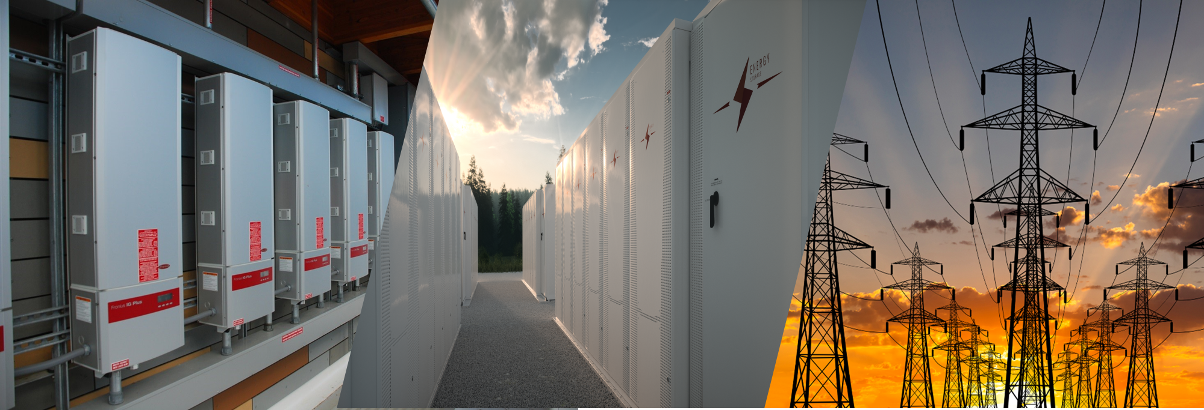


Forum for the Implementation of Reliability Standards for Transmission (i2X FIRST)| 10/28/26
A DOE initiative supported by the Office of Critical Minerals and Energy Innovation (CMEI)

Slide 9
Key Goals and Outcomes from i2X FIRST
To facilitate understanding and adoption of new and recently updated standards relevant for existing and newly interconnecting inverter-based resources.
The Forum will convene the industry stakeholders to enable practical and more harmonized implementation of these interconnection standards.
The presentation portion of the meeting will be recorded and posted, and presentation slides will be shared.
Additionally, the leadership team will produce a summary of each meeting capturing:
Recommended best practices
Challenges
Gaps that require future work
Notes:
[DOE]

Slide 10
I2x FIRST, October 28th, Implementing IEEE 2800.2 Recommended Practice for Test and Verification Procedures for IBRs
Hybrid i2x FIRST meeting during ESIG Fall Technical Workshop, Reston, VA, October 26-29
Meeting Introduction: Julia Matevosyan, ESIG
IEEE2800.2 Background: Andy Hoke, NLR
Navigating IEEE 2800.2-2026 Recommended Practices for Inverter-Based Resource Integration: Ryan Quint, Elevate Energy Consulting
IEEE 2800.2 Implementation, IBR Developer Perspective: Mohamed El Khatib, Invenergy
IEEE 2800.2: OEM Readiness & Challenges Ahead: Miguel Campos, Vestas
IEEE 2800.2 Implementation, ISO Perspective: Fred Huang, ERCOT
Audience Q&A and Discussion, led by Andy Hoke, NLR
Follow ESIG i2X FIRST website: https://www.esig.energy/i2x-initiatives/#i2X-Season-3 for meeting materials & recordings and for future meeting details, agendas, and to register!

Slide 11
i2X FIRST, Season 3 Meetings – Preliminary Topics
June 4, 2026, 11 a.m. - 1 p.m. ET: Deep Dive NERC PRC-029 Implementation Updates
August 6, 2026, 11 a.m.- 1 p.m. ET: NERC Milestone 4 Projects and NERC Project 2022-04 EMT Modeling
October 2026 hybrid session during ESIG Fall Technical Workshop – Implementing IEEE 2800.2 Recommended Practice for Test and Verification Procedures for IBRs
January 14, 2027: IEEE 2800 Updates Session
Follow ESIG i2X FIRST website: https://www.esig.energy/i2x-initiatives/#i2X-Season-3 for meeting materials & recordings and for future meeting details, agendas, and to register!

Slide 12

i2X Technical Assistance Hours
i2x Technical Assistance Hours – provide technical assistance to interconnection stakeholders focused on adoption of a harmonized and/or comprehensive interconnection requirements or standards. One-one sessions with ESIG and Elevate Energy Consulting staff for key interconnection stakeholders.
https://www.esig.energy/i2x-initiatives/#Office-Hours

Slide 13

ESIG Fall Technical Workshop
Monday, October 26:
​8:00 am – 5:00 pm: Oscillations Workshop
Opening Session
Preventive analysis and actions to minimize oscillations
Monitoring, detection, and management of oscillations in real time
Oscillation root-cause analysis and mitigation
Tuesday, October 27 to Thursday October 29:
8:30 am – 5:30 pm: Technical Workshop
Topics of Interest to ERCOT IBRWG:
Grid Forming Performance and Modeling Requirements Practical Implementation
From Standard to Practice: Implementing IEEE 2800.2 Recommended Practice for Test and Verification Procedures for IBRs (i2x FIRST Session, available virtually)
Lessons Learned from Integrating High Shares of Wind and Solar in Large Island Grids
https://www.esig.energy/event/2026-fall-technical-workshop/

Slide 14
Electromagnetic Transient Training
Energy Systems Integration Group 2026
October 6-8th, 2026
Venue
Donated by The Texas Reliability Entity:
8000 Metropolis Drive
Building A Suite 300
Austin, TX 78744
This 3-day in-person training is intended to enhance the knowledge and ability of the current workforce through coursework focused on performing EMT simulations in the current interconnection and planning paradigm. Training participants will learn practical methods and best practices that can be leveraged into enhanced study practices across the industry. These training modules will focus on the expected day-to-day needs of engineers performing EMT analysis as well as managing EMT study practices within their organization.
Topics
Focusing on IBR and EMT study fundamentals with introductions to design evaluation, model quality and testing and special studies. An example agenda is posted on the EMT Training event page on the ESIG website.
Accommodations
Multiple hotel blocks available. Additional details available on the EMT Training event page on the ESIG website
Materials from Fall 2025 Course Here
Explore the Event Page Here
Explore Here
Thanks to Texas Reliability Entity for hosting at their facilities!

Slide 15
Advanced EMT Training
Energy Systems Integration Group 2026
November 10th-12th, 2026
Venue
Donated by The New England Independent System Operator: ISO New England
55 Helmsford Way
Windsor, Connecticut 06095
This training is intended to expand upon the material and concepts presented in the ESIG EMT Fundamentals training. The coursework will provide deeper dive into special studies, focusing on issues such as modeling complex IBR plants, control interactions between multiple generation resources on the network or within a specific plant, sub-synchronous resonance issues, and other advanced topics necessary to move the paradigm forward. These topic areas, as a starting point in the training, will provide holistic view of EMT modeling in the new study paradigm and this knowledge will be used as a basis to tackle practical topics like ensuring design evaluation changes are implemented through pre-commissioning checks and model verification, commissioning best practices, and post-commissioning model validation based on actual event data.
Topics
Focusing on IBR controls and EMT special studies, an example agenda is posted on the Advanced EMT Training event page on the ESIG website.
Accommodations
Multiple hotel blocks available. Additional details available on the Advanced EMT Training event page on the ESIG website
Explore the Event Page Here
Thanks to ISO-NE for hosting at their facilities!

Slide 16

julia@esig.energy

