Slide 1
Comprehensive Transmission Planning and Batch 1+
LLWG Update
Sept 16, 2026

Slide 2
Future process: Initial view on scope and potential high-level CTP design
Single source of truth
Integrated batch process
Consolidated modeling and reliability study
Streamlined endorsement
Data inputs
Batch study
Modeling
Reliability study
Endorsement
ILLE large load data
Large load data (from TSPs)
Batch model build
Batch study
Commit-ment window
Post commitment & CTP Year N Model
CTP assessment
Final model snapshot
Actionable Trans. Plan
Endorsed Trans. Plan
TPL¹
SC²
Dynamic
RPG-like analysis
RIOO
Gen. data
Economic
TSP engagement
MOD, TPIT
Topology
data
Stakeholder engagement and public comment (e.g., via monthly updates, to define stakeholder gates)
Key Design Change:
Post-commitment in Batch Zero proceeds to Batch Refinement Study/RPG
Post commitment in Batch 1+ feeds into full Planning Studies
Base Load Economic Forecast, TSP RFI
Remaining
load data
(medium, economic)
TPL and Alternative Project Analytics
Short circuit

Slide 3
Future process – Overall CTP scope: Starting point for ERCOT
Integrate batch process, streamline modeling and planning processes, and define clear governance handoffs
Scope for Comprehensive Transmission Planning Process development
Batch-CTP integration
Define the future role of Batch within the annual planning cycle
Determine the technical study required to support Large Load commitment decisions
Design the transition from Batch study outputs to the CTP planning process
Modeling and planning
Establish a planning-led source of truth for planning models and assumptions
Develop a standardized planning model framework and taxonomy
Standardize planning cases, assumptions, and study methodology
Clarify ERCOT and TSP responsibilities for case development, model conditioning, and study execution
TSP/stakeholder process and governance
Define the stakeholder engagement and endorsement process for CTP
Clarify ERCOT and TSP roles in project identification and solution development
Establish governance, milestones, and response timelines for transmission plan development

Slide 4
Future process – Batch 1+: Starting point for ERCOT
Initial Batch 1+ Revision Requests priorities span four focus areas to continue advancing the Large Load framework
Initial ERCOT priorities for Revision Request development
Large Load Interconnection
Develop ILLE-TSP-ERCOT interaction process for Batch Studies
Establish a framework for resubmitting unmet Large Load ramp requests across Batches
Define carry-forward treatment for non-committed Large Loads across Batch cycles
Establish a governance framework for post-study project changes (e.g., delayed in-service date or end-use technology changes)
Eligibility
Refine the financial security methodology for transmission upgrades and direct interconnection costs to align with PUCT changes in 58481.
Study frameworks
Modernize Batch study scope, responsibilities, and model governance
    Short circuit studies
    SSO studies
    Dynamic model change evaluation
Market rules & operational enhancements
Enhance Large Load reporting and confidentiality provisions
Enhance Bring Your Own Generation (BYOG) framework
Enhance the Provisional Controllable Load Resource (PCLR) framework

Slide 5
Over the last few weeks, we have conducted TSP interviews and first workshop (Aug 31)
Initial process design & TSP interviews
Initial NPRR/PGRR draft package
Board consideration and transition
Stakeholder workshops
ERCOT scoped the early process design and completed initial TSP touchpoints
ERCOT engages TSPs and stakeholders to understand preferences and pain points in depth
Draft rule package released for stakeholder review; full engagement sessions continue
TAC and Board consider the package for approval; ERCOT transitions to the new CTP process

Slide 6
Stakeholder roadmap: Path to Batch 1+ and CTP Board approval
Stakeholder engagement
Meeting
Targeted date
2026
2027
Q3
Q4
Q1
Q2
Forums
Objective
Jul
Aug
Sep
Oct
Nov
Dec
Jan
Feb
Mar
Apr
Workshops and working groups
Interview TSP planning staff on CTP scope
July 16 – late August
Conduct stakeholder workshops on CTP process design and Batch 1+
Draft scope from ERCOT
Workshop 1 8/31
Further scoping details discussion
Workshop 2 9/24
Details of design elements discussion
Workshop 3 10/14
Review Revision Requests and market comments
Workshop 4 11/9
Workshop 5 12/2
PRS
Engage with Protocol Revisions Subcommittee on NPRR(s)
PRS 10/14
PRS 11/11
PRS 12/9
PRS 1/12
PRS 2/16
PRS 3/10
PRS 4/14
Specific sessions to be selected for updates
ROS
Engage with Reliability and Operations Subcommittee engagement on PGRR(s)
ROS 10/1
ROS 11/5
ROS 12/3
ROS 1/7
ROS 2/4
ROS 3/4
ROS 4/8
LLWG
Engage with Large Load Working Group on Batch 1+
LLWG 8/21
LLWG 9/17
LLWG 10/15
LLWG 11/19
LLWG 12/17
TAC
Review/endorse combined NPRR/PGRR package for Board approval
TAC 7/29
TAC 8/28
TAC 10/28
TAC 11/18
TAC 1/20
TAC 2/24
TAC 3/24
TAC 4/28
PUCT OM
Provide updates to Commission on progress/emerging policy considerations
As needed
ERCOT Board
Formally present CTP and Batch 1 PGRRs/NPRRs for approval
Board 12/7-8
Board 2/8-9
Board 4/12-13
7/8 ERCOT market notice
11/1 File initial Revision Requests
March TAC approval
April Board approval

Slide 7
TSP engagement summary to date
  Following the market notice on July 8, 2026, ERCOT has engaged TSPs on the CTP scope
  From July 16 through August 19, we have interviewed TSPs individually and in groups on current pain points and intended future design features of the CTP
  Gain understanding of new ideas and feasible planning changes
  Appendix contains 4 slides of feedback
27
TSPs engaged
21
sessions held

Slide 8
ERCOT welcomes input on design choices across the process
Data inputs
Batch study
Modeling
Reliability study
Endorsement
ILLE submitting large load request
Large load data (from TSPs)
Batch model build
Batch study
Commit-ment window
Post commitment CTP Year N Model
CTP assessment
Final model snapshot
Actionable Trans. Plan
Endorsed Trans. Plan
TPL¹
SC²
Dynamic
RPG-like analysis
RIOO
Gen. data
Economic
TSP engagement
TSP engagement
MOD, TPIT
Topology
data
Stakeholder engagement and public comment (e.g., via monthly updates, to define stakeholder gates)
Focus of this discussion
Base Load Economic Forecast, TSP RFI
Remaining
load data
(medium, economic)
ERCOT is working to deliver a process that is reliable and seamless.
We welcome your input on design choices and considerations that support this goal
TPL and Alternative Project Analytics
Short circuit
Source: ERCOT Extended Work Sessions for Comprehensive Transmission Planning (6/16, 6/18, 6/23, 6/25, 6/30)

Slide 9
Batch study: Scope history of Batch 1+
Rough Notes on parking deck of 20+ items from Batch Zero discussions
(spreadsheet posted with agenda)
For this first workshop ERCOT provides the rollover of Batch Zero parking deck ideas for the stakeholder process in the posted spreadsheet
However, ERCOT likely cannot address 20+ design element changes in Batch 1+
ERCOT offers its initial set of 12 needed changes for Batch 1+
ERCOT is exploring and will briefly walk-through list in the slides of BYOG/PCLR ideas.
ERCOT is considering how to leverage a survey to “focus stakeholder priorities” for Batch 1+ so that subsequent workshops have a smaller prioritized list of design needs
Appendix contains numerous slides on design options
Other BYOG/PCLR have continued to “be sent in” with some overlap from parking deck
ERCOT has reviewed and proposed an initial set of 12 areas/items to focus on

Slide 10
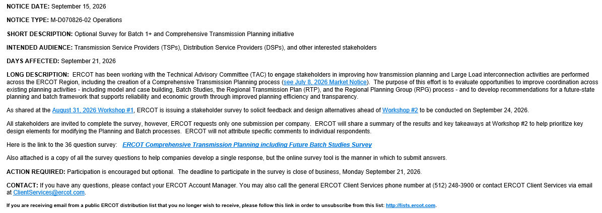
ERCOT has issued CTP/Batch 1+ survey to all Stakeholders
Link for the Sep 15 Market Notice below that contains survey link and PDF version of the survey

Slide 11
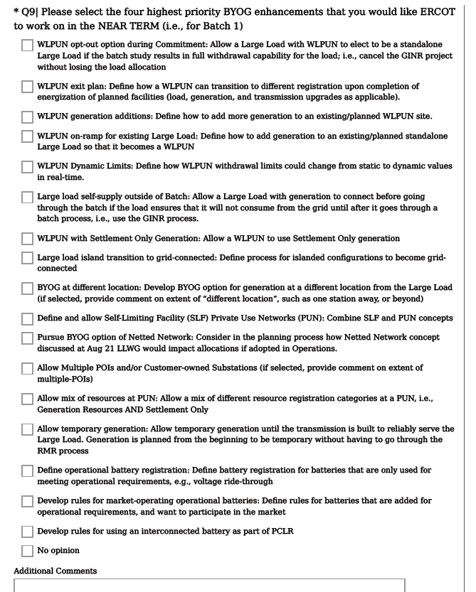
Survey questions for
BYOG/PCLR changes
(select top 4 only)
Survey results will be shared and discussed at next week’s Workshop #2
Workshop Sept 24

Slide 12
Thank you
Q&A

Slide 13
Appendix

Slide 14
Scope issues discussed by ERCOT and TSPs (1/4)
Topic
What we’ve heard
Potential questions to consider
Overall process design
  TSPs want clarity on the large load interconnection process beyond Batch 0, including how Batch 1 will differ
  Most TSPs support efforts to streamline planning and large load interconnection studies, but there is concern about the time/effort required and the pace of implementing process changes
  TSPs are interested in reducing project re-study across planning exercises (e.g., RTP, RPG, and Batch)
  When and how should ERCOT transition to the CTP planning framework?
  How should Batch, RTP, and RPG be sequenced and integrated to avoid project restudy?
  How should ERCOT balance end-to-end process speed against TSPs’ request for a more collaborative process?
Division of responsibilities
  TSPs are interested in leading the development of local solution projects (e.g. Tier 3/4 and neutral projects)
  TSPs are interested in more cross-TSP collaboration via regionally-focused ‘planner-to-planner’ engagements during the CTP process
  TSPs are looking for close, predictable involvement with documented responsibilities on a set schedule for data submissions, project collaboration, and meetings
  What’s the right ERCOT/TSP split for modeling and study responsibilities?
  What is the best engagement model for planning activities between TSPs?

Slide 15
Scope issues discussed by ERCOT and TSPs (2/4)
Topic
What we’ve heard
Potential questions to consider
Batch to CTP integration
  There is open debate on how to handle Batch-identified projects when the committed load behind them later drops out, especially if the project is still seen as necessary
  Should projects tied to loads that commit in Batch move forward as-is, or should they be re-studied in CTP?
Batch process scope
  There is interest in limited upfront TSP screening prior to application (e.g., local physical viability, identification of required interconnection facilities), so considering appropriate activities.
  There is discussion around the role of the Batch study and whether it is primarily an abbreviated screening study, or a mechanism for identifying transmission projects
  How much upfront TSP screening can occur without becoming a parallel review?
  What’s the minimum viable Batch scope, and how should it evolve for Batch 1?

Slide 16
Scope issues discussed by ERCOT and TSPs (3/4)
Topic
What we’ve heard
Potential questions to consider
Load qualification and application
  There is a growing interest in a changing approach for medium load (<75 MW) applications
  There is interest in an ERCOT portal for large loads to submit interconnection requests directly, which could be accessible by TSPs
  There are mixed opinions on whether loads or TSPs should submit load interconnection applications to the ERCOT load portal
  What medium load changes should be considered?
  What are the tradeoffs for customers submitting load applications with ERCOT vs. TSPs?
Case building and creation
  Many TSPs recognize efficiency gains from building a single set of CTP cases to replace current SSWG and RTP cases, but there is debate over who produces them
  Reducing case-building steps (e.g., combining topology and short circuit parameter submission) is a shared priority for several TSPs
  TSPs include transmission projects and loads of varying levels of maturity in case builds; CTP process would benefit from the standardization of case input requirements
  TSPs agree that compliance with CTP data collection deadlines is critical to streamlining the CTP process
  Short-circuit is a critical missing shared case, and discussions continue on ERCOT building a shared model with TSPs providing feedback
  Who should own the shared CTP case set: ERCOT, SSWG, or both?
  Should ERCOT own the short-circuit model, and on what timeline?
  How should data-submission deadlines be enforced?

Slide 17
Scope issues discussed by ERCOT and TSPs (4/4)
Topic
What we’ve heard
Potential questions to consider
Reliability studies
  TSPs support having committed Batch study load feed into the CTP reliability study as firm load and used as the basis for planning
  TSPs believe that when a project has already been analyzed through the RTP (or CTP in the future), that analysis should stand in for the ERCOT Independent Review (‘EIR’), with a brief stakeholder comment period (e.g., ~30 days) vs. a full duplicative re-study
  Future operational risks aren’t surfaced early enough; some want ERCOT to run a system-wide reliability/economic needs assessment at least annually
  Some TSPs want ERCOT to hold firmer EIR turnaround targets so they do not jeopardize customers' in-service timelines
  Should a fixed comment period replace full RPG re-study if the CTP study were to serve as the EIR in some cases?
  How often should ERCOT run system-wide needs assessments?
  How early should operational risks surface so TSPs have time to mitigate them?
Project approval pathways outside of CTP
  There is consideration of a fast-track approval pathway
  There is consensus on retaining legacy RPG elements to enable ongoing approval of certain projects between CTP cycles (e.g., neutral projects, local projects)
  There is debate on the degree to which RPG should be consolidated and included within CTP
  Should ERCOT create a fast-track pathway for certain projects?
  What elements of RPG should be preserved without recreating a parallel process?

Slide 18
Batch study: Initial Batch 1+ Revision Requests priorities span four focus areas to continue advancing the Large Load framework
Initial ERCOT priorities for Revision Request development
Details follow
Large Load Interconnection
Develop ILLE-TSP-ERCOT interaction process for Batch Studies
Establish a framework for resubmitting unmet Large Load ramp requests across Batches
Define carry-forward treatment for non-committed Large Loads across Batch cycles
Establish a governance framework for post-study project changes (e.g., delayed in-service date or end-use technology changes)
Eligibility
Refine the financial security methodology for transmission upgrades and direct interconnection costs to align with PUCT changes in 58481.
Study frameworks
Modernize Batch study scope, responsibilities, and model governance
    Short circuit studies
    SSO studies
    Dynamic model change evaluation
Market rules & operational enhancements
Enhance Large Load reporting and confidentiality provisions
Enhance Bring Your Own Generation (BYOG) framework
Enhance the Provisional Controllable Load Resource (PCLR) framework

Slide 19
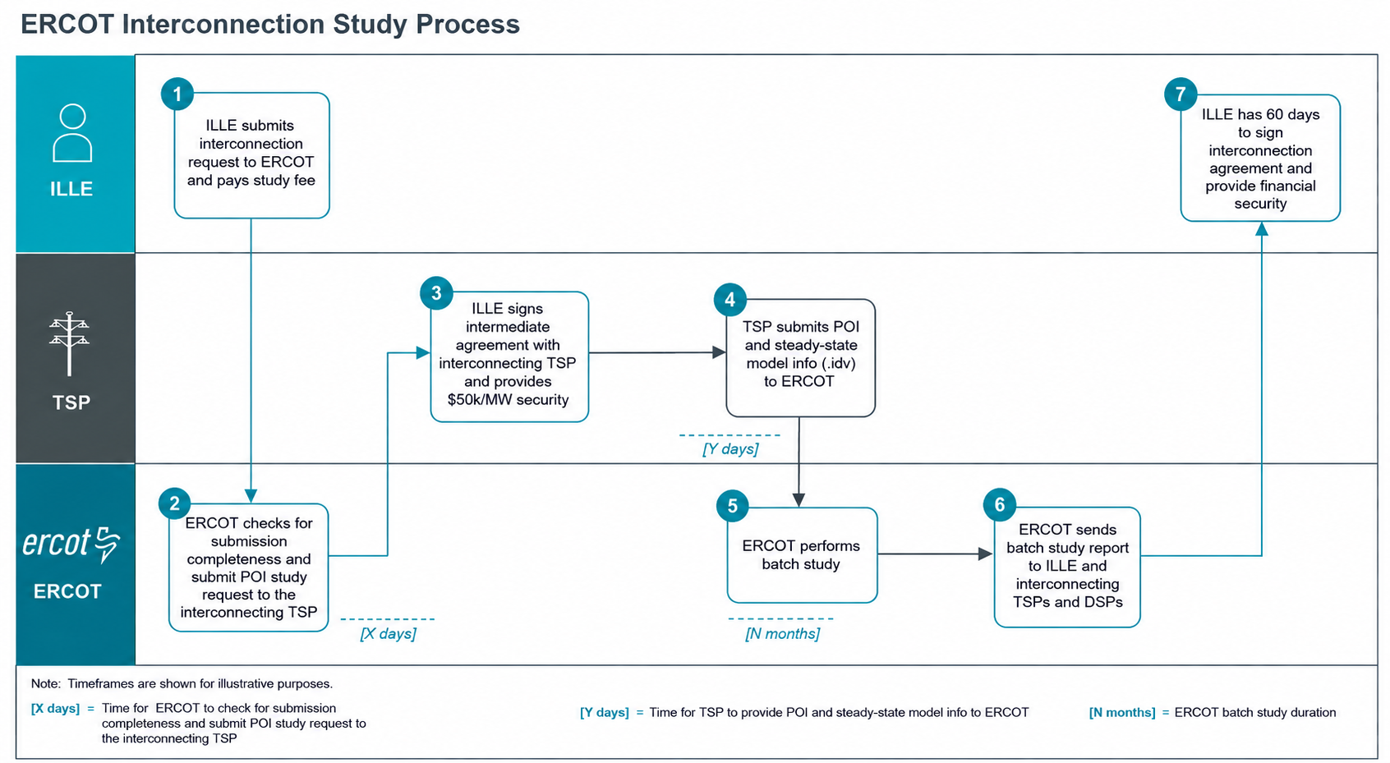
Batch study: Batch study interaction process (strawman)

Slide 20
Batch study: Large Load Batch Tracking Number
When an application is deemed complete, ERCOT will assign a Large Load Batch Tracking Number
Sequential Number for that Batch
Batch Number
XXLLBNNNN
Example: 01LLB0003
Project #3 in Batch 01
20

Slide 21
Batch study: Requesting Study of Unfulfilled Ramp Request
Example: 0NLLB0003
Unfulfilled MW Request
Allocated MWs
2030
2031
2032
Requested, MW
500
1000
1000
Allocated, MW
200
300
1000
Options
A
B
C
Automatic Request in
Batch N+1
ILLE May Request Re-Study in Subsequent Batch
Reallocate during CTP
Adds study time and complexity to the CTP
Adds study time and complexity to Batch N+1 without study payment from ILLE or guarantee ILLE still wants to pursue the additional MWs
ILLE keeps original LLB tracking number

Slide 22
Batch study: Treatment of non-committed large loads in subsequent batches
An ILLE that does not sign an interconnection agreement for a Large Load project in
Batch N may request to be included in Batch N+1:
ILLE must formally request to be included in Batch N+1 by the designated deadline
ILLE must pay the Batch N+1 study fee but the $50k/MW financial security and Intermediate Agreement will carry over
ILLE must not make any material changes to the Large Load, including PCLR and WLPUN election
  Exceptions: ILLE may decrease project size, extend the Initial Energization date, and/or extend the ramp schedule
The project will keep its Large Load Batch (LLB) tracking number
All portal information, including steady state and dynamic models will carry over to Batch N+1

Slide 23
Batch study: Treatment of loads excluded from Batch Zero
Loads excluded from Batch Zero will have the same deadline – they will not receive any “special treatment” in the Batch 1 study itself
Large Loads that received a Batch Zero tracking number (BZ-NNN) that were excluded from Batch Zero may be included in Batch 1 with the following special considerations:
ILLE must formally request to be included in Batch 1 by the designated deadline (same deadline as any new requests)
ERCOT will waive the Batch 1 study fee if the interconnecting TSP/DSP attests that the ILLE has already paid at least $100k in study fees for the project
ILLE must meet all other Batch 1 Study requirements, including Intermediate Agreement and $50k/MW financial security
ILLE must not make any material changes to the Large Load
  Exceptions: ILLE may request PCLR or WLPUN treatment, decrease project size, extend the Initial Energization date, and/or extend the ramp schedule

Slide 24
Batch study: ERCOT is considering potential BYOG enhancements¹ (1/2)
Dimension
Enhancement
Batch study process changes only (maybe – TBD)
Allow a WLPUN to elect to be a standalone Large Load if the batch study results in full withdrawal capability for the load; i.e., cancel the GINR project without losing the load allocation
Define a WLPUN exit plan
Add more generation to an existing/ planned WLPUN site
Add generation to an existing/ planned standalone Large Load so that it becomes a WLPUN
Other WLPUN enhancements
Calculate WLPUN withdrawal limits dynamically in real-time
Allow a Large Load to connect without going through the batch study process if the load will never consume from the grid, i.e., use the GINR process
Allow a WLPUN to use Settlement Only generation
Alternative BYOG options
Define process for islanded configurations to become grid connected
Allow BYOG when generation is at a different location from the Large Load
Allow Self-Limiting Facility (SLF) Private Use Networks (PUN)
1. ERCOT has not yet evaluated the impacts or feasibility of these enhancements and is not sure if any particular enhancement will be available in the future.

Slide 25
Batch study: ERCOT is considering potential BYOG enhancements¹ (2/2)
Dimension
Enhancement
Alternative BYOG options (continued)
Define Netted Network
Develop rules for Multiple POIs and/or Customer Owned Substations
Allow a mix of different resource types at a PUN, i.e., Generation Resources AND Settlement Only
Define process for temporary generation until the transmission is built to reliably serve the Large Load
Battery-related options
Define battery registration for batteries that are only used for meeting operational requirements, e.g., voltage-ride through
Develop rules for batteries that are added for operational requirements that also want to sell Ancillary Services
Develop rules for using a battery at a PCLR
1. ERCOT has not yet evaluated the impacts or feasibility of these enhancements and is not sure if any particular enhancement will be available in the future.

Slide 26
Recent history of transmission planning
Prior to 2020, Planning to committed load, until Permian growth broke the model:
Early-2000s transmission planning centered on generation integration through Competitive Renewable Energy Zones (CREZ), moving energy generated by wind generation from West Texas to load centers
Loads were able to interconnect seamlessly through interconnection requests submitted to TSPs
ERCOT's December 2019 Delaware Basin Load Integration Study found that actual load requests in the Permian Basin far outpaced standard forecasts, prompting a five-stage plan for new 345-kV transmission lines
From 2020-2023, Load growth results in ERCOT pursuing a load-driven transmission planning process:
In March 2022, ERCOT implemented an interim large-load interconnection process for specified loads seeking near-term interconnection. The process was designed to support compliance with NERC requirements, identify required transmission upgrades, and establish any interim reliable load limit pending those upgrades
Following HB 5066’s enactment in 2023, the PUCT was required to direct ERCOT to identify regions where transmission capacity is insufficient for existing and forecasted load and to develop reliability plans
Since 2024, ERCOT has responded to unprecedented load growth driven by computational load growth:
In 2026, ERCOT implemented the PUCT-approved Batch Zero framework under SB 6-related large-load reforms. The process is intended to classify eligible large-load projects and study their collective transmission needs. ERCOT had planned to issue notifications by August 7, 2026, but delayed them after Governor Abbott’s August 3 directive requiring verification and audit of data-center projects before they advance
Separately from Batch Zero, ERCOT’s longer-range transmission planning has evaluated EHV concepts, including potential 765-kV backbone facilities, as one option for accommodating exceptional forecasted load growth

