Slide 1
Project Update
Troy Anderson
ERCOT Portfolio Management
September 16, 2026
Outline:
Recent / Upcoming Project Highlights
2026 Release Targets
Other Project Updates
Priority / Rank Recommendations
Technology Working Group (TWG)
Aging Revision Request Prioritization
Key Takeaways
Monthly project status update for ERCOT Portfolio Management presented to PRS
Covers 2026 release highlights, project updates, priority/rank recommendations, TWG update, and project planning

Slide 2
Project Update Agenda
Recent / Upcoming Project Highlights
2026 Release Targets
Other Project Updates
Priority/Rank Recommendations for Revision Requests with Impacts
    NPRR1317 – Creation of Non-Settled Generator (NSG) and Clarification of the Types, Usage, and Registration of Distributed Generation
Technology Working Group (TWG)
  Next meeting is 9/24/2026
Location of Revision Request Project Information: http://www.ercot.com/services/projects
Notes:
Delete this slide before presenting

Slide 3
Recent / Upcoming Project Highlights
2026 August Release – 8/26/2026-8/27/2026 Complete
  NPRR1290 – Gap Resolutions and Clarifications for the Implementation of RTC+B
  NPRR1323 – Correction to Inadvertent Removal of Real-Time MCPC Capping for NPRR1290 Phase 2
2026 October Release – 10/28/2026-10/29/2026 In Flight
  NPRR1198 – Congestion Mitigation Using Topology Reconfigurations
  NPRR1281 – Improvements to Alternate FFSS Resource Designation
      Used for the first time on Operating Day November 15th when the FFSS contract period begins
2026 November Off-Cycle Release – 11/11/2026 In Flight
  SCR829 – API for the NDCRC Application
2026 December Release – 12/16/2026-12/17/2026 In Flight
  NPRR1201 – Limitations on Resettlement Timeline and Default Uplift Exposure Adjustments
  PGRR127 – Addition of Proposed Generation to the Planning Models
Note: Projected Go-Live dates are subject to change.
Please watch for market notices as the effective dates approach.

Slide 4
2026 Release Targets - Approved NPRRs / SCRs / xGRRs
R1
R3
R5
January 1/28-1/29 | February 2/25-2/26 | March 3/25-3/26 | April 4/29-4/30 | May 5/27-5/28 | June 6/24-6/25
NPRR1234(c) PGRR131 NPRR1283 NPRR1285 NPRR1299 | NPRR1266 NPRR1277 | NPRR1287 Add’l Public Data Products in ERCOT Data Portal | CRR Historical Data Removal | NPRR1265 OBDRR055 | SCR820 PGRR145 NPRR1325
R2
R4
R6
ü
ü
ü
ü
ü
ü
ü
ü
ü
ü
4/24
1/1
ü
ü
3/1
ü
6/1
7/11
ü
ü
2/1
3/2
SCR820 TO/QSE Testing (see TWG meetings)
Cipher Security Upgrades (see TWG meetings)
RTC+B Stabilization
R7
R9
July 7/29-7/30 | August 8/26-8/27 | September 9/30-10/1 | October 10/28-10/29 | 11/11 | December 12/16-12/17
 | NPRR1290 NPRR1323 | NPRR1281 | NPRR1198 NPRR1281 PGRR127 | SCR829 | NPRR1201 PGRR127
R8
R10
R11
ü
ü
E
E
E
P
E
Go-live dates can differ from Protocol effective dates – Please refer to market notices for more details
APPENDIX
Red Text: New additions and target release changes
Strike-Through Text: Previous target release
(a), (b), etc.: Multiple phase release
Project Status Codes
NS = Not Started
I = Initiation
P = Planning
E = Execution
H = On Hold
NPRR1234(c) – RIOO changes for End-Use
Industry Classification to Loads
Release targets are subject to change

Slide 5
Other Project Updates
NPRR936 – CRR Account Holder Limits – and –
NPRR1288 – Remove Multiple Month Transactions in CRR Auctions
  Go-live target = 2027 R2 (February)
NPRR1188 – Implement Nodal Dispatch and Energy Settlement for Controllable Load Resources – and – NPRR1244 – Clarification of Controllable Load Resource Primary Frequency Response Responsibilities
  Go-live target = 2027 R1 (January)
NPRR1238 – Voluntary Registration of Loads with Curtailable Load Capabilities
  Part of Large Load Curtailment Manager project
  Initial implementation in June 2026, full scope by end of 2026
  NPRR1238 portion expected to go-live late in 2026
NPRR1309 – Board Priority - Dispatchable Reliability Reserve Service Ancillary Service (DRRS)
  PUCT approved on 7/9/2026 – Project started in July 2026
NPRR1328 – Establishment of Generation Firming Program
  Pending PUCT approval
  Project began administrative activities in July 2026 – necessary to meet December 2027 go-live requirement
NPRR826 – Mitigated Offer Caps for RMR Resources – and –
NPRR1342 – Mitigated Offer Caps for Contract for Capacity Resources
  Working to get this project started soon
  Potential mid-2027 go-live
NPRR1004 – Load Distribution Factor Process Update
  Project started in early September 2026 – target go-live is TBD

Slide 6
Priority / Rank Recommendations for Revision Requests with Impacts
Recommendations for…
Revision Request | Description | Priority | Rank | Comments
NPRR1317 | Creation of Non-Settled Generator (NSG) and Clarification of the Types, Usage, and Registration of Distributed Generation | TBD | TBD | $400k-$600k, 8-12 months Impacted Systems: RIOO, MMS, EMS
PPL Rank Information
Next 2026 Rank in Business Strategy = 4850 Next 2029 Rank in Business Strategy = 5300
Next 2027 Rank in Business Strategy = 4940 Next Rank in Regulatory = 450
Next 2028 Rank in Business Strategy = 5120

Slide 7
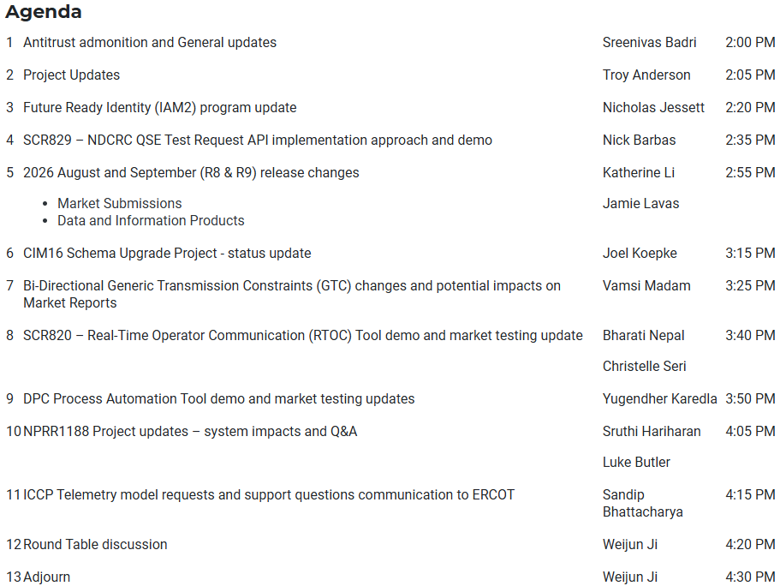
Technology Working Group (TWG) - 8/20/2026 Meeting
Next TWG scheduled for 9/24/2026

Slide 8
2026 Project Planning
ERCOT understands that Market Participants need lead time to implement changes in their systems for many Revision Requests
Approved Revision Request Project Starts
  NPRR936 – CRR Account Holder Limits
  NPRR1004 – Load Distribution Factor Process Update
  NPRR1188 – Implement Nodal Dispatch and Energy Settlement for Controllable Load Resources
  NPRR1198 – Congestion Mitigation Using Topology Reconfigurations
  NPRR1201 – Limitations on Resettlement Timeline & Default Uplift Exposure Adj
  NPRR1238 – Voluntary Registration of Loads with Curtailable Load Capabilities
  NPRR1244 – Clarification of CLR Primary Frequency Response Responsibilities
  NPRR1277 – Revisions to EAL Formula
  NPRR1281 – Improvements to Alternate FFSS Resource Designation
  NPRR1288 – Remove Multiple Month Transactions in CRR Auctions
  NPRR1290 Phase 2 – Gap Resolutions and Clarifications for RTC+B + NPRR1323
  NPRR1309 – Board Priority - Dispatchable Reliability Reserve Service Ancillary Service (DRRS)
  NPRR1323 – Correction to Inadvertent Removal of Real-Time MCPC Capping for NPRR1290 Phase 2
  SCR829 – API for the NDCRC Application
Revision Request Projects with Starts Delayed to Early 2027
  SCR818 Phase 2 – Changes to Incorporate GIC Modeling Data into Existing Modeling Applications
  SCR831 – Short Circuit Model Integration
Other priority Review Request projects may start in 2026 with a future year Go-Live
  Residential Demand (NPRR1296), Establishment of Generation Firming Program (NPRR1328)
Green Text: Deemed “High Priority” at 2025 Prioritization Workshop

Slide 9
Questions/Comments?
Troy.Anderson@ercot.com

