Slide 1
ERCOT Frequency Events
August 2026
ERCOT
Operations Planning
PDCWG Meeting
September 16, 2026

Slide 2
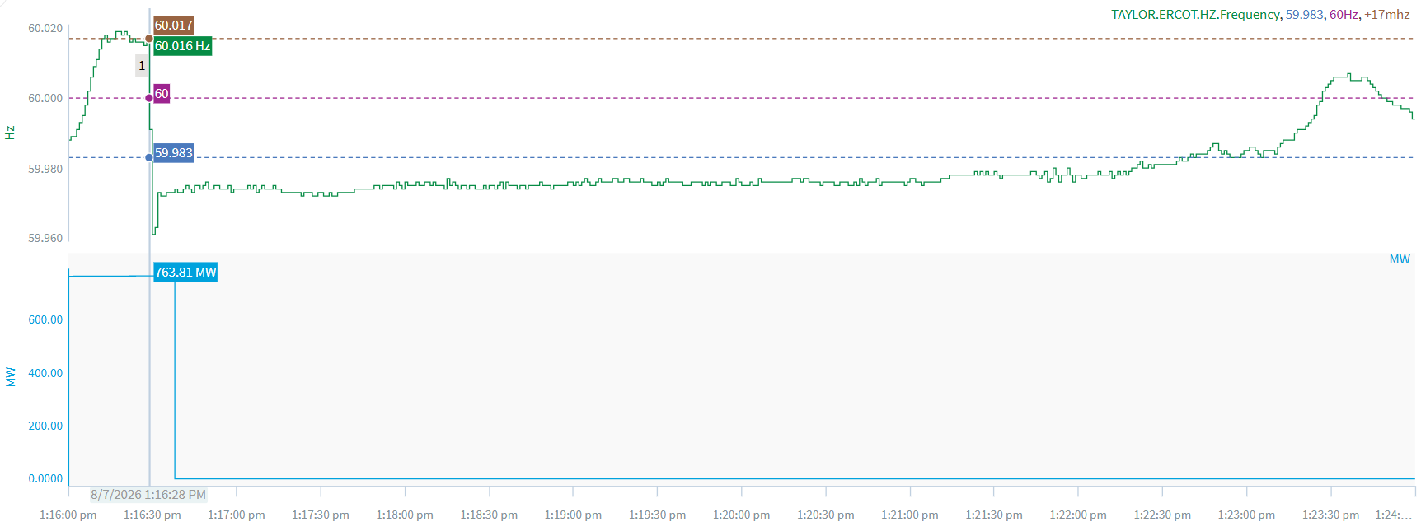
8/7/2026 13:16:28 (FME)
Notes:
A unit tripped offline for ~757 MW
Starting Frequency: 60.016 Hz
Minimum Frequency: 59.961 Hz
A-C Time : 2 seconds
Recovery Time(back to deadband): 6 minutes 11 seconds
Trip Reason: Unknown at this time.
Contextual Information: A total of 287 MW of regulation Up and manual offset of 400 were deployed during the event.

Slide 3
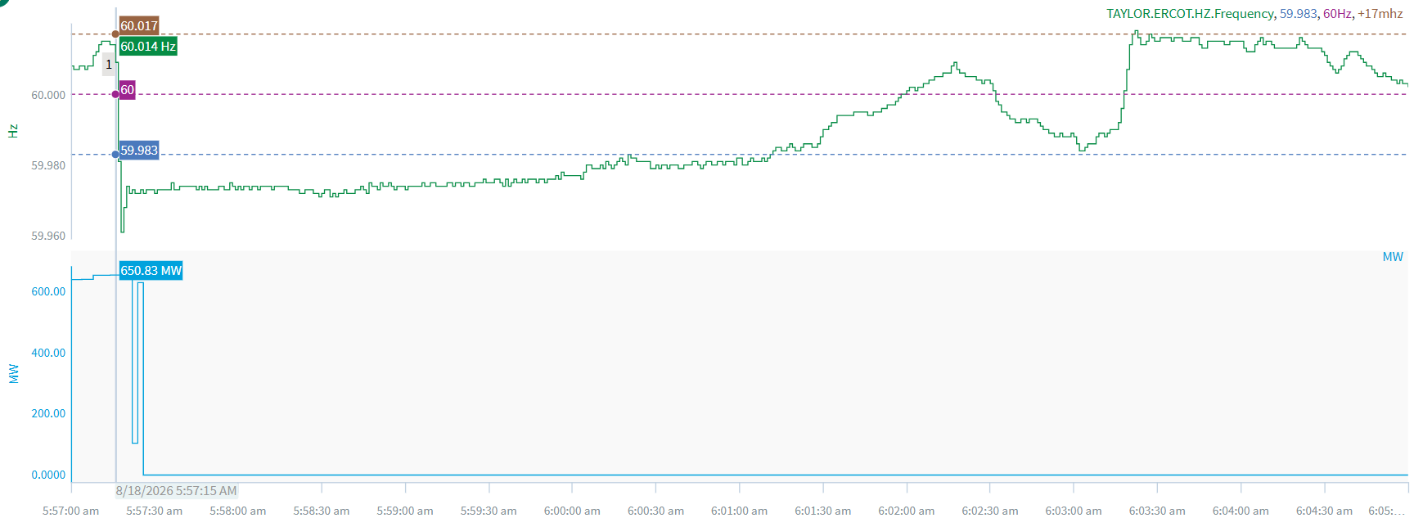
8/18/2026 5:57:15 (Non-FME)
Notes:
A unit tripped offline for ~626 MW
Starting Frequency: 60.014 Hz
Minimum Frequency: 59.961 Hz
A-C Time : 3 seconds
Recovery Time(back to deadband): 3 minutes 56 seconds
Trip Reason: Unknown at this time.
Contextual Information: A total of 296 MW of regulation Up was deployed during the event.
Reason for no selection: A-B frequency too small

Slide 4
Questions/Comments?

