Slide 1
ERCOT Telemetry Review & Common Issues
Luis Gonzalez
Engineer, Resource Integration
August 26, 2026
Outline:
Telemetry Sign Conventions
MW/MVAr Flow Direction Examples
DESR/DGR Telemetry
Multiple Units per MPT
Virtual Breakers
This document intends to help Resource Entities and Qualified Scheduling Entities understand ERCOT’s telemetry for Commissioning of Resources by illustrating some common areas where lack of visibility into ERCOT systems may cause confusion. No part of this document is intended to instruct how precisely telemetry should be measured or calculated.
Refer to governing documents (Nodal Protocols, Planning Guide, ICCP Handbook, Nodal Operating Guide) for requirements.

Slide 2
Telemetry – Sign Convention
Generally, for 2-terminal devices:
flow into the device is positive
For equipment with only unidirectional positive or negative flow, values should telemeter as positive, down to positive or negative 0.
Equipment | + | -
Line | MW/MVAr into terminal of line from the gen site | MW/MVAr out from the grid into terminal of line
Transformer High-Side | MW/MVAr from grid into high-voltage terminal of the transformer | MW/MVAr out from the high-voltage terminal of the transformer toward grid
Load | Consuming MW/MVAr | N/A
Unit | MWs always positive Exporting MVAr | Absorbing MVAr
ESR | Discharging MW Exporting MVAr | Charging MW Absorbing MVAr
Capacitor | Exporting MVAr | N/A
Reactor | N/A | Absorbing MVAr
Dynamic Reactive Devices | Exporting MVAr | Absorbing MVAr
+
-
-
+
+
+
+
-
-
+
-

Slide 3

Transmission-Connected ESR
Four-Quadrant Flow Directions
P
Q
DIRECTION OF POWER FLOW
Line
+100 MW
+43 MVAr
+100 MW
-43 MVAr
-105 MW
+43 MVAr
-105 MW
-43 MVAr
Transformer Hi-Side
-100 MW
-43 MVAr
-100 MW
+44 MVAr
+105 MW
-43 MVAr
+105 MW
+43 MVAr
+103 MW
+59 MVAr
+103 MW
-28 MVAr
-103 MW
+59 MVAr
-103 MW
-28 MVAr
Discharging ESR
Lagging
Discharging ESR
Leading
Charging ESR
Lagging
Charging ESR
Leading
These two quadrants also describe Generation Resources

Slide 4
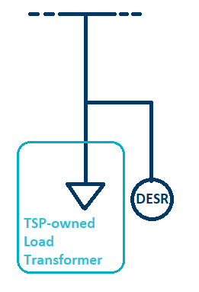
DGR/DESR Telemetry
In the ERCOT Operations Model, DESR/DGRs are modeled in parallel with a load point representing the TSP’s Load Transformer
But physically, the DESR/DGR is connected at a distribution level on the low-side of the TSP’s Transformer. DESR and the associated Load point telemetry should reflect the physical configuration as shown here
Please note this is not how DGR/DESRs appear in the ERCOT Operations Model
DGR/DESR Gross and Net MW/MVAr telemetry values should be identical
because the Point of Common Coupling on the low-side of the TSP’s transformer

Slide 5
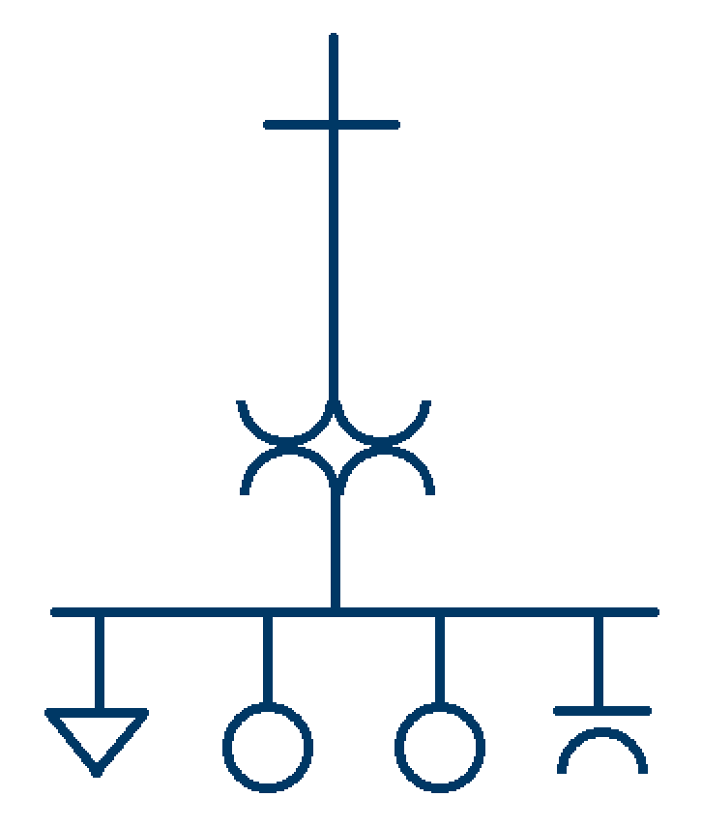
Multiple Units/Single MPT
Typical method for evaluation of power balance of gross equipment values vs. Transformer high-side values for reasonability:
(UNIT1 GMW) + (UNIT2 GMW) – (LOAD1 MW) – (Transformer Losses) ~= -1*(MPT1 MW)
(UNIT1 GMVAr) + (UNIT2 GMVAr) – (LOAD1 MVAr) – (Transformer Losses) + (Shunt MVAr) ~= -1*(MPT1 MVAr)
UNIT1 Net MW + UNIT2 Net MW typically line up with Transformer High-Side Values
UNIT1 Net MVAr + UNIT2 Net MVAr + Shunt Device MVAr typically line up with Transformer High-Side Values
Transmission-connected Resource net values are often measured at the high side of a Unit’s MPT
Potentially describe this in a less formulaic way:
(UNIT1 GMW) + (UNIT2 GMW) – (LOAD1 MW) – (Transformer Losses) ~= -1*(MPT1 MW)
(UNIT1 GMV) + (UNIT2 GMV) – (LOAD1 MVAr) – (Transformer Losses) + (Shunt MVAr) ~= -1*(MPT1 MVAr)
Additional equipment behind the same MPT can make telemetering logic more complex
MPT1
Shunt Device MVAr should not be combined into Unit Net MVAr values
+
+
+
+
(Positive sign-convention flow direction shown)
LOAD1
UNIT1
UNIT2
CAP1
IRRs might telemeter 0 MW while generating and may have a positive value when backfeeding (when P=0)
When multiple Units are behind the same MPT, the RE/QSE determines how best to calculate/represent the net output of each Unit
  Gross values can be a basis for prorating net values
  Owners of jointly-owned equipment might have different QSEs. One QSE will provide telemetry for the jointly-owned equipment.

Slide 6
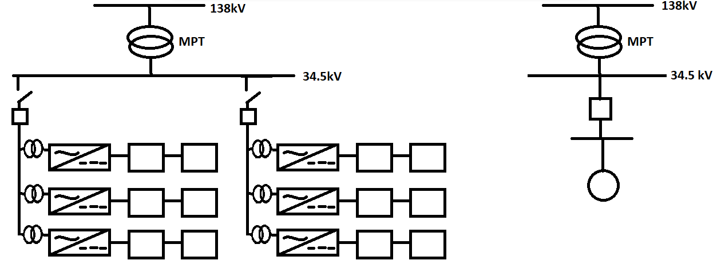
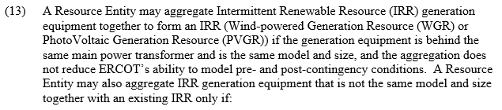
Virtual Breakers
52-F1
52-F2
VIRTUAL_BKR1
DC
DC
DC
DC
UNIT1
DC
DC
DC
DC
DC
DC
DC
DC
In ERCOT’s Operations Model, a collector system is collapsed down into a single Resource* as shown on the right, and the feeder breakers are collapsed down into a Virtual Breaker or Pseudo-Breaker representing the Online/Offline status of the Resource.
*IRR Inverter/Turbine Aggregation: Nodal Protocols 3.10.7.2(13)

Slide 7
Virtual Breakers
52-F1
52-F2
VIRTUAL_BKR1
DC
DC
DC
DC
UNIT1
DC
DC
DC
DC
DC
DC
DC
DC
Here, breakers 52-F1 and 52-F2 are equivalized into VIRTUAL_BKR1
Using a logical OR condition in this example would make the most sense:
  if either 52-F1 OR 52-F2 is CLOSED, VIRTUAL_BKR1 = CLOSED
  Resource is online at reduced capacity if some (not all) of the feeder breakers are OPEN
  If 52-F1 AND 52-F2 are OPEN, VIRTUAL_BKR1 = OPEN

Slide 8
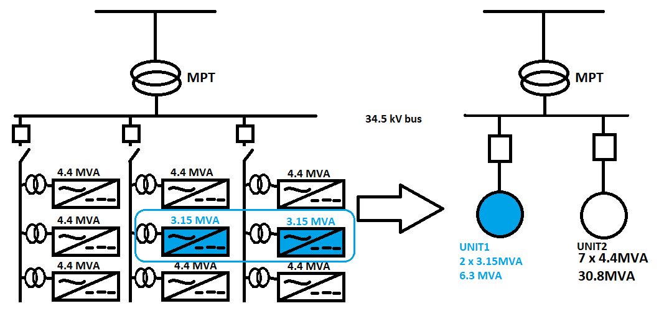
Virtual Breakers
Logic may be more complex:
Different models of inverters/turbines on the same feeders but aggregated into different Resources for not meeting aggregation conditions of NP 3.10.7.2 (13):
Using logical OR for the Virtual Breaker status no longer works
When the equipment comprising a Resource is connected to the medium-voltage bus and therefore the grid, the appropriate Resource Virtual Breaker status is CLOSED
Feeders dedicated to serving only auxiliary load would reasonably be excluded from logical conditions for Virtual Breaker status
Inverter/Turbine Aggregation: Nodal Protocols 3.10.7.2(13)

Slide 9
Questions/Comments?
Luis.Gonzalez@ercot.com
ResourceIntegrationDepartment@ercot.com

