Slide 1
Actions Following an Apparent Ride-Through Failure
Mario A. de la Garza
August 27, 2026
Outline:
Nodal Operating Guide Section 2.13(1), (3) - (5)
Nodal Operating Guide Section 2.13(6)

Slide 2
NOG Section 2.13 (1), (3), (5)
NOG §§ 2.13(1)
NOG §§ 2.6.2.1, 2.9.1 contain ride-through performance criteria (“Required Criteria”)
For Resources with approved exemption or extension, maximum ride-through capabilities submitted to ERCOT are requirement for compliance purposes
Resources must strive to meet or exceed Required Criteria to fullest extent equipment allows
NOG §§ 2.13(3)
If Resource fails to ride-through event based on its maximized capabilities, RE must:
  Investigate Apparent Performance Failure (APF)
  Report to ERCOT the APF’s cause
  Perform model validation and report results to ERCOT
NOG §§ 2.13(5)
RE for Resource with APF, RE must:
  Develop plan to ensure Resource meets applicable ride-through requirements (maximized or Required Criteria)
  Submit plan to ERCOT for approval w/n 90 days
  If ERCOT approves plan, implement it w/n 180 days (unless ERCOT approves longer timeline)
Key Takeaway: ERCOT needs maximized Resource-specific ride-through capabilities

Slide 3
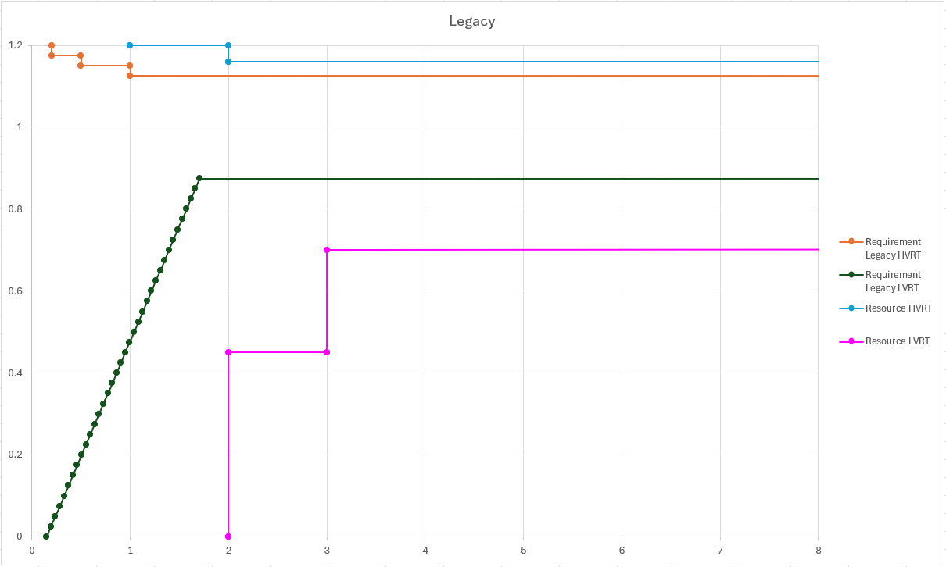
NOG Section 2.13 (6)
To encourage Resources to maximize equipment FRT/VRT parameters to maximum level equipment allows and new Resources to design equipment to use inverter or converter capabilities to fullest extent, any APF where system conditions at POIB exceeded Required Criteria but were below maximized FRT/VRT capabilities shall be reported to ERM only if RE does not fully meet (3) and (5) above
Key Takeaway: If Resource does not ride-through in area between Required Criteria and maximized capability RE meets requirements in NOG $§$2.13 (3) and (5), ERCOT will not report RE to ERM

Slide 4
Questions/Comments?
Mario.delaGarza@ercot.com

