Slide 1
Monthly Review of Reliability Unit Commitment Market Impacts – July 2026
Wholesale Market Working Group
ERCOT Market Analysis
August 2026

Slide 2
RUC Resource-Hours
July 2026 | Total | Capacity |  | Congestion
 |  | Opt-Out | Non-Opt-Out | Opt-Out | Non-Opt-Out
Instructed Resource-Hours
Total Count | 439.0 | 17.0 | 369.0 | 5.0 | 48.0
Effective Resource-Hours*
Total Count | 422.4 | 17.0 | 358.2 | 5.0 | 42.3
Average Megawatts (MW) for Effective Resource-Hours
Average LSL | 47.2 | 90.8 | 43.8 | 71.0 | 56.0
Average LDL | 54.0 | 113.8 | 49.3 | 122.9 | 61.9
Average BP | 57.2 | 157.0 | 50.4 | 144.3 | 63.9
Average HSL | 190.8 | 196.0 | 174.6 | 392.0 | 301.8
* The difference between “Instructed” and “Effective” values is a result of Resources starting up, shutting down, receiving partial hour instructions, or otherwise not being dispatchable by SCED.

Slide 3
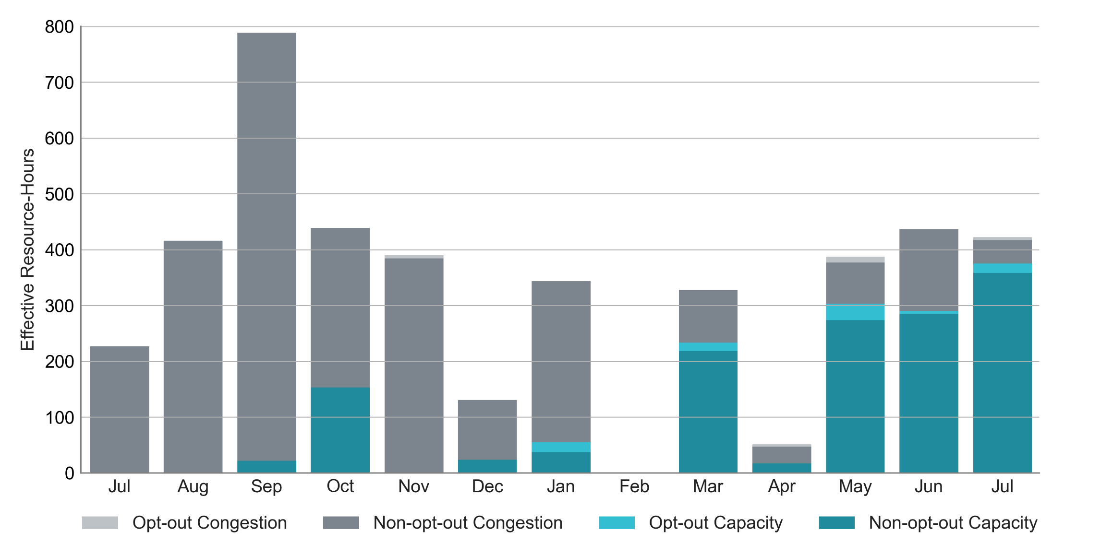
RUC Instruction Reasons: Last 13 Months
RUC activity decreased slightly in July compared to June.
89% of RUC effective Resource-hours in July 2026 were nominally attributed to address capacity needs.

Slide 4
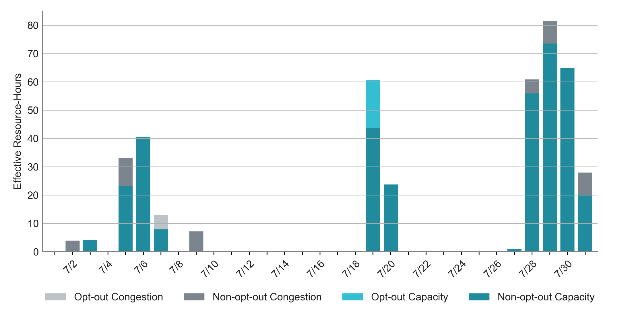
RUC Instruction Reasons in July 2026
There were 422.4 RUC total effective Resource-hours in July and 375.2 hours (89%) were committed to address capacity needs.
The highest effective Resource-hours in July occurred on July 29th to support capacity needs, which was associated with the higher projected load forecast.

Slide 5
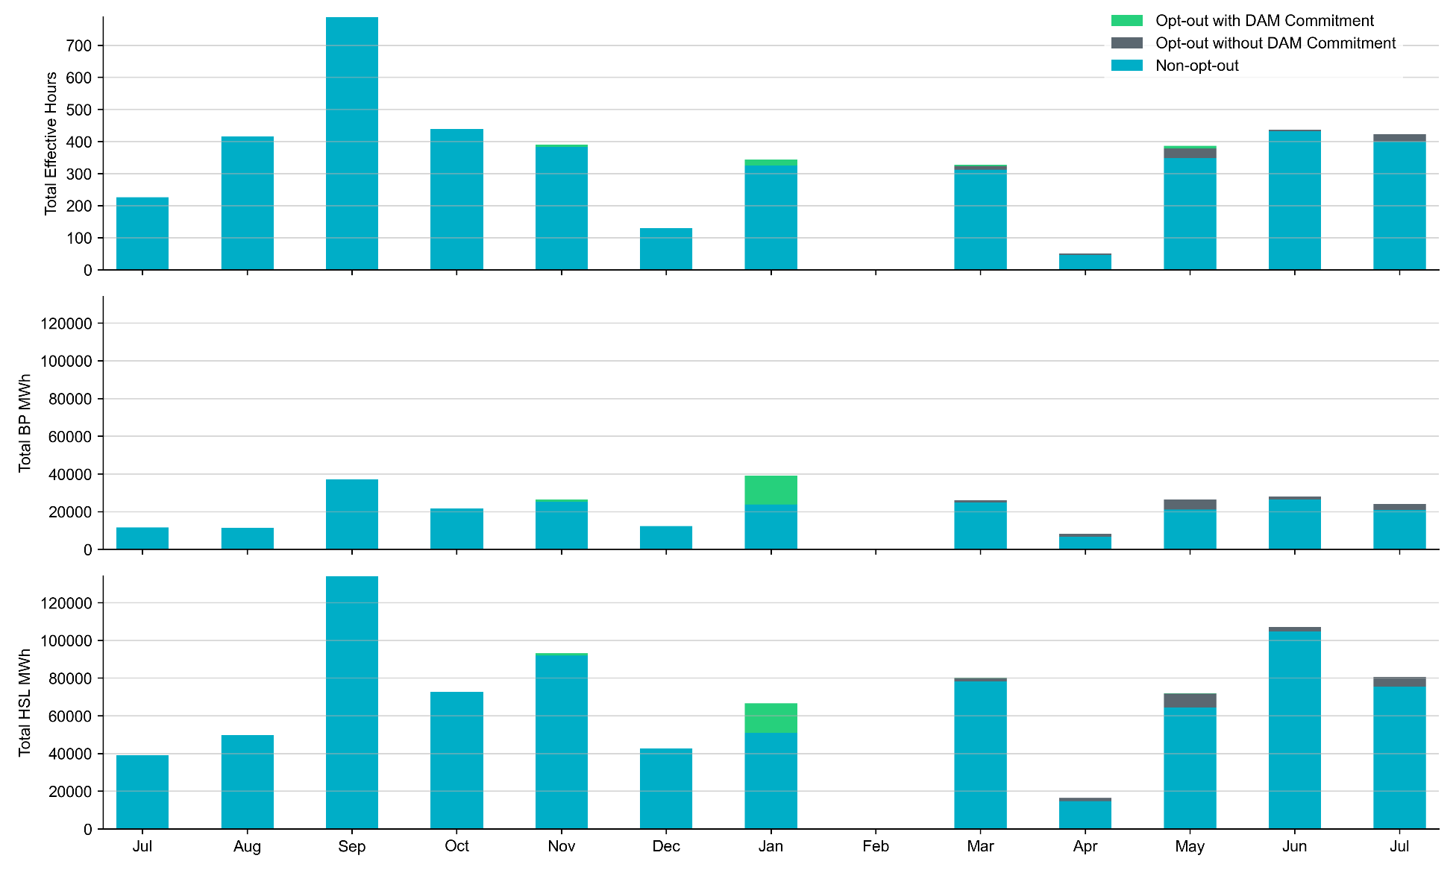
Non-opt-out and Opt-out Totals: Last 13 Months
July 2026 had a total of 400.0 non-opt-out effective Resource-hours (95%) and 22.0 opt-out effective Resource-hours (5%).

Slide 6
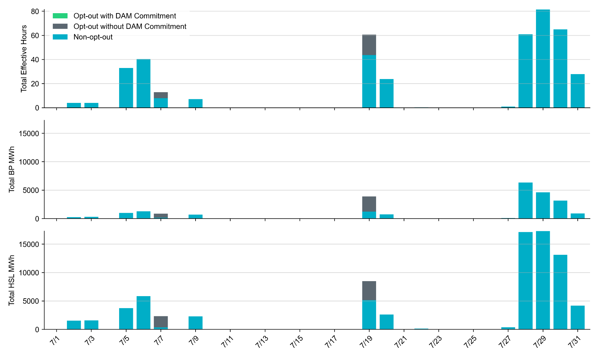
Non-opt-out and Opt-out Totals: July 2026
July 2026 had a total of 400.4 non-opt-out effective Resource-hours (95%) and 22.0 opt-out effective Resource-hours (5%).

Slide 7
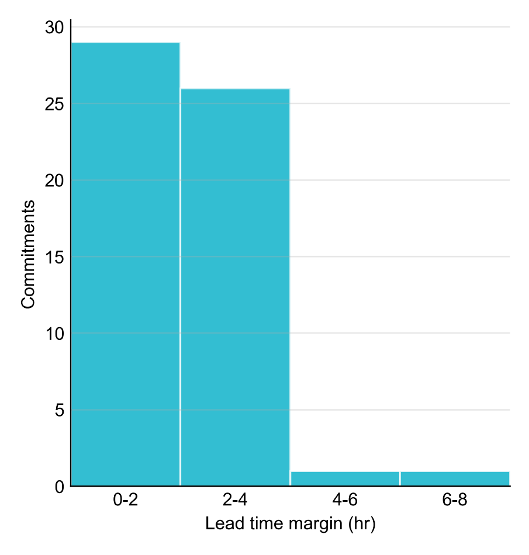
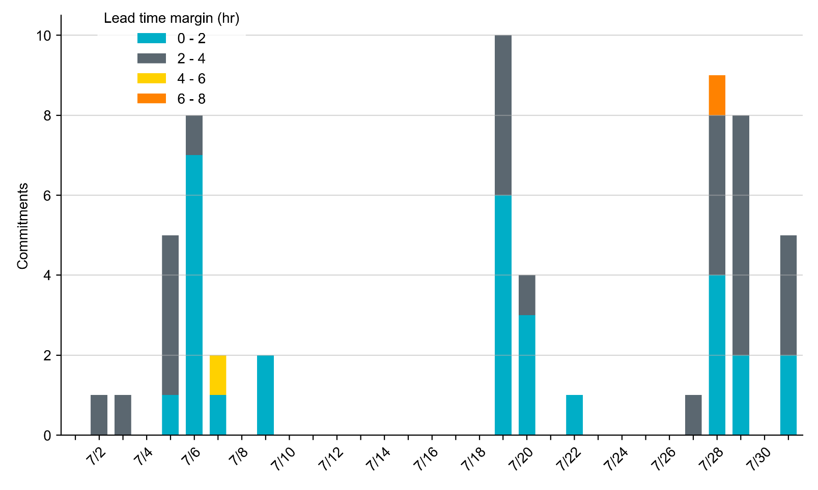
RUC Lead Time Margin: July 2026
50% of RUC commitment windows had a lead time margin of 2 hours or less.
“Lead time” refers to the length of time between a RUC instruction and the start of the commitment window.
“Lead time margin” is the difference between lead time and the Resource’s startup time.
  In cases where a Resource is committed for multiple back-to-back time blocks, lead time margin is calculated from the first instruction.

Slide 8
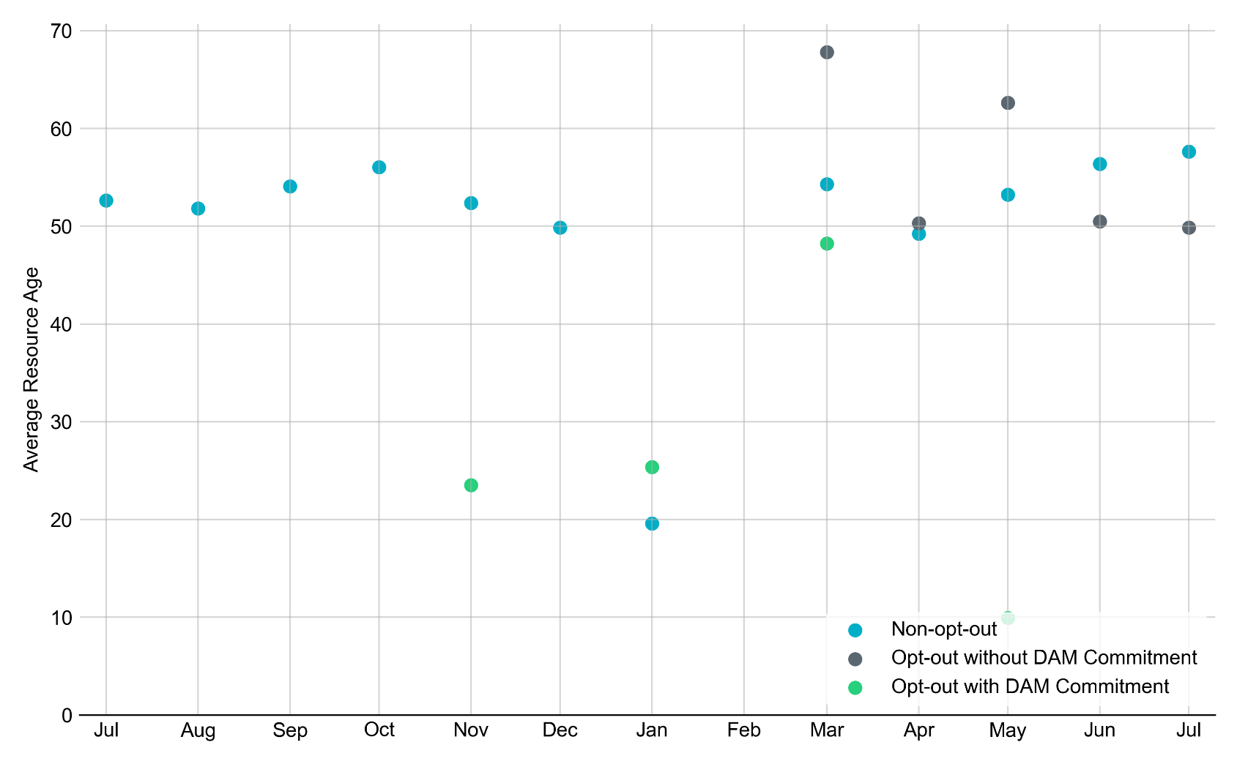
Average Resource Age: Last 13 Months
In July 2026, the average age of RUC-committed Resources was 57.6 years for non-opt-out Resource-hours.
Note: For Resource configurations with multiple physical generators, the age of the oldest generator is used.

Slide 9
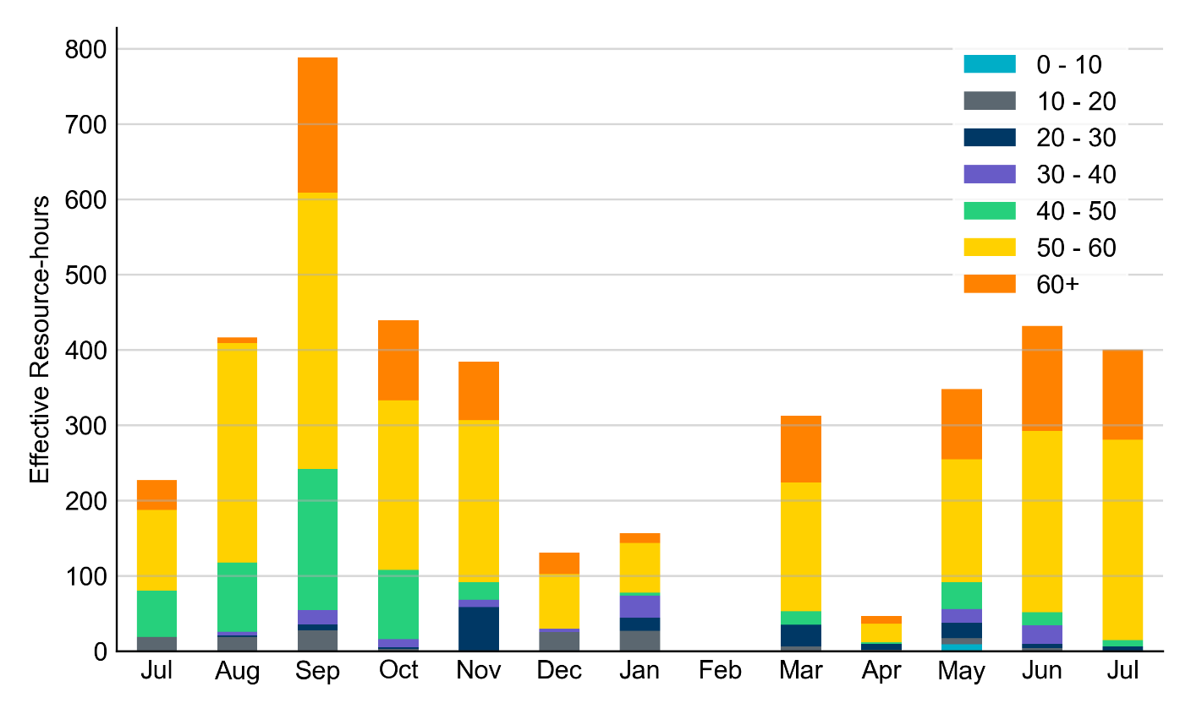
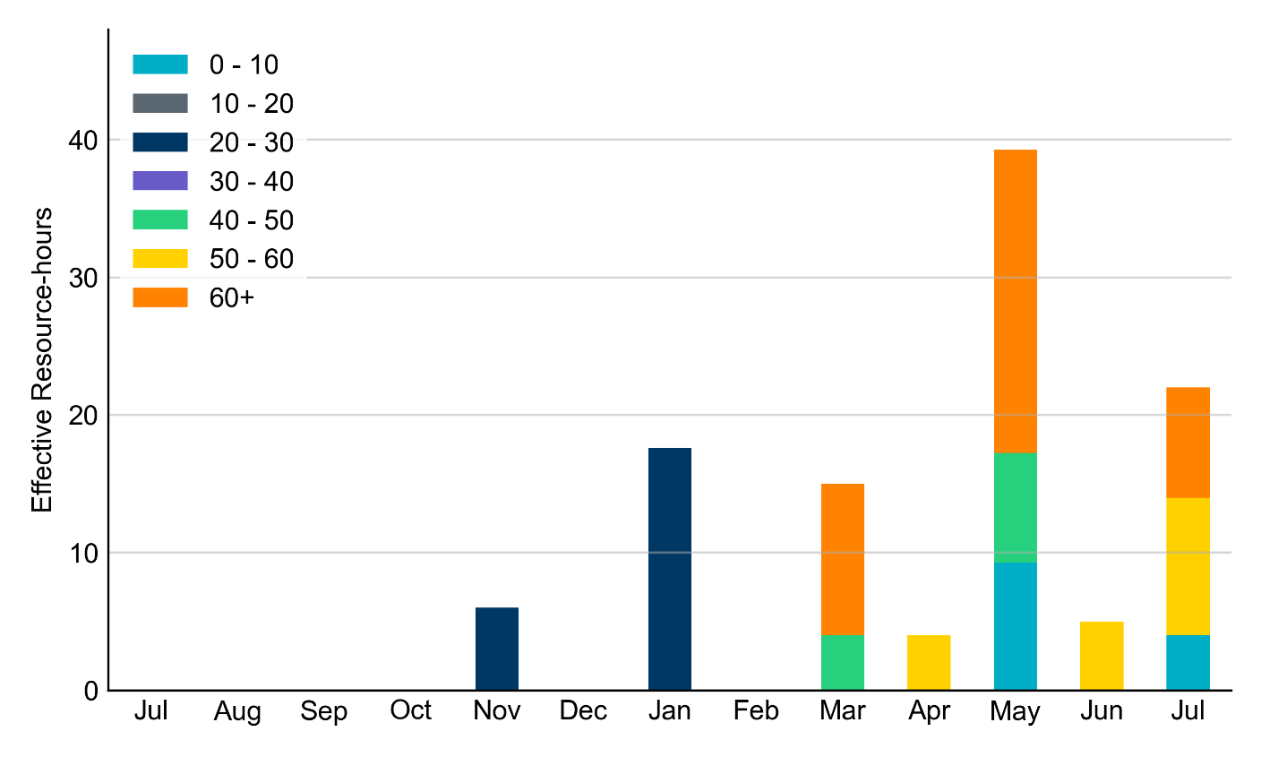
Age Category: Last 13 Months
Non-Opt-Out
Opt-Out
In July 2026, 96% of RUC effective Resource-hours were provided by Resources that were at least 50 years old.
Note: For Resource configurations with multiple physical generators, the age of the oldest generator is used.

Slide 10
RUC-Instructed Resource Dispatch above Low Dispatch Limit (LDL) in Non-Opt-Out Hours
Out of 427.5 non-opt-out effective Resource-hours, RUC-instructed Resources were dispatched above their LDL for 13.9 resource-hours.
  In 0.3 of these Resource-hours, the Locational Marginal Price (LMP) for the RUC-instructed Resource exceeded the RUC offer floor.
  In 13.6 of these Resource-hours, the LMP for the RUC-instructed Resource fell below the RUC offer floor.​ All 13.6 Resource-hours saw the RUC-instructed Resource being mitigated.
There were Exceptional Fuel Cost submissions for a single RUC-Committed Resource in July 2026.

Slide 11
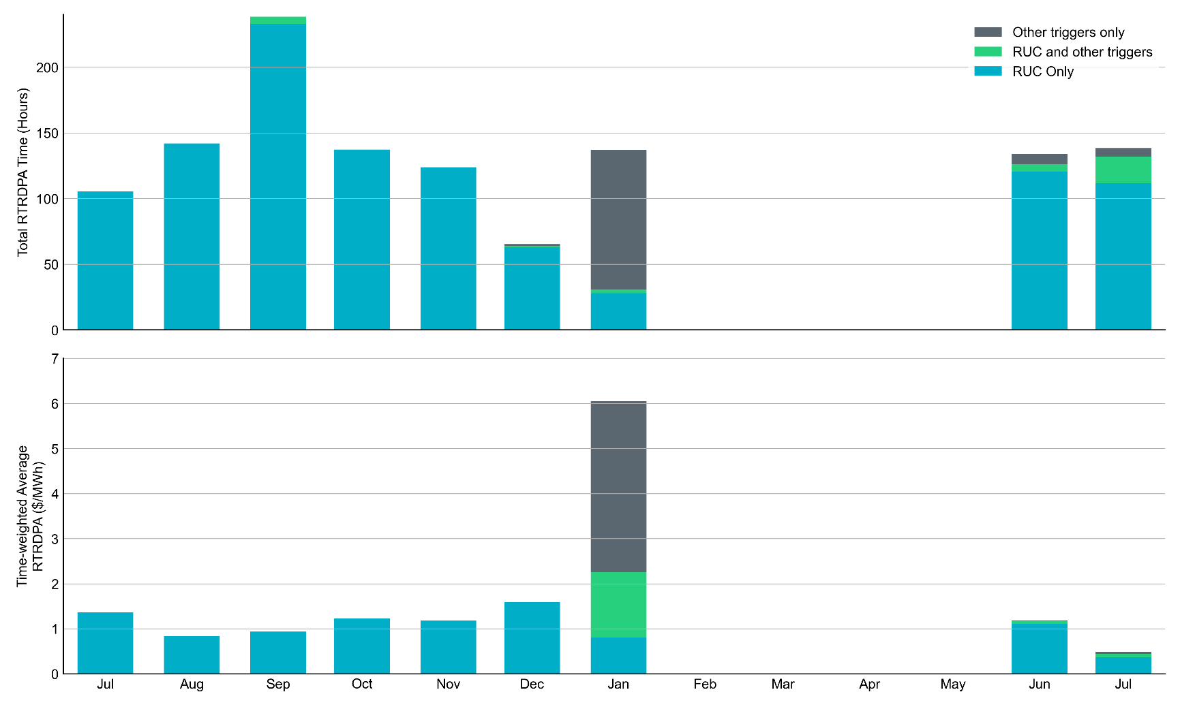
Reliability Deployment Price Adder for Energy: Last 13 Months
July 2026 had a total of 138.3 RTRDPA hours with a time-weighted average value of $0.49/MWh.
These graphs show RTRDPA instances by reliability action: 'RUC Only' for instances triggered solely by Reliability Unit Commitment, 'RUC and other triggers' for instances with RUC and additional triggers, and 'Other triggers only' for instances with non-RUC triggers. The daily average RTRDPA is calculated using the total duration across all categories. See ERCOT protocol section 6.5.7.3.1 for details.

Slide 12
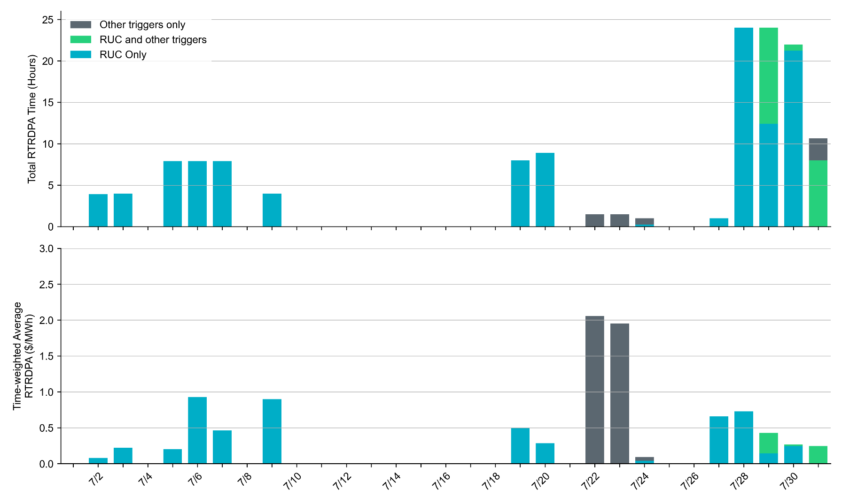
Reliability Deployment Price Adder for Energy: July 2026
July 22nd had the highest daily time-weighted average RTRDPA of $2.06/MWh.
These graphs show RTRDPA instances by reliability action: 'RUC Only' for instances triggered solely by Reliability Unit Commitment, 'RUC and other triggers' for instances with RUC and additional triggers, and 'Other triggers only' for instances with non-RUC triggers. The daily average RTRDPA is calculated using the total duration across all categories. See ERCOT protocol section 6.5.7.3.1 for details.

Slide 13
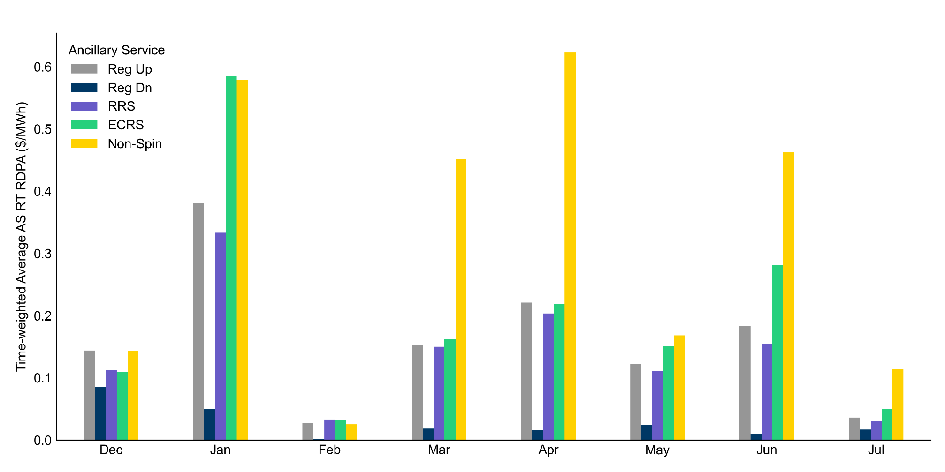
Reliability Deployment Price Adders for Ancillary Services: Last 8 Months
In July 2026, average Ancillary Service price adders decreased from June with the exception of Regulation Down.
The average values are calculated as time-weighted average Real-Time Reliability Deployment Price Adders for each Ancillary Service during SCED intervals with RDPA active for any reliability event trigger. RDPAs for Ancillary Services are only available after RTC+B implementation on December 5, 2025

Slide 14
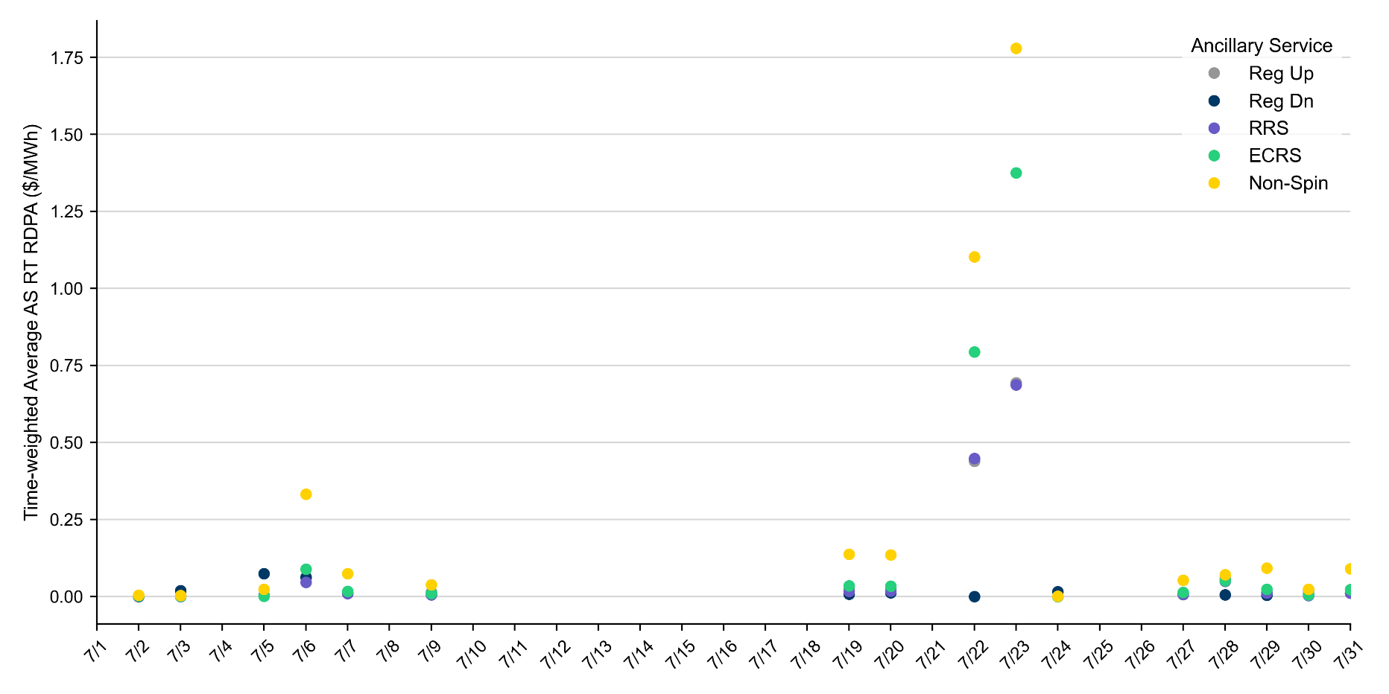
Reliability Deployment Price Adder for Ancillary Services: July 2026
RDPA | Monthly Time Weighted Average ($/MWh)
Regulation Up (Reg-Up) | 0.09
Regulation Down (Reg-Down) | 0.02
Responsive Reserve Service (RRS) | 0.08
ERCOT Contingency Reserve Service (ECRS) | 0.15
Non-Spinning Reserves (Non-Spin) | 0.25
The daily average values are calculated as time-weighted average Real-Time Reliability Deployment Price Adders (RDPA) for each Ancillary Service during SCED intervals with RDPA active for any reliability event trigger.

Slide 15
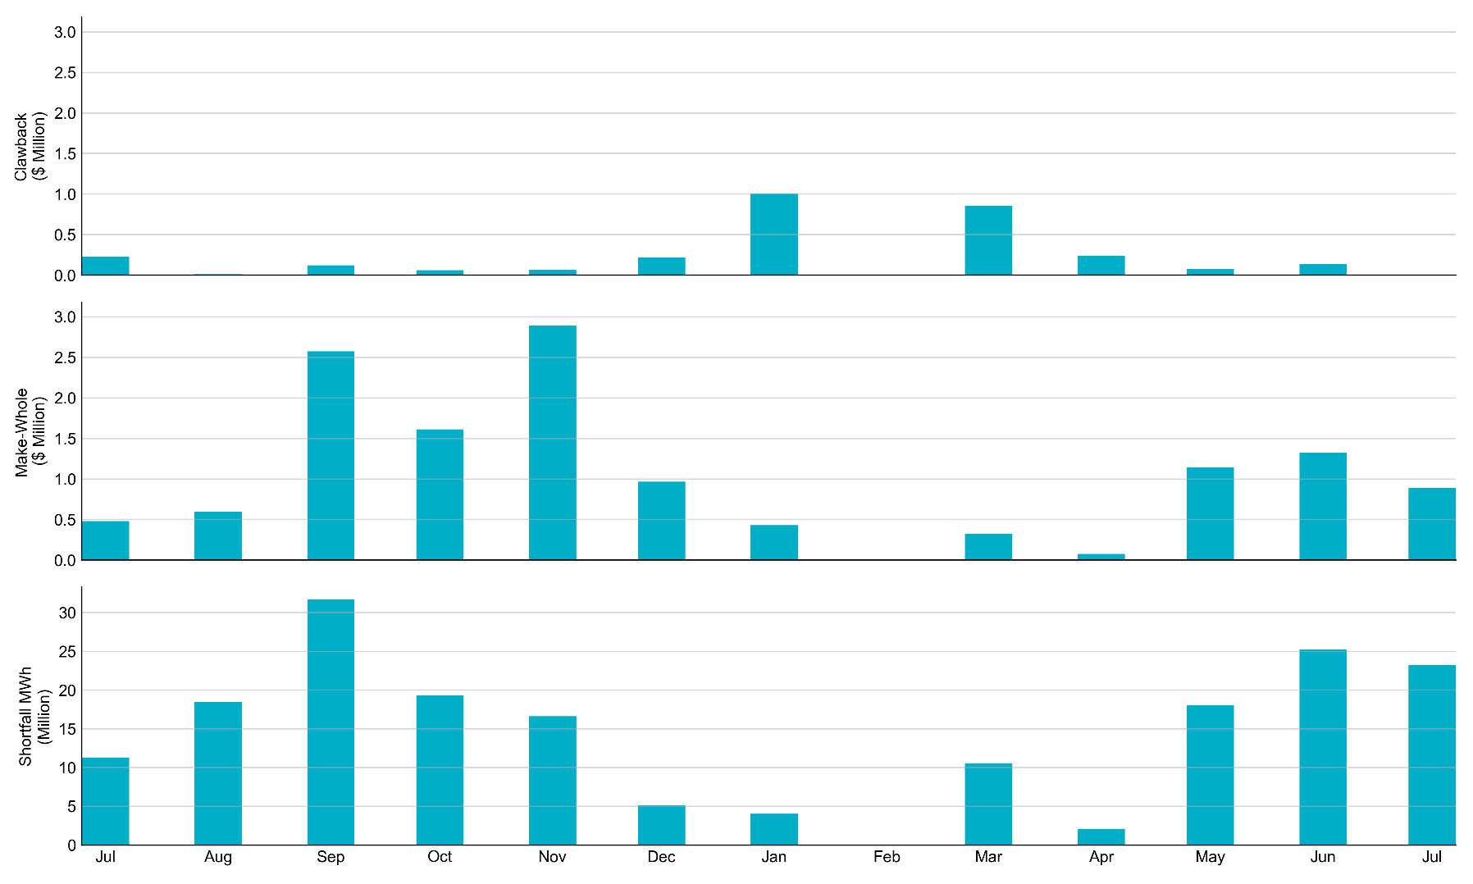
RUC Clawback, Make-Whole, and Shortfall
For July 2026, the total Clawback charge was $882. The total Make-Whole payment was $889,608.
Of the $889,608 in Make-Whole payments made in July 2026, $6.69 was uplifted to load due to rounding. The remaining amount was collected through Capacity-Short charges.

Slide 16
RUC Clawback by Settlement Type
Month | Initial Settlement ($) | Final Settlement Change ($) | True-up Settlement Change ($) | Net ($)
Jul ‘25 | 246,479 | 0 | -18,991 | 227,488
Aug ‘25 | 12,319 | 0 | -2,121 | 10,198
Sep ‘25 | 122,634 | 0 | 0 | 122,634
Oct ‘25 | 128,343 | 0 | -68,059 | 60,284
Nov ‘25 | 80,805 | 0 | -14,883 | 65,922
Dec ‘25 | 233,500 | 0 | -14,862 | 218,638
Jan ‘26 | 1,130,396 | 0 | -123,980 | 1,006,416
Feb ‘26 | 0 | 0 | 0 | 0
Mar ‘26 | 856,743 | - | - | -
Apr ‘26 | 242,784 | - | - | -
May ‘26 | 77,429 | - | - | -
Jun ‘26 | 138,880 | - | - | -
Jul ‘26 | 882 | - | - | -
Negative dollars represent a payment from ERCOT to a market participant
“-” indicates settlement has yet to be completed.
Net figures may differ slightly due to rounding.

Slide 17
RUC Make-Whole by Settlement Type
Month | Initial Settlement ($) | Final Settlement Change ($) | True-up Settlement Change ($) | Net ($)
Jul ‘25 | -382,887 | 0 | -95,893 | -478,780
Aug ‘25 | -487,773 | 0 | -110,640 | -598,413
Sep ‘25 | -2,035,251 | 0 | -538,306 | -2,573,557
Oct ‘25 | -1,016,193 | 0 | -596,880 | -1,613,073
Nov ‘25 | -1,151,712 | 0 | -1,739,486 | -2,891,198
Dec ‘25 | -271,995 | 0 | -696,055 | -968,051
Jan ‘26 | -431,896 | 0 | 2 | -431,893
Feb ‘26 | 0 | 0 | 0 | 0
Mar ‘26 | -324,968 | - | - | -
Apr ‘26 | -76,725 | - | - | -
May ‘26 | -1,140,481 | - | - | -
Jun ‘26 | -1,301,171 | - | - | -
Jul ‘26 | -889,608 | - | - | -
Negative dollars represent a payment from ERCOT to a market participant
“-” indicates settlement has yet to be completed.
Net figures may differ slightly due to rounding.

Slide 18
Questions/Comments

