Slide 1
ERCOT Frequency Control Report
July 2026
PDCWG | August 19th , 2026
ERCOT
Operations Planning
August 20, 2026
Outline:
Frequency Control
  CPS1, BAAL, RMS1
Frequency Profile
Time Error
BAAL-003 Performance
ERCOT Energy Statistics
ERCOT System Inertia

Slide 2
Summary of July 2026
CPS1: 186.86%
Current CPS1 12-Month Rolling Average: 183.04%
0 BAAL Exceedance(s)
0 hourly CPS1 score below 100%
BAAL-003 Events have updated through 2025
2025 BAAL-003 FRM Performance: -1706.02
2026 RMS1 Statistics
  Mean: 11.39 mHz
  Min: 09.29 mHz
  Max 14.75 mHz
Energy Statistics
  Total Energy: 49,833,074 MWh
  Wind Energy: 8,880,082 MWh
  Percent Energy from Wind: 17.82%
  Solar Energy: 9,312,720 MWh
  Percent Energy from Solar: 18.69%
Minimum System Inertia
  Mean: 299,094 MW*s
  Max: 340,235 MW*s on July 22nd
  Min: 265,803 MW*s on July 10th

Slide 3
Frequency Control
CPS1, BAAL, & RMS1

Slide 4
Hourly CPS1 by Day
Jul-26 CPS1 (%): 186.86
Notes:
CPS1 Score is 184.80%
Scores Below 100%: No instances of CPS1 Score under 100%

Slide 5
BAAL Exceedances & Violations
There were 0 BAAL exceedance(s) in July.

Slide 6
15-Minute Average CPS1%
Jul-26 CPS1 (%): 186.86
Notes:
CPS1 score is above 170% for all 15-minute intervals.

Slide 7
12-Month Rolling Average CPS1
Current 12-Month Rolling Average 183.04%
Notes:
12 month rolling average CPS1 score is 183.04 which is continuing the increasing trend of CPS1 scores.

Slide 8
Daily RMS1 of ERCOT Frequency by Year
Notes:
Daily RMS1 frequency by year.
2026 RMS1 Statistics
Mean: 11.39 mHz
Min: 09.29 mHz
Max 14.75 mHz

Slide 9
Daily RMS1 of ERCOT Frequency by Month
Notes:
A More granular look at last 15 years of RMS1 by month.
2026 Monthly July RMS1 Statistics
Mean: 10.86 mHz
Min: 09.73 mHz
Max 12.01 mHz

Slide 10
Daily RMS1 of ERCOT Frequency by Month
Notes:
Same data with 10 years shown instead of 15

Slide 11
Frequency Profile Comparison

Slide 12
Frequency Profile Comparison
Notes:
Comparison of frequency profile between July 2025 and 2026. Compared to last year, there are slightly less instances of frequency hovering around the dead bands.

Slide 13
Frequency Profile Comparison
Notes:
Comparison of frequency profile between July 2024 and 2026. Like the previous slide, there are less instances of frequency hovering around the dead bands.

Slide 14
Time Error Correction

Slide 15
ERCOT Daily Time Error
Notes:
We see low time error accumulation throughout the month of June but a higher for July later July 22-24.

Slide 16
Time Error Corrections Log Summary
There have been no time error corrections since December 2016

Slide 17
BAL-003 Performance

Slide 18
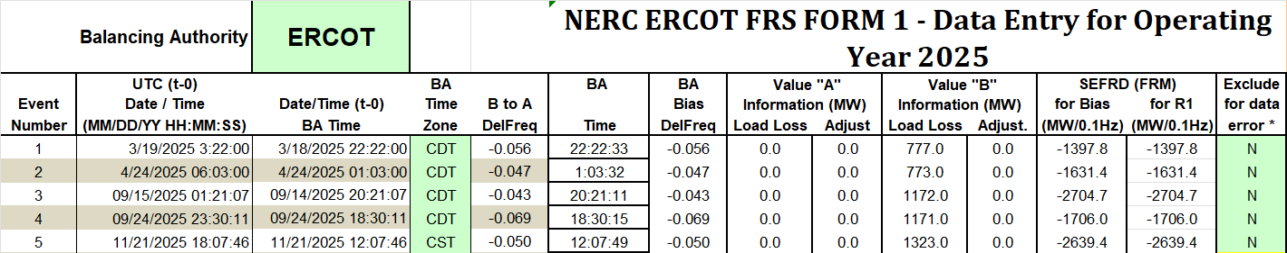
Op. Year 2025 BAL-003 Selected Events
Notes:
BAL-003

Slide 19
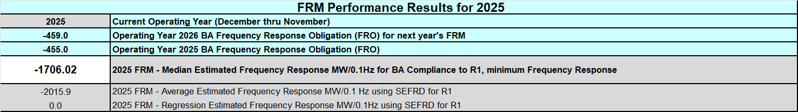
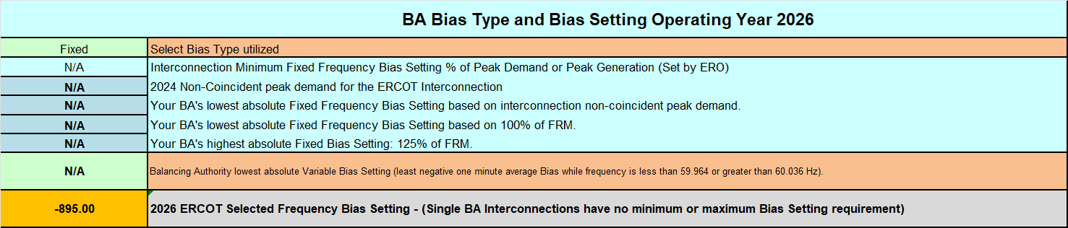
Op. Year 2025 BAL-003 FRM Performance - Update
Notes:
OP2018: FRO = -381.0, FRM_median = -843.17, FRM_average = -959.7
OP2019: FRO = -381.0, FRM_median = -811.14, FRM_average = -892.5
OP2020: FRO = -425.0, FRM median = -789.34, FRM average = -879.0
OP2021: FRO = -471.0, FRM median = -913.56, FRM average = -992.
OP2022: FRO = -412.0, FRM median = -1060.40, FRM average = -1153.4
OP2023: FRO = -463.0, FRM median = -1130.21, FRM average = -1302.7
OP2024: FRO = -395.0, FRM median = -1127.76, FRM average = -1264.3
OP2025: FRO = -455.0, FRM median = -1706.02, FRM average = -2015.9
OP2026: FRO = -459.0,

Slide 20
ERCOT Energy Statistics

Slide 21
Total Energy
Notes:
49,833,074 MWh

Slide 22
Total Energy from Wind Generation
Notes:
8,880,082 MWH

Slide 23
% Energy from Wind Generation
Notes:
17.82% of total energy was provided by wind generation

Slide 24
Total Energy From Solar Generation
Notes:
9,312,720 MWh

Slide 25
% Energy from Solar Generation
Notes:
18.69% of total energy was provided by solar generation

Slide 26
ERCOT System Inertia

Slide 27
Daily Minimum System Inertia
Notes:
Minimum Inertia in July 2026 = 265,803 MW*s
Historical Overall Minimum was 109,029 MW*s on 3/22/2021
June Data:
Mean: 299,094 MW*s
Max: 340,235 MW*s on July 22nd
Min: 265,803 MW*s on July 10th

Slide 28
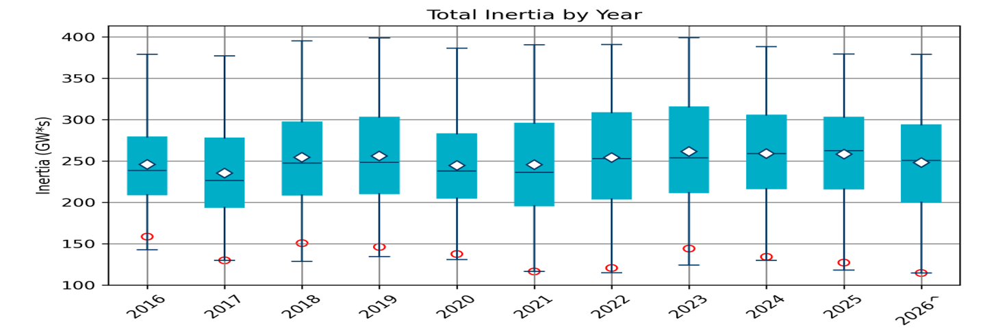
Total Inertia 2016-2026
Date and Time | 2016 4/10 2:00 AM | 2017 10/27 4:00 AM | 2018 11/03 3:30 AM | 2019 3/27 1:00 AM | 2020 05/01 2:00 AM | 2021 03/22 1:00 AM | 2022 03/21 2:00 AM | 2023 04/18 3:00 AM | 2024 03/29 4:00 AM | 2025 03/18 12:00 PM | 2026* 03/14 12:00 PM
Min synch. Inertia (GW*s) | 143 | 130 | 128.8 | 134.5 | 131.1 | 116.6 | 115.0 | 124.3 | 129.9 | 118.3 | 114.7
System load at minimum synch. Inertia (MW) | 27,831 | 28,425 | 28,397 | 29,883 | 30,679 | 31,767 | 33,784 | 35,578 | 37,039 | 49,130 | 48,013
Non-synch. Gen. in % of System Load | 47 | 54 | 53 | 50 | 57 | 66 | 65 | 61 | 68 | 74 | 81
FFR Award | N/A | N/A | N/A | N/A | 0 | 0 | 0 | 0 | 134 | 298 | 430
Critical Inertia (GW*s) | 100 | 100 | 100 | 100 | 100 | 100 | 100 | 100 | 93 | 92 | 87
Red circles denote inertia at max IRR penetration (= IRR Gen/Total Gen)
Notes:
Summary of ERCOT inertia for the previous 10 years. Lowest inertia this year was on March 14th.
For each box, the central mark (red line) is the median, the edges of the box (in blue) are the 25th and 75th percentiles, the whiskers correspond to +/- 2.7 sigma (i.e., represent 99.3% coverage, assuming the data are normally distributed. The corresponding lowest inertia in each year is given in the table.
The circle on each boxplot is showing inertia during time when highest portion of load was served by wind/solar generation in that year.

Slide 29
Questions/Comments?

