Slide 1
NPRR 1188 – System Impacts Overview
Vamsi Paruchuri
Xiangjun Xu
August 20,2026
Outline:
NPRR 1188 overview
SCED and DAM changes
Market Manager UI & External webservice changes
Report Changes
Q&A
Key Takeaways
NPRR 1188 project is in design and development phase, impacts QSEs Market Submissions EWS APIs
Requires Meters installations in the field for CLRs and go through qualification process before Go-Live.

Slide 2
NPRR 1188 Overview
NPRR 1188 enables nodal dispatch for Controllable Load Resources (CLR) that are not ALR’s
Aggregate Load Resources (ALR) will continue to be settled at Load Zones (LZ)
New Resource Nodes (RN) and ERCOT-Polled Settlement (EPS) meters will be added for CLR’s that are not ALR’s.
CLRs should have the Meters installed in the field and go through qualification process to be able to participate in the market from the Go-Live date.
MOTE Testing: Dec 2026
Go-Live date: Jan 2027

Slide 3
SCED and DAM Changes for CLR’s that are not ALR’s
SCED
  Changed from LZ to nodal dispatch
  EPS meters and RN’s will be added
  New telemetry: ONTEST and ONHOLD – basepoint will be set to telemetry MW
  OUTL status – not consuming energy, telemetry MW = 0
DAM
  Can submit energy bids for DAM Ahead Market
  RN’s will be added
  DAM LPC = 0, dispatch range will be [0, MPC-LPC] in DAM

Slide 4
External Webservice XSD Changes
RTMEnergyBid will be renamed to EnergyBidCurve, as it will be used for both Realtime and Day Ahead Markets:
api-specs/ews/xsds at ews_NPRR1188 · ercot/api-specs · GitHub
ErcotTransaction.xsd
ErcotTransactionTypes.xsd
*** Awards XSD changes will be presented in the next TWG meeting***

Slide 5
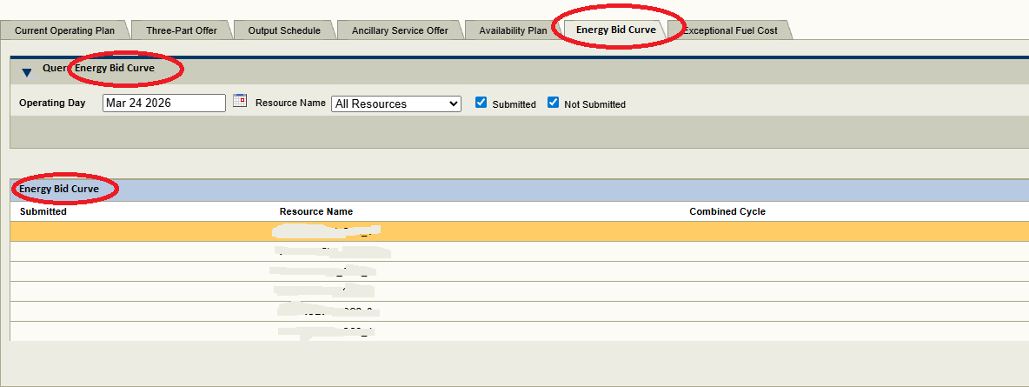
Market Manager (MMS UI) Changes

Slide 6
Report Changes
CDR
  DAM Aggregate Credit Exposure
  This will have XSD changes
    Timelines for when the XSD changes will be made available to the market will be communicated in future TWG meetings.
Extracts and Disclosures
  2-Day DAM Energy Curves
  2-Day SCED Energy Curves
  2-Day DAM Bids and Offers Reports
  60-Day DAM Disclosure Reports
  60-Day SCED Disclosure Reports

Slide 7
NPRR 1188 Q&A
Will current Settlement Point names for the CLRs stay the same or change as well?
  Currently, for all CLRs, the Settlement Point name is the applicable Load Zone name.
  With this implementation
    CLRs that are not ALRs will be mapped to Resource Node Settlement Points (changing with NPRR1188)
    For CLRs that are ALRs, the Settlement Point name will stay at the applicable Load Zone name (no change).
Will there be DA Energy Awards for DA Energy Bids at the Resource?
  Yes, there will be cleared DA Energy Bid awards for CLRs.
If you are awarded DA Energy Bid at Resource, will it be considered a DA Energy Purchase in the DAM?
  Yes, DA Energy purchase @ CLR Settlement Point.
Will the MRID be the same or change?
  Currently the MRID contains ‘REB’, will it be ‘EBC’? Ex - QSE.20260813.REB.ResourceName
    Yes, MRID will change from ‘REB’ to ‘EBC’.

Slide 8
Questions/Comments?
Xiangjun.Xu@ercot.com
Vamsi.Paruchuri2@ercot.com

