Slide 1
SCR820 – Real-Time Operator Communications System (RTOC)
Bharati Nepal
Christelle Seri
August 20, 2026
Outline:
Status updates
Market Testing Updates
Recap Tool Access
Primary Contacts
Key Takeaways
RTOC project and market testing updates

Slide 2
Status Updates
Market testing is underway while production capabilities continue to expand.
PROJECT UPDATES
DEVELOPMENT UPDATES
Testing & operating readiness
Production capabilities
✓
QSE testing underway
•
SOL Exceedance displays
Primary contact information is being gathered.
First version developed and deployed to Production.
•
SOL Exceedance History
✓
Parallel communications planned
History tab has been rolled out.
Control Room Operations plans to use the RTOC tool alongside hotline calls for routine testing.
•
Default dashboard
Provides a quick activity overview.
✓
Protocol update in discussion
•
Emergency conditions
Internal discussions are underway to draft an NPRR enabling Control Room use of the tool in addition to the current Hotline Call.
Development in progress on new screen to manage emergency condition
RTOC Market Testing | Project and development status

Slide 3
RTOC Tool – Project Timelines
KEY TAKEAWAY
QSE market testing is now included in the project timeline. Please note that certain dates are subject to change pending the implementation of a nodal protocol revision request (NPRR)
PROJECT TIMELINE
Complete
Apr 2026
Apr–Jun 2026
Jun–Aug 2026
Q4 2026–Q1 2027*
Q1–Q2 2027*
Planning
Development
TO Market Testing
QSE Market Testing
Parallel Operation
Go-Live
Requirements & design finalized
Development & internal ERCOT testing
Market testing with Transmission Operators
Market testing with Qualified Scheduling Entities
TOs/QSEs Parallel Operation
TOs/QSEs Go Live
PROTOCOL DEPENDENCY
Parallel Operations and Go-Live dates depend on implementation and final approval of the NPRR protocol changes.
01 Protocol update
02 Parallel Operations
03 Go-Live
ERCOT is developing a draft NPRR to update protocols so RTOC can be used in addition to the current Hotline Call.
ERCOT and TO/QSE primary contacts will test and verify RTOC messages alongside Hotline Calls and routine communication tests. RTOC will NOT be a designated communication medium for control rooms. Hotline and voice communication will be the primary medium for Realtime system activities
RTOC is introduced into control rooms as a monitored 24×7 communication tool for normal and emergency operations.
During Parallel Operations, Hotline and voice communications remain the primary medium for real-time system activities.
* Coordinated with final approval of NPRR changes. Revised dates will be communicated through an updated market notice.
Reference: M-A032326-01A — Access and familiarization of the Real-Time Operation Communications (RTOC) tool

Slide 4
Market Testing Updates
TRANSMISSION OPERATORS
QUALIFIED SCHEDULING ENTITIES
QSE TEST WINDOW
22
26
6/29–8/21
RTOC market testing readiness, engagement, and next steps
124 total users
97 total users
Active market testing
1
Access & onboarding
2
Contact readiness
22 TOs and 26 QSEs successfully logged in and navigated all application displays.
ERCOT Control Room / Project team completed primary contact collection for TO control rooms.
Only main QSEs are requested to log in; they may acknowledge messages on behalf of sub-QSEs.
QSE primary contact collection is currently in progress.
TO contacts complete • QSE contacts in progress
3
Testing & participation
MARKET NOTICE
Communications testing will occur twice weekly to confirm users can read, respond to, and acknowledge messages.
QSE access & familiarization
M-A062326-01
40%
TO online participation
20%
QSE online participation
Focus: increase live participation and response rates during recurring tests.
Access and familiarization of the Real-Time Operation Communications (RTOC) Tool — Qualified Scheduling Entities (QSE)
Weekly RTOC hotline testing
Weekly RTOC hotline testing
Support
ERCOTRTOCSupport@ercot.com

Slide 5
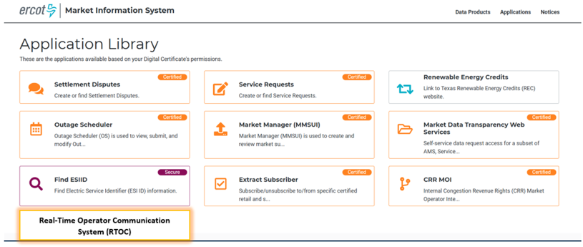
RTOC Tool Access
Digital certificate • role-based authorization • MIS Application Library
01
CERTIFICATE
02
ROLE
03
LAUNCH
Access is granted through an approved digital certificate.
Add the appropriate RTOC role to authorize the user.
Open RTOC from the MIS Application Library when enabled.
Available roles
Where users will launch RTOC
Operator
REQUEST
RTOC_M_OPERATOR
Read-only
VIEW
RTOC_M_VIEW
Action: confirm certificate + required role before launch.
MIS link will be enabled after market testing is complete.

Slide 6
Provide Primary Contact Information
Help us keep RTOC Market Testing communications timely and targeted.
WHAT TO PROVIDE
WHY WE NEED IT
One primary contact for your organization
A clear contact path keeps testing moving.
• Receive testing-related communications
• Get the application URL, updates, and instructions promptly
01
Primary contact name
02
Email address
03
Role / designation
HOW TO SUBMIT
Email your contact details to
ERCOTRTOCSupport@ercot.com
Primary contact name • Email address • Role / designation

Slide 7
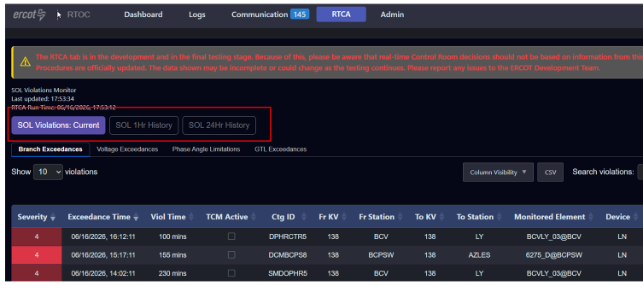
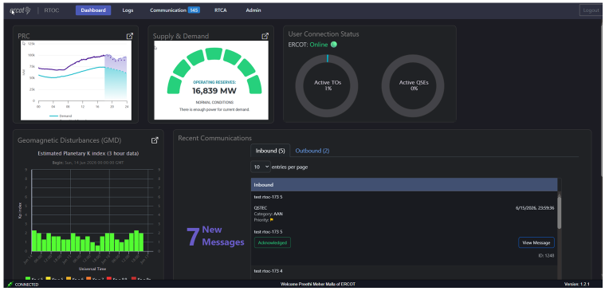
New Features Rolled Out
RTOC enhancements
1
SOL Exceedance History
2
Default Dashboard
RTCA DISPLAY
• Addition of 1-hour and 24-hour history views for SOL exceedances history data
• Provides an overview of the new communications, GMD updates, and system conditions.
7

Slide 8
August Release (R8): What’s New
RELEASE DATE
August 27, 2026
R8 enters RTOC Production and becomes available for Market Testing the same day.
ENHANCEMENT
DEFECTS
6 fixes
Application performance
Communication
RTOC-156
Communication - No indication of failed message
RTOC-206 • Communication
RTOC-228
Communication - Message sent with sticky checked are not going through
Improve application performance
RTOC-234
Communication - Read and ack % are not getting update
Dashboard
RTOC-233
Dashboard - User connection monitor - is not getting updated to reflect the number of active users
RTOC-232
Dashboard - Pop ups open in same window
RTOC-235
Dashboard - Active Alerts & Acknowledgements - is not displaying SOL Exceedances
1 enhancement included

Slide 9
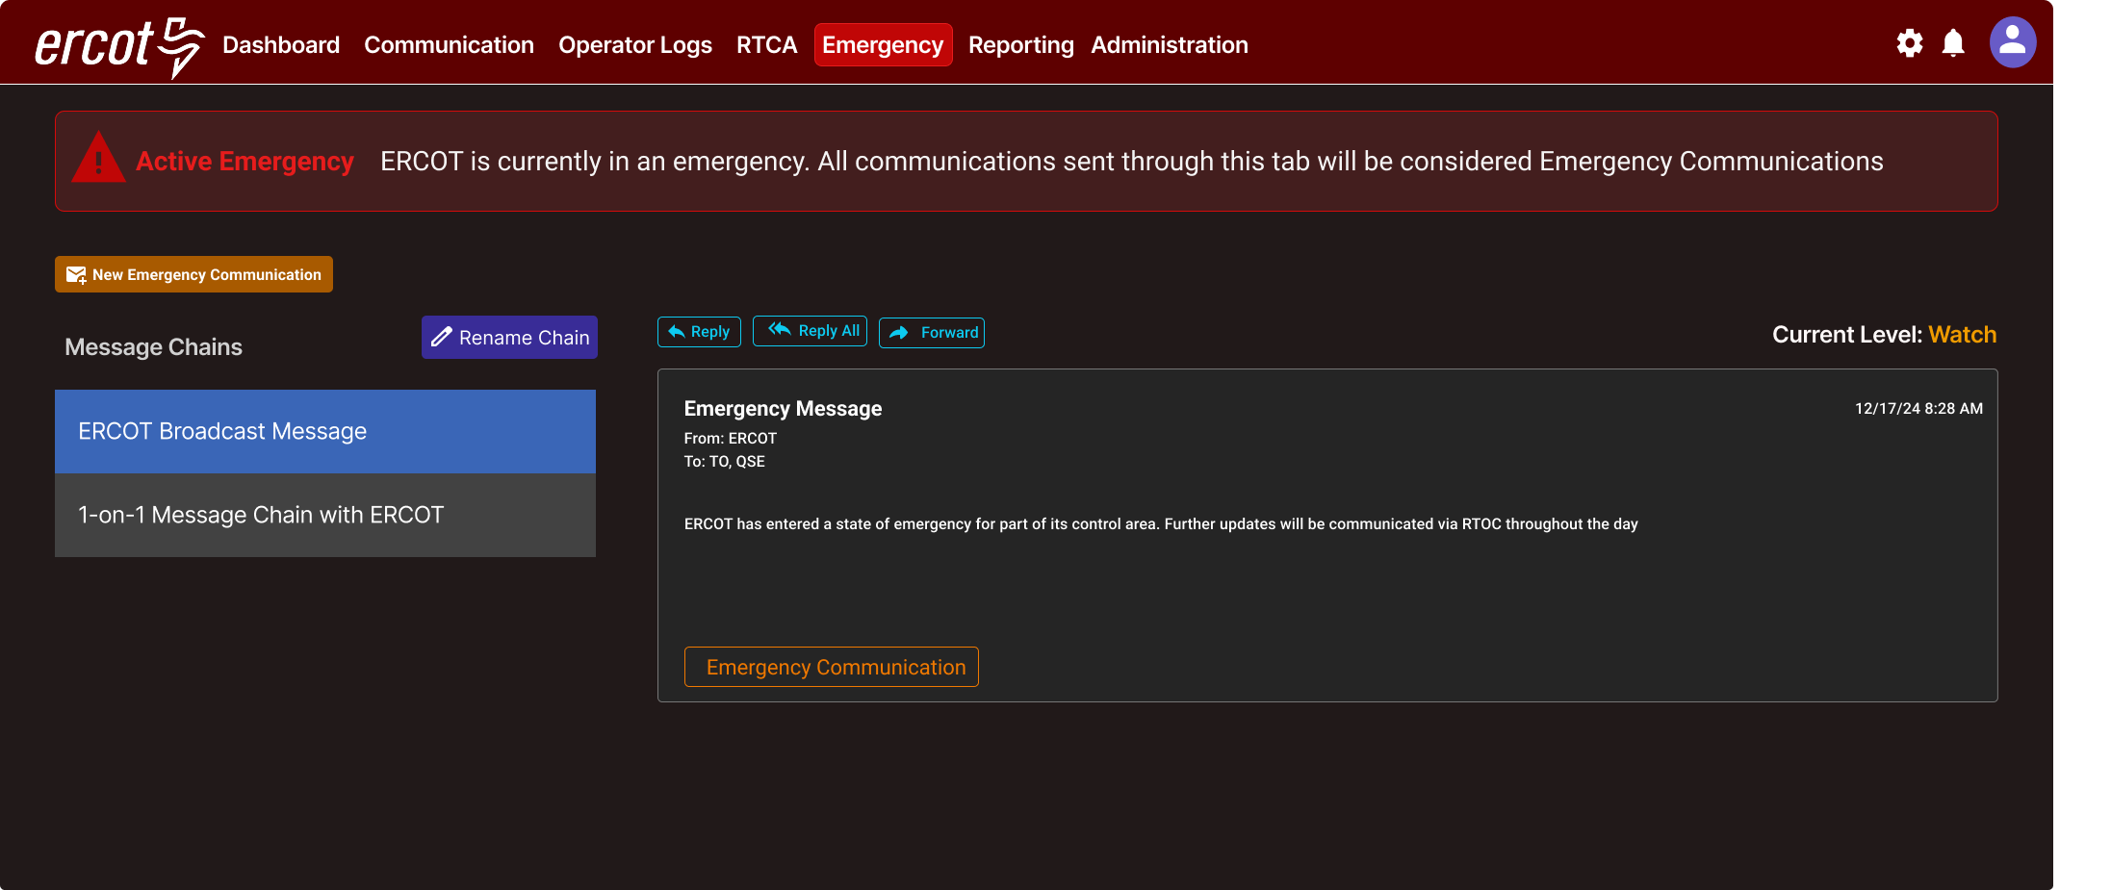
RTOC Emergency Page

Slide 10
Questions/Comments?

