Slide 1
ERCOT Frequency Events
July 2026
ERCOT
Operations Planning
PDCWG Meeting
August 19, 2026

Slide 2
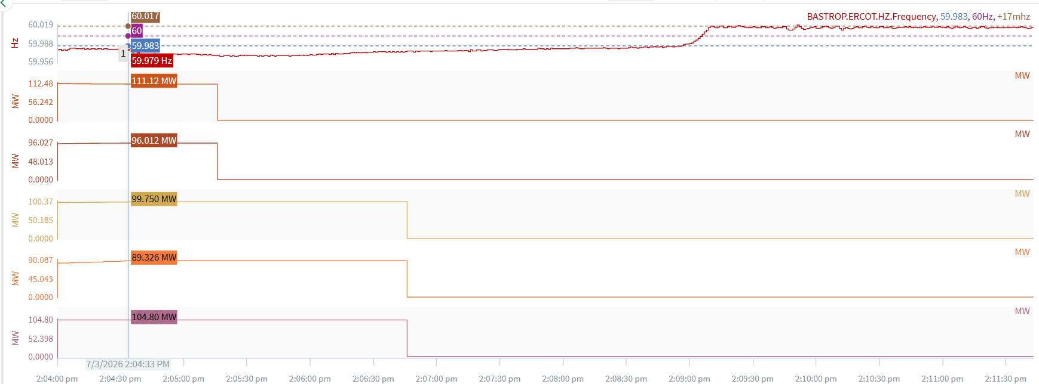
7/3/2026 14:04:33 (Non-FME)
Notes:
Multiple for a combine loss of approximately ~502 MW
Starting Frequency: 59.979 Hz
Minimum Frequency: 59.957 Hz
A-C Time : 3 seconds
Recovery Time(back to deadband): 4 minutes 24 seconds
Trip Reason: Unknown at this time.
Contextual Information: A total of 616 MW of regulation Up was deployed during the event.
Reason for no selection: A-B frequency too small. Event occurred below deadband.

Slide 3
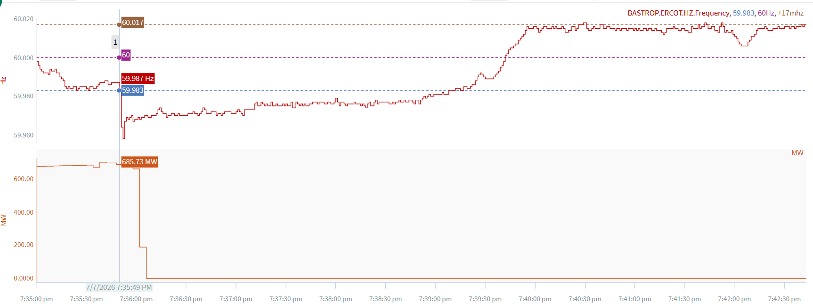
7/7/2026 19:35:49 (Non-FME)
Notes:
A unit tripped offline for ~658 MW
Starting Frequency: 59.987 Hz
Minimum Frequency: 59.958 Hz
A-C Time : 3 seconds
Recovery Time(back to deadband): 3 minutes 19 seconds
Trip Reason: PA fan issue.
Contextual Information: A total of 547 MW of regulation Up was deployed during the event.
Reason for no selection: A-B frequency too small

Slide 4
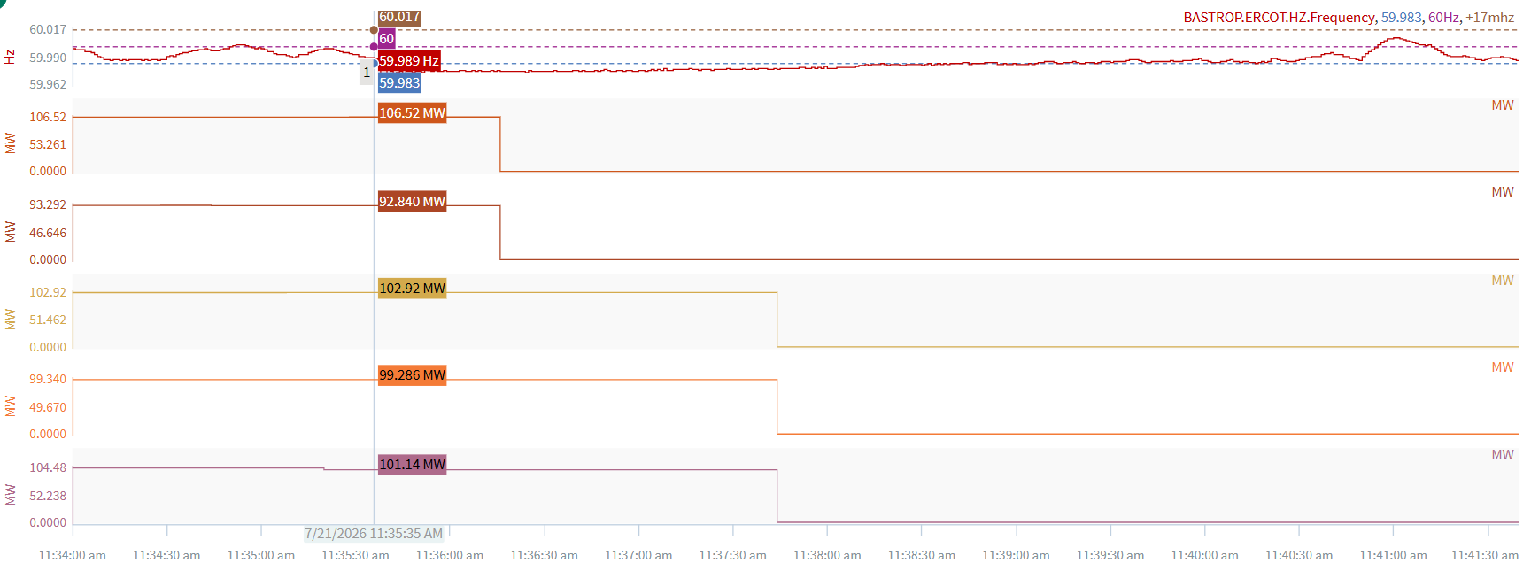
7/21/2026 11:35:35 (Non-FME)
Notes:
A unit tripped offline while experiencing a runback for ~503 MW
Starting Frequency: 59.989 Hz
Minimum Frequency: 59.961 Hz
A-C Time : 3 seconds
Recovery Time(back to deadband): 3 minutes 31 seconds
Trip Reason: Unknown at this time.
Contextual Information: A total of 564 MW of regulation Up was deployed during the event.
Reason for no selection: A-B frequency too small

Slide 5
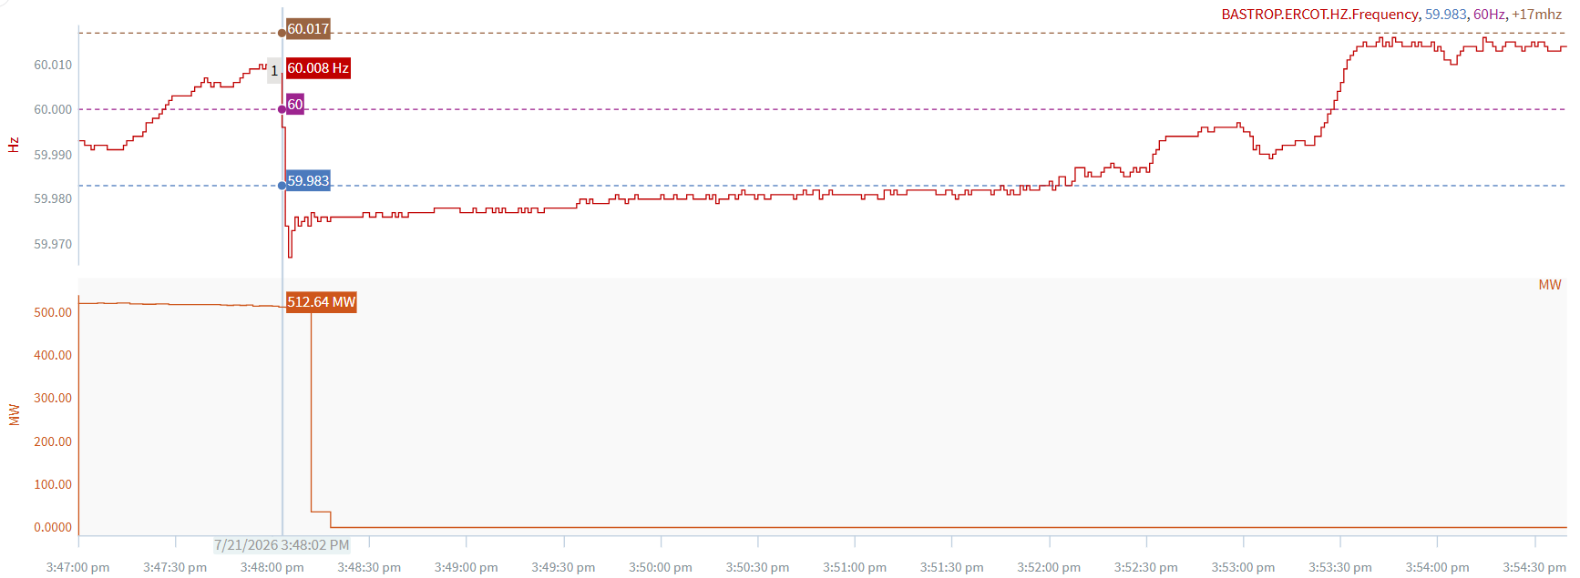
7/21/2026 15:48:02 (Non-FME)
Notes:
A unit tripped offline for ~515 MW
Starting Frequency: 60.008 Hz
Minimum Frequency: 59.967 Hz
A-C Time : 3 seconds
Recovery Time(back to deadband): 4 minutes 00 seconds
Trip Reason: Unknown at this time
Contextual Information: A total of 298 MW of regulation Up was deployed during the event.
Reason for no selection: A-B frequency too small

Slide 6
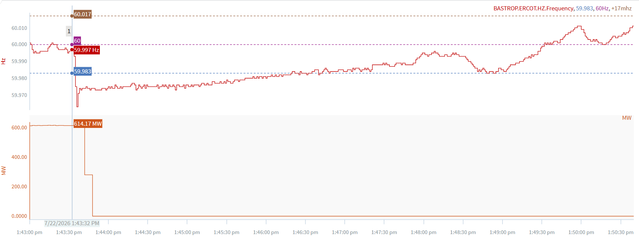
7/22/2026 13:43:32 (Non-FME)
Notes:
A unit tripped offline for ~615 MW
Starting Frequency: 59.997 Hz
Minimum Frequency: 59.963 Hz
A-C Time : 4 seconds
Recovery Time(back to deadband): 3 minutes 01 seconds
Trip Reason: Unknown at this time
Contextual Information: A total of 335 MW of regulation Up was deployed during the event.
Reason for no selection: A-B frequency too small

Slide 7
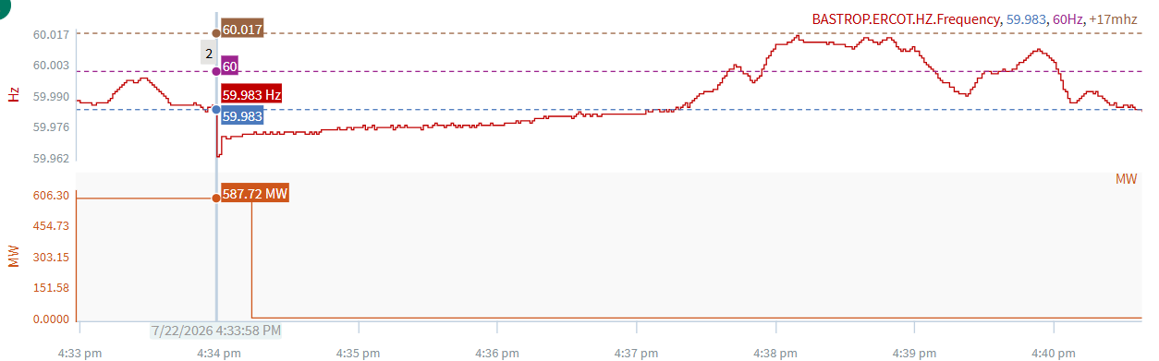
7/22/2026 16:33:58 (Non-FME)
Notes:
A unit tripped offline for ~606 MW
Starting Frequency: 59.983 Hz
Minimum Frequency: 59.962 Hz
A-C Time : 1 seconds
Recovery Time(back to deadband): 3 minutes 18 seconds
Trip Reason: Unknown at this time
Contextual Information: A total of 554 MW of regulation Up was deployed during the event.
Reason for no selection: A-B frequency too small

Slide 8
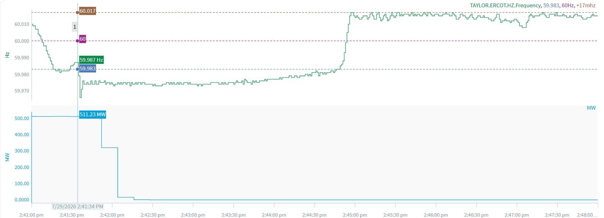
7/29/2026 14:41:34 (Non-FME)
Notes:
A unit tripped offline for ~522 MW
Starting Frequency: 59.987 Hz
Minimum Frequency: 59.966 Hz
A-C Time : 2 seconds
Recovery Time(back to deadband): 3 minutes 13 seconds
Trip Reason: Unknown at this time
Contextual Information: A total of 262 MW of regulation Up and 300 MW of manual offset was deployed during the event.
Reason for no selection: A-B frequency too small

Slide 9
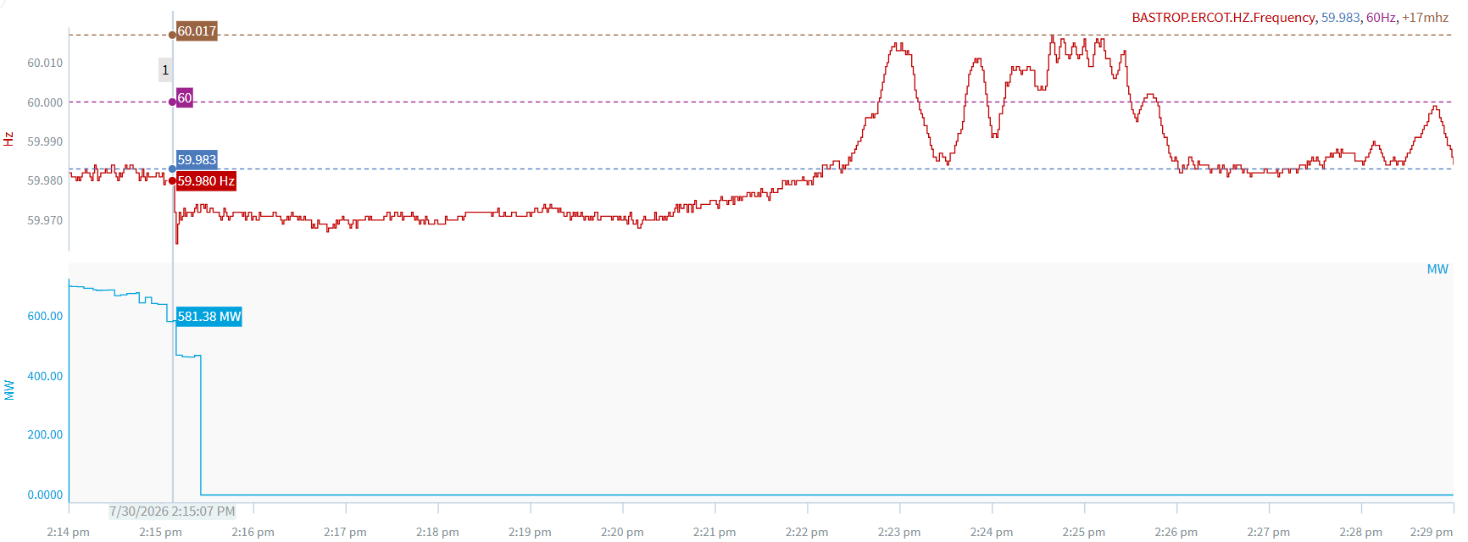
7/30/2026 14:15:07 (Non-FME)
Notes:
A unit tripped offline for ~467 MW
Starting Frequency: 59.980 Hz
Minimum Frequency: 59.964 Hz
A-C Time : 3 seconds
Recovery Time(back to deadband): 7 minutes 17 seconds
Trip Reason: Unknown at this time
Contextual Information: A total of 616 MW of regulation Up was deployed during the event.
Reason for no selection: A-B frequency too small. Event occurred below deadband.

Slide 10
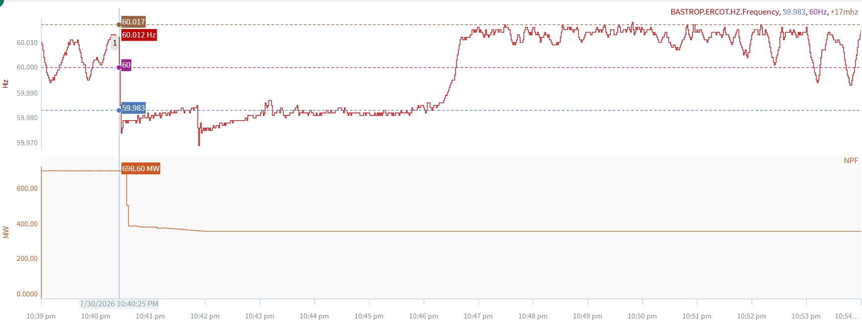
7/30/2026 22:40:25 (Non-FME)
Notes:
A combine cycle partially tripped for ~312 MW
Starting Frequency: 60.012 Hz
Minimum Frequency: 59.974 Hz
A-C Time : 3 seconds
Recovery Time(back to deadband): 5 minutes 38 seconds
Trip Reason: Due to an 86 on the steam turbine.
Contextual Information: A total of 346 MW of regulation Up and 200 MW of manual offset was deployed during the event.
Reason for no selection: A-B frequency too small.

Slide 11
Questions/Comments?

