Slide 1
NDSWG Meeting
August 2026

Slide 2
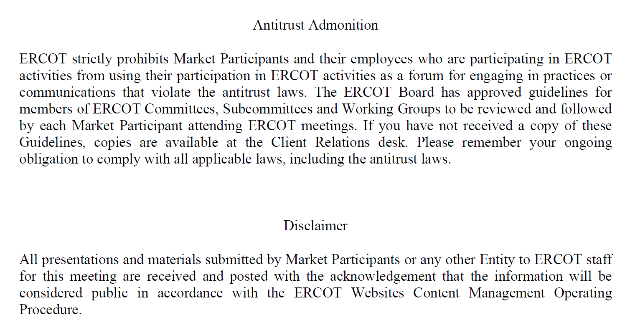

Slide 3
Topics
DPC Tool Update
Contingency Expectations by ERCOT Operations
Dynamic Ratings Project
NPRR 1265 Unregistered Distributed Generator
Other topics:
  Transmission Lines with flat ratings
  Summer Restriction ending
  NDSWG Contacts reminder
  CIM 16 project update

Slide 4
NPRR 1265 Unregistered Distributed Generator(UDG)
NPRR1265 established a definition for UDGs(1MW or less) and introduced new reporting requirements for TSPs and DSPs.
Key events for reporting:
  January 15, 2027: ERCOT will post pre-populated data
  February 1, 2027: DSP must submit UDG data to TSP
  March 30, 2027: TSP must update Network Operations Model
  Annually: ERCOT will publish a UDG report
MIS Posting:
  Unregistered Distributed Generator (UDG) Template - NP 3.2.5.1(2):
https://mis.ercot.com/secure/data-products/data-product-details?id=np3-822-m
  Unregistered Distributed Generator (UDG) Annual Report - NP3.2.5.2(1) :
https://www.ercot.com/mp/data-products/data-product-details?id=np3-823-m

Slide 5
Other Topics
Transmission Lines with flat ratings
  ~30% of OwnerShareRatings
Summer restriction
  Ending on September 15
  Submit NOMCRs early to minimize DPCs
NDSWG Contacts reminder
  Contacts update will be moved to the beginning of the year
CIM 16 Project Update:
  Native model available by the end of August
  Training tentatively scheduled for October 27
  Check MOTE Access

