Slide 1
SCR820 – Real-Time Operator Communications System (RTOC)
Bharati Nepal
Christelle Seri
August 20, 2026
Outline:
Status updates
Market Testing Updates
Recap Tool Access
Primary Contacts
Key Takeaways
RTOC project and market testing updates

Slide 2
Status Updates
Project updates
  QSE testing has started, and we are working on gathering primary contacts
  Control Room Operations is planning to send communications through RTOC tool for testing purpose in parallel with hotline calls for routine tasks
  Internal discussions are underway to draft NPRR to update Protocols that allow Control Room to use this tool in addition to current Hotline Call
  Development updates
  The first version of the SOL Exceedance data displays has been developed and deployed to Production environment
  SOL Exceedance History tab has been rolled out
  A default dashboard now gives a quick activity overview
  Development has begun on new screens to manage emergency conditions

Slide 3
RTOC Tool – Project Timelines
Project Timeline
Phase | Milestone | Target Date
Planning | Requirements & Design Finalized | Complete
Development | Development & Internal ERCOT Testing | Apr 2026
TOs Testing | Market Testing | Apr – June 2026
QSE Testing | Market Testing | June – Aug 2026
Parallel Operation | TOs/QSEs Parallel Operation | Q4 2026 – Q1 2027*
Go Live | TOs/QSEs Go Live | Q1 2027 – Q2 2027*
Key Takeaway: The timelines for QSE market testing have been added.
Please note that certain dates are subject to change pending the implementation of a nodal protocol revision request (NPRR).
We have determined that protocol updates are necessary so the control room can use the tool and start parallel operations. An updated market notice with revised timelines will be sent. (Original market notice for your reference: M-A032326-01A Access and familiarization of the Real- Time Operation Communications (RTOC) tool)
ERCOT is developing draft NPRR to update the protocols to use this tool in addition to current Hotline Call
Parallel Operations - ERCOT and TO/QSE primary point of contacts will test and verify RTOC messages in conjunction with Hotline Calls and any daily communications test. RTOC will NOT be a designated communication medium for control rooms. Hotline and voice communication will be the primary medium for Realtime system activities.
Go-Live* - RTOC is introduced into control rooms as a monitored 24x7 communication tool during normal and emergency operations.
*Coordinated with final approval of any NPRR changes

Slide 4
Market Testing Updates
Companies onboarded and logged into the application during market testing
    TOs – 22 – Total Users – 124
    QSEs – 26 – Total Users - 97
22 TOs and 26 QSEs users were able to successfully login and navigate through all the displays
ERCOT Control room/Project team completed gathering primary contacts from TO’s control rooms and currently working on gathering contacts from QSEs.
Market notice was published regarding QSE testing M-A062326-01 Access and familiarization of the Real-Time Operation Communications (RTOC) Tool - Qualified Scheduling Entities (QSE)
Only main QSEs are requested to log in and they may acknowledge on behalf of their sub QSEs
QSE testing dates are 6/29 – 8/21
We will begin testing communications twice a week to ensure that users can read, respond to, and acknowledge messages.
ERCOTRTOCSupport@ercot.com

Slide 5
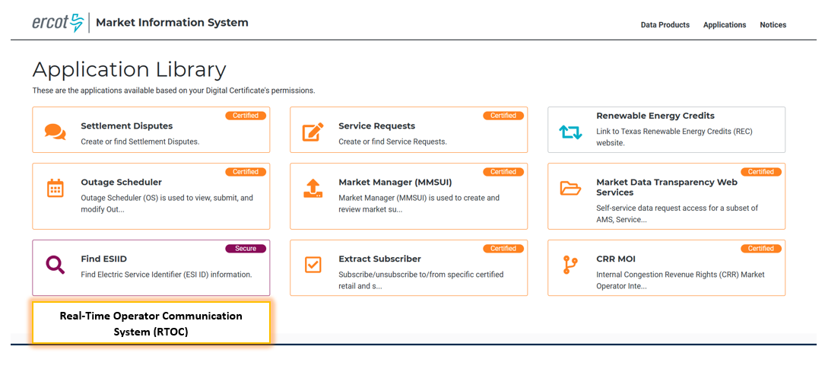
RTOC Tool Access
Access control
  Application access will be granted via digital certificates
  New roles must be added to the certificate for authorization
    Operator (RTOC_M_OPERATOR)
    ReadOnly (RTOC_M_VIEW)
  Link will be available on mis.ercot.com application library (It will be enabled after the completion of the market testing)
Available to request

Slide 6
Provide Primary Contact Information
We need your help to streamline communication for RTOC Market Testing.
Please share the following details for your organization:
Primary Contact Name
Email Address
Role/Designation
Why?
To provide testing-related communications
Share application URL, updates, and instructions promptly
How to Submit:
Email your details to: ERCOTRTOCSupport@ercot.com

Slide 7
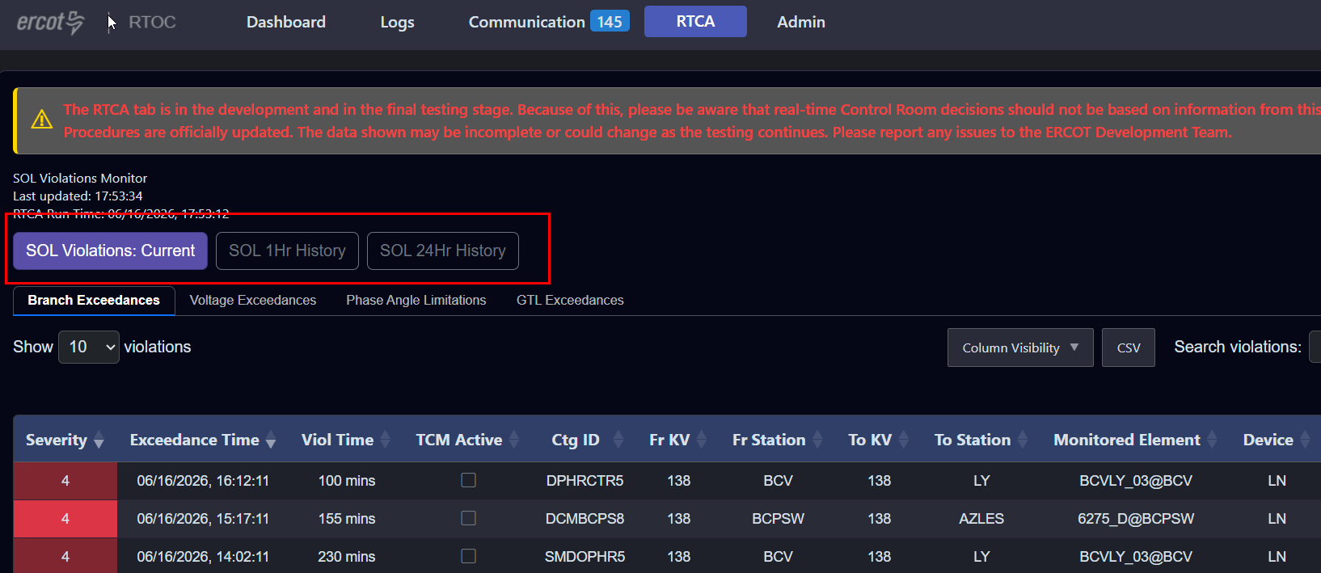
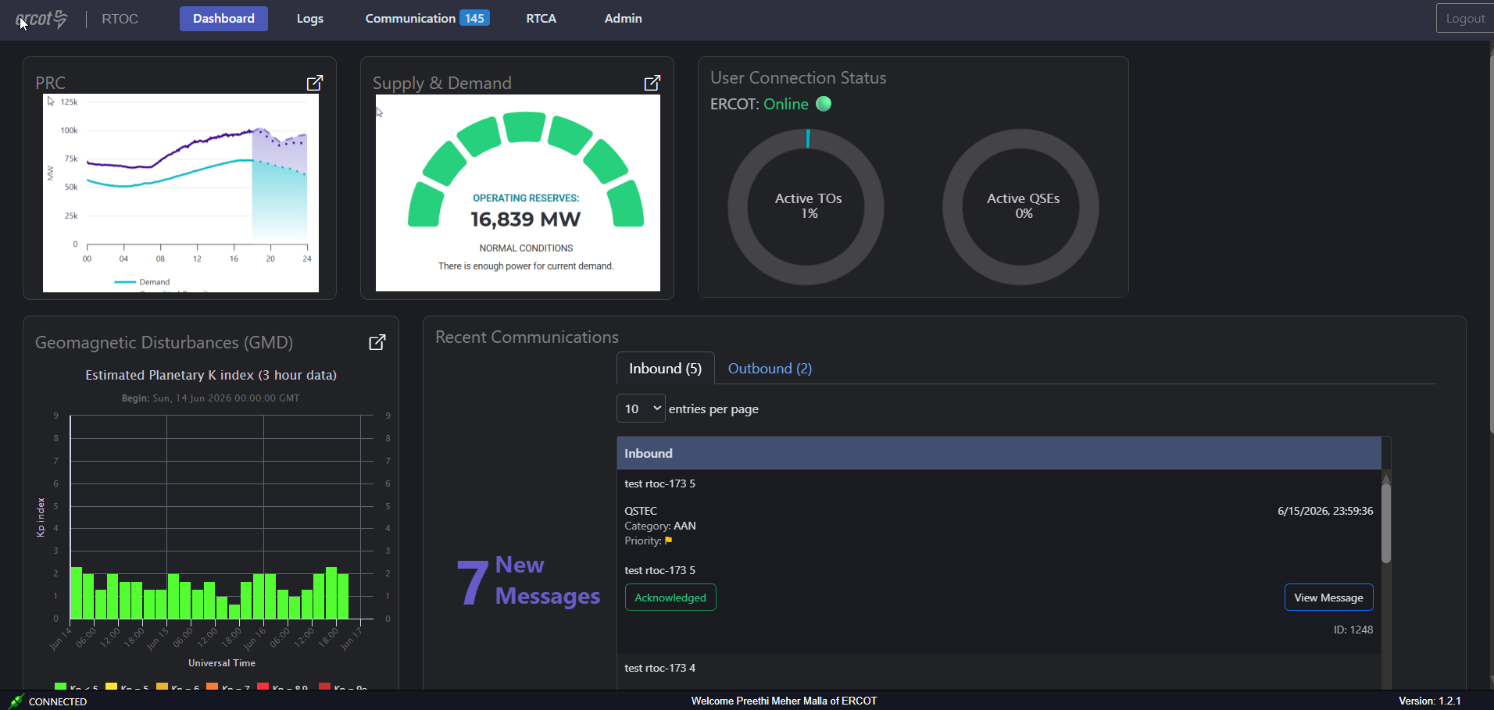
New features rolled out
Enhancements:
  RTCA Display update – to provides SOL Exceedance history data
    1 hr history
    24 hr history
Default dashboard to provide an overview of the new communications, GMD updates and system conditions

Slide 8
New features rolled out in August
Enhancements:
  RTOC-206 Communication - Improve Application Performance
Defects:
  RTOC-156 Communication - No indication of failed message
  RTOC-228 Communication - Message sent with sticky checked are not going through
  RTOC-232 Dashboard - Pop ups open in same window
  RTOC-233: Dashboard - User connection monitor - is not getting updated to reflect the number of active users
  RTOC-234 Communication - Read and ack % are not getting updated
  RTOC-235 Dashboard - Active Alerts & Acknowledgements - is not displaying SOL Exceedances
August Release (R8) will go into RTOC Production system on 08/27/2026 and available for Market Testing from this date.

Slide 9
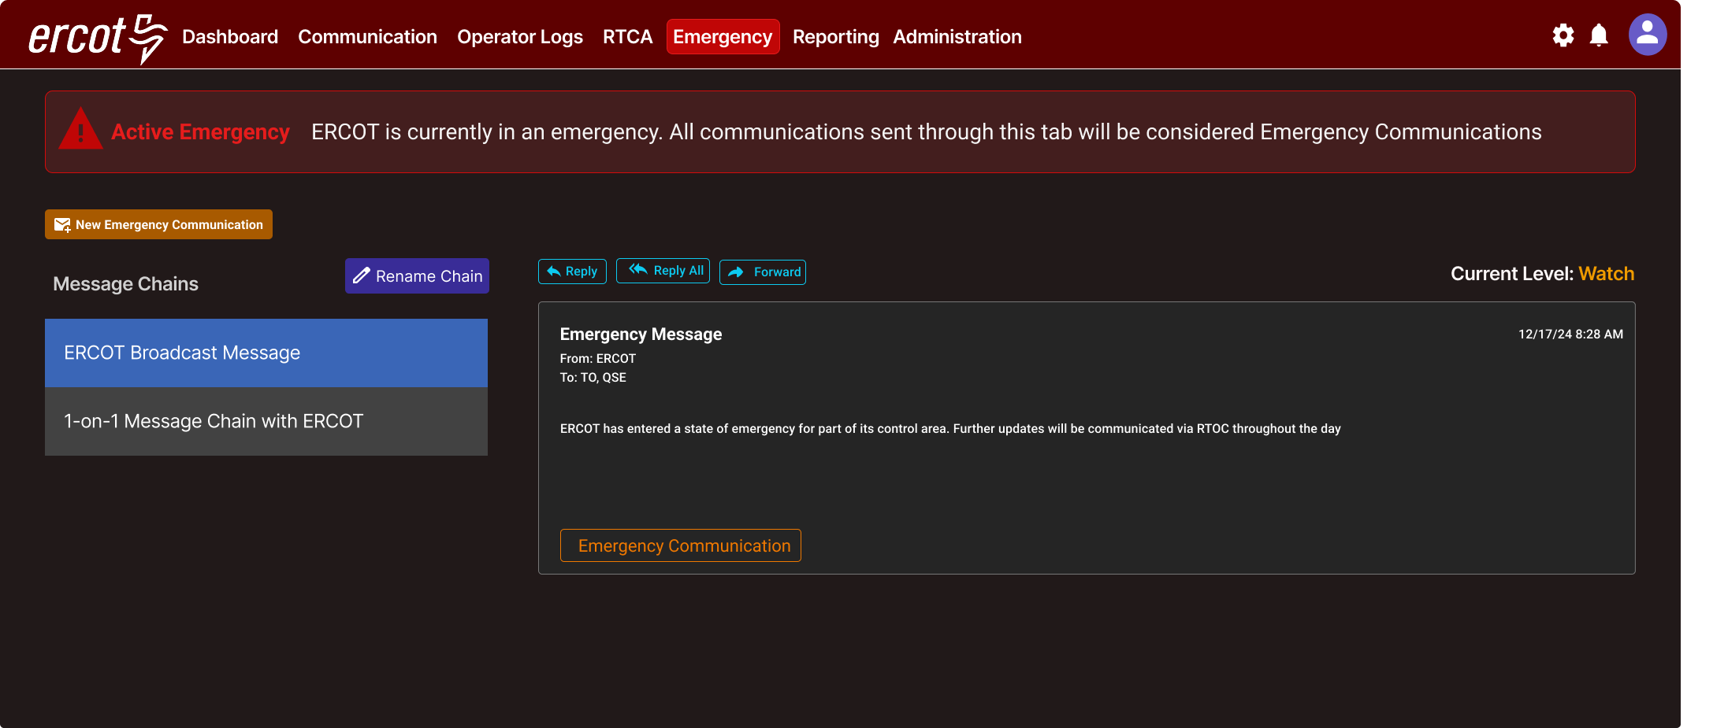
RTOC Emergency Page

Slide 10
Questions/Comments?

