Slide 1
Future Ready Identity Program
August 17, 2026
Outline:
  Why ERCOT is modernizing Market Participant Authentication
  Timeline
  The Plan for Testers
  Ask of our Point of Contacts
  Appendix:
      How Market Participants will Register, Authenticate and be Managed Future State
Key Takeaways
How ERCOT is modernizing the Market Participant authentication and what does that path forward look like

Slide 2
Why ERCOT is modernizing Market Participant authentication
ERCOT is moving from certificate-based access to a modern identity platform (Ping Identity) that is easier to use, easier to operate, and better positioned for evolving security needs.
Today
Digital certificate-based access
Future
Username/password + MFA
Modernization
Aligns Market Participant access with contemporary, standards-based authentication
Security refresh
Enables stronger MFA and adaptable controls as identity threats evolve
Simpler support
Reduces certificate handling, renewal, and troubleshooting burden over time
Phased transition
Readiness activities, testing, training, and Market Notices will guide the change
From a Security perspective, it’s essential to stay ahead of the threat.
A modern, Future Ready Identity and Access Management (IAM) solution is the best way to block unauthorized access, stop account takeovers, and prevent 99% of automated cyber attacks.

Slide 3
Timeline
Early Testers will get the first look at how to register and login to the new Stakeholder Login Portal with MFA and provide feedback to the team. Those Early Testers will evolve throughout the IAM Program, based on the applications to be integrated in each wave.
Sept 2026
Early Testers + User Acceptance Testing*
Jan 2027
User Acceptance Testing – MPSP**
NPRR 1306 Effective Date***
2027 - 2028
Discontinuation of old technology, moving into Ping as the official and only authentication method
2027
Testing and go-lives for applications integrating into Ping
Aug 2026
Early Testers Go-Live
Oct 2026
Future Ready
Identity
Stakeholder Portal
Go-Live
Feb 2027
MPSP**
Go-Live
Registration and login to Ping Dev
Apps included, not limited to:
NMMS – MOD
MMS – OS UI
CRR
MarkeTrak
Grid Geo
Key Takeaway:
The delivery approach for the IAM Program is in iterative waves, which consist of planned advanced notices (communications), testing and education with the stakeholder roles relevant to the applications and changes coming.
User Acceptance Testing for all impacted roles before the October Stakeholder Portal go-live
User Acceptance Testing for all impacted roles (e.g.: USAs, ARs/BARs) before MPSP** go-live
*User Acceptance Testing will consist of applications as they are tagged to a Wave, testers will vary based on impacted roles
**MPSP = Market Participant Service Portal
***NPRR 1306 - Removal of Digital Certificate References for Market Participants with ERCOT MIS Access

Slide 4
The Plan for Testers
Early
Testers
UAT Testers for Oct Go-Live
UAT Testers for iterative Waves
1
2
3
August 2026
Optional volunteers
Early Access and preview into the new Stakeholder Login experience
Registration and login only into a Development environment, no other functionality available at this time
On point to provide feedback on overall process, communication, trainings and experience
September 2026
Impacted users, tagged for testing based on their roles
Testing the Stakeholder registration and login experience in a Development environment
Raising defects and issues found
Dec 2026 – Aug 2027
Impacted users (e.g.: USAs), tagged for testing based on their roles
Testing the Stakeholder Login experience, entitlement assignments, and application(s) slated for go-live in a Development environment
Raising defects and issues found

Slide 5
Asks of our Point of Contacts
 |  | Understanding the Roadmap Ahead* We will make sure you know what’s coming next from a change and communications perspective Subject Matter Expertise We need your partnership to understand how the communications and future trainings are received in your respective groups/teams, in addition to: Providing regular feedback and survey responses Helping identify the person/people for each area of testing Your Advocacy and Your Team’s Support We ask that you communicate your support for this important initiative to your teams so that we can effectively partner with you as this effort moves forward
01
02
03
*Heads up: The Stakeholder Login Portal is going live this October. The roadmap ahead includes application go-lives that will have a different set of communications, trainings and guides. Closer to that time, we will engage with you again to so that you understand the changes ahead and the comms support that will be required.

Slide 6
Questions/Comments?
IAM2FutureReady@ercot.com

Slide 7
Appendix

Slide 8
The New
Stakeholder
Experience
October 2026 – through 2027

Slide 9
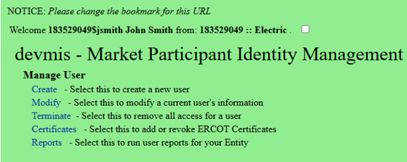
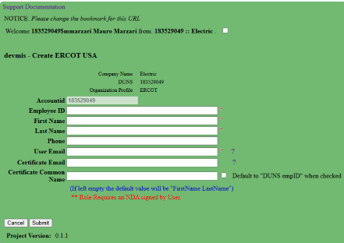
How Stakeholders Register (1/3)
Current State
1. MIDM Admin initiates MP user creation
2. MIDM Admin submits details
Draft – for illustrative purposes only; to be finalized

Slide 10
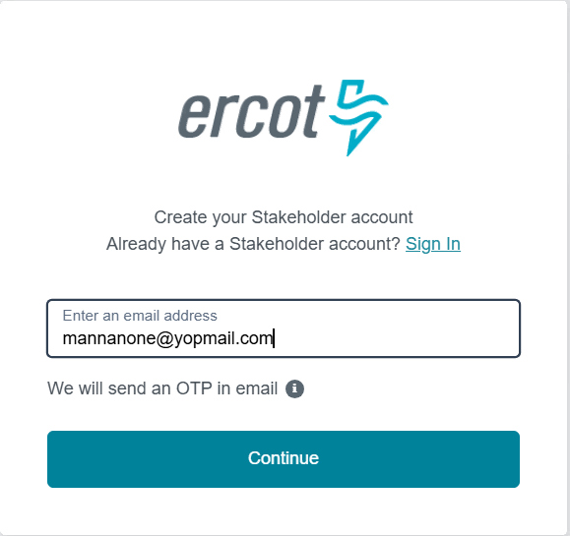
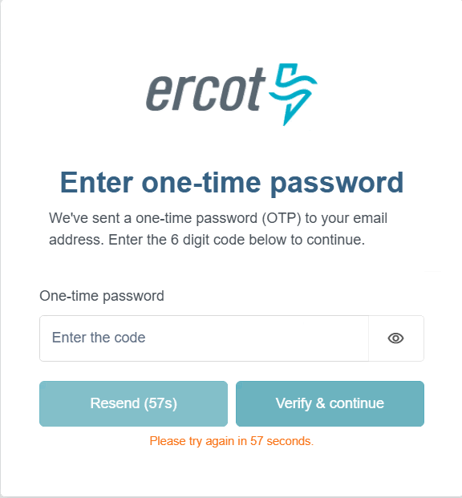
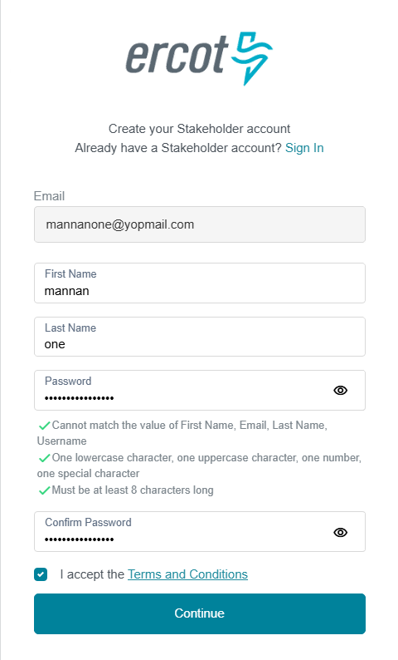
How Stakeholders Register (2/3)
Future State
1. User Registration
2. Verify Email
3. Submit details
Draft – for illustrative purposes only; to be finalized

Slide 11
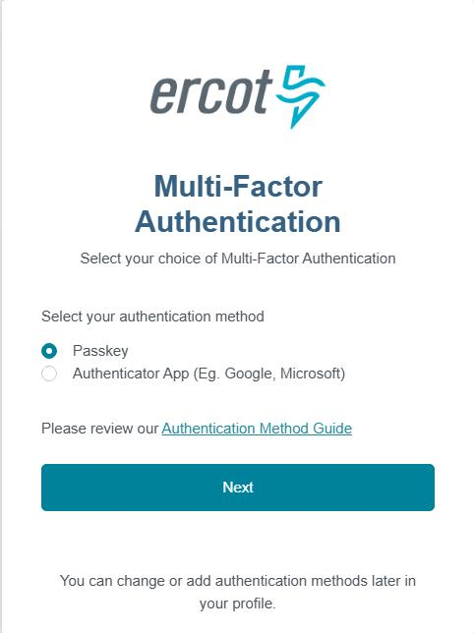
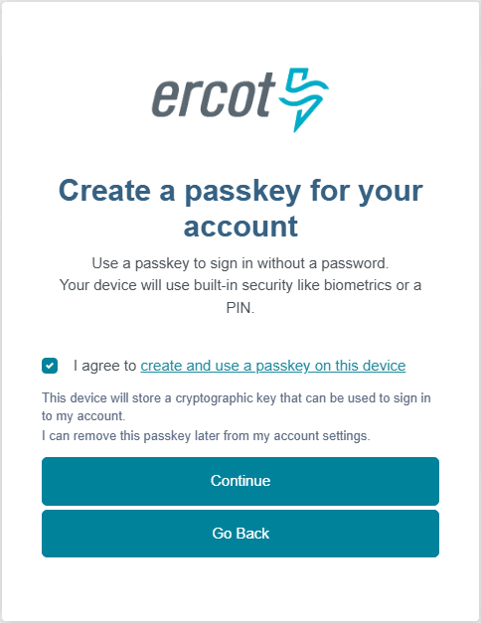
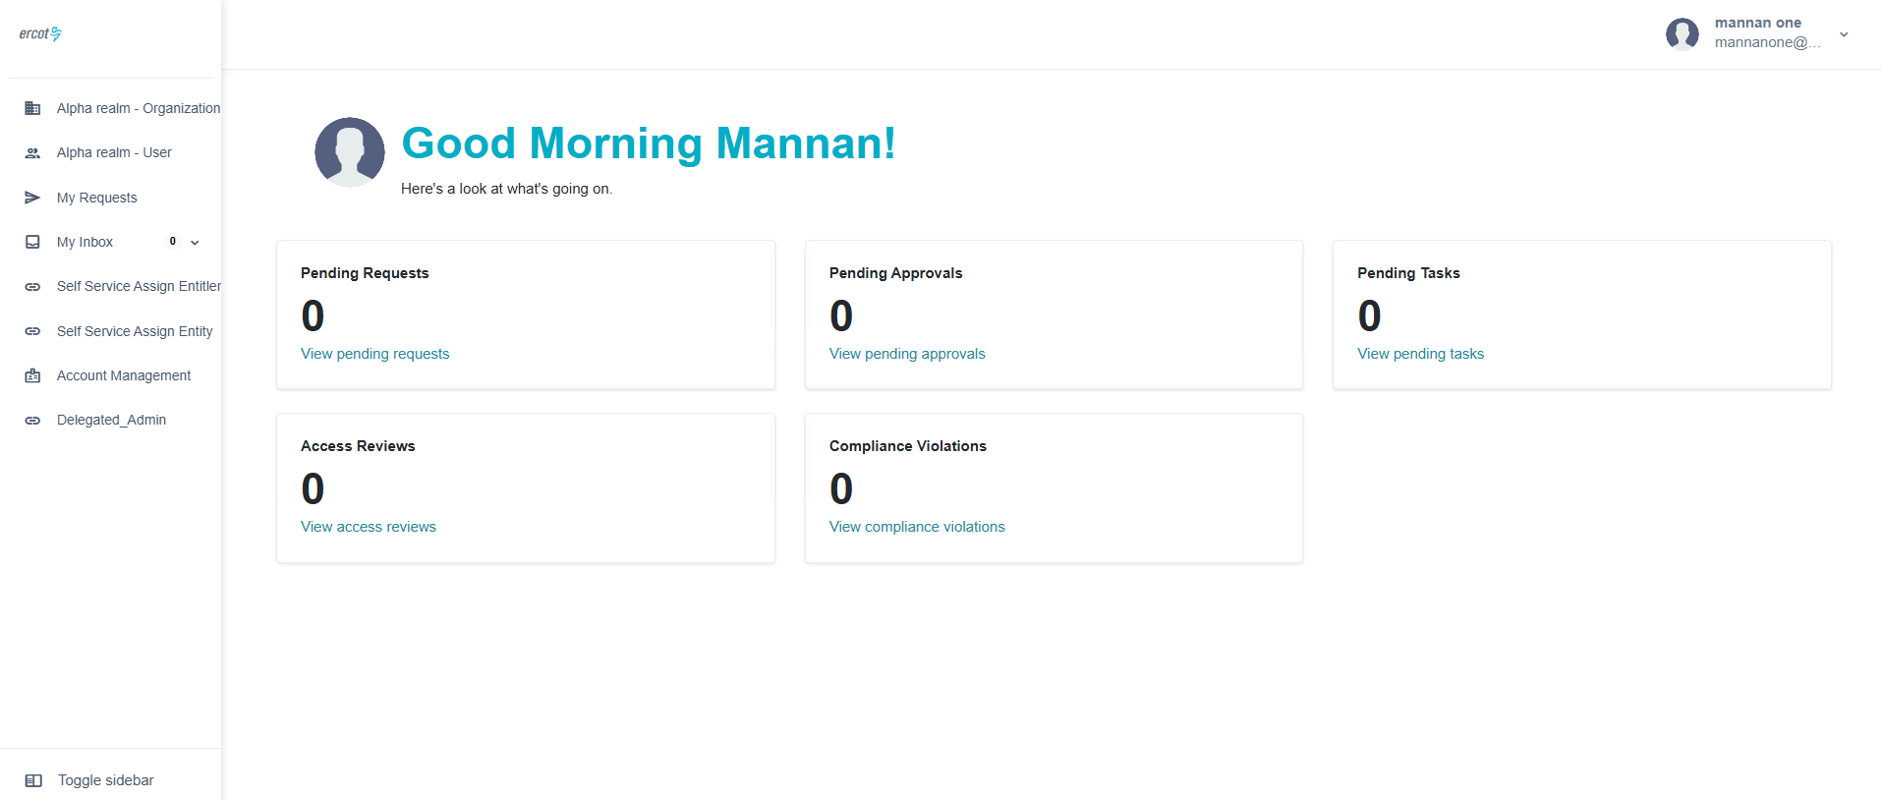
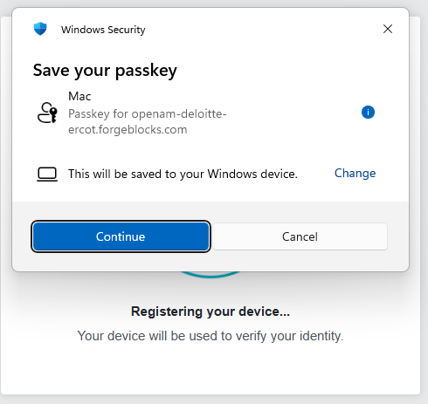
How Stakeholders Register (3/3)
Future State (cont.)
4. Select MFA
5. Setup MFA
5. Access Portal
Draft – for illustrative purposes only; to be finalized

Slide 12
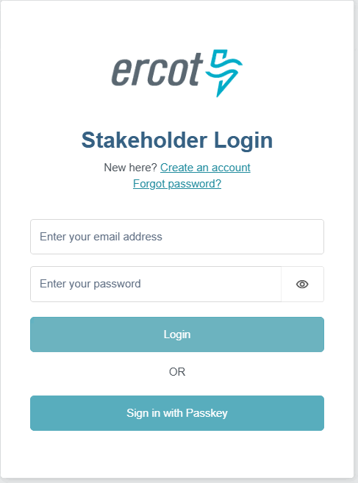
How Stakeholders Authenticate
Current State
Future State
1. Sign in by uploading certificate sent by Admin
1. Sign in securely with MFA or enjoy a frictionless passwordless login experience
Draft – for illustrative purposes only; to be finalized

Slide 13
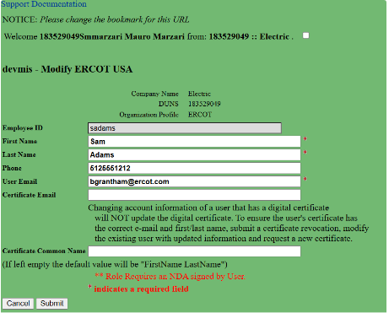
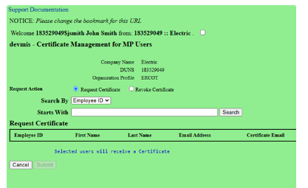
How Stakeholders are Managed – Current state
Current State
MIDM Admin manages MP profile
MIDM Admin manages USA certificates
MIDM Admin manages MP users' certificates
Draft – for illustrative purposes only; to be finalized

Slide 14
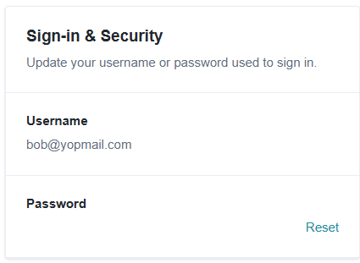
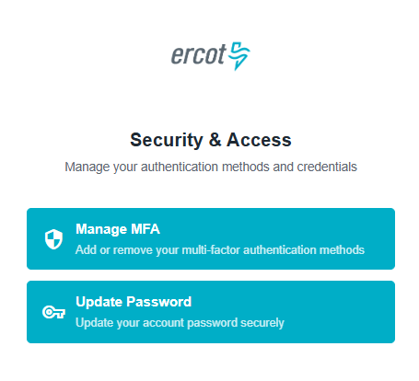
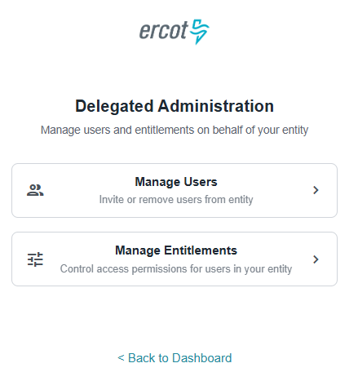
How Stakeholders are Managed – Future State
Future State
Self Service Profile Management
Self Service MFA and Password Management
USAs manage their users and entitlements
Draft – for illustrative purposes only; to be finalized

Slide 15
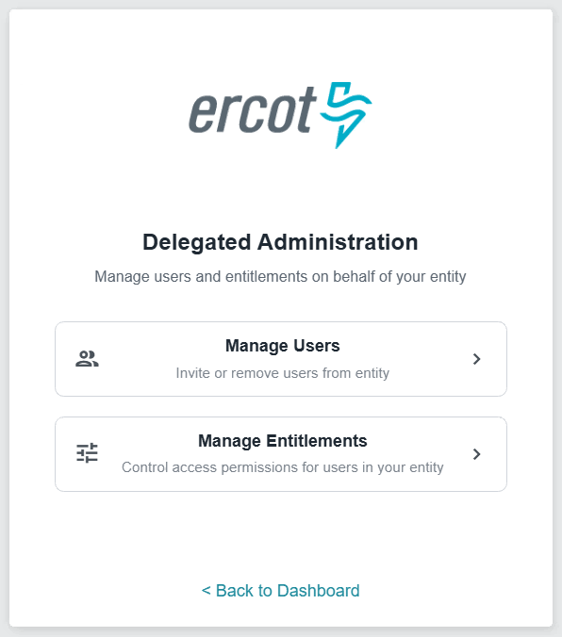
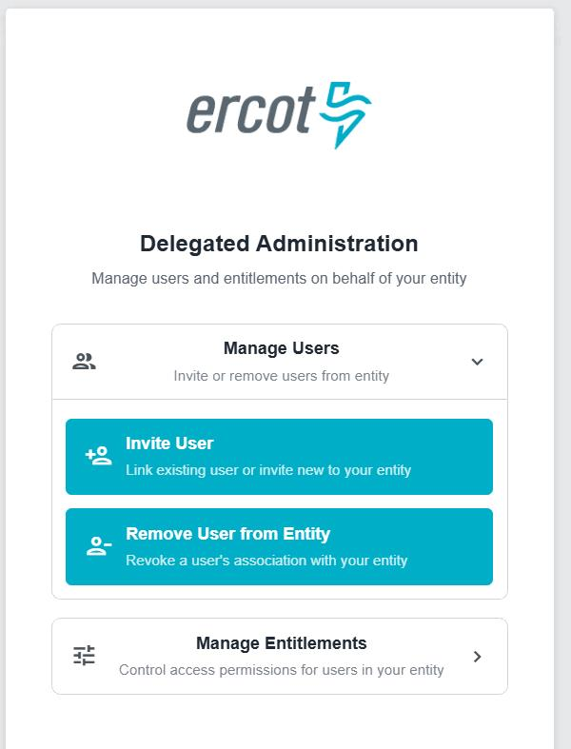
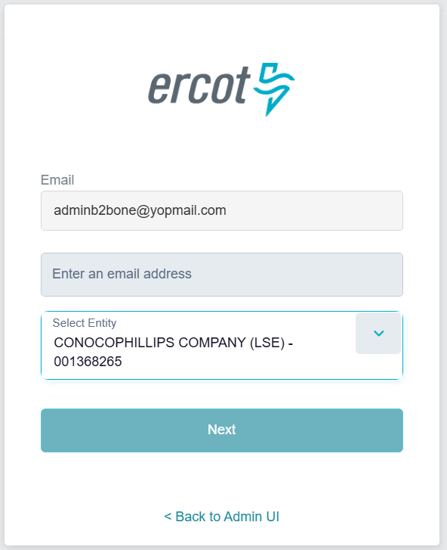
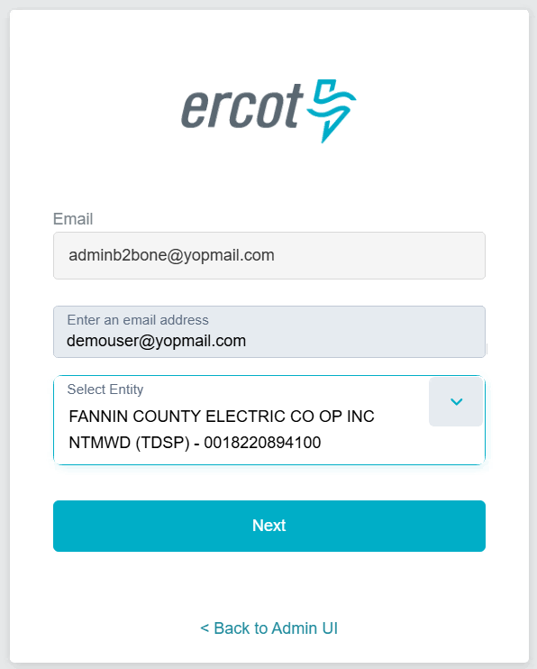
How USAs Manage Users
Future State
Invite new or existing users(1/2)
1. Delegated Administration
2. Manage Users
3. Invite User
4. Provide user mail & entity
Draft – for illustrative purposes only; to be finalized

Slide 16
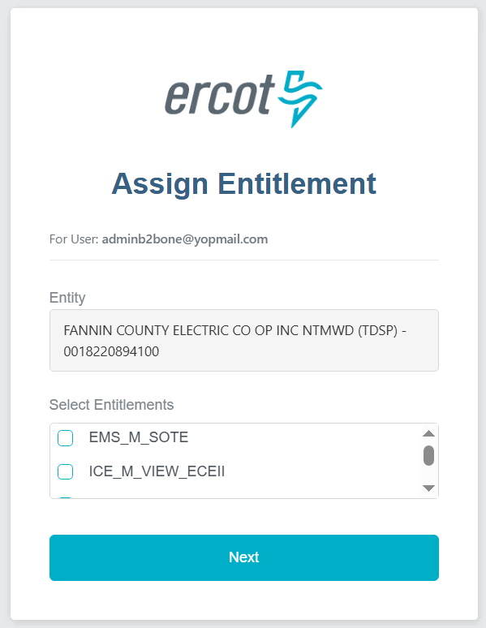
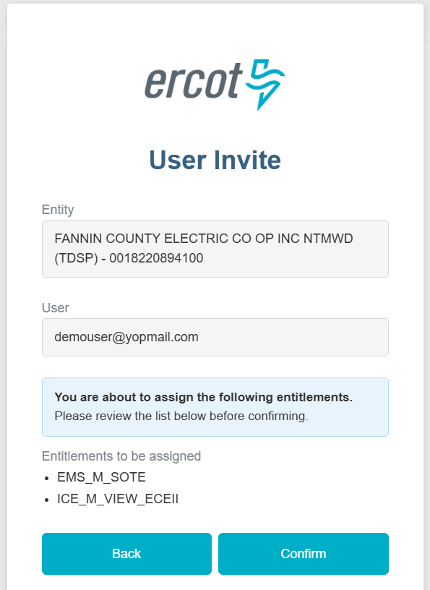
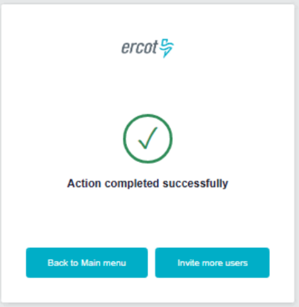
How USAs Manage Users
Future State
Invite new or existing users(2/2)
5. Select Entitlement
6. Confirm entity & entitlements
7. Success
Draft – for illustrative purposes only; to be finalized

Slide 17
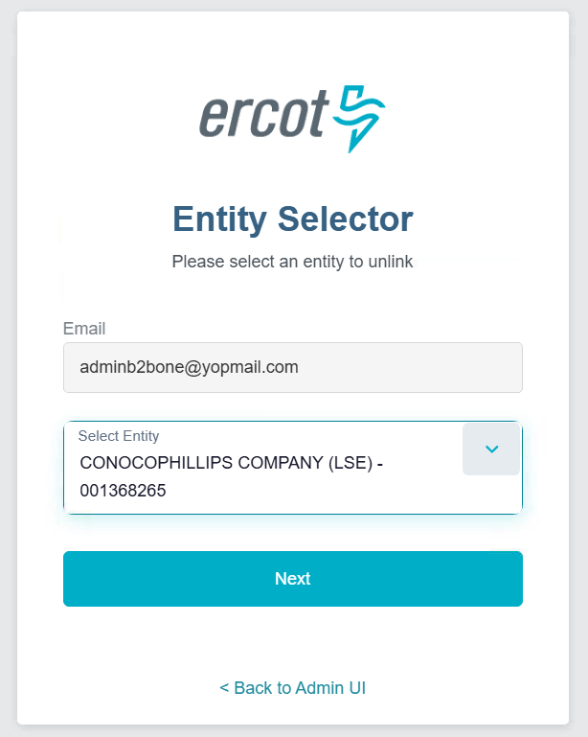
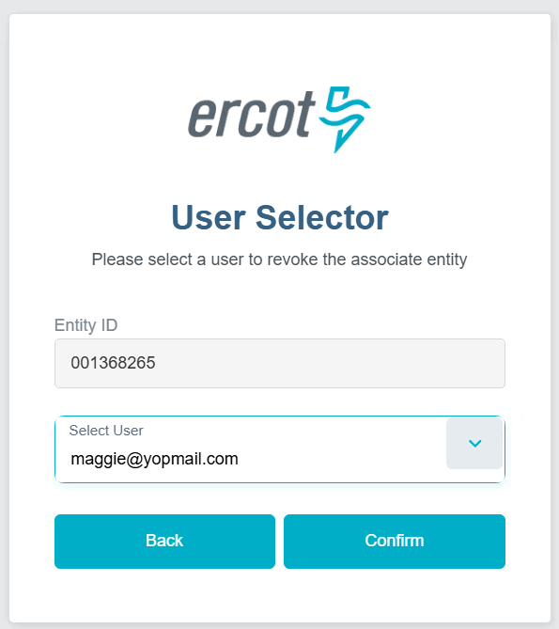
How USAs Manage Users
Future State
Unlink users from entity(1/2)
1. Delegated Administration
2. Manage Users
3. Remove User from Entity (Select Entity)
4. Select User
Draft – for illustrative purposes only; to be finalized

Slide 18
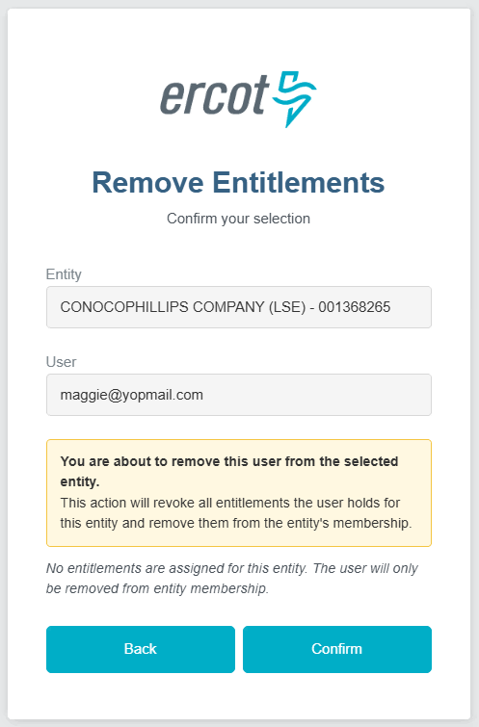
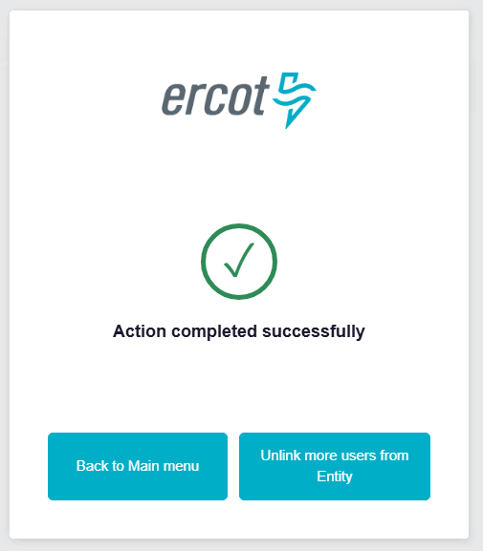
How USAs Manage Users
Future State
Unlink users from entity(2/2)
5. Confirm selection
6. Success
Draft – for illustrative purposes only; to be finalized

Slide 19
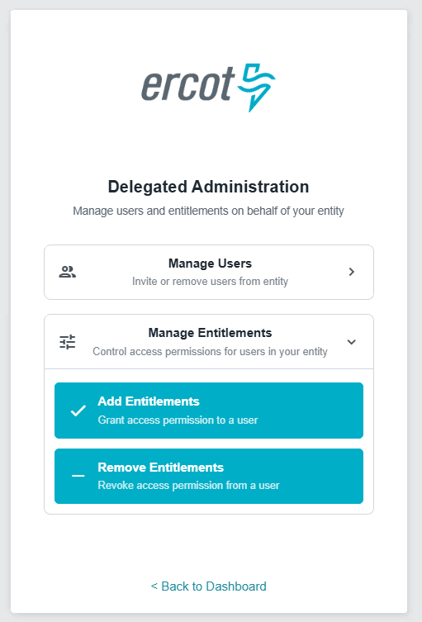
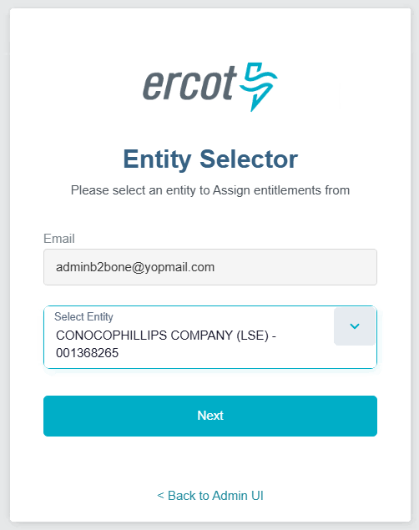
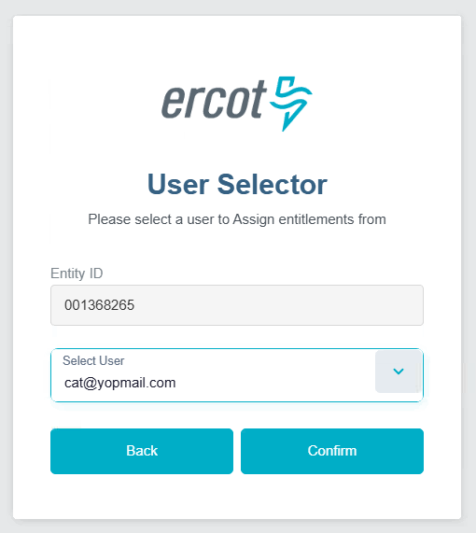
How USAs Manage Users
Future State
Assign Entitlements (1/2)
1. Delegated Administration
2. Manage Entitlements
3. Add Entitlements(Select Entity)
4. Select User
Draft – for illustrative purposes only; to be finalized

Slide 20
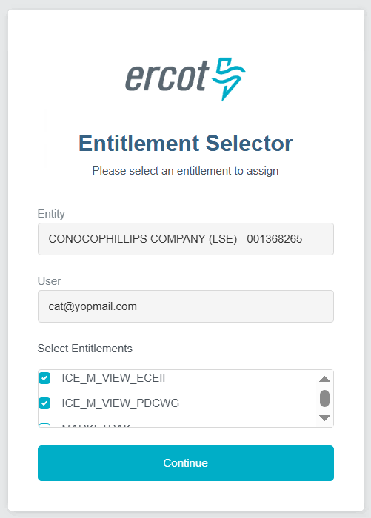
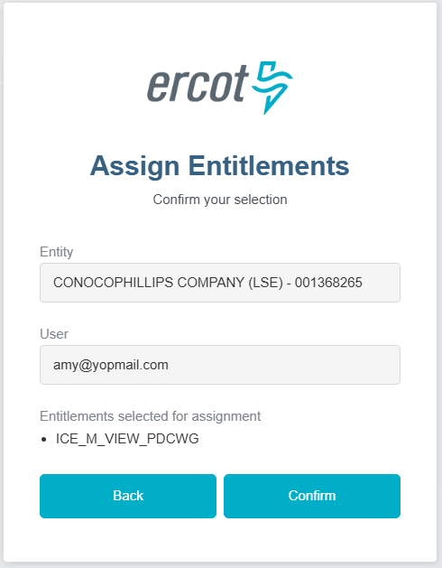
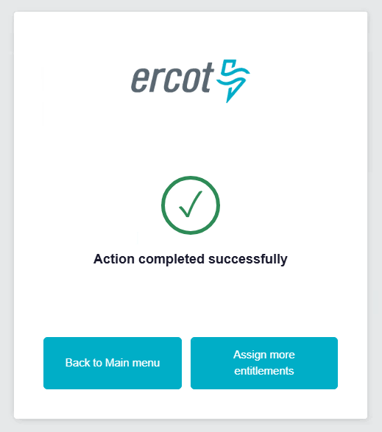
How USAs Manage Users
Future State
Assign Entitlements (2/2)
6. Select Entitlements
5. Confirm selection
6. Success
Draft – for illustrative purposes only; to be finalized

Slide 21
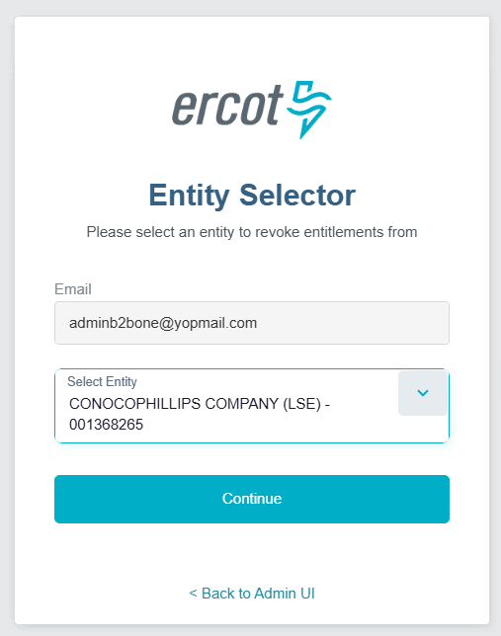
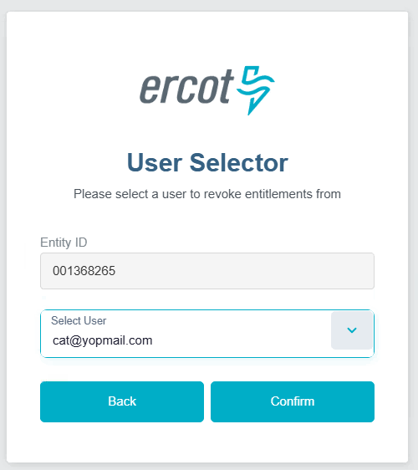
How USAs Manage Users
Future State
Remove Entitlements (1/2)
1. Delegated Administration
2. Manage Entitlements
3. Remove Entitlements(Select Entity)
4. Select User
Draft – for illustrative purposes only; to be finalized

Slide 22
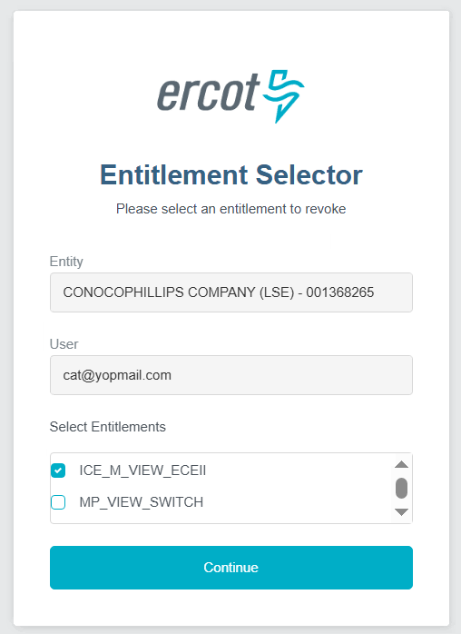
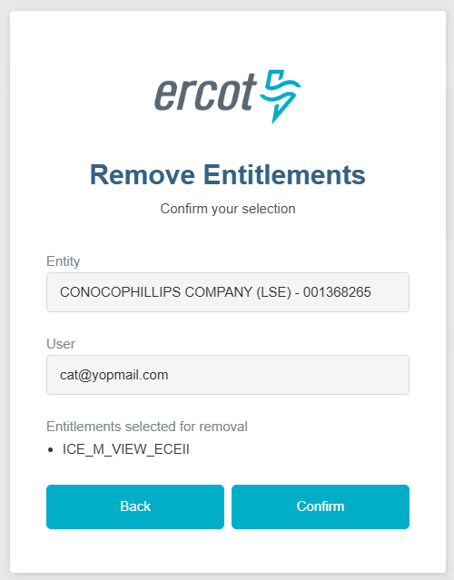
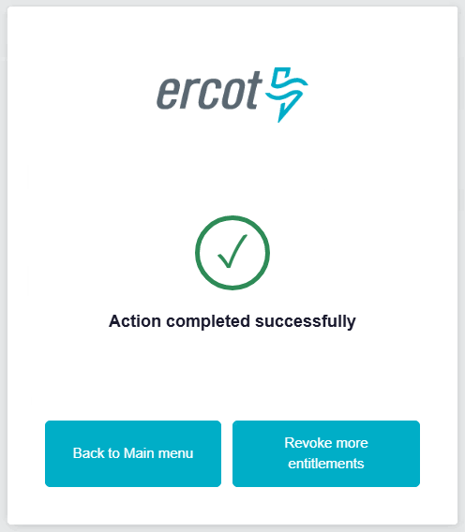
How USAs Manage Users
Future State
Remove Entitlements (2/2)
6. Select Entitlements
5. Confirm selection
6. Success
Draft – for illustrative purposes only; to be finalized

