Slide 1
2026 August & September (R8 & R9) Releases – Market & Outage Scheduler Changes
Katherine Li
August 20, 2026
Outline:
2026 August (R8) Release
2026 September (R9) Release
Key Takeaways
  NPRR1290/NPRR1323 RTC Gap Resolutions and Clarifications, and Market and OS submission changes in August (R8) releases.
  No Market or Outage Scheduler submission changes in July (R9) release.

Slide 2
2026 August/September (R8/R9) Release
2026 August (R8) Release will be deployed into Production on 08/27/2026.
  NPRR1290/NPRR1323 RTC Gap Resolutions and Clarifications – SCED prices capping logic updates.
  One market submission change related to Energy-Only offer/bid is currently planned for August (R8) release with a possibility that it may be re-scheduled to October (R10) release.
  Two outage scheduler submission changes are currently planned for August (R8) release.
2026 September (R9) Release will be deployed into Production on 10/01/2026.
  September (R9) release does not have any Market or Outage Scheduler submission changes that may impact Market Participants.

Slide 3
2026 August (R8) Release – NPRR1290/NPRR1323 RTC Gap Resolutions and Clarifications
  Background:
  Current functionality implemented with RTC+B, “[t]he System Lambda used to determine LMPs from SCED Step 2 shall be capped at the effective [Value of Lost Load] (VOLL).”
  The 2026-R8 release will implement the changes approved under NPRR1290, adopting the revised methodology for capping any LMPs greater than VOLL. All other LMPs below VOLL remain unchanged .
  Link to discussion/additional information - https://www.ercot.com/mktrules/issues/NPRR1290#summary
  Planned system changes
  MMS – SCED, LASCED
  Reports

Slide 4
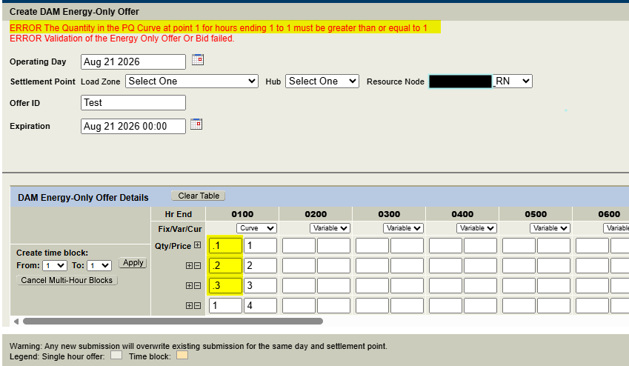
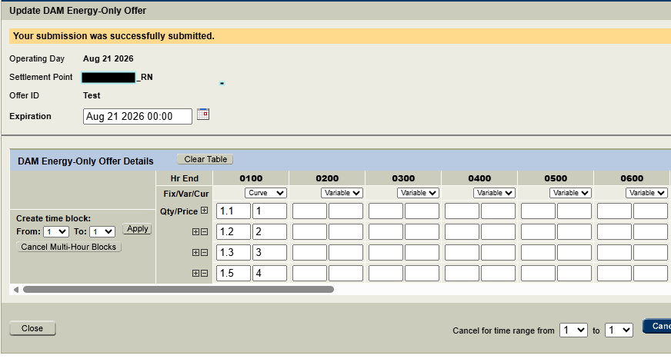
2026 August (R8) Release – Market Submission Validation Change
The minimum quantity should be one MW
  DAM Energy-Only Offers, protocol section 4.4.5.9.1(3), and
  DAM Energy-Only Bids, protocol section 4.4.9.6.1(2),
Currently for an Energy-Only offer/bid curve with multiple price-quantity points, only the last quantity on the curve is being validated that it is greater than or equal to one MW.
  The market validation will change to check and validate the first quantity on the curve is greater than or equal to one MW.
  Currently this change is planned for August (R8) release with a possibility that it may be re-scheduled to October (R10) release.
  Market Notice - https://www.ercot.com/services/comm/mkt_notices/M-A081426-01

Slide 5
2026 August (R8) Release – Outage Scheduler Submission Changes
Fixing an issue in Outage Scheduler User Interface (OS UI) to ensure that Resource Planned Outage Limit (RPOL) Violation warning message shall be provided, consistently, for each day that is of the RPOL Violation if the submission has multiple days of RPOL Violation – moved to future release.
Allowing changes to ‘Nature of Work’ for an outage that is in Active state.
Improving messages for a valid update to ‘Nature of Work’ along with a valid update to “Actual End Time”.
  Currently it generates a warning message which is not expected.

Slide 6
2026 August (R8) Release – Outage Scheduler Submission Changes
Allowing changes to ‘Nature of Work’ for an outage that is in Active state.
Improving messages for a valid update to ‘Nature of Work’ along with a valid update to “Actual End Time”.
  Currently it generates a warning message which is not expected.

Slide 7
Questions/Comments?
Katherine.Li@ercot.com
Sreenivas.Badri@ercot.com

