Slide 1
Contingency Expectations & DPC Review
Shift Engineering
August 18, 2026
Outline:
Contingency Definitions
Single Circuit and Double Circuit Examples
Shift Engineer DPC Workflow
DPC Forms and Best Practices
Key Takeaway
ERCOT and TOs both must work together to ensure RTCA accurately assesses the post-contingent state.

Slide 2
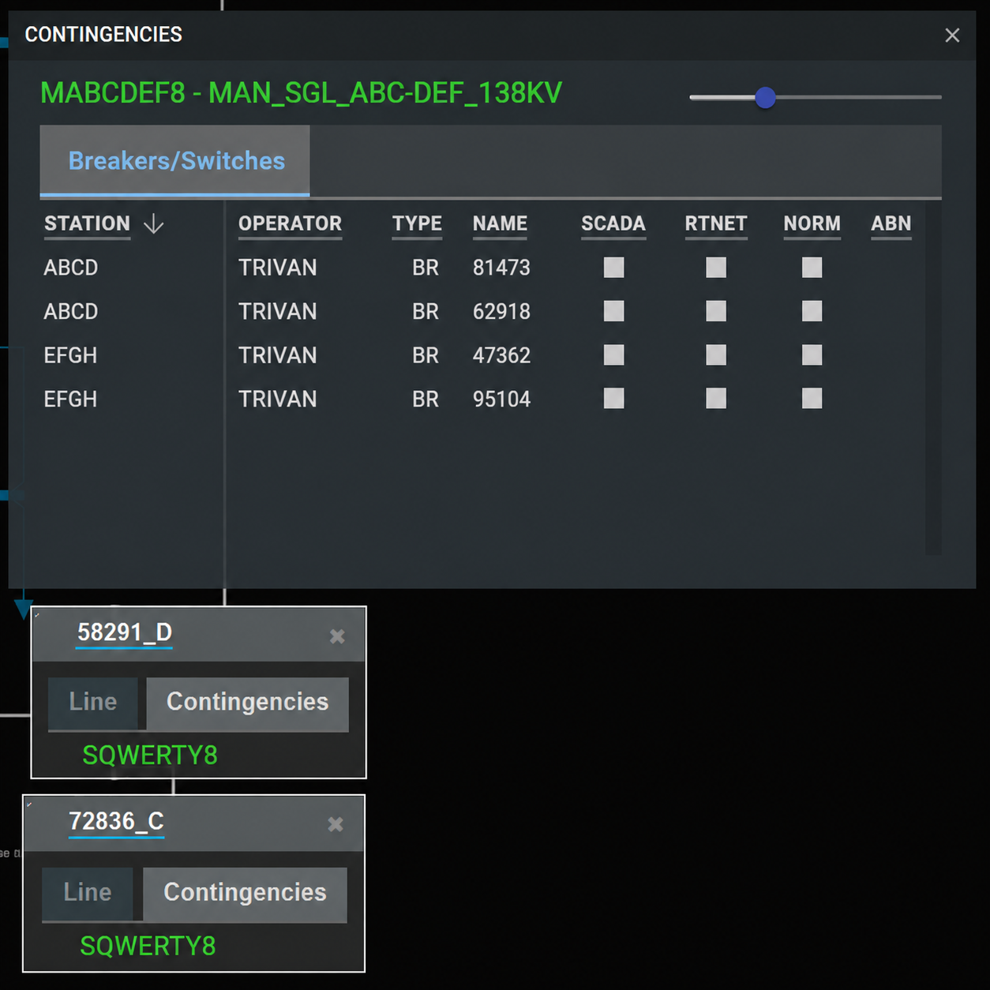
Contingency Definitions
Contingency definitions should list the contingency equipment and associated clearing devices.
  Missing clearing devices necessitate immediate correction and will prevent work in the field from continuing.
  Including the contingency equipment in the definition increases the situational awareness of the control room. In addition to this it enables contingency/equipment association in SOTE and GridGeo.
Since the contingency definition did not include the contingency equipment, the lines do not associate with the manual contingency.
Goal: ERCOT’s RTCA accurately assesses the post-contingent state.

Slide 3
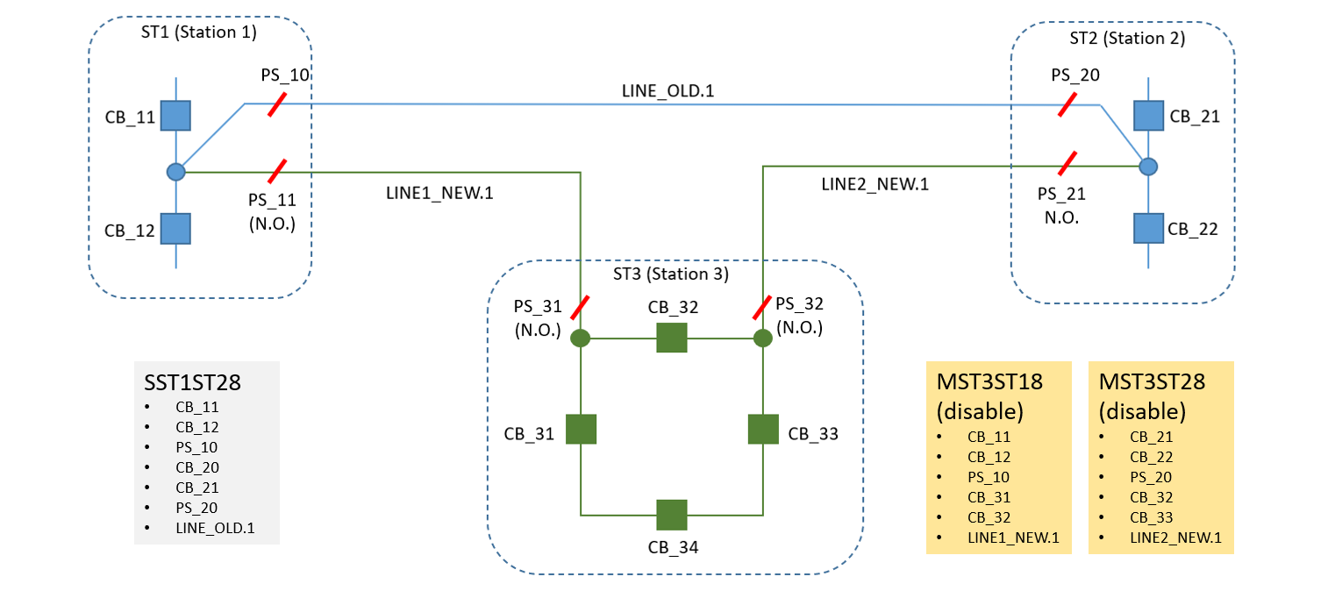
Using Pseudo Switches for Future Topology
Note: Pseudo switches indicate to the operator that we are looking at multiple topology states within the same model.

Slide 4
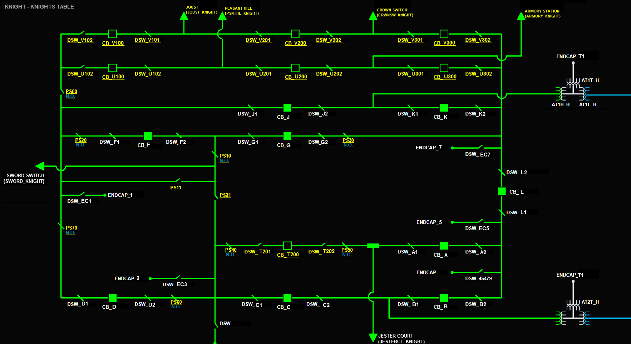
Provide a Clear Final State
Note: It should be obvious at a glance how the pseudo switches can be used to switch from the old to new path.

Slide 5
Single Circuit with Pseudo Switches
SST1ST28
  LINE_OLD.1
  ST1 CB_11
  ST1 CB_12
  ST2 CB_21
  ST2 CB_22
Auto traced single contingency.

Slide 6
Single Circuit with Pseudo Switches
MST1ST38
  LINE1_NEW.1
  ST1 CB_11
  ST1 CB_12
  ST1 PS_10
  ST1 PS_11
  ST3 CB_31
  ST3 CB_32
MST2ST38
  LINE2_NEW.1
  ST2 CB_21
  ST2 CB_22
  ST2 PS_20
  ST2 PS_21
  ST3 CB_32
  ST3 CB_33
Note: Manual contingency definitions include the contingency equipment and the associated clearing devices.

Slide 7
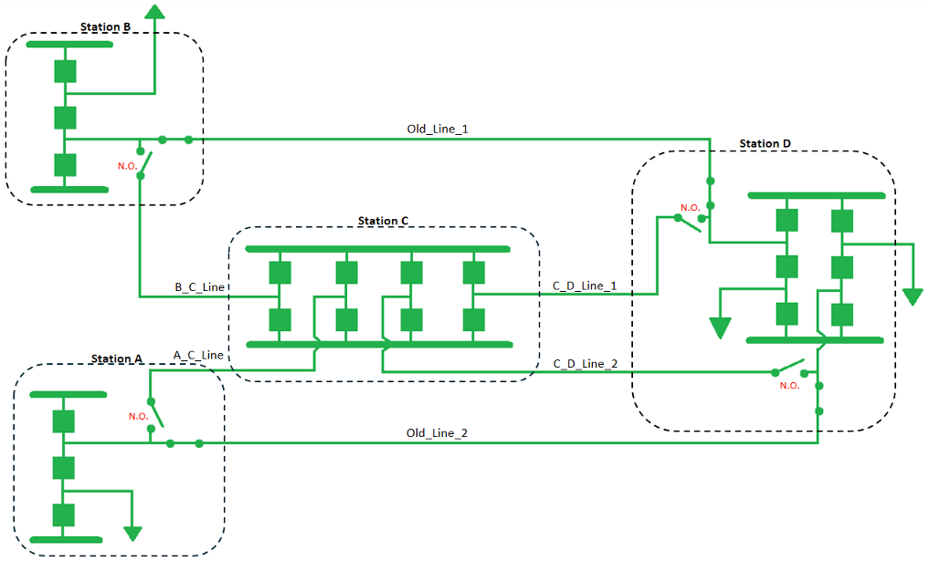
Double Circuit with Pseudo Switches
Note: Double circuit contingencies must be redefined with manuals as well to support energization.

Slide 8
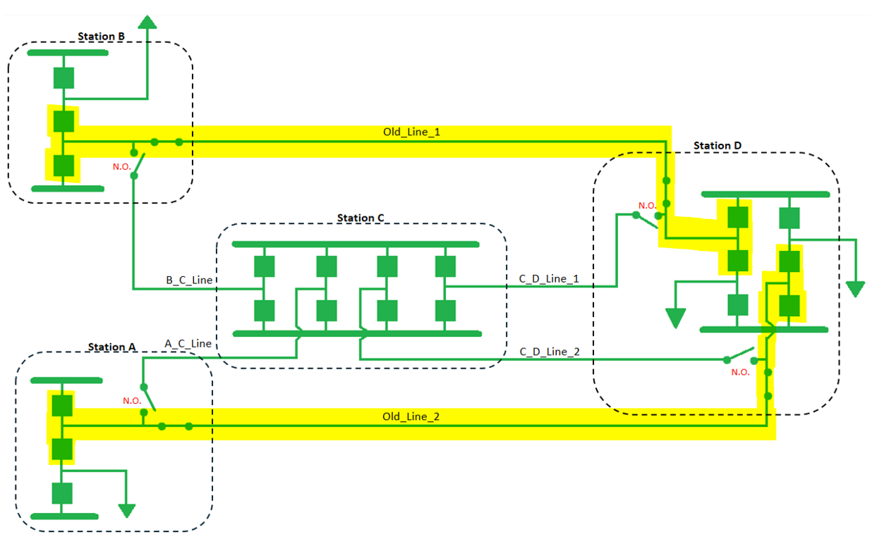
Double Circuit with Pseudo Switches

Slide 9
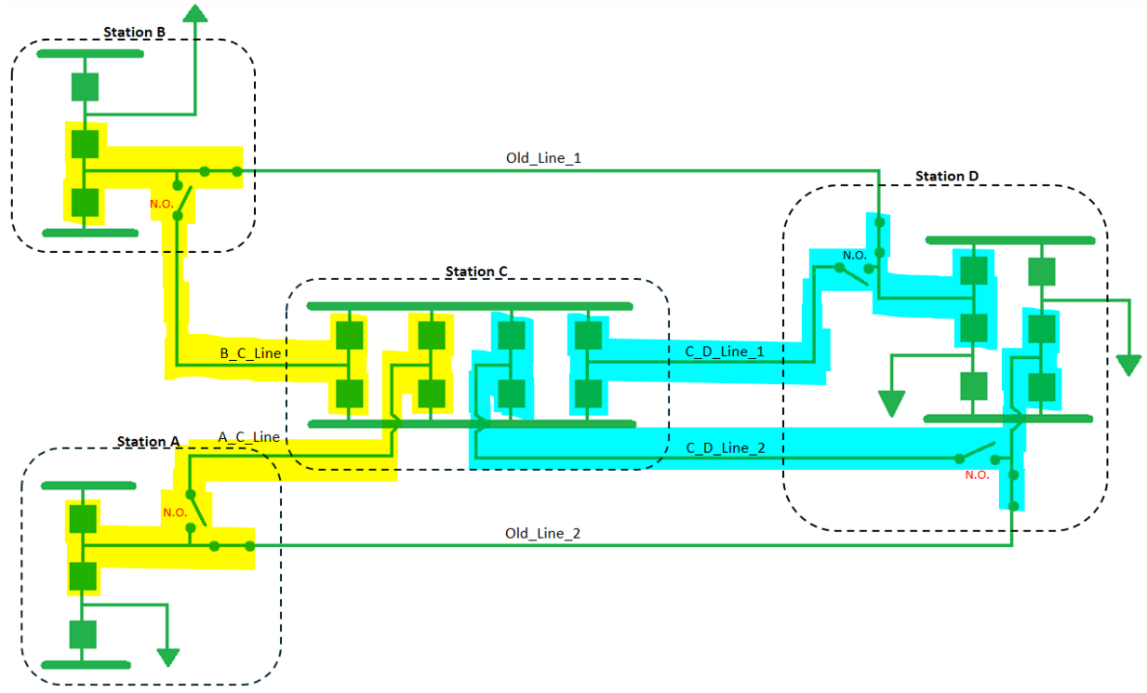
Double Circuit with Pseudo Switches

Slide 10
Contingency DPC Workflow
< 5 Minutes
Shift Engineer approves the DPC for implementation
Enable/Disable
Ready for field change
New/Modify
Shift Engineer checks the DPC contingency definitions against topology
> 1 Hour
Shift Engineers will review the DPCs to ensure that contingencies adequately cover the equipment.
New/Modify DPCs have a longer lead time and should be requested ahead of scheduled work.

Slide 11
DPC Best Practices
Contact the shift engineer early in the operating day to review DPCs associated with your planned energization. The shift engineer can ensure the DPCs are in their queue and that the contingency definitions are valid.
Coordinate contingency definitions with neighboring TOs to avoid missing clearing devices.
Once the new DPC Tool is operational, Temporary Enable/Disable DPCs will provide a lot of flexibility for energizations if the manual contingencies are defined ahead of time.
For New/Modify DPCs, contact the shift engineer at least one hour prior to the desired implementation time.

Slide 12
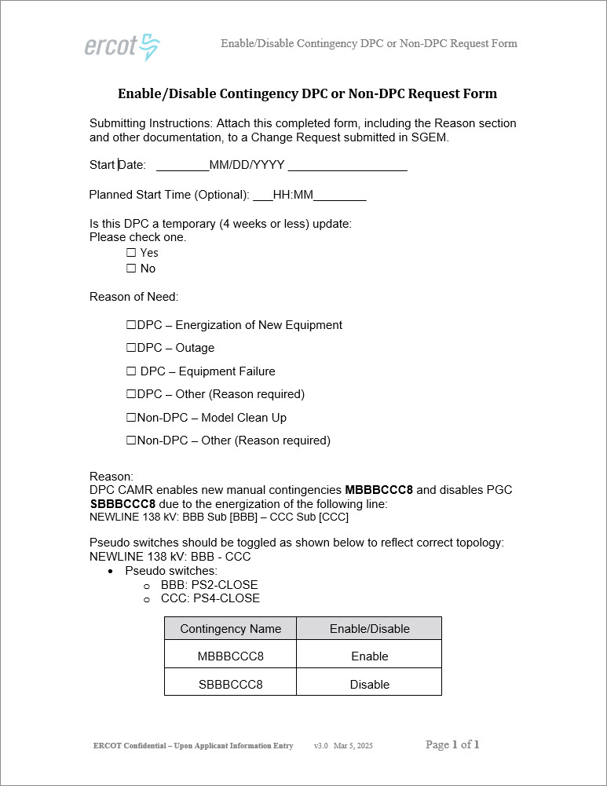
Forms - DPC – Enable/Disable
Start Date and Planned Start time:
  Must match the Effective time on the CAMR
Is this DPC a temporary (4 weeks or less) update:
  Example: Switch cycle
Reason of Need:
  Most common is DPC – Energization of New Equipment
Reason:
  This field should be used to provide the Modeling and Operations teams with the information related the DPC.
    Several downstream groups see this form, provide information on contingency updates, switch status, and line energization.
      Example:
      DPC CAMR enables new manual contingencies MBBBCCC8 and disables PGC SBBBCCC8 due to the energization of the following line:
      NEWLINE 138 kV: BBB Sub [BBB] – CCC Sub [CCC]
      Pseudo switches should be toggled as shown below to reflect correct topology:
      NEWLINE 138 kV: BBB – CCC
      Pseudo switches:
      BBB: PS2-CLOSE
      CCC: PS4-CLOSE
    Required if ‘Other’ is selected

Slide 13
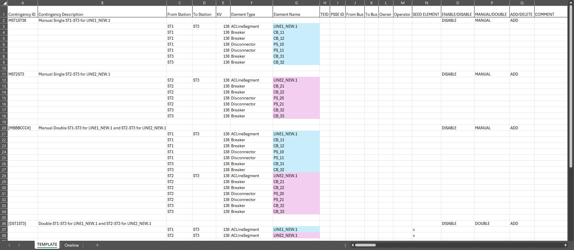
Form - Manuals Contingency Spreadsheet – Template (Sheet1) - ADD

Slide 14
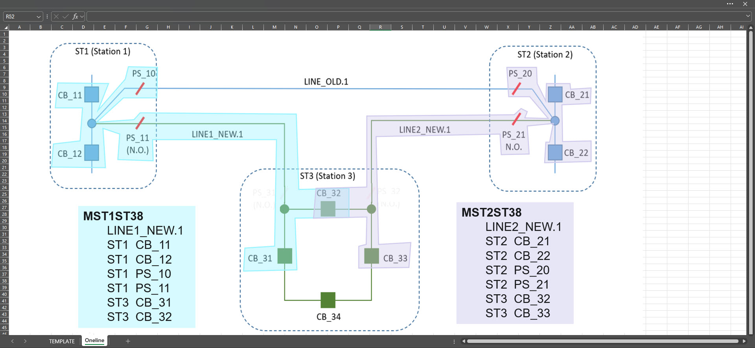
Form - Manuals Contingency Spreadsheet – Oneline (Sheet2)

Slide 15
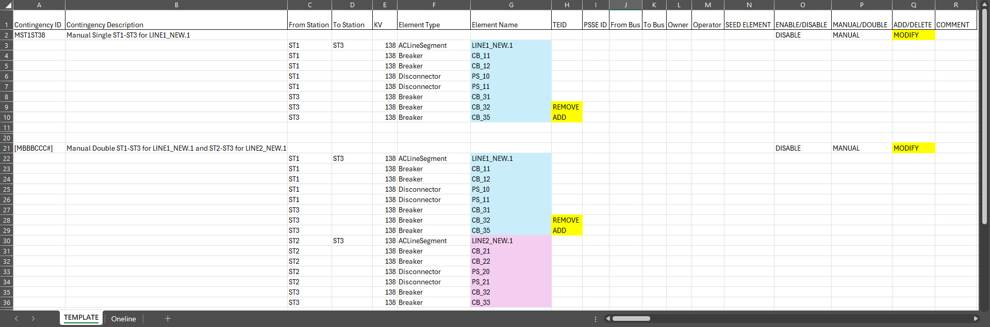
Form - Manuals Contingency Spreadsheet – Template (Sheet1) - MODIFY
Modification to existing contingency definition must be marked clearly
  Especially for DPCs – downstream systems review, add, and update contingencies based on the spreadsheet data

Slide 16
Standard and DPC Contingencies Compare
Standard Contingencies
Contingency CAMR proposed for same PLD as NOMCR
IP2 is the deadline, but propose as soon as possible
  Allows more time for review
Standard Attachments
Spreadsheet
  Manual and double contingencies created as disabled
  Highlight the definitions
Enable/Disable form not needed for standard submissions
DPC Contingencies
Proposed ~3 business days before PLD
Adding/modifying contingencies by DPC is time consuming
  DPCs go through all levels of testing before implementation
  Add ‘DPC’ in the Project / Name Fields
  Send a DPC email after the CAMR is proposed
  Contingencies cannot be deleted by DPC
DPC Attachments
Enable/Disable Word Document
  Effective Date and Time must match the CAMR
  Use a thorough description in CAMR and under the Reason field
Spreadsheet (add/modifications only)
  Highlight the definitions
  If not adding or modifying, spreadsheet is not required
Include onelines in the spreadsheet attachment
Use additional tabs as needed for Breaker-to-Breaker onelines with highlighted paths
  Reduces the number of attachments in MAGE
Notes:
Not every NOMCR needs a manual contingency. Manuals are mainly needed when new topology changes the expected contingency path. If the new equipment is radial, does not affect existing fault-isolating devices, and does not create a new power-flow path, Auto Tracer should be able to handle the single contingencies through the normal model build process. When the topology is unique, TSPs could contact NOMCRHelp before proposing the CAMR.

Slide 17
Good Practices and Reminders
  Equipment names should match MAGE
    Trace new contingencies in MAGE (view-only) model or Model Auditing to verify the contingency definition
        Substation Code
        Voltage Level
        Element Type (Breaker, Disconnector, ACLineSegment, SeriesDevice, Winding)
        Element Name
  For new Manual Contingencies, all pseudo switches and devices that will be relevant to clearing a fault must be included
  Contingencies for a bypass, shoefly, or switch cycle:
    Describe the reason in the project and name description fields of the CAMR (and on the E/D form for the DPC)
    For clarity, include the N.O. device that will be swapping state to enable the bypass, shoefly, or switch cycle contingency
      If using a transfer bus, include all N.O. switches and clearing devices

Slide 18
Naming Practices and Reminders
Contingency ID (name) Format
Unique 8-character ID for each contingency, in the form of ABBBCCC#, where:
  A represents the type of contingency (S for Single, D for Double, M for Manual, Q for shunt, X for transformer, U for unit)
  BBB represents the first three letters in the beginning substation’s mnemonic in the ERCOT Network Operations Model
  CCC represents the first three letters in the ending substation’s mnemonic in the ERCOT Network Operations Model and in the case of double circuit contingencies involving different voltage levels, the last C together with # will represent the voltage class (example:DBBBCC58/DBBBCC89)
  # represents the voltage class (5 for 345 kV, 8 for 138 kV, 9 for 69 kV)
Autotransformer Contingency Name
Unique 8-character ID for each contingency, in the form of XAAA##BC, where
  X represents Autotransformer
  AAA represents the first three letters in substation’s mnemonic in the ERCOT Network Operations Model
  B represents the voltage class of the high-side of the Autotransformer (5 for 345 kV, 8 for 138 kV, 9 for 69 kV)
  C represents the voltage class of the low-side of the Autotransformer (5 for 345 kV, 8 for 138 kV, 9 for 69 kV)
  ## represents the Autotransformer number

Slide 19
Questions/Comments?
NOMCRHelp@ercot.com
Ryan.Wells@ercot.com

