Slide 1
Bi-Directional Generic
Transmission Constraints
Operations Support
August 14, 2026
Outline:
Background: What is a GTC?
The issue identified by the QSA
Operational impact of the current approach
Proposed change: bi-directional modeling
Potential Impacts to Reports

Slide 2
Background: What Is a Generic Transmission Constraint?
Definition — per ERCOT Nodal Protocol Section 3.10.7.6, a GTC is a constraint created from a defined group of transmission elements, used to manage flow between areas of the ERCOT grid.
Purpose — GTCs are typically used to enforce stability, voltage and thermal cascading limits.
Directional by design — stability issues are usually directional, so GTCs have historically been modeled and enforced in one direction only.
Key Takeaway: GTCs enforce non-thermal stability limits and have traditionally been built as one-directional constraints.

Slide 3
The Issue: The One-Way Model Doesn't Fit
QSA finding — the recent Quarterly Stability Assessment identified the need to build a GTC due to some Energy Storage Resources (ESRs) seeking interconnection in weak-grid areas.
Why it's different — because ESRs can rapidly switch between charging and discharging, their flow must be constrained in both directions in SCED to effectively control the flow and avoid constraint oscillations
The gap — today's framework requires two separate one-directional GTCs created to achieve that, which poses significant operational challenges in managing the GTC flows .
Key Takeaway: The current framework poses significant operational challenges in managing the GTC flows with in the stability limits for GTCs dominated by ESRs.

Slide 4
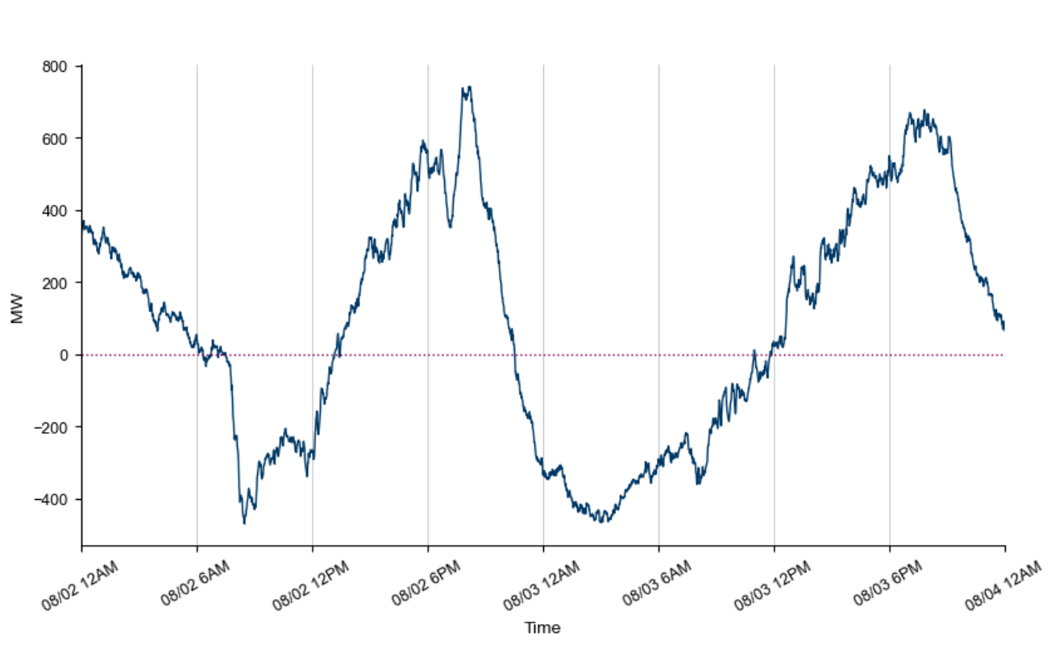
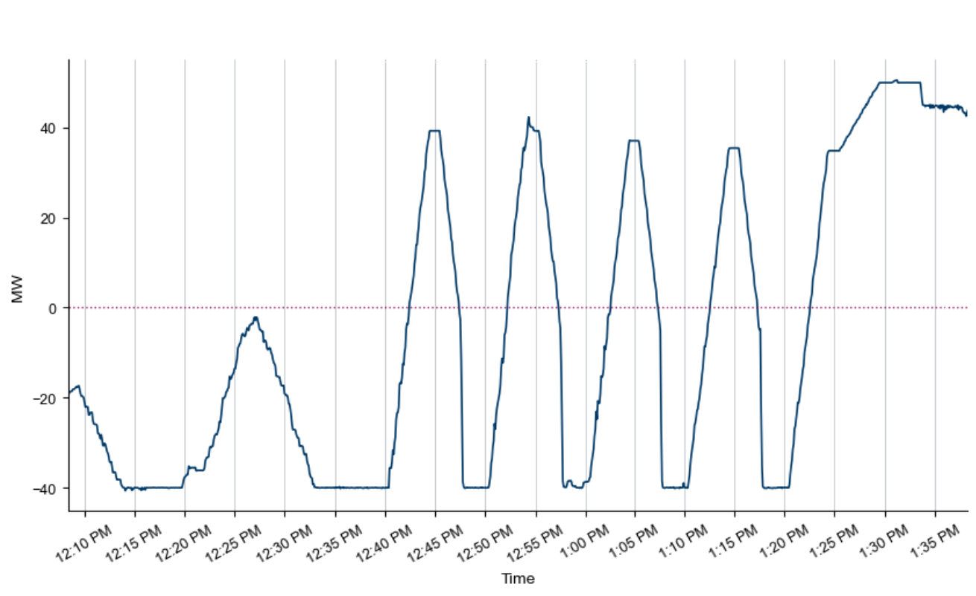
GTC flow change comparison:
Flow change pattern for existing GTCs
Behavior of ESRs.

Slide 5
Operational Impact: Running Two GTCs per interface
 | Operational Challenges
1 | Persistent oscillation Rapid charge/discharge switching can push an ESR to violate one direction while complying with the other, forcing operators to keep both GTCs active to manage the flow across .
2 | Higher data volume & delay Activating twice the constraints increases the data moved from EMS to MMS, adding delay to constraint data transfers.
Key Takeaway: Two simultaneous one-directional GTCs create oscillation risk, data delays, and manual workload for operators.

Slide 6
Proposed Direction: Model the GTC as Bi-Directional
GTC Modeling — Add an attribute to indicate a GTC as bi-directional. GTC methodology will have single limit enforced in both flow directions.
EMS — Single constraint added in TCM to monitor flow in both directions. Operators activate one constraint to SCED
SCED — EMS sends one set of constraint and shift factors to SCED and SCED would model two constraints to represent charging and discharging flow constraints.
DAM / RUC / CRR — DAM, RUCs (HRUC, DRUC, WRUC) and CRR will also model two flow constraints to manage the flow in both directions under the limits.
Key Takeaway: Moving to a bi-directional constraint require changes to EMS and MMS applications and Reports

Slide 7
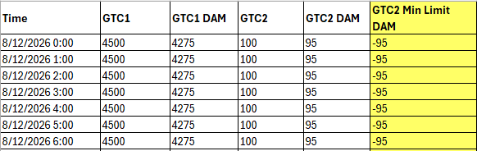
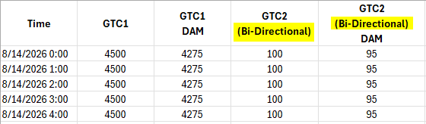
Potential Impacts to Reports with Bi-Directional GTCs
Generic Transmission Limits— Two options are being considered for reflecting which GTC are Bi-directional in the GTL report.
  Add new column to show the Min DAM Limit for the Bi-directional GTCs to show the Minimum Limit used in Day ahead market applications
  Update the header to clearly annotate “Bi-directional” following the GTC name to imply the interface limits will be applied in both positive and negative flow direction

Slide 8
Potential Impacts to Reports with Bi-Directional GTCs
EMS Reports — The NSA Active Constraints and Inactive constraints reports will have a new column labeled “BiDirectional” to indicate which GTCs are Bi-directional with Y/N in the data.
MMS active and binding Transmission Constraints reports — No structural change Since MMS applications (DAM/RUCs/SCED) models the constraint as two unique constraints, there will be two rows in the report for each direction of the Bi-directional GTC, with the constraint for the reverse flow represented by appending “-R” to the constraint name.

Slide 9
Questions/Comments?
Vamsi.madam@ercot.com

