Slide 1
CRR Updates
CMWG
Samantha Findley
ERCOT CRR Market Operations
August 17, 2026
Outline:
  LTAS transactions and solution times
  CRR auction limits table – no changes
  Project update for NPRRs 936 and 1288

Slide 2
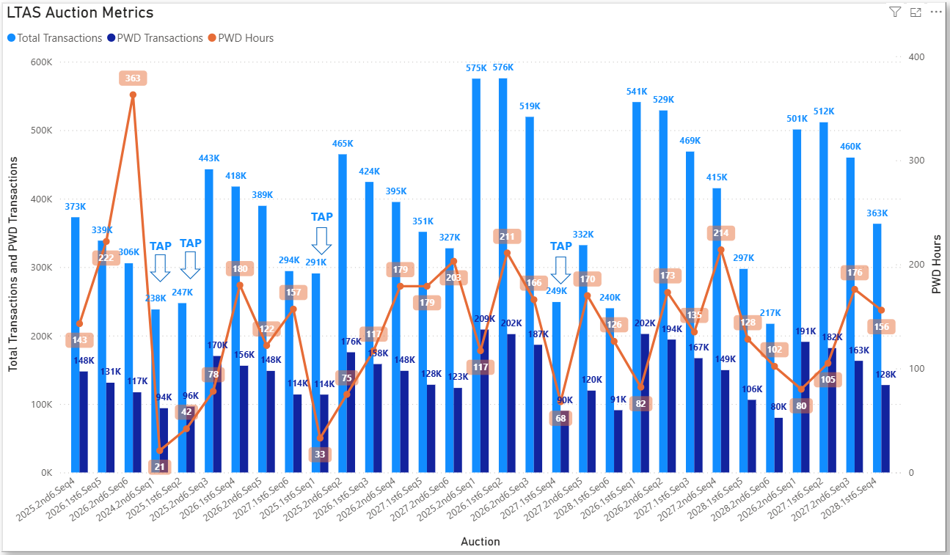
Historical LTAS transactions and solution times

Slide 3
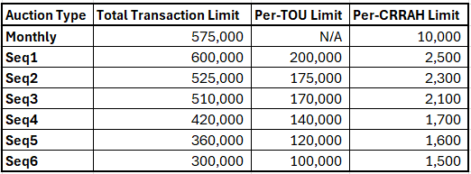
CRR auction transaction limits – no changes

Slide 4
Project update for NPRRs 936 and 1288
936 CRR Account Holder Limits
  Removes the current limit of 3 CRRAHs per Counter-Party (CP)
  Moves the current transaction limit per CRRAH to the CP level; all CRRAHs under the same CP will contribute to and share the CP’s transaction limit.
1288 Remove Multiple Month Transactions in CRR Auctions
  Removes capability to submit multi-month transactions in Long-term auctions
Targeting go-live in early February 2027; will issue market notices 60/30/10/1 days ahead.
Market testing is not required for these NPRRs, but ERCOT will set up a test auction in the Market Operations Test Environment (MOTE) prior to go-live for CRRAHs to test submitting single month transactions and sharing the per-CP transaction limit. Transaction limits to be determined in project testing phase.
CRR auctions will be running on cloud servers beginning this week with 2028.2nd6.AnnualAuction.Seq5.

Slide 5
Questions/Comments?
ercotcrr@ercot.com

