Slide 1
DAM PTP Bid Fee
NPRR1343, Introduction of PTP Obligation Bid Fee in the DAM
ERCOT Staff
August 17, 2026
Outline:
Background: Why a PTP Bid Fee is Needed
Options considered & Defining an Inefficient Bid
Defining an Inefficient Bid
Impacts to Market Participants & PTP Participation
Safe Harbor explanation
Safe Harbor impact
Recommendation and Next Steps
Key Takeaways
A targeted bid fee is needed to incentivize more efficient PTP submissions which will improve DAM optimization performance

Slide 2
Background: Why a PTP Bid Fee Is Needed
The DAM Engine is under growing strain
PTP hourly bids are the most difficult products for the DAM engine to solve; high submission volumes increases solve times significantly.
To allow enough time to analyze and post the results prior to the 13:30 deadline, ERCOT targets a DAM execution time below 2.5 hours.
Operating Days (OD) with more than 200,000 PTP bids run a much greater risk of exceeding that window; running sometimes more than 3.5 hours. (See red region in figure X)
Since RTC+B, roughly 44% of all PTP bids submitted go unawarded.
Rising submission volumes increase the risk of late DAM solution posting and DAM abort scenarios, undermining market certainty and efficient operations.
The IMM has recommended a PTP bid fee since the 2020 State of the Market report.
DAM PTP Bid Volume Since RTC+B
206,214
56%
44%
avg. PTP bids
per DAM run
of DAM runs exceed
200,000 PTP bids
of PTP bids submitted
go unawarded
NPRR1343 status
Proposes a modifiable per-bid fee on inefficient hourly PTP Obligation bids in the DAM.
Unawarded PTP Obligation bids targeted by the fee are deemed inefficient based on their bid price being significantly below the market clearing price of the path.
Fee rate, thresholds, and “safe harbor” percentile to be endorsed by WMS and approved by TAC, communicated to Market Participants in advance of the DAM run they affect.
Fee revenue is included in the DAM Congestion Rent calculation (Section 7.9.3.1).
Key Takeaway: A modifiable, targeted bid fee encourages more efficient PTP bidding, easing DAM execution strain without discouraging bids that carry useful price signals.

Slide 3
Options Considered & Defining an Inefficient Bid
For Option 2 and 3
A bid is “inefficient” if any of the following apply:
Option 1:
All PTPs are assessed a bid fee.
1
Placed on a de-energized settlement point
The source or sink Settlement Point is de-energized. No power may be injected or withdrawn at Settlement Points that are electrically isolated.
Option 2:
Only inefficient bids are assessed a bid fee.
The efficiency of a PTP will be determined by the bid price compared to the clearing price of the path it is placed on.
2
Placed between electrically similar settlement points
The source and sink are Electrically Similar Settlement Points (ESSPs). Transmission elements are unlikely to bind between ESSPs, so there is no congestion to hedge against.
Option 3:
Only inefficient bids are assessed a bid fee, excluding those placed at a price that would historically clear.
3
Priced below the calculated PTP inefficient threshold
The bid’s not-to-exceed price falls below two thresholds defined by an absolute ($) and relative (%) amount less than the path’s clearing price for the given hour.
Stakeholders and the IMM raised concern that fees on all unawarded PTPs could deter nearly-awarded bids that provide useful price signals even when unawarded. Including a “safe harbor” gives market participants security that they will not be assessed a fee for circumstances outside of their control.
Key Takeaway: Option 3: A fee only on inefficient bids was favored by CMWG stakeholders and the IMM. It targets inefficient bidding while giving stability to participants.

Slide 4
Defining an Inefficient Bid
Some bids are placed at invalid settlement points
Bids placed at de-energized or electrically similar settlement points cannot be considered by DAM.
ERCOT posts the expected de-energized and electrically similar settlement points by 06:00.
Based on stakeholder feedback, bids placed at de-energized or electrically similar settlement points will only be considered inefficient if they appear in both the 06:00 posting and the DAM results.
5% of inefficient PTPs are placed at invalid settlement points
Key Takeaway: Bids placed at invalid settlement points do not contribute to the market.

Slide 5
Defining an Inefficient Bid
PTP clearing price clusters near $0 and above $5
The bid price of unawarded PTPs cluster either close to or far from the clearing price.
A 20% absolute threshold protects the many PTPs that clear above $5 from being considered inefficient.
A $1 absolute threshold protects the many PTPs that clear near $0 from being considered inefficient.
Key Takeaway: A $1 absolute and a 20% relative thresholds protect near-misses while still targeting truly inefficient bids.

Slide 6
Defining an Inefficient Bid
How a bid's efficiency is judged
Settlement Point A → Settlement Point B, delivery hour 10:00 AM
Absolute threshold = $1 | Relative threshold = 20%
Relative
threshold
Absolute
threshold
Awarded /
Clearing Price
$8
$9
$10
$7.50
$8.50
Unawarded, Inefficient bid
Unawarded, Efficient bid
A bid is inefficient only if it is below both thresholds; here, a bid price below the $8 relative price will be assessed a fee.
8.9%
26.5%
of unawarded bids are bid
within 20% of the path's
clearing price
of unawarded bids are bid
within $1 of the path's
clearing price
Key Takeaway: Thresholds should be set to capture many of the bids that are placed far from the clearing price; by targeting bids that were never likely to clear, efficient bidding behavior will be encouraged bringing performance improvement.

Slide 7
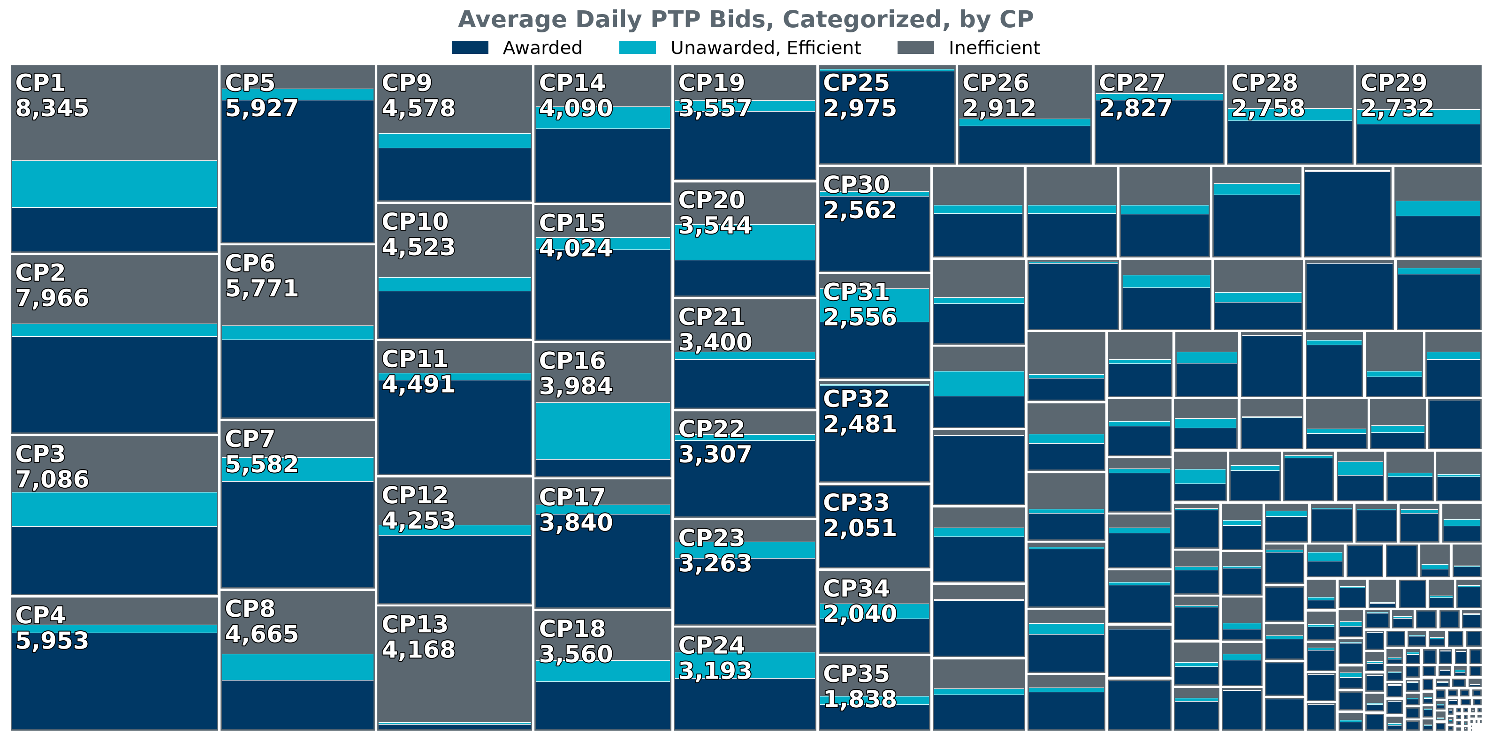
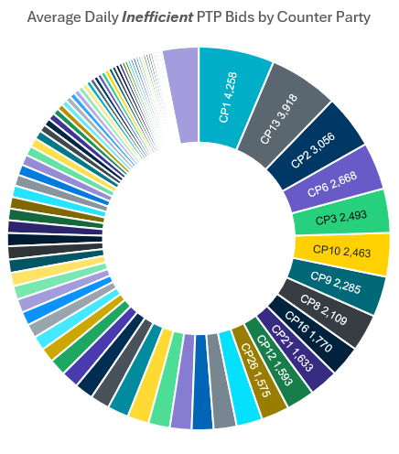
Impacts to Market Participants & PTP Participation
Inefficient bidding is concentrated
A small number of Counter Parties account for a disproportionate share of inefficient bids.
50% of inefficient PTPs are bid by just 15 (6%) of participating Counter Parties
Key Takeaway: Inefficient bidding is concentrated among a small subset of participants. A high bid fee will most disincentivize these largely inefficient participants without penalizing PTP activity broadly.

Slide 8
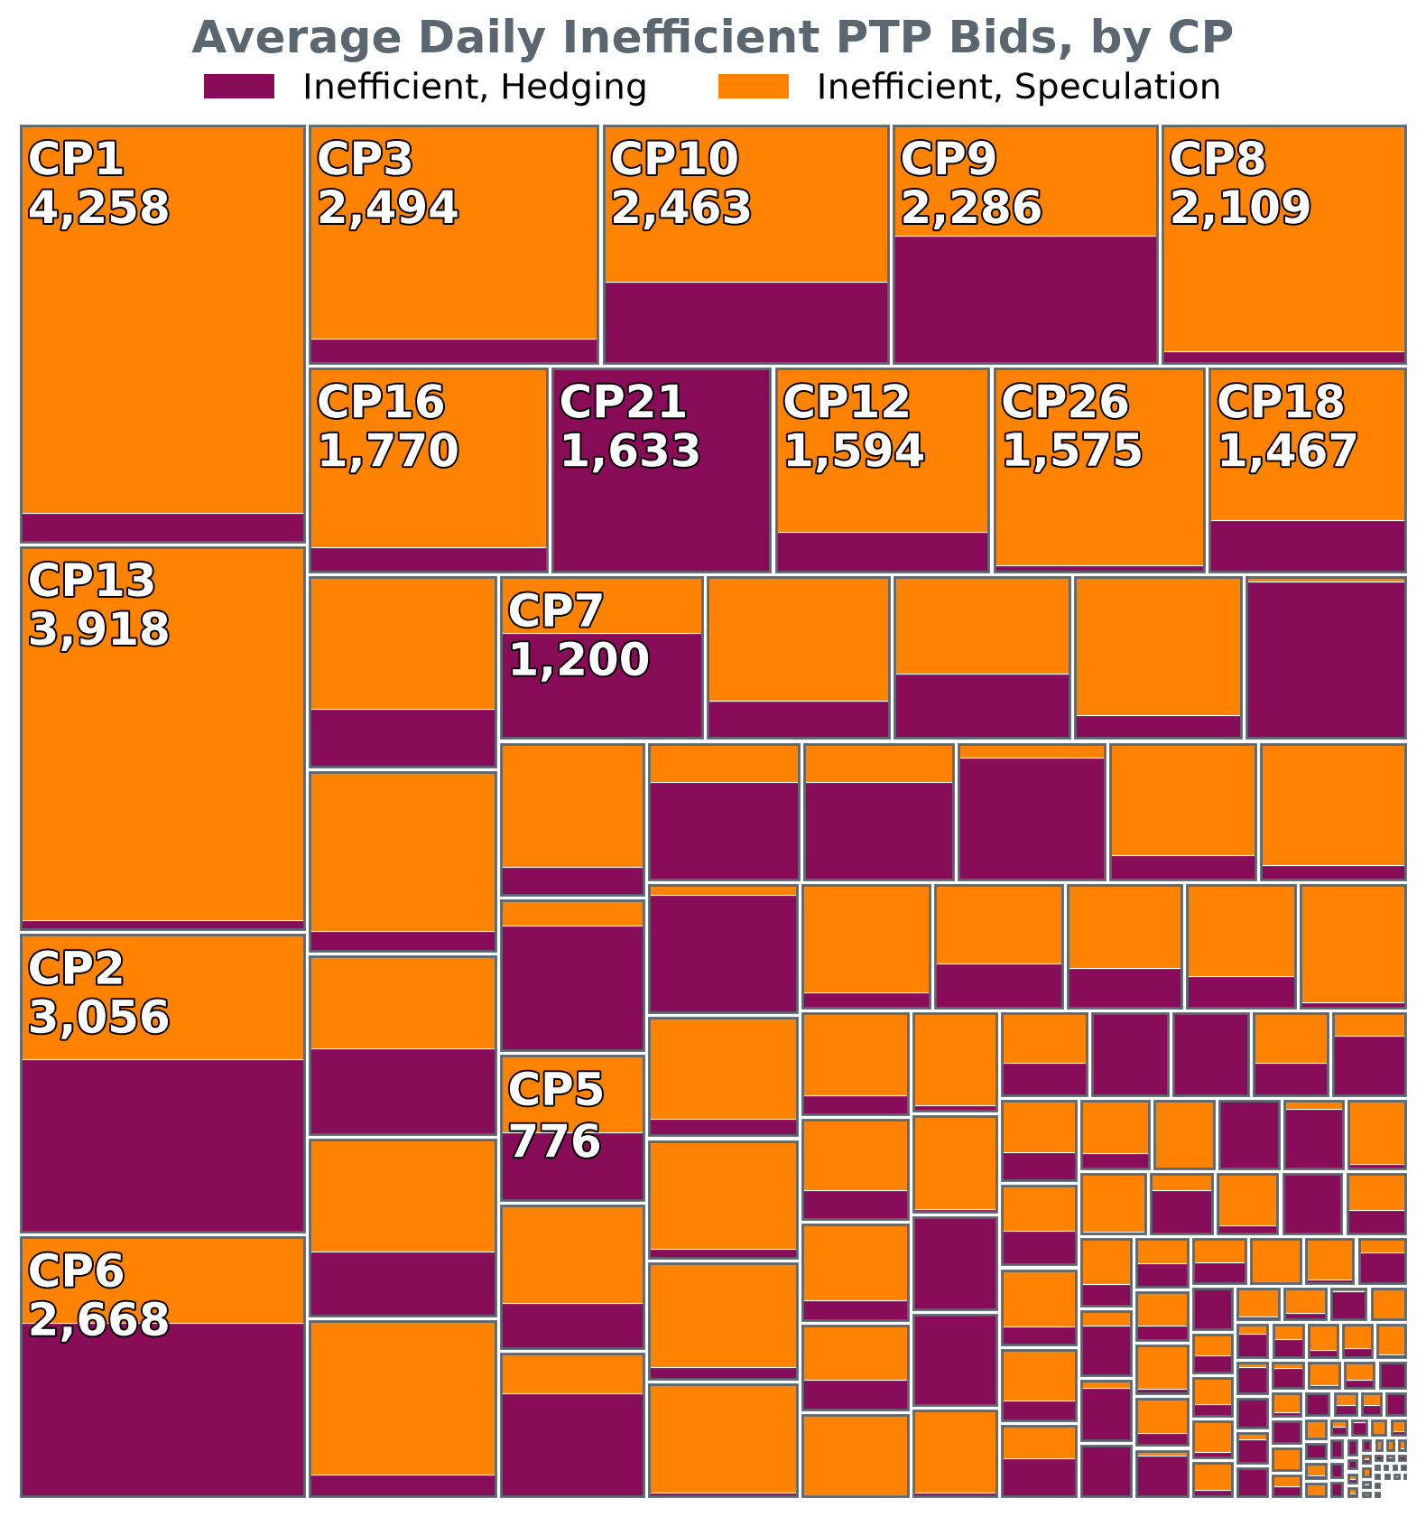
Impacts to Market Participants & PTP Participation
Here, a hedging PTP has the source or sink at a hub or a load zone. A speculative PTP has the source and sink at resource nodes only.
Inefficient bidding is concentrated
The majority of inefficient PTPs come from speculative paths
Hedging-oriented PTPs are already more likely to clear than speculative bids; hedging will inherently be considered more efficient than speculation.
65%
of inefficient bids are on speculative paths
35%
of inefficient bids are on hedging paths
Key Takeaway: Inefficient bidding is concentrated on speculative paths; A high bid fee will most disincentivize these inefficient, speculative bids without penalizing hedging activity broadly.

Slide 9
Impacts to Market Participants & PTP Participation
The Expected Value of an Inefficient PTP is $1
The expected value of a PTP concentrates near $1.
A fee below this value means the majority of inefficient bidding will continue to be profitable.
Total Market Cost
~$66K/day
Average system-wide fee total,
at a flat $1/bid,
across 238 study days,
using ($1, 20%) thresholds
Key Takeaway: A $1/bid fee will target inefficient, speculative paths making them less desirable.

Slide 10
Safe Harbor Explanation
How the safe harbor works
ERCOT excludes an hourly PTP bid from a QSE's inefficient bid count if its bid price is above the s^{th} percentile of the path’s price for that hour over the last 30 days.
The s^{th} percentile is a modifiable parameter; to be recommended by ERCOT, endorsed by WMS, and approved by TAC; alongside the fee rate and thresholds.
This protects bids priced consistently with recent market conditions, even if they fall below the inefficient threshold for a single hour.
How a bid's efficiency is judged, with Safe Harbor
Absolute threshold = $1 | Relative threshold = 20% | S^{th} Percentile = 50th
30-day 50th percentile price
Relative
threshold
Absolute
threshold
Awarded /
Clearing Price
$7
$8
$9
$10
$6
$7.50
$8.50
Unawarded, Inefficient bid
Unawarded, Safe Harbor bid
Unawarded, Efficient bid
Why it matters
Shields bids on volatile paths or during extreme-events (e.g., a winter weather event) from a fee when prices spike unpredictably.
Keeps the fee focused on chronic inefficient bidding rather than one-off misses during abnormal conditions.
Some days may still exceed 200,000 PTP bids, so a combination of inefficient thresholds, fee, and safe harbor will be evaluated due to execution-time risk.
Total Market Cost
~$46K/day
Average system-wide fee total,
at a flat $1/bid,
across 238 study days,
using ($1, 20%, 50th) thresholds
Key Takeaway: Safe harbor keeps the fee framework fair across market conditions, exempting hourly bids that track with historic prices while still targeting chronic inefficient bidding.

Slide 11
Safe Harbor Impact
Key Takeaway: Safe harbor protects participants during extreme weather/pricing events while still discouraging inefficient bids, bringing performance improvement.

Slide 12
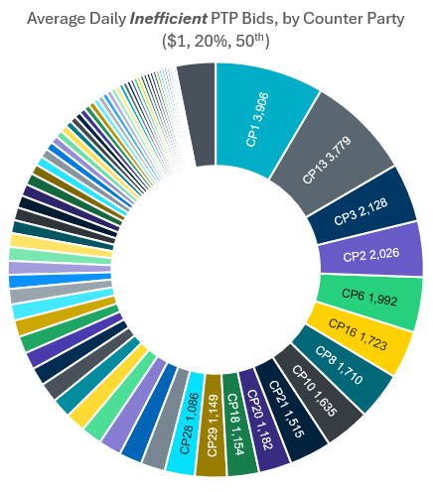
Safe Harbor Impact
50% of inefficient PTPs are bid by just 11 (5%) of participating Counter Parties
Key Takeaway: Safe harbor reduces the number of PTPs considered inefficient by most participants while still targeting chronic inefficient bidding.

Slide 13
Recommendation and Next Steps
Recommended fee design
Next steps
$1.00
$1
Incorporate Safe Harbor description and 0600 ESSP determination list into NPRR1343 protocol language via comments.
fee per inefficient
hourly PTP bid
absolute threshold
($/MWh)
Bring the recommended fee, thresholds, and safe harbor s^{th} percentile to WMS for endorsement.
20%
50th pctl.
Seek TAC approval.
relative threshold
safe harbor basis —
median 30-day DASPP
Issue a Market Notice ahead of the DAM run in which the fee takes effect.
Total Market Cost
~$46K/day
Monitor inefficient bid volume and DAM execution time post-implementation; revisit via WMS/CMWG if needed.
Average system-wide fee total,
at a flat $1/bid,
across 238 study days,
using ($1, 20%, 50th) thresholds
Key Takeaway: ERCOT recommends a $1 fee on PTP bids priced below a 20% relative / $1 absolute threshold, with a 50th-percentile safe harbor; pending WMS and TAC approval.

Slide 14
Questions/Comments?
Alfredo.Moreno@ercot.com

