Slide 1
BAL-001-TRE Evaluation Process
PDCWG | July 22 , 2026
ERCOT
Operations Planning

Slide 2
BAL-001-TRE process
ERCOT Identifies Frequency Measurable Events (FMEs)
1
ERCOT Posts FME Notification within 14 Calendar Days
2
ERCOT Calculates Initial & Sustained Primary Frequency Response (PFR) per BAL-001-TRE Standard
3
ERCOT Posts the Initial and Sustained Primary Frequency Response Unit Performance Reports(FME Reports) to MIS
4
ERCOT Calculates and Posts in MIS the Rolling 12-Month Average Initial and Sustained PFR Scores
6
ERCOT Evaluates RRS MW Limits for Resources Not Meeting the performance Criteria and Posts the RRS Limit Reports to MIS
7
Market Participants to Review Reports and Submit Exclusion Requests for Legitimate Operating Conditions within 30 days
5

Slide 3
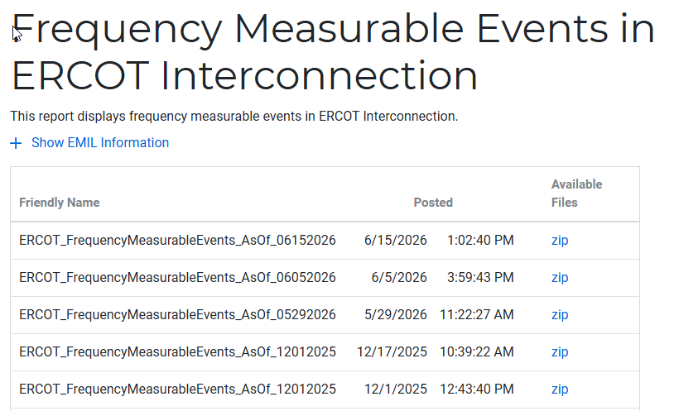
Frequency Measurable Events(FME) Notification
ERCOT will identify the FMEs per the selection criteria discussed at the May 20, 2026 PDCWG meeting.
Within 14 calendar days after each FME, ERCOT will post the FME information on MIS. The information posted will include time of the FME, pre-perturbation average frequency, post-perturbation average frequency and MW loss.

Slide 4
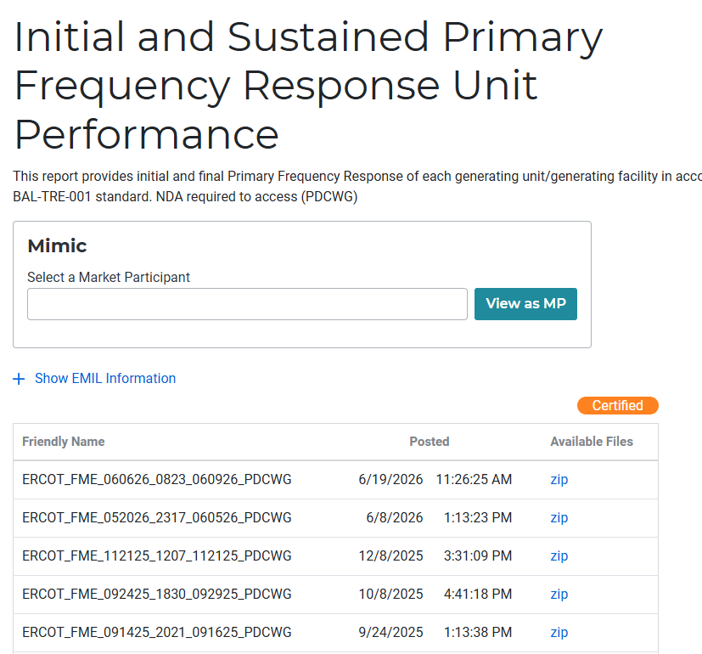
Frequency Measurable Events(FME) Evaluation
ERCOT shall calculate the Initial and Sustained Primary Frequency Response of each generating unit/generating facility ,ESRs and CLRs during the FME, per BAL-001-TRE standard.
ERCOT shall post the Initial and sustained Primary Frequency Response Unit performance Report on MIS and notify the Market Participants using the PDCWG distribution list. These reports are certified and will need QSE digital certificate with an appropriate role to access.
The Market Participants are expected to subscribe to the PDCWG distribution list, which requires signed Non-Disclosure Agreement(NDA) with ERCOT.
The Market Participants are expected to review the PFR performance of their Resources

Slide 5
BAL-001-TRE Exclusion
Requirements 9.3 and 10.3 in the BAL-001-TRE allow the ERCOT to exclude a generating unit’s initial and sustained PFR performance during a Frequency Measurable Event (FME) from the rolling average calculation due to a legitimate operating condition that prevents the normal PFR performance.
Per ERCOT Nodal Operating Guide Section 2.2.8 (2), the Market Participants shall request an exemption from, or correction of, performance during an FME within 30 days of the MIS posting date of the Initial and Sustained Frequency Response Unit Performance report
The BAL-001-TRE PFR Responsibility Exclusion Process document is posted on Compliance in ERCOT site.

Slide 6
BAL-001-TRE Exclusion
The Market Participant must submit adequate evidence documenting the legitimate operating condition that prevented normal PFR performance and supporting the merits of the exemption request.
ERCOT may make a determination on the exclusion based on the request and accompanying evidence, or ERCOT may request additional documentation, if necessary.
ERCOT may also ask the Performance, Disturbance, Compliance Working Group (PDCWG) to review the exclusion request and make a recommendation. However, PDCWG’s recommendation is not binding; ERCOT will make the final determination on whether to approve the exclusion request.
ERCOT Operations Planning will notify the Market Participant whether the exclusion request is approved or denied.
The BAL-001-TRE exclusion process document provides a list of examples for legitimate operating conditions that may prevent a generating unit from exhibiting normal PFR performance during an FME.

Slide 7
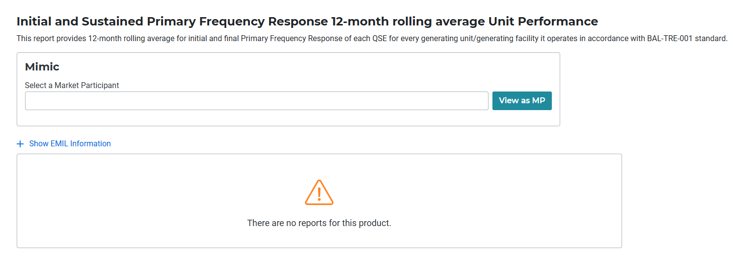
Rolling Average Evaluation
Every month, ERCOT shall calculate and post in MIS the 12-month rolling average of the Initial and Sustained Primary Frequency Response scores. Market Participants are notified via the PDCWG distribution list.
These reports are certified and will need QSE digital certificate with an appropriate role to access.
Per BAL-001-TRE, if a Resource has not participated in a minimum of eight FMEs in a 12-month period, performance shall be based on rolling eight FMEs the Resource has participated.
Each Resource should maintain a minimum 12-month rolling average score for initial and sustained PFR of 0.75.

Slide 8
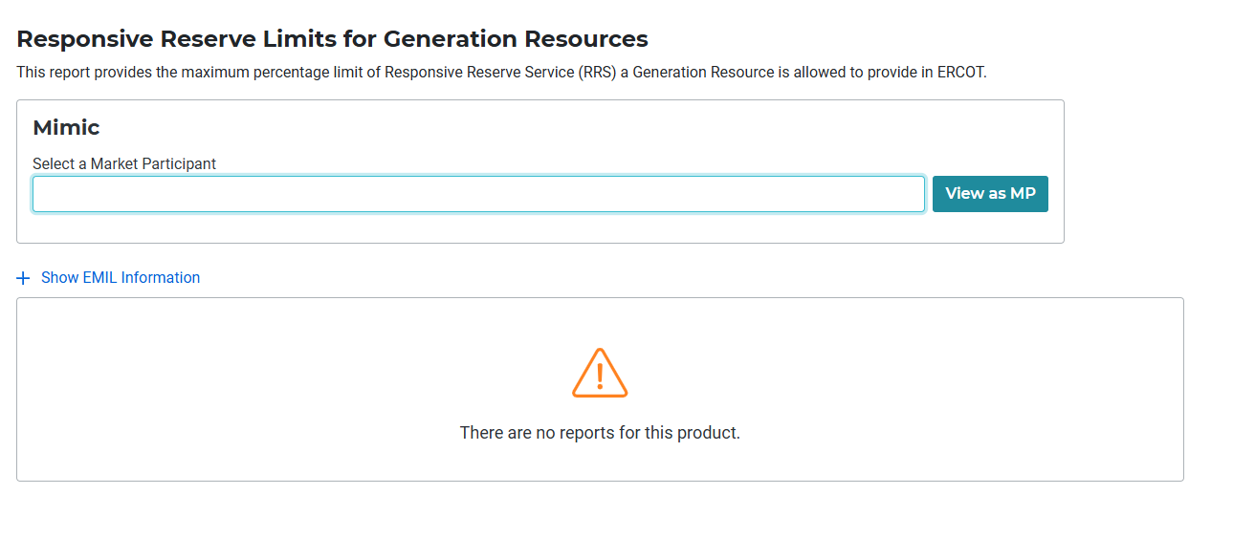
RRS MW limits for Resources to Provide RRS-PFR
Per ERCOT Nodal Operating Guide section 2.3.1.2.1, ERCOT shall establish MW limit on individual Resources ability to provide RRS using PFR. The MW limit shall be based on Resource performance during the FMEs and actual tests.
ERCOT Nodal Operating Guide Appendix 8N, outlines the methodology used for calculating RRS MW limits for Individual Resources to provide RRS using PFR based on the performance during FMEs.
  The Resources that does not meet the 12-month rolling average criteria or have failed to score greater than or equal to 0.75 for Initial and Sustained PFR for three consecutive FMEs, where the Resource was evaluated over two calendar month will be subject to review of their respective RRS MW limit.
The RRS limit Reports are posted on MIS and Market Participants are notified using the PDCWG distribution list. These reports are certified and will need QSE digital certificate with an appropriate role to access.

Slide 9
Questions/Comments?

