Slide 1
2026 SPWG Future Year Case Build Updates
Adam Herrera
Planning Model Administration
July 14, 2026
Outline:
Case Build Participation
Case Stats
Generation Added
SPWG vs SSWG Comparison
Issues Observed

Slide 2
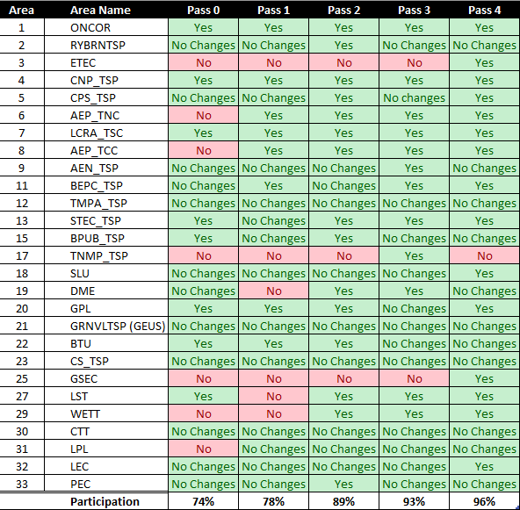
Case Build Participation

Slide 3
Case Stats
Islands
  There are no islands in the FY cases
Orphan buses
  There are 12 in 2027
  There are 14 in 2028
  There are 16 in 2029
  There are 16 in 2030
  There are 16 in 2031
Bus Fault Summary
  There are a few buses over 70kA
Buses with a bus number equal to 0
  There are 2 buses in the FY cases

Slide 4
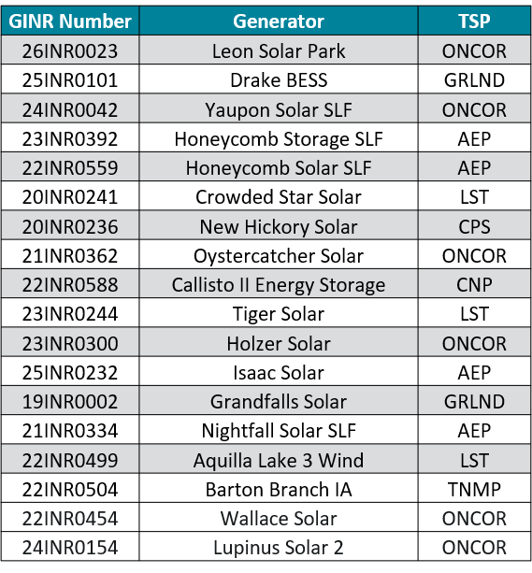
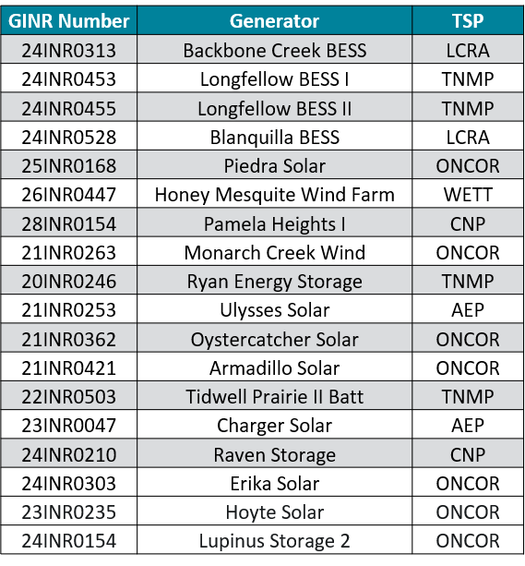
Generation Added
58 generation models met Planning Guide 6.9(2) as of 05/22/26
GINR Number | Generator | TSP
24INR0491 | Gunnar BESS | AEP
25INR0018 | Yellow Cat Wind | ONCOR
26INR0521 | Millers Branch Solar III | AEP
21INR0371 | Pecan Prairie South | CTT
21INR0428 | Pecan Prairie North | CTT
24INR0136 | Eagle Springs Storage | LCEC
24INR0137 | Eagle Springs Solar | LCEC
24INR0274 | Bufflehead BESS | ONCOR
25INR0189 | Staccato BESS | LCRA
26INR0250 | Duffy BESS | CNP
25INR0231 | Apache Hill BESS | BEPC
24INR0291 | Rubicon Alpha Wind | AEP
26INR0622 | Buffalo Gap 1 Wind Repower | AEP
26INR0625 | Buffalo Gap 2 Wind Repower | AEP
26INR0626 | Buffalo Gap 3 Wind Repower | AEP
23INR0091 | Cascade Solar | CNP
23INR0207 | El Patrimonio Solar | CPS

Slide 5
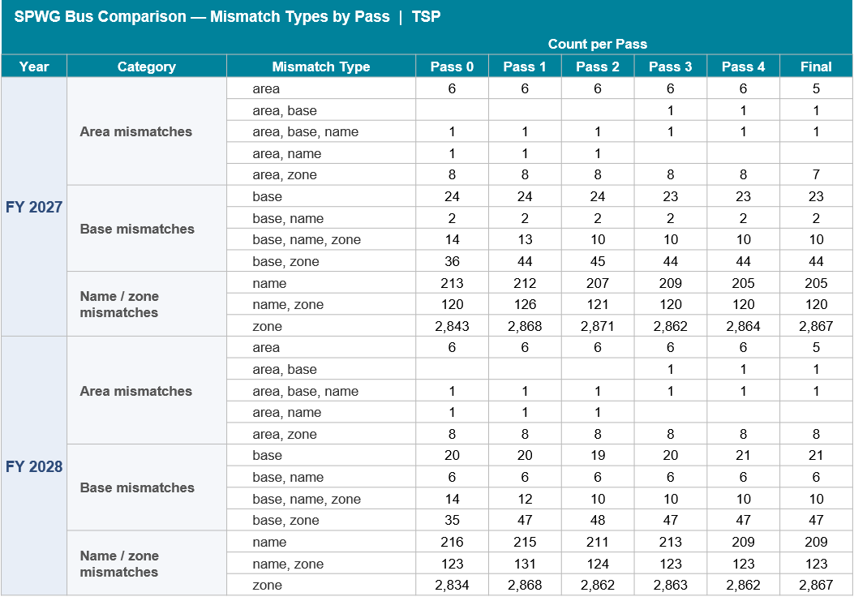
SPWG vs SSWG Case Comparison (TSP)

Slide 6
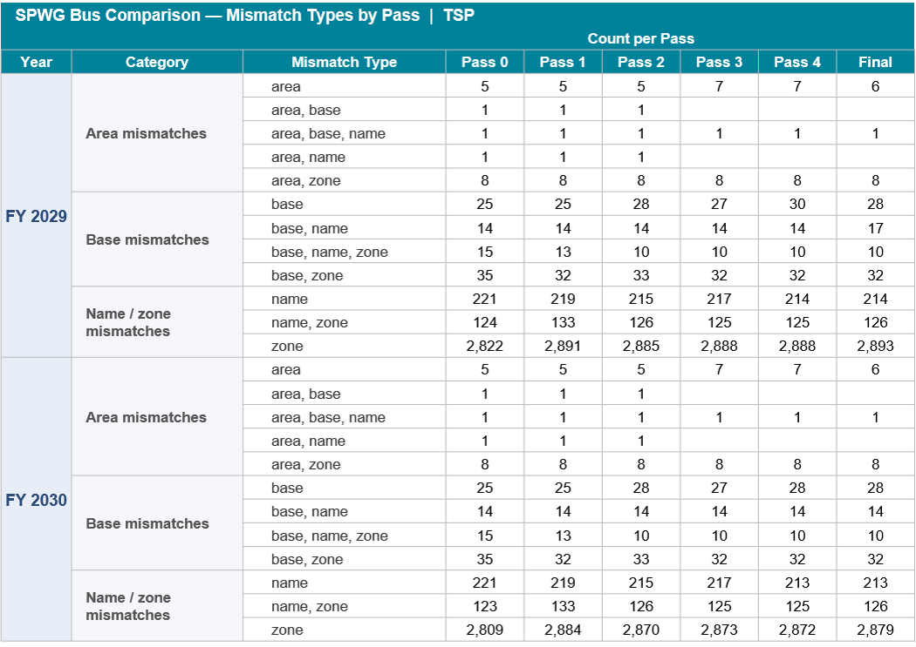
SPWG vs SSWG Case Comparison (TSP)

Slide 7
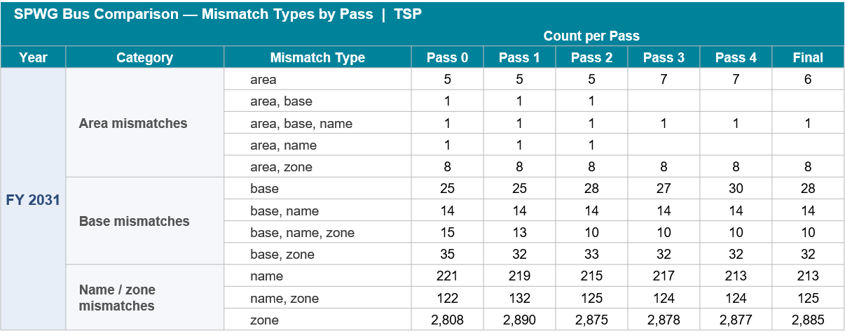
SPWG vs SSWG Case Comparison (TSP)

Slide 8
SPWG vs SSWG Case Comparison (ERCOT)
SPWG Bus Comparison — Mismatch Types by Pass | Bus Numbers >= 100,000
 |  |  | Count per Pass
Year | Category | Mismatch Type | Pass 0 | Pass 1 | Pass 2 | Pass 3 | Pass 4 | Final
FY 2027 | Area mismatches | area | 4 | 4 | 2 | 2 | 5 | 5
 |  | area, base | 2 | 2 | 1 | 1
 |  | area, base, name
 |  | area, name
 |  | area, zone | 1 | 1 | 1 | 1
 | Base mismatches | base | 110 | 112 | 114 | 114 | 114 | 112
 |  | base, name | 7 | 7 | 6 | 6 | 1 | 1
 |  | base, name, zone |  |  |  |  | 3 | 4
 |  | base, zone | 1 | 1 | 1 | 1 | 1 | 2
 | Name / zone mismatches | name | 30 | 30 | 29 | 34 | 23 | 27
 |  | name, zone | 1 | 1 | 1 | 1 | 1 | 1
 |  | zone | 10 | 10 | 10 | 10 | 11 | 11
FY 2028 | Area mismatches | area | 4 | 4 | 2 | 2 | 5 | 5
 |  | area, base | 2 | 2 | 1 | 1
 |  | area, base, name
 |  | area, name
 |  | area, zone | 1 | 1 | 1 | 1
 | Base mismatches | base | 111 | 113 | 115 | 115 | 115 | 113
 |  | base, name | 7 | 7 | 6 | 6 | 1 | 1
 |  | base, name, zone |  |  |  |  | 5 | 6
 |  | base, zone | 1 | 1 | 1 | 1 | 1 | 2
 | Name / zone mismatches | name | 30 | 30 | 32 | 37 | 26 | 30
 |  | name, zone | 1 | 1 | 1 | 1 | 1 | 1
 |  | zone | 10 | 10 | 10 | 10 | 11 | 11

Slide 9
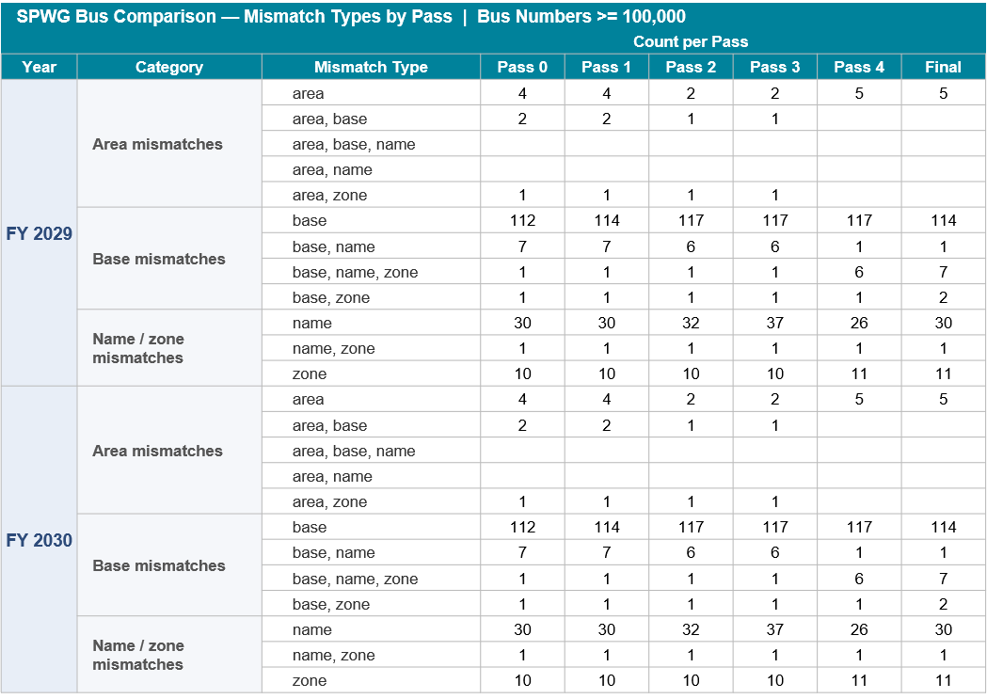
SPWG vs SSWG Case Comparison (ERCOT)

Slide 10
SPWG vs SSWG Case Comparison (ERCOT)
SPWG Bus Comparison — Mismatch Types by Pass | Bus Numbers >= 100,000
 |  |  | Count per Pass
Year | Category | Mismatch Type | Pass 0 | Pass 1 | Pass 2 | Pass 3 | Pass 4 | Final
FY 2031 | Area mismatches | area | 4 | 4 | 2 | 2 | 5 | 5
 |  | area, base | 2 | 2 | 1 | 1
 |  | area, base, name
 |  | area, name
 |  | area, zone | 1 | 1 | 1 | 1
 | Base mismatches | base | 112 | 114 | 117 | 117 | 117 | 114
 |  | base, name | 7 | 7 | 6 | 6 | 1 | 1
 |  | base, name, zone | 1 | 1 | 1 | 1 | 6 | 7
 |  | base, zone | 1 | 1 | 1 | 1 | 1 | 2
 | Name / zone mismatches | name | 30 | 30 | 32 | 37 | 26 | 30
 |  | name, zone | 1 | 1 | 1 | 1 | 1 | 1
 |  | zone | 10 | 10 | 10 | 10 | 11 | 11

Slide 11
Case Build Reports
ERCOT has been providing the following reports during each pass:
  Orphan Bus Report
  Island Report
  SPWG to SSWG Bus Comparison Report
Are these reports useful?
Are there better ways to promote addressing orphaned buses, islands, and other bus discrepancies in early passes?

Slide 12
Issues Observed
TSP change files included generation additions, modifications, and deletions
TSP change files modified buses outside of their area
TSP change files added bus numbers equal to 0
TSP change files used bus numbers outside of their bus range

Slide 13
Questions/Comments?
SPWGData@ercot.com

