Slide 1
Batch Zero Readiness Meeting #8
July 9, 2026
Disclaimer: This presentation is provided solely for informational and discussion purposes and does not constitute a binding interpretation of the ERCOT Protocols, Planning Guide, or any other governing authority. In the event of any conflict between this presentation and the ERCOT Protocols, Planning Guide, or other applicable governing documents, the governing documents shall prevail.

Slide 2
Agenda
Updates since last Batch Readiness meeting
Batch Zero Readiness Discussion Schedule
FAQ
Appendix

Slide 3
Market Notice: Transition from LLIS to Batch Zero and other information
NOTICE DATE: July 8, 2026
NOTICE TYPE: M-B062326-04 General
SHORT DESCRIPTION: Details for ending the Large Load Interconnection Study process under PGRR115 and submission deadlines for PGRR145 (Batch Zero) on July 10, 2026
INTENDED AUDIENCE: Interconnecting Large Load Customers and other interested stakeholders
DAYS AFFECTED: July 10, 2026
LONG DESCRIPTION: This notice provides additional clarifications to Market Notice M-B062326-01 Implementation of the Batch Zero Process (PGRR145/NPRR1325), sent June 23, 2026.
Consistent with the PUCT approved language in PGRR145 and as previously detailed in the weekly Batch Zero Readiness meetings, the current Large Load Interconnection Study (LLIS) process codified in the current Planning Guide Section 9 is in effect through end of day on July 10, 2026. After this time, ERCOT will not conduct further reviews of LLIS studies or restudies and no additional study approvals can be granted.
Additionally, Section 9.2.2(3) of PGRR145 requires submission of dynamic models to ERCOT on or before July 10, 2026. ERCOT defines the deadline as the ILLE having submitted the required information to BatchZero@ercot.com by July 10, 2026 by 2359 CDT.
ERCOT is also announcing that MOD is reopened for Ad Hoc TPIT updates. MOD will close at 3:00 PM on July 16, 2026. The resulting TPIT report will be posted on July 20, 2026. This will be the final TPIT update prior to the start of Batch Zero. ERCOT strongly encourages all Transmission Service Providers (TSPs) to complete their MOD submissions prior to the July 16 deadline to avoid potential application performance issues.
Reminder of other important dates:
July 24, 2026 - Deadline for Transmission Service Providers (TSPs) and/or Distribution Service Providers (DSPs) to submit completed Large Load Interconnection details to ERCOT.
August 7, 2026 - Deadline for ERCOT to notify TSPs/DSPs of Batch Zero classification results, including eligibility determinations and identified dynamic model or data deficiencies.
ERCOT will not have sufficient data to provide public reporting on the aggregate amount and classification of Large Loads included in Batch Zero prior to August 7. ERCOT will provide statistics as the data becomes available.
Finally, a reminder that ERCOT will hold its last Batch Zero Market Readiness Webex meeting Thursday, July 9, 2026, 2-3pm
ADDITIONAL INFORMATION: ERCOT has posted the necessary guides, forms, frequently asked questions, and attestations to the Large Load Integration page and stakeholder questions can be sent to LLWG_Feedback@ercot.com.
CONTACT: If you have any questions, please contact your ERCOT Account Manager. You may also call the general ERCOT Client Services phone number at (512) 248-3900 or contact ERCOT Client Services via email at ClientServices@ercot.com.
Source: ERCOT Market Notice Archives, https://www.ercot.com/services/comm/mkt_notices/M-B062326-04

Slide 4
Agenda
Updates since last Batch Readiness meeting
Batch Zero Readiness Discussion Schedule
FAQ
Appendix

Slide 5
Weekly Batch Zero Readiness Discussions (see ERCOT Meeting Calendar)
Monday
Tuesday
Wednesday
Thursday
Friday
June
1
2
3
4
5
Board Meeting
Board Meeting
Batch Readiness Meeting
2-3PM
8
9
10
11
12
Batch Readiness Meeting
2-3PM
Also:
With retirement of the Readiness calls, use the LLWG_Feedback@ercot.com channel for questions.
ERCOT will stop sending weekly study/status emails to TSPs after next week.
ERCOT is posting FAQ to assist with implementation questions on Large Load Integration page.
17
PUCT approval of PGRR145/NPRR1325
15
16
18
19
LLWG/Batch Readiness
10-11:30AM
22
Batch Zero
Market Notice issued
24
25
26
23
Batch Readiness Meeting
2-3PM
29
30
July
1
2
3
Batch Readiness Meeting
2-3PM
6
7
8
9
10
Batch Readiness Meeting
2-3PM
LLIS Submission
Process ends
13
14
15
16
17
20
21
22
23
24
TSP Due date for Batch Zero
27
28
29
30
31

Slide 6
Batch Zero eligibility submission and validation process
Performed by ILLE
Performed by TSP/DSP
Performed by ERCOT
1
Eligibility Path Identification
Working with TSP/DSP, ILLE uses the Load Information Form (LIF) to identify the applicable Batch Zero eligibility pathway and the associated submission requirements and documentation
Until Jul 10
2
Preparation of Submission Materials
ILLE executes the required attestations, and prepares technical documentation, forms, and supporting evidence applicable to the selected eligibility pathway
3
Submission of Materials
ILLE submits the applicable materials and supporting evidence to the Interconnecting TSP/DSP and, where required, directly to ERCOT (e.g., dynamic load models and supporting documentation)
4
Review Coordination
Interconnecting TSP/DSP coordinate responsibility for reviewing submission materials, determine the applicable Eligibility/Entry Path, and prepare the LCP². Review responsibility and completion status are tracked within the LIF
5
Validation and Completeness Review
Interconnecting TSP/DSP, as applicable, review submitted materials, validate completeness against the applicable eligibility requirements, and document status/comments in the LIF
Jul 10- Jul 24
6
Package Reconciliation and Follow-up
ILLE provides administrative corrections, clarifications, or non-material supplemental information to address issues identified during TSP/DSP review¹
7
Final Package Assembly
Interconnecting TSP/DSP, as applicable, finalize the coordinated eligibility package and confirm all applicable items are complete within the LIF
8
Submission to ERCOT
Interconnecting TSP submits the final coordinated eligibility package to ERCOT via email with the Interconnecting DSP and ILLE copied, where applicable
Jul 24-Aug 7
9
ERCOT Initial Eligibility Assessment
ERCOT performs validation of the Batch Zero eligibility package, including attestations, TSP/DSP confirmations, and submission completeness
10
Dynamic Model Deficiency Resolution
ERCOT notifies ILLEs of identified dynamic model or data deficiencies. ILLEs submit corrected models, updated parameters, or supplemental technical information during the cure period
Aug 7-Aug 31
11
ERCOT Final Eligibility Validation
ERCOT finalizes Batch Zero eligibility determinations following resolution of outstanding dynamic model and data deficiencies
1. The post–July 10 validation period is intended to address administrative corrections, clarification requests, and minor submission errors identified during TSP/DSP review (e.g., typos or incorrect references). It is not intended to allow submission of materially missing eligibility items or satisfaction of requirements that were not completed by the applicable July 10 deadline (e.g., posting financial security, executing required commitments, or completing required attestations) | 2. Including selection of the applicable Entry Path, incorporation of LLIS/RPG/PBRP study information, transmission upgrade and TPIT data, and calculation of the resulting modeled load schedule
Source: ERCOT discussions

Slide 7
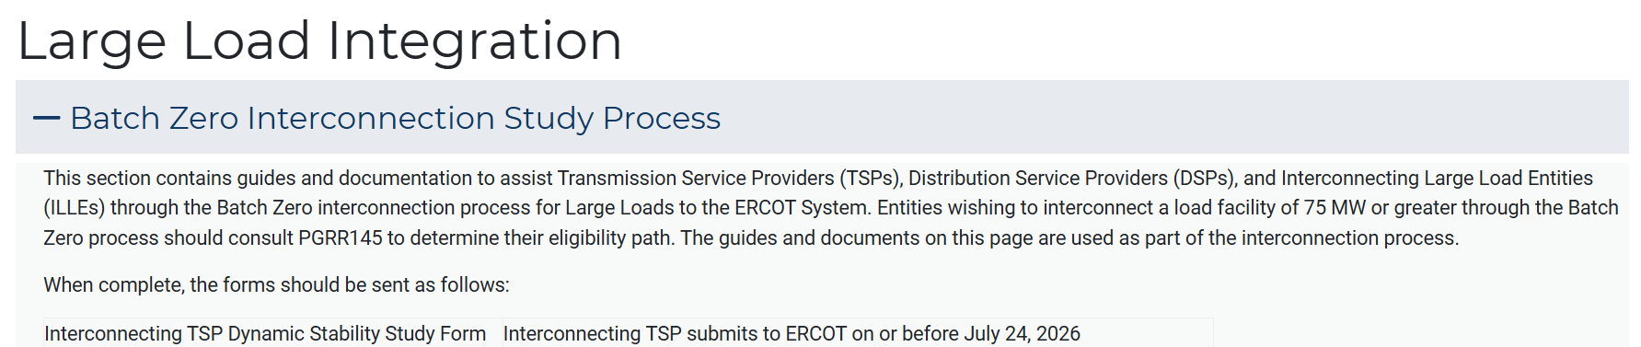
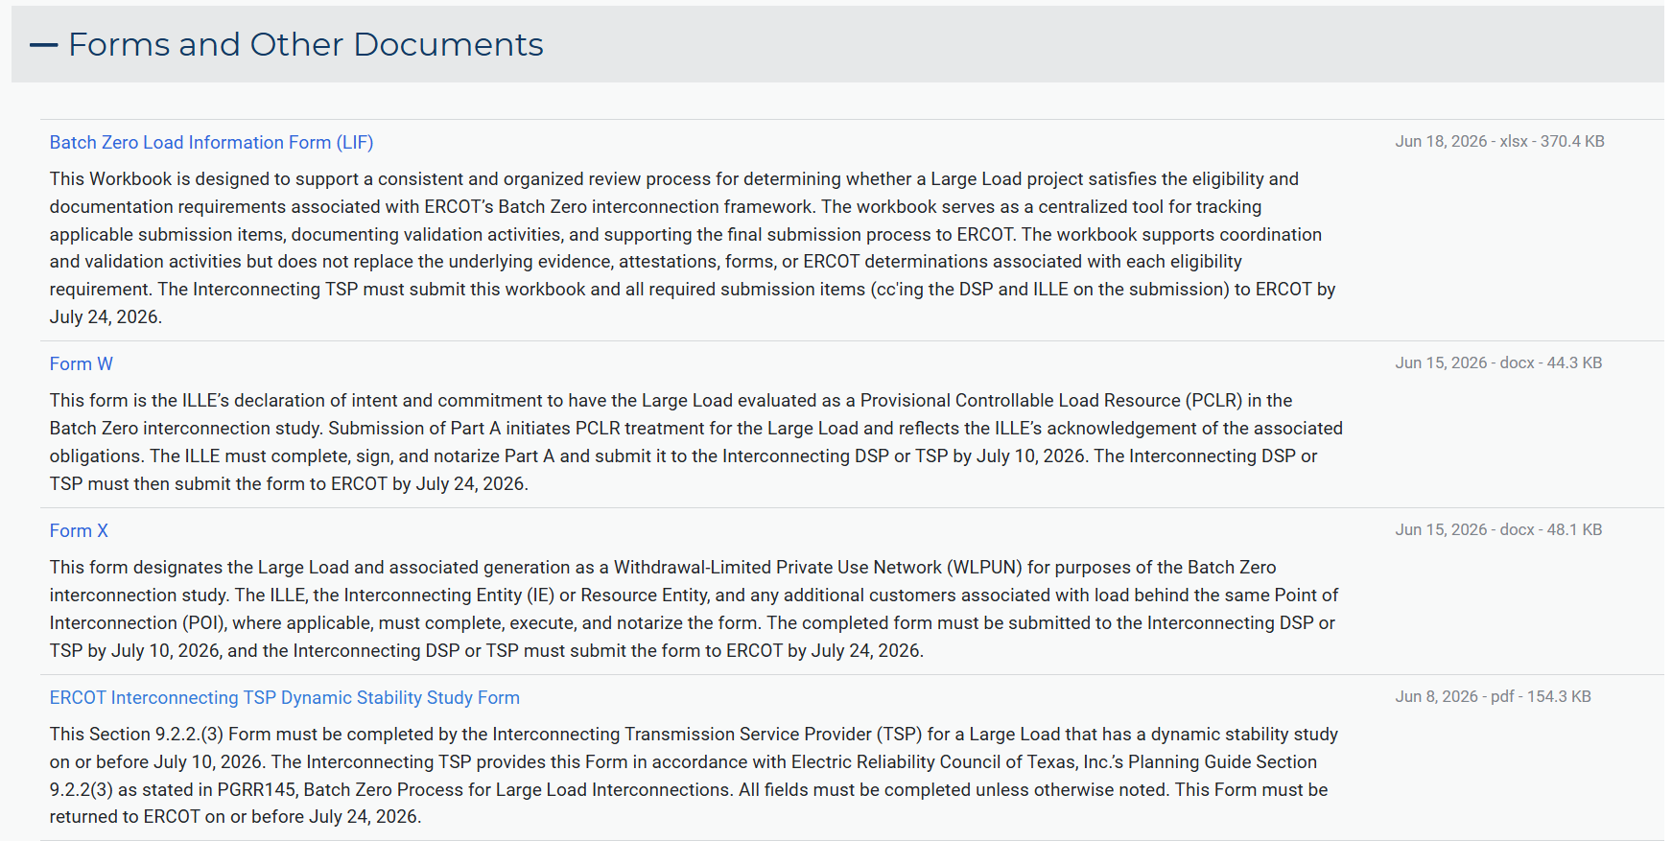
Batch Zero documentation on ERCOT Large Load Integration webpage
  Key messages
  Official Batch Zero documentation and supporting materials on the Large Load Integration webpage
  The webpage includes the official Load Information Form (LIF) and required attestations, other than submission instructions and key filing deadlines for Batch Zero participants
Source: ERCOT Large Load Integration webpage

Slide 8
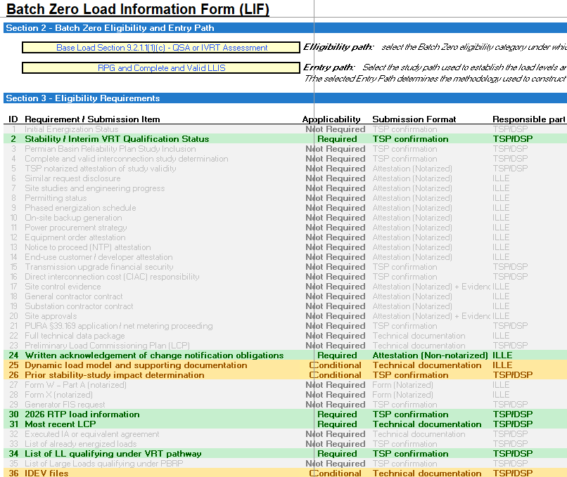
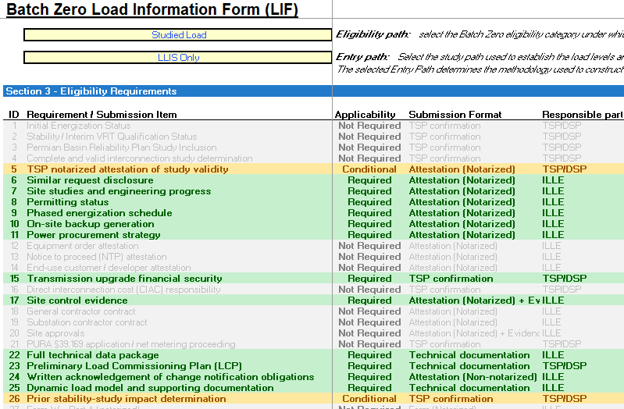
LIF guidance update
Base Load Section 9.2.1.1(1)(c) Pathway
Key updates
Row 34 is not required
For projects qualifying under the Planning Guide Section 9.2.1.1(1)(c) Base Load pathway, ERCOT is not collecting Requirement 34 ("List of LL qualifying under VRT pathway")¹
  Leave row 34 blank
  Continue completing all other applicable LIF requirements
Studied Load Pathway
Full technical data package
For all pathways, ERCOT is not collecting Requirement 22 (“Full technical data package”)
  Leave row 22 blank
1. Requirement 34 applies to the VRT pathway and is not applicable for projects using the 9.2.1.1(1)(c) Base Load pathway
Source: ERCOT Large Load Integration- Batch Zero Interconnection Study Process https://www.ercot.com/services/rq/large-load-integration

Slide 9
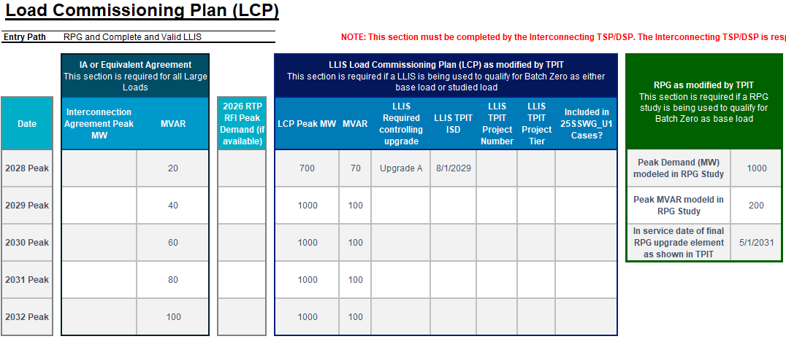
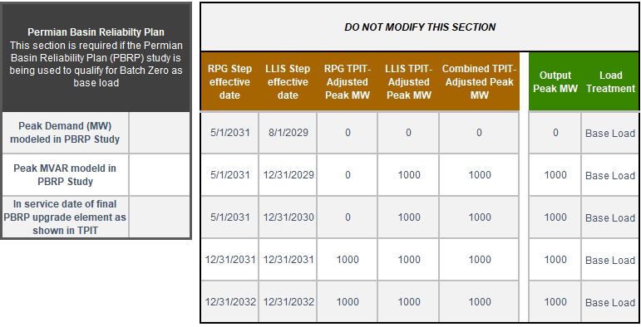
Completing the LIF for Projects energizing prior to 2028
Example scenario: Project energizes in 2027, with 500 MW on-line, ramps to 700 MW in 2028 and reaches full 1,000 MW in 2029
Supporting screenshots
Process description
  Complete the LCP beginning with the 2028 Peak row, and all other required sections as applicable
  Leave the "2026 RTP RFI Peak Demand” column blank unless a value was previously collected through the 2026 RTP RFI
    If no value was collected through the 2026 RTP RFI, do not enter anything in this column
  ERCOT will issue a separate RFI for Base Load projects to collect 2026 and 2027 peak load ramp amounts for Long-Term Load Forecasting
    This RFI is separate from the LIF and does not require any changes to the LIF template
Source: Batch-Zero-Load-Information-Form-06172026

Slide 10
Key Deadlines for Batch Zero
July 10
Last day for ERCOT to review and approve LLIS studies
July 24
Deadline for required information for inclusion in Batch Zero to be submitted to ERCOT
August 7
Deadline for ERCOT to notify TSPs and DSPs of Large Load inclusion and classification in Batch Zero
Per PGRR145, the current Large Load Interconnection Study (LLIS) process will cease operation after July 10, 2026
This means July 10 is the last day ERCOT is able to review and approve LLIS studies
Starting on July 11, the Batch Zero Interconnection Study will be the only path to connect a Large Load to the ERCOT system
The inclusion and treatment of Large Loads in Batch Zero will be determined by the status of qualifying studies as they stand at the end of the day on July 10, 2026

Slide 11
Review of PGRR115 Process Timelines – Study Reviews and Approvals
Per Section 9.4 of the current Planning Guide, all LLIS studies must be submitted to ERCOT for review and approval.
ERCOT will continue to review studies under this process through July 10.
As described in the Planning Guide, it can take up to 30 Business Days for ERCOT to review a submitted study.
ERCOT review is not guaranteed to result in an approval. Any required updates to a submitted study are treated as a new submission, which restarts the timeline for review.
ERCOT does not have visibility into the amount of time needed by TSPs to perform a LLIS study. Please reach out to your lead TSP with questions about the status of a study that has not yet been submitted to ERCOT for review.
Key Takeaways
The existing study review process remains in effect through July 10.
ERCOT continues to review submitted study reports as quickly as possible once submitted.
ERCOT cannot guarantee a new or updated study report submitted after May 28, 2026 will be reviewed by July 10.

Slide 12
Batch Zero key submission deadlines and main responsibilities
X
Detailed next
1
July 10
2
July 24
August 7
August 31
ILLE
Deadline for ILLE to submit required Batch Zero eligibility materials to the Interconnecting TSP/DSP and, where required, directly to ERCOT (e.g., dynamic load models)
Deadline for ILLEs to resolve identified dynamic model and technical data deficiencies and submit corrected materials
TSP/DSP
Deadline for TSPs/DSPs to submit complete Batch Zero eligibility packages and supporting materials to ERCOT
ERCOT
Last day ERCOT will review and approve LLIS studies under the legacy process
Deadline for ERCOT to notify TSPs/DSPs of Batch Zero classification results, including eligibility determinations and identified dynamic model or data deficiencies
Early submission encouraged prior to July 10: Interconnecting DSPs/TSPs and ILLEs are encouraged to begin submitting Batch Zero eligibility materials and supporting documentation as early as practicable in advance of the July 10, 2026 milestone. ERCOT may review submitted materials on a rolling basis and provide preliminary feedback regarding completeness, potential deficiencies, or additional information needs

Slide 13
1
July 10 Batch Zero milestone: activities required
  Detailed next
ILLE
TSP/DSP
ERCOT
  Working with the TSP/DSP, identify the applicable Batch Zero eligibility pathway within the LIF
  Prepare required attestations, technical documentation, and supporting evidence
  Submit dynamic load models and supporting technical materials to ERCOT and the Interconnecting TSP, where applicable
  Resolve known documentation or technical gaps prior to TSP/DSP validation review
  Coordinate review responsibilities between TSP and DSP, as applicable
  Begin preliminary review of submitted ILLE materials and supporting evidence
  Align on the designated entity responsible for final ERCOT package submission
  Finalize LLIS study review activities under the legacy process

Slide 14
By July 10, ILLEs must submit dynamic model packages to ERCOT and provide completed LIF workbooks and supporting materials to the TSP/DSP (1/2)
1
  Submission email
  Additional details
  Additional details
ILLE
ILLE must submit:
Dynamic Model Package
  Dynamic model
  Model parameters
  Supporting technical documentation
  ERCOT Dynamic Working Group Large Load Data Survey
ERCOT
  Submission requirements:
    Submit to BatchZero@ercot.com
    Include BZ-ID in subject line
    Include BZ-ID in all file names
  Additional notes:
    Base load: submit eligibility package to TSP/DSP by July 10
    Studied load: submit eligibility package to TSP/DSP by July 24 (July 10 encouraged)
    Best practice: copy/inform the ILLE, TSP/DSP, and ERCOT on submissions where applicable
ILLE must submit:
Dynamic Model Package
  Dynamic model
  Model parameters
  Supporting technical documentation
  ERCOT Dynamic Working Group Large Load Data Survey
TSP
ILLE must submit:
Eligibility package
  Completed LIF
  Applicable attestations
  Supporting documentation
  Form W (PCLR), if applicable
  Form X (WLPUN), if applicable
  Affiliate form, if applicable

Slide 15
1
By July 10, ILLEs must submit dynamic model packages to ERCOT and provide completed LIF workbooks and supporting materials to the TSP/DSP (2/2)
  Frequently Asked Question
  Answer
  What supporting technical documents and information are needed in the dynamic model package?
Supporting technical documentations and information includes documents that help understand, check, and accurately represent the submitted dynamic model and the associated facility or equipment. This documentation should include, but is not limited to:
User-Defined Model (UDM) documentation, such as user manuals, model descriptions, control logic, block diagrams, or software documentation that explains the model implementation and operation.
Technology-specific documentation, if available, provided by the equipment manufacturer or developer, describing the control systems or operating characteristics of the equipment or technologies such as ride-through solution.
⁠PSS/E load flow (.raw) file compatible with version 35, and/or an IDEV or Python file containing the project configuration and transformer model data required by the ERCOT Dynamic Working Group Large Load Data Survey.
  What if dynamic data and files are too large to email or blocked by email server?
If files (such as .dll files) cannot be submitted by email due to file type restrictions or file size limitations, please note this in your submission. ERCOT LLI Team will respond and coordinate with the ILLE to arrange a secure shared drive for uploading those files¹
Which PSS/e version should the dynamic model support?
For Batch Zero, all submitted models must be compatible with PSS/E Version 35
1. Please note that ERCOT does not maintain a dedicated shared drive for all submissions. Shared drives will be created only when needed to facilitate the transfer of files that cannot be submitted via email. This approach helps ensure secure file management and avoids the accumulation of unrelated or unnecessary files

Slide 16
Questions about Dynamic Model Submissions due July 10 (2/2)
Note- if email to submit models or email to request a link is received to BatchZero@ercot.com by deadline (July 10, 2359), then link will be provided by Monday July 13 to complete submission by close of business July 13.
ILLE Dynamic Model Files¹
If files are < 30MB
Email Model files to BatchZero@ercot.com
Email is rejected by ERCOT if too large:
Option 1 (encouraged):
ILLE sends request to BatchZero@ercot.com with BZ-### to request link to ERCOT share drive (2-hour turnaround if received during business hours)
ERCOT sets up individual folder and emails ILLE
ILLE uploads files
Option 2 is experiencing blocks on ERCOT systems:
Example, Google drive access not allowed by ERCOT security.
  ILLE posts on their share drive and emails instructions to ERCOT
  ERCOT staff downloads files
If files are > 30MB
Use BZ-### as identifier
Person emailing for folder needs to work at ILLE company or have permission from company.
1.Current ongoing LLIS submittals should be emailed to LargeLoadInterconnection@ercot.com ; Batch Zero submittals with BZ ID# should be submitted to BatchZero@ercot.com

Slide 17
2
July 24 Batch Zero milestone: activities required
  Lead role
ILLE
TSP/DSP
ERCOT
  Respond to TSP/DSP validation questions and resolve identified submission deficiencies, as applicable
  Provide supplemental technical materials or clarifications needed to support package completeness
  Complete review and validation of ILLE submission materials against applicable eligibility requirements
  Resolve outstanding package deficiencies and confirm submission completeness within the LIF
  Finalize the coordinated Batch Zero eligibility package and submit required materials to ERCOT
  Prepare for formal completeness, classification, and eligibility review of submitted Batch Zero packages
  Clarification: the post–July 10 validation period is intended to address administrative corrections, clarification requests, and minor submission errors identified during TSP/DSP review (e.g., typos or incorrect references). It is not intended to allow submission of materially missing eligibility items or satisfaction of requirements that were not completed by the applicable July 10 deadline (e.g., posting financial security, executing required commitments, or completing required attestations)

Slide 18
By July 24, TSPs must submit complete Batch Zero eligibility packages to ERCOT
2
  Detailed next
  Submission email
  Inform ILLE of submission
  Additional details
TSP
TSP must submit supporting documentation:
Completed LIF workbook, if applicable
Form W (PCLR), if applicable
Form X (WLPUN), if applicable
Eligibility attestations
Affiliate form, if applicable
ERCOT
  Submission requirements:
    Submit to BatchZero@ercot.com
    Include BZ-ID(s) in the body of the email
    Include BZ-ID in all file names
  Additional notes:
    Submit to ERCOT by July 24
    Inform ILLE of final submission files made to ERCOT
  Submission owner:
    One TSP/DSP submits final package
Batch Zero Steady State Models (IDEVs); can be separate single email
TSP should also inform ILLE of key files being submitted to ERCOT:
Completed LIF workbook, if applicable
Form W (PCLR), if applicable
Form X (WLPUN), if applicable
Eligibility attestations
Affiliate form, if applicable
Batch Zero Steady State Models (IDEVs); if applicable
ILLE

Slide 19
TSP/DSP email confirmation template for LIF & Forms by eligibility path
Email confirmation template for each Large Load
Key highlights
Subject: Batch Zero Eligibility Submission – [Insert BZ-ID]
To: BatchZero@ercot.com
Cc: [ILLE Contact]; [Joint T(D)SP Contact - if applicable]
Required email fields
Only the subject line and CC recipients are required. The remainder of the email may be left blank
  Include the Batch Zero ID in the subject line using the prescribed email subject format
  Copy the ILLE contact and Joint T(D)SP contact (if applicable) on the email to ensure all required parties are included

Slide 20
Batch Zero Steady State Model File Submission Guidelines
For more details see p.28-33 in the Appendix
Email should include:
Submission guidelines
Model files should be submitted to BatchZero@ercot.com
Subject line of “Batch Zero Steady-State Model Submission”
List of all applicable BZ-Ids in the body of the email
A word document
  A basic write-up listing which model file applies to which case
  A list of the Large Loads included in the submission with their BZ IDs
  A confirmation that all broken contingencies caused by the topology updates can be removed and replaced with contingencies provided in the submitted CON files
For base load in each study year
  An IDV file with topology updates to add all the Large Loads, if applicable (e.g., “2028_SUM_Base_Load_Topology”)
  An IDV file to add all the load points but set to 0 MW and 0 MVAr instead of the LCP (e.g., “2028_SUM_Base_Load_Load_Point”)
  An IDV file to add any Tier 4 transmission project needed for the LCP that has not already been included in the November 2025 SSWG cases (25SSWG_U1 cases) (e.g., “2028_SUM_Base_Load_Tier_4”)
For study load in each study year
  An IDV file with topology updates to add all the Large Loads, if applicable (e.g., “2028_SUM_Study_Load_Topology”)
  An IDV file to add all the load points but set to 0 MW and 0 MVAr instead of the LCP (e.g., “2028_SUM_Study_Load_Load_Point”)
CON files associated with any topology changes for each study year, and one CON file should be developed for each contingency category
TSP early submission is strongly encouraged to allow sufficient time to address any steady state model issues by July 24, 2026
Please submit model information in stages if the eligibilities for some loads are still under determination to help the processing timeline
ERCOT will work with TSPs to address small topology/contingency issues until August 1, 2026
Please send a separate email to BatchZero@ercot.com to notify ERCOT of the submission in case the submission is blocked by the email system due to file size

Slide 21
Agenda
Updates since last Batch Readiness meeting
Batch Zero Readiness Discussion Schedule
FAQ
Appendix

Slide 22
FAQ Walkthrough
ERCOT will open up FAQ spreadsheet and walk-through latest updates

Slide 23
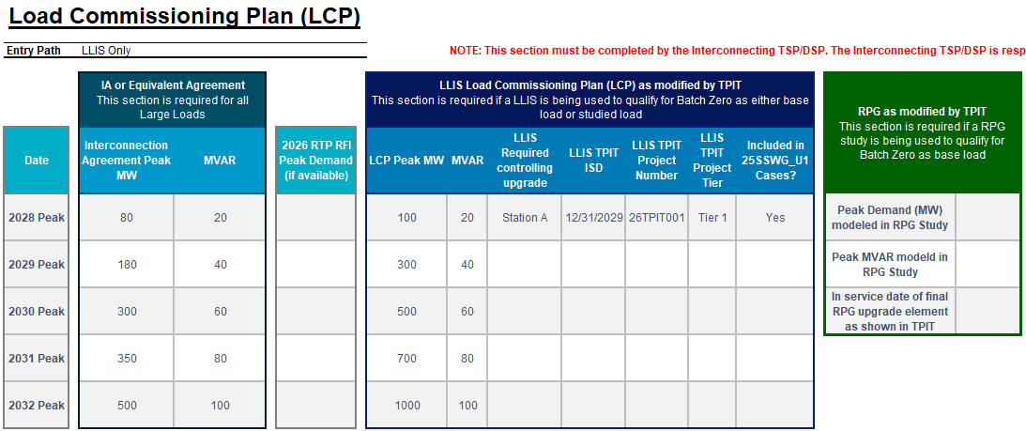
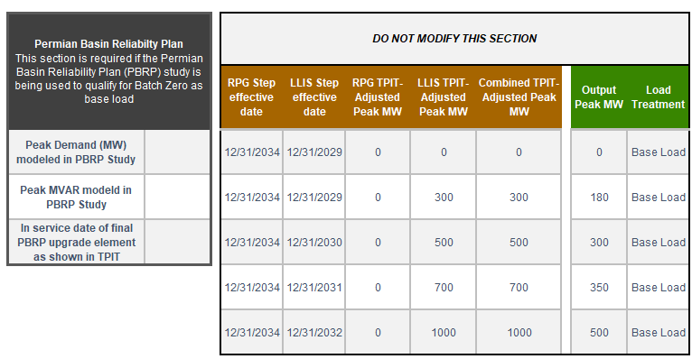
Case Study (1/7): Complete and valid LLIS ONLY
Populate Interconnection Agreement Peak MW using the executed IA
Supporting screenshots
Process description
  Populate Interconnection Agreement Peak MW and MVAR using the executed Interconnection Agreement (IA) or equivalent agreement
  Enter the maximum load level contractually permitted in each annual model year
  These values are used later to determine the final Output Peak MW schedule
Source: Batch-Zero-Load-Information-Form-06172026

Slide 24
Case Study (2/7): Complete and valid LLIS ONLY
Populate Existing LCP Peak MW and MVAR
Supporting screenshots
Process description
  Populate Existing LCP Peak MW and MVAR using the approved LLIS Load Commissioning Plan (LCP)
  For each annual model year, enter the load level reflected in the approved LLIS schedule
Source: Batch-Zero-Load-Information-Form-06172026

Slide 25
Case Study (3/7): Complete and valid LLIS ONLY
Enter LLIS upgrades and TPIT dates
Supporting screenshots
Process description
  For each load increase that depends on a transmission upgrade, enter the controlling upgrade in LLIS Required Controlling Upgrade
  If the upgrade appears in the latest TPIT report, enter the latest TPIT in-service date in LLIS TPIT ISD
  If a load increase depends on a transmission upgrade but the upgrade is not included in the latest TPIT report, enter the controlling transmission upgrade in LLIS Required Controlling Upgrade and leave LLIS TPIT ISD blank
  These entries determine whether the LLIS load increase remains available in the original year or is deferred to a later year
Source: Batch-Zero-Load-Information-Form-06172026

Slide 26
Case Study (4/7): Complete and valid LLIS ONLY
Populate LLIS supporting information
Supporting screenshots
Process description
  For each LLIS load increase that depends on a transmission upgrade, identify the associated TPIT project
  Populate the applicable TPIT Project Number, TPIT Project Tier, and indicate whether the upgrade is reflected in the 25SSWG_U1 cases
  This information is provided for reference and validation purposes and supports ERCOT review of the TPIT assumptions
Source: Batch-Zero-Load-Information-Form-06172026

Slide 27
Case Study (5/7): Complete and valid LLIS ONLY
Review the LLIS TPIT-Adjusted Peak MW
Supporting screenshots
Process description
  No user input is required in this section
  The LLIS TPIT-Adjusted Peak MW schedule is modified automatically to reflect the latest TPIT in-service date for each LLIS-controlled step
  If a required upgrade enters service later than assumed in the LLIS, the associated load increase is automatically deferred until the TPIT in-service year
Source: Batch-Zero-Load-Information-Form-06172026

Slide 28
Case Study (6/7): Complete and valid LLIS ONLY
Review the Combined TPIT-Adjusted Peak MW
Supporting screenshots
Process description
  No user input is required in this section
  Under the LLIS Only Entry Path, the Combined TPIT-Adjusted Peak MW schedule is equal to the LLIS TPIT-Adjusted Peak MW schedule
  Combined TPIT-Adjusted Peak MW reflects the load levels available after applying TPIT adjustments
Source: Batch-Zero-Load-Information-Form-06172026

Slide 29
Case Study (7/7): Complete and valid LLIS ONLY
Review the Output Peak MW
Supporting screenshots
Process description
  No user input is required in this section
  The workbook automatically calculates Output Peak MW as the lower of:
    the Interconnection Agreement Peak MW schedule; and
    the Combined TPIT-Adjusted Peak MW schedule
  The resulting Output Peak MW schedule represents the final Batch Zero modeled load schedule
  Under the LLIS Only Entry Path, the resulting schedule is modeled as Base Load in all years
Source: Batch-Zero-Load-Information-Form-06172026

Slide 30
Questions?
LLWG_Feedback@ERCOT.com
Related Notes:
  Batch Zero scoping @ RPG future meetings- July 21 and Aug 18
  Market Notice sent to begin Stakeholder engagement on Comprehensive Transmission Planning effort

Slide 31
Batch Zero ERCOT communications and submission channels
LLWG_Feedback@ercot.com for General Batch Zero Questions
Channel for general implementation questions, stakeholder feedback, and process clarification requests related to the Batch Zero Large Load interconnection framework
LargeLoadInterconnection@ercot.com for Existing LLIS Process Questions
Channel for questions related to the legacy LLIS process (e.g., ongoing study reviews, dynamic model submissions, and existing interconnection study coordination)
BatchZero@ercot.com for Formal Batch Zero Submissions
Channel for submission of ILLE Dynamic Models and completed Batch Zero eligibility packages by the designated Interconnecting TSP (with notification to the applicable DSP and ILLE through copied submission correspondence, as appropriate)
NOTE: ERCOT plans to assign a new unique Batch Zero identifier (“BZ ID”) to each submitted Large Load project for Batch Zero intake and tracking purposes. These identifiers will serve as the primary reference number for Batch Zero implementation activities
Supporting materials and forms are available on the Large Load Integration webpage

Slide 32
Agenda
Updates since last Batch Readiness meeting
Batch Zero Readiness Discussion Schedule
FAQ
Appendix

Slide 33
Batch Zero Steady State Model File Submission Guidelines
All topology and contingency updates should be based on the Batch Zero topology (.RAW) and contingency files (.CON) to be posted on the MIS TSP Certified Site
Model files should be built on top of the medium load topology updates submitted to ERCOT through the 2026 RFI process (medium load topology updates were not included in the ERCOT posted topology)
The model file submission is required for all base load except for the Large Load energized before March 25, 2022 (PG9.2.1.1(1)(a)) and all the study load
For Large Load with eligibility determined by LLIS, model files are only collected for the following categories (“Likely Treatment in Batch Zero” column in the weekly TSP communication email):
  (1) Eligible as Base load in Batch Zero
  (2a) 9.2.1.4(4) (studies complete and valid: eligible to be base load)
  (2b) 9.2.1.4(4) (TSP notified of potentially invalid studies: restudy may be needed for base load, otherwise studied load)
  (2c) 9.2.1.4(4) (Study validity under ERCOT review)
  (3) Eligible as studied load or base load, all studies complete
  (4) One study complete, may be eligible to be studied or as base load

Slide 34
Batch Zero Steady State Model File Submission Guidelines
Early submission is strongly encouraged to allow sufficient time to address any model issues by July 24, 2026
Please submit model information in stages if the eligibilities for some loads are still under determination to help the processing timeline
ERCOT will work with TSPs to address small topology/contingency issues until August 1, 2026
Model files should be submitted to BatchZero@ercot.com with the subject line of “Batch Zero Steady-State Model Submission”
Please send a separate email to BatchZero@ercot.com to notify ERCOT of the submission in case the submission is blocked by the email system

Slide 35
Batch Zero Steady State Model File Submission Guidelines
Email should include list of all BZ-Ids in the body of the email
A word document
  A basic write-up listing which model file applies to which case
  A list of the Large Loads included in the submission with their BZ IDs
  A confirmation that all broken contingencies caused by the topology updates can be removed and replaced with contingencies provided in the submitted CON files
For base load in each study year
  An IDV file with topology updates to add all the Large Loads, if applicable (e.g., “2028_SUM_Base_Load_Topology”)
  An IDV file to add all the load points but set to 0 MW and 0 MVAr instead of the LCP (e.g., “2028_SUM_Base_Load_Load_Point”)
  An IDV file to add any Tier 4 transmission project needed for the LCP that has not already been included in the November 2025 SSWG cases (25SSWG_U1 cases) (e.g., “2028_SUM_Base_Load_Tier_4”)
For study load in each study year
  An IDV file with topology updates to add all the Large Loads, if applicable (e.g., “2028_SUM_Study_Load_Topology”)
  An IDV file to add all the load points but set to 0 MW and 0 MVAr instead of the LCP (e.g., “2028_SUM_Study_Load_Load_Point”)
CON files associated with any topology changes for each study year, and one CON file should be developed for each contingency category

Slide 36
Batch Zero Steady State Model File Submission Guidelines
Please use the following naming convention for your submission (2028 is used as an example below)
  2028_SUM_Base_Load_Topology.IDV
  2028_SUM_Base_Load_Load_Point.IDV
  2028_SUM_Base_Load_Tier_4.IDV
  2028_SUM_Study_Load_Topology.IDV
  2028_SUM_Study_Load_Load_Point.IDV
  2028_SUM_P1.1.CON
  2028_SUM_P1.2.CON
  2028_SUM_P1.3.CON
  2028_SUM_P1.4.CON
  2028_SUM_P2.1.CON
  2028_SUM_P2.2_EHV.CON
  2028_SUM_P2.3_EHV.CON
  2028_SUM_P4.1_EHV.CON
  2028_SUM_P4.2_EHV.CON
  2028_SUM_P4.3_EHV.CON
  2028_SUM_P4.4_EHV.CON
  2028_SUM_P4.5_EHV.CON
  2028_SUM_P5.1_EHV.CON
  2028_SUM_P5.2_EHV.CON
  2028_SUM_P5.3_EHV.CON
  2028_SUM_P5.4_EHV.CON
  2028_SUM_P5.5_EHV.CON
  2028_SUM_P7.1.CON (including P7.1_ERCOT1 category)
  2028_SUM_LL.CON

Slide 37
Batch Zero Steady State Model File Submission Guidelines
IDV files submitted for large loads to be included in the Batch Zero Interconnection Study should follow the following general structure and organization.
  For each study year (2028, 2029, 2030, 2031, and 2032), provide the following model files separately for the Large Load eligible for base load and the Large Load eligible for study load and indicate as such in the filename (.e.g., “2028_Sum_Base_Load, 2028_Sum_Study_Load”)
    An IDV file with needed topology updates to add all the Large Loads for the study year, if applicable (file name should end with “_Topology”)
    An IDV file to add all the load points but set to 0 MW and 0 MVAr instead of the LCP for the study year (file name should end with “_Load_Point”). If the load point has already been modeled in the posted cases but need to be moved to a new bus, please also disconnect the load point that becomes obsolete besides providing the new load point
    An IDV file to add any Tier 4 transmission project needed for the LCP that has not already been included in the November 2025 SSWG cases (25SSWG_U1 cases) for the study year (file name should end with “_Tier_4”)
    Please provide comments in each IDV file to indicate the assigned BZ ID for each Large Load
    Please provide comments in the base load IDV to indicate the Batch Zero eligibility path
    Please include comments in the IDV file related to the Tier 4 project to indicate the TPIT number for the project and the BZ ID for the associated Large Load (base load only)

Slide 38
Batch Zero Steady State Model File Submission Guidelines
CON files submitted for large loads to be included in the Batch Zero Interconnection Study should follow the following general structure and organization for each study year (2028, 2029, 2030, 2031, and 2032)
  Applicable contingency categories: P1, P2.1, P7, P2.2(EHV), P2.3(EHV), P4.1(EHV), P4.2(EHV), P4.3(EHV), P4.4(EHV), P4.5(EHV), and P5(EHV), Planning Guide 4.1.1.2(1)(c) Large Load contingencies
  Use one CON file for each contingency category with the name starting with the contingency category (e.g., “P1.1.CON”, “P2.2_EHV.CON”, “LL.CON”)
  These should include not only new contingencies, but also corrections to existing contingencies that would be broken by new Large Load or Tier 4 model changes. Contingency edits should be comprehensive of all changes made. For example, if two loads cut into the same line, all update files should reflect both cut-ins together.

Slide 39
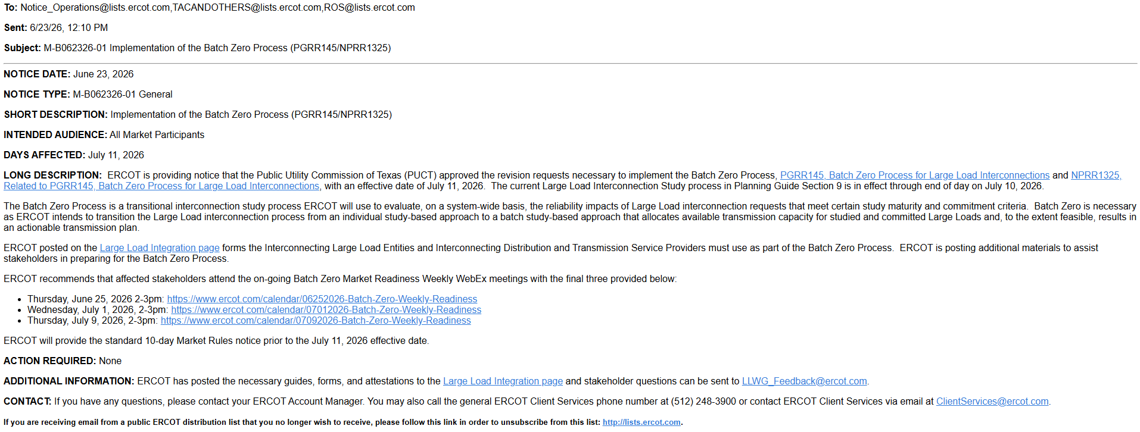
June 23 Market Notice for Batch Zero Process
Source: ERCOT Market Notice Archives, M-B062326-01 Implementation of the Batch Zero Process (PGRR145/NPRR1325)

Slide 40
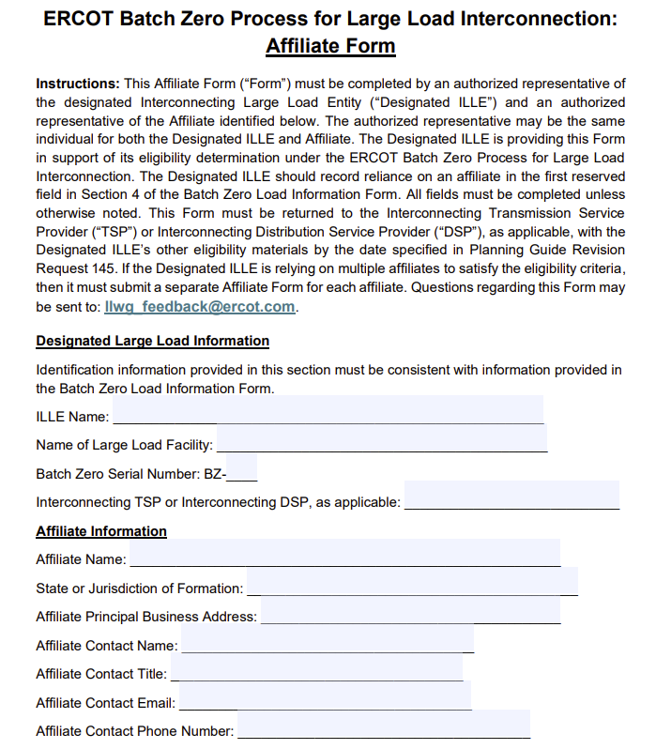
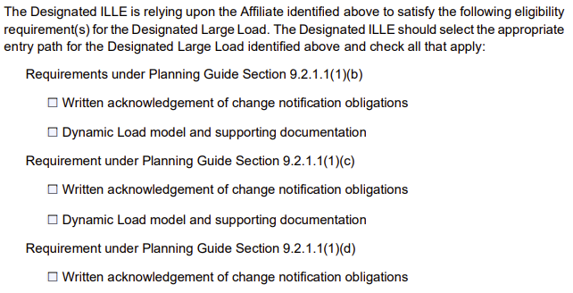
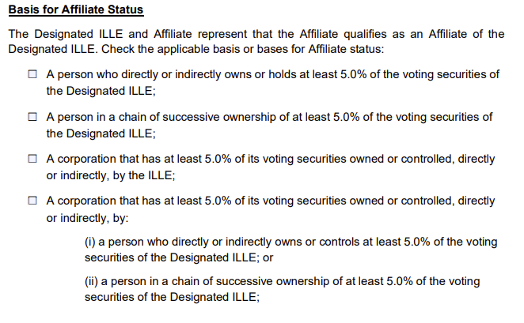
ERCOT Affiliate Attestation Form
Representative attestation template
Key attestation elements
2
1
Project/Affiliate identification information
Captures the Designated ILLE, Large Load facility, interconnecting TSP/DSP, and affiliate information needed to establish the affiliate supporting the Batch Zero submission
1
2
Requirements supported by Affiliate
Identifies the applicable Planning Guide eligibility pathway and the specific eligibility requirements and supporting documentation the affiliate is satisfying on behalf of the Designated ILLE
3
3
Basis for Affiliate Status
Documents the ownership or control relationship between the Designated ILLE and affiliate based on the affiliate criteria in 16 Tex. Admin. Code § 25.5(3)(A)–(E)
An ILLE may satisfy one or more eligibility criteria through the actions of a non-affiliated entity that has been designated by the ILLE to perform such actions as the ILLE’s agent under a contractual arrangement¹
1. The ILLE is not required to provide a copy of the contract as part of its submission package to its Interconnecting TSP or DSP, but the ILLE must provide a copy if ERCOT requests it
Source: ERCOT Large Load Integration webpage – ERCOT Affiliate Attestation Form

Slide 41
Key Deadlines for Batch Zero
July 10
Last day for ERCOT to review and approve LLIS studies
July 24
Deadline for required information for inclusion in Batch Zero to be submitted to ERCOT
August 7
Deadline for ERCOT to notify TSPs and DSPs of Large Load inclusion and classification in Batch Zero
As drafted in PGRR145, the current Large Load Interconnection Study (LLIS) process will cease operation after July 10, 2026
This means July 10 is the last day ERCOT is able to review and approve LLIS studies
Starting on July 11, the Batch Zero Interconnection Study will be the only path to connect a Large Load to the ERCOT system
The inclusion and treatment of Large Loads in Batch Zero will be determined by the status of qualifying studies as they stand at the end of the day on July 10, 2026

Slide 42
Review of PGRR115 Process Timelines – Kick-off and Study Scoping
Per Section 9.3.2 of the current Planning Guide, all LLIS studies must be preceded by a kick-off meeting and defined study scope agreed on by ERCOT, the lead TSP, and any affected TSPs. This meeting is required under the Planning Guide and cannot be waived.
The lead TSP is responsible for scheduling the kick-off meeting. ERCOT does not control when a meeting is scheduled.
ERCOT will continue to attend kick-off meetings and to support the study scoping process through July 10.
As described in the Planning Guide, it can take up to 35 Business Days to finalize a study scope after a kick-off meeting is held.
Key Takeaways
The existing kick-off and scoping process remains in effect.
ERCOT continues to attend kick-off meetings and review study scopes.
ERCOT cannot guarantee a new or updated study report submitted after May 28, 2026 will be reviewed by July 10.

Slide 43
Model Review
Voltage Ride-Through (VRT) Testing
ERCOT will perform VRT testing for applicable Large Computational Loads (LCLs) subject to NOGRR282.
If a model does NOT meet NOGRR282 requirements:
ERCOT will notify the interconnecting TSP and ILLE
The load remains in Batch Zero with no impact to allocation
The ILLE should coordinate with the TSP to update the model before the completion of Batch Zero

Slide 44
Summary of Key Dates
July 10
Last day for ERCOT to review submitted studies under the current LLIS Process
August 7
ERCOT notifies TSPs/DSPs of Batch Zero classifications
LLIS study reviews continue
May
June
July
August
May 28
Last day a study submitted to ERCOT is guaranteed a review by July 10
July 24
Batch Zero information for qualifying loads due to ERCOT

Slide 45
Additional notes on base loads in Batch Zero
The design of PGRR145 is intended to allow for loads that qualify as base load in Batch Zero to continue moving toward energization prior to Batch Zero or while Batch Zero is in progress.
For example, base loads are still able to qualify for the quarterly stability assessment (QSA) appropriate for their planned Initial Energization date while Batch Zero is in progress. They are also eligible to be added to the ERCOT Network Operations Model during that time.

Slide 46
Dynamic Models for the Batch Zero – Key Deadlines
July 10, 2026
July 10, 2026
LL projects not submitting models and required information by this deadline will be excluded from Batch Zero.
ILLE Model Submission Deadline
ILLE Must Submit to ERCOT and the Interconnecting TSP by July 10⁽¹⁾:
August 7, 2026
Dynamic models
Model parameters
Supporting technical documentation
Completed ERCOT Dynamic Working Group Large Load Data Survey⁽²⁾
ERCOT will notify ILLE of any identified deficiencies in submitted models or required information.
August 31, 2026
Any LL projects with incomplete data or unresolved model issues remaining after this date will also be excluded from Batch Zero.
(1). LargeLoadInterconnection@ercot.com
(2). https://www.ercot.com/files/docs/2025/12/19/ERCOT-Dynamics-Working-Group-Large-Load-Data-Survey_v2.docx

Slide 47
Dynamic Models for the Batch Zero – Key Deadlines
July 24, 2026
TSP Determination Deadline
TSP Must Submit to ERCOT by July 24 (if applicable) ⁽¹⁾:
If a dynamic stability study has previously been performed for a Large Load, the interconnecting TSP must submit a written determination indicating whether the submitted dynamic data is expected to adversely impact prior stability study results.
(1). LargeLoadInterconnection@ercot.com

Slide 48
Large Load Dynamic Model Submission Elements
Model Compatibility
Data Survey Completion
All submissions must be compatible with the planning and operations model software version specified in the Dynamic Working Group Procedure Manual in effect on March 4, 2026.
All model submissions must include completion of the latest ERCOT Dynamic Working Group Large Load Data Survey⁽¹⁾.
Updated / Improved Models
ERCOT Defaults
ILLEs are expected to submit updated or improved models that properly represent load behavior — especially where enhanced models are available.
For operational loads not providing dynamic models or updating models, ERCOT will use the available models previously provided or assume minimum ride-through capability where no model is provided.
(1). https://www.ercot.com/files/docs/2025/12/19/ERCOT-Dynamics-Working-Group-Large-Load-Data-Survey_v2.docx

Slide 49
Applicability for Batch-0 Dynamic Model Submission
PGRR 145 Section | Criteria | Submission Required
9.2.1.1(1)(a) | Energized before March 25, 2022 | No⁽¹⁾
9.2.1.1(1)(b) | Energized between March 25, 2022, and July 10, 2026 | No⁽¹⁾
9.2.1.1(1)(c) | Qualified for QSA or included in interim VRT by May 1, 2026 | No⁽¹⁾
9.2.1.1(1)(d) | Included in the 2024 Permian Basin Reliability Plan Study and contributed to transmission needs | Yes⁽¹⁾⁽²⁾
9.2.1.1(1)(e) | Not energized as of July 10, 2026, and meets specified requirements | Yes
9.2.1.1(1)(f) | Not energized as of July 10, 2026, and meets specified requirements | Yes
9.2.1.1(1)(g) | Not energized as of July 10, 2026, and meets specified requirements | Yes
9.2.1.2(1) | Meets criteria (a)-(d) and subject to reliability assessment and allocation | Yes
(1). If an updated model if available, the ILLE should supply a version that more accurately represents the LL.
(2). No submission is needed if meeting criteria in 9.2.1.1(1)(a)-(c).

Slide 50
Objectives for today
Review eligibility requirements by Batch Zero pathway
Review the proposed eligibility requirements, submission materials, and validation responsibilities applicable to each Batch Zero eligibility pathway, including distinctions between ILLE and TSP/DSP requirements
Review proposed attestations, and supporting materials
Review the proposed submission toolkit supporting the Batch Zero process, including standardized attestation templates and TSP/DSP confirmation templates
Review proposed submission and validation process
Walk through the proposed E2E2 Batch Zero submission and validation process, including a representative example illustrating how submission materials are prepared, reviewed, validated, and transmitted

Slide 51
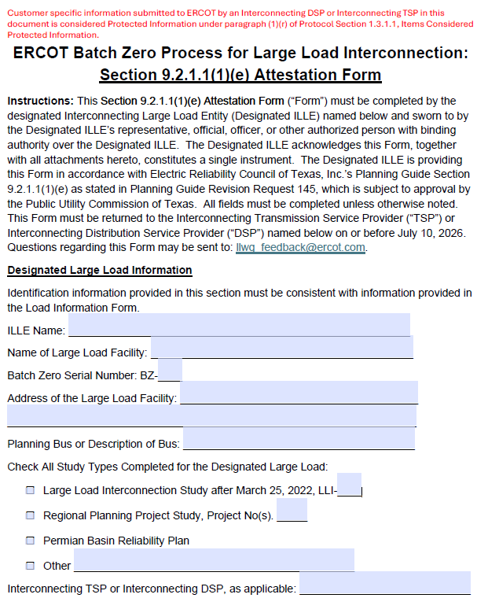
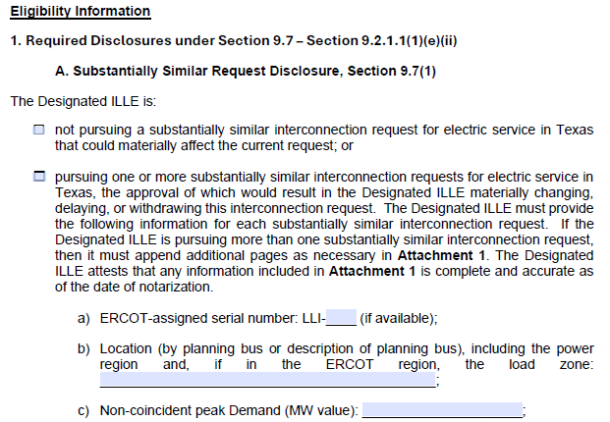
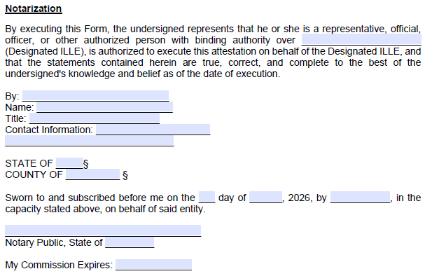
Deep-dive: Batch Zero ILLE Attestation
Representative attestation template
Key attestation elements
2
1
Project identification information
Includes the core project information required to associate the attestation with the applicable Batch Zero request, including ILLE name, facility name, and project location¹
1
2
Eligibility certification and attestation
ILLE representative certifies that the project satisfies the applicable eligibility criteria and that the submitted information is complete and accurate at the time of execution
3
3
Notarization and authorized execution
Authorized ILLE representative executes the attestation before a notary public, confirming authority to bind the entity and certify the submission under oath
1. ERCOT plans to assign a new unique Batch Zero identifier (“BZ ID”) to each submitted Large Load project for Batch Zero intake and tracking purposes. These identifiers will serve as the primary reference number for Batch Zero implementation activities and may differ from existing LLI numbers, RPG references, PBRP references, or other project identifiers currently used in ERCOT processes.
Source: Batch Zero Readiness Meeting #3 - Webex Only materials

Slide 52
Eligibility Requirements by Batch Zero Pathway (1/4)
Eligibility requirements
Eligibility path
For the ILLE¹
For the TSP/DSP
Base Load § 9.2.1.1(1)(a)
(Energized before 3/25/2022)
Optional updated dynamic load models (if enhanced or updated models are available) to ERCOT and the Interconnecting TSP
List of already energized loads
Confirmation that the Large Load satisfies the applicable requirements of Base Load Section 9.2.1.1(1)(a)
Base Load § 9.2.1.1(1)(b)
(Energized between 3/25/2022 and 7/10/26)
Optional updated dynamic load models (if enhanced or updated models are available) to ERCOT and the Interconnecting TSP
Using form on ERCOT Large Load Integration website – ILLE acknowledges obligation to notify TSP of changes
Completed Batch Zero LIF Workbook, including LCP
Confirmation that the Large Load satisfies the applicable requirements of Base Load Section 9.2.1.1(1)(b)
Base Load § 9.2.1.1(1)(c)
(QSA or IVRT Assessment))
Optional updated dynamic load models (if enhanced or updated models are available) to ERCOT and the Interconnecting TSP
Using form on ERCOT Large Load Integration website – ILLE acknowledges obligation to notify TSP of changes
Completed Batch Zero LIF Workbook, including LCP
List of Large Loads qualifying under the quarterly stability assessment / interim VRT pathway (working with ERCOT)
Confirmation that the Large Load satisfies the applicable requirements of Base Load Section 9.2.1.1(1)(c)
Base Load § 9.2.1.1(1)(d)
(Permian Basin Reliability Plan Study Load)
Dynamic load model to ERCOT and the Interconnecting TSP
Using form on ERCOT Large Load Integration website – ILLE acknowledges obligation to notify TSP of changes
Completed Batch Zero LIF Workbook, including LCP
List of Large Loads qualifying under the Permian Basin Reliability Plan Study pathway (working with ERCOT)
Confirmation that the Large Load satisfies the applicable requirements of Base Load Section 9.2.1.1(1)(d)
If needed, prior stability-study impact determination (form available on the ERCOT Large Load Integration website)
1. Unless otherwise specified, ILLE needs to provide the required documentation to the interconnecting TSP/DSP
Source: ERCOT PGRR145, ERCOT NPRR1325

Slide 53
Eligibility Requirements by Batch Zero Pathway (2/4)
Eligibility requirements
Eligibility path
For the ILLE¹
For the TSP/DSP
Base Load § 9.2.1.1(1)(e)
(Advancing Large Load)
Provide Attestation Form (form available on the ERCOT Large Load Integration website):
  Section 9.7 disclosures
  Equipment with 18-month lead time
  Notice to proceed
  End-use customer
  Confirm site control and provide supporting evidence
  Written acknowledgement of change notification obligations
Dynamic load model to ERCOT and the Interconnecting TSP
Affliate Form if applicable
Completed Batch Zero LIF Workbook, including LCP
Confirmation of complete and valid set of interconnection studies (working with ERCOT)
Confirmation ILLE has provided financial security for system upgrades
Confirmation ILLE has satisfied direct interconnection cost (CIAC) responsibility
Confirmation that the Large Load has attested to other applicable requirements of Base Load Section 9.2.1.1(1)(e)
If needed, prior stability-study impact determination (form available on the ERCOT Large Load Integration website)
Base Load § 9.2.1.1(1)(f)
(Committed Large Load)
Provide Attestation Form (form available on the ERCOT Large Load Integration website):
  Section 9.7 disclosures
  Site approvals or no approvals plus statement supporting conclusion
  Confirm site control and provide supporting evidence
  Binding general contractor contract
  Binding contract with substation contractor
  Written acknowledgement of change notification obligations
Dynamic load model to ERCOT and the Interconnecting TSP
Affliate Form if applicable
Completed Batch Zero LIF Workbook, including LCP
Confirmation of complete and valid set of interconnection studies (working with ERCOT)
Confirmation ILLE has provided financial security for system upgrades
Confirmation ILLE has satisfied direct interconnection cost (CIAC) responsibility
Confirmation that the Large Load has attested to other applicable requirements of Base Load Section 9.2.1.1(1)(f)
If needed, prior stability-study impact determination (form available on the ERCOT Large Load Integration website)
1. Unless otherwise specified, ILLE needs to provide the required documentation to the interconnecting TSP/DSP
Source: ERCOT PGRR145, ERCOT NPRR1325

Slide 54
Eligibility Requirements by Batch Zero Pathway (3/4)
Eligibility requirements
Eligibility path
For the ILLE¹
For the TSP/DSP
Base Load § 9.2.1.1(1)(g)
(PURA §39.169 Net Metering Proceeding Load)
Provide Attestation Form (form available on the ERCOT Large Load Integration website):
  Section 9.7 disclosures
Dynamic load model to ERCOT and the Interconnecting TSP
Affliate Form if applicable
Completed Batch Zero LIF Workbook (not LCP)
Confirmation ILLE has provided financial security for system upgrades
Confirmation that the Large Load is associated with a qualifying PURA §39.169 net metering proceeding
Confirmation that the Large Load satisfies the applicable requirements of Base Load Section 9.2.1.1(1)(g)
If needed, prior stability-study impact determination (form available on the ERCOT Large Load Integration website)
Studied Load § 9.2.1.2(1)
Full technical data package required to perform steady-state, short circuit, dynamic, and transient stability analyses
Provide Attestation Form (form available on the ERCOT Large Load Integration website):
  Section 9.7 disclosures
  Confirm site control and provide supporting evidence
  Written acknowledgement of change notification obligations
Preliminary LCP to the Interconnecting TSP
Dynamic load model to ERCOT and the Interconnecting TSP
Affliate Form if applicable
Completed Batch Zero LIF Workbook, including LCP
Confirmation of study requirement (working with ERCOT)
Confirmation ILLE has provided financial security for system upgrades equal to $50k/MW of peak Demand
If needed, prior stability-study impact determination
Confirmation that the Large Load satisfies the applicable requirements of Studied Load
If needed, prior stability-study impact determination (form available on the ERCOT Large Load Integration website)
1. Unless otherwise specified, ILLE needs to provide the required documentation to the interconnecting TSP/DSP
Source: ERCOT PGRR145, ERCOT NPRR1325

Slide 55
Eligibility Requirements by Batch Zero Pathway (4/4)
Eligibility requirements
Eligibility path
For the ILLE¹
For the TSP/DSP
PCLR §§ 9.2.1.2 and 9.2.2.1(2)
(Provisional Controllable Load Resource)
Full technical data package required to perform steady-state, short circuit, dynamic, and transient stability analyses
Provide Attestation Form (form available on the ERCOT Large Load Integration website):
  Section 9.7 disclosures
  Confirm site control and provide supporting evidence
  Written acknowledgement of change notification obligations
Preliminary LCP to the Interconnecting TSP
Dynamic load model to ERCOT and the Interconnecting TSP
Notarized Form W – Part A
Affliate Form if applicable
Completed Batch Zero LIF Workbook
Confirmation of Transmission upgrade financial security
Confirmation of receipt of written acknowledgement of change notification obligations
If needed, prior stability-study impact determination (form available on the ERCOT Large Load Integration website)
Confirmation that the Large Load satisfies the applicable requirements of PCLR
WLPUN §§ 9.2.1.2 and 9.2.2.1(2)
(Withdrawal-Limited Private Use Network)
Full technical data package required to perform steady-state, short circuit, dynamic, and transient stability analyses
Provide Attestation Form (form available on the ERCOT Large Load Integration website):
  Section 9.7 disclosures
  Confirm site control and provide supporting evidence
  Written acknowledgement of change notification obligations
Preliminary LCP to the Interconnecting TSP
Dynamic load model to ERCOT and the Interconnecting TSP
Notarized Form X
Affliate Form if applicable
Completed Batch Zero LIF Workbook
Confirmation of Transmission upgrade financial security
Confirmation of receipt of written acknowledgement of change notification obligations
If needed, prior stability-study impact determination (form available on the ERCOT Large Load Integration website)
Confirmation of Generator FIS request and associated generation information for the WLPUN
Confirmation that the Large Load satisfies the applicable requirements of Studied Load – WLPUN
1. Unless otherwise specified, ILLE needs to provide the required documentation to the interconnecting TSP/DSP
Source: ERCOT PGRR145, ERCOT NPRR1325

Slide 56
Qualifying Study: Complete and valid LLIS ONLY
Obtain the LCP from the approved LLIS study
Review TPIT and modify any dates in the LCP according to 9.2.1.1(2)(c)(ii)(B)
Obtain the ramp schedule in the executed IA for the load.
Compare the modified LCP and the executed IA. Use the lower value for each year.
Load is base load in all years according to this schedule

Slide 57
Case Study (1/7): Complete and valid LLIS ONLY
Populate Interconnection Agreement Peak MW using the executed IA
Supporting screenshots
Process description
  Populate Interconnection Agreement Peak MW and MVAR using the executed Interconnection Agreement (IA) or equivalent agreement
  Enter the maximum load level contractually permitted in each annual model year
  These values are used later to determine the final Output Peak MW schedule
Source: Batch-Zero-Load-Information-Form-06172026

Slide 58
Case Study (2/7): Complete and valid LLIS ONLY
Populate Existing LCP Peak MW and MVAR
Supporting screenshots
Process description
  Populate Existing LCP Peak MW and MVAR using the approved LLIS Load Commissioning Plan (LCP)
  For each annual model year, enter the load level reflected in the approved LLIS schedule
Source: Batch-Zero-Load-Information-Form-06172026

Slide 59
Case Study (3/7): Complete and valid LLIS ONLY
Enter LLIS upgrades and TPIT dates
Supporting screenshots
Process description
  For each load increase that depends on a transmission upgrade, enter the controlling upgrade in LLIS Required Controlling Upgrade
  If the upgrade appears in the latest TPIT report, enter the latest TPIT in-service date in LLIS TPIT ISD
  If a load increase depends on a transmission upgrade but the upgrade is not included in the latest TPIT report, enter the controlling transmission upgrade in LLIS Required Controlling Upgrade and leave LLIS TPIT ISD blank
  These entries determine whether the LLIS load increase remains available in the original year or is deferred to a later year
Source: Batch-Zero-Load-Information-Form-06172026

Slide 60
Case Study (4/7): Complete and valid LLIS ONLY
Populate LLIS supporting information
Supporting screenshots
Process description
  For each LLIS load increase that depends on a transmission upgrade, identify the associated TPIT project
  Populate the applicable TPIT Project Number, TPIT Project Tier, and indicate whether the upgrade is reflected in the 25SSWG_U1 cases
  This information is provided for reference and validation purposes and supports ERCOT review of the TPIT assumptions
Source: Batch-Zero-Load-Information-Form-06172026

Slide 61
Case Study (5/7): Complete and valid LLIS ONLY
Review the LLIS TPIT-Adjusted Peak MW
Supporting screenshots
Process description
  No user input is required in this section
  The LLIS TPIT-Adjusted Peak MW schedule is modified automatically to reflect the latest TPIT in-service date for each LLIS-controlled step
  If a required upgrade enters service later than assumed in the LLIS, the associated load increase is automatically deferred until the TPIT in-service year
Source: Batch-Zero-Load-Information-Form-06172026

Slide 62
Case Study (6/7): Complete and valid LLIS ONLY
Review the Combined TPIT-Adjusted Peak MW
Supporting screenshots
Process description
  No user input is required in this section
  Under the LLIS Only Entry Path, the Combined TPIT-Adjusted Peak MW schedule is equal to the LLIS TPIT-Adjusted Peak MW schedule
  Combined TPIT-Adjusted Peak MW reflects the load levels available after applying TPIT adjustments
Source: Batch-Zero-Load-Information-Form-06172026

Slide 63
Case Study (7/7): Complete and valid LLIS ONLY
Review the Output Peak MW
Supporting screenshots
Process description
  No user input is required in this section
  The workbook automatically calculates Output Peak MW as the lower of:
    the Interconnection Agreement Peak MW schedule; and
    the Combined TPIT-Adjusted Peak MW schedule
  The resulting Output Peak MW schedule represents the final Batch Zero modeled load schedule
  Under the LLIS Only Entry Path, the resulting schedule is modeled as Base Load in all years
Source: Batch-Zero-Load-Information-Form-06172026

Slide 64
Qualifying Study: RPG ONLY
Review the RPG report and identify the in-service date of the last upgrade in the project.
Use the ramp schedule from the IA
Load is base load in that year according to this schedule
IA
Compare the modified LCP and the executed IA. Which is lower?
Construct LCP for the load that is 0 MW for all years prior to the in-service of the last upgrade
Review TPIT and modify any dates in the LCP according to 9.2.1.1(2)(c)(ii)(A)
Obtain the ramp schedule in the executed IA for the load.
Modified RPG
Modify the RPG ramp according to the rules in 9.2.1.2(3) to set limits on studied amount
Load is a hybrid load
- Studied in years before RPG in-service
- Base load after that

Slide 65
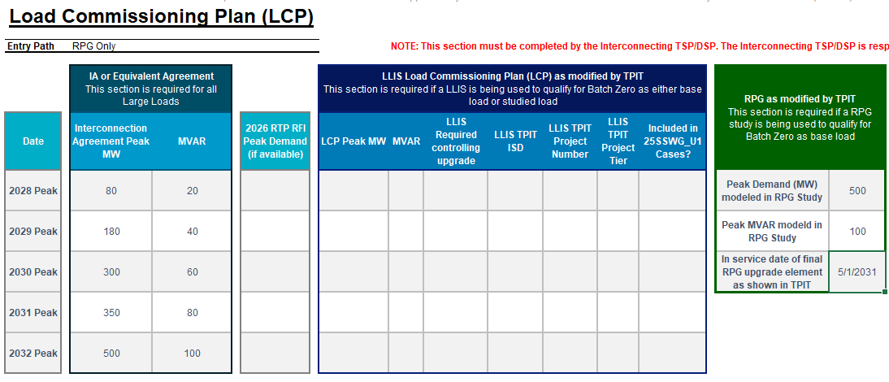
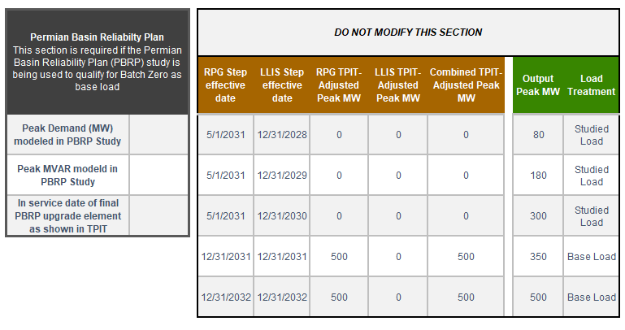
Case Study (1/6): RPG ONLY
Populate Interconnection Agreement Peak MW using the executed IA
Supporting screenshots
Process description
  Populate Interconnection Agreement Peak MW and MVAR using the executed Interconnection Agreement (IA) or equivalent agreement
  Enter the maximum load level contractually permitted in each annual model year
  These values are used later to determine the final Output Peak MW schedule
Source: Batch-Zero-Load-Information-Form-06172026

Slide 66
Case Study (2/6): RPG ONLY
Populate RPG study information
Supporting screenshots
Process description
  Populate Peak Demand (MW) modeled in RPG Study and Peak MVAR modeled in RPG Study using the RPG study that qualified the Large Load for Batch Zero
  These values represent the load level determined to be supportable once all required RPG transmission upgrades are in service
  The workbook uses these values together with the TPIT in-service date to construct the RPG-supported schedule
Source: Batch-Zero-Load-Information-Form-06172026

Slide 67
Case Study (3/6): RPG ONLY
Enter RPG TPIT ISD
Supporting screenshots
Process description
  Populate In-service Date of Final RPG Upgrade Element as shown in TPIT using the latest TPIT in-service date for the final RPG upgrade required to support the Large Load
  The workbook uses this date to determine when the RPG-supported load becomes available for modeling
Source: Batch-Zero-Load-Information-Form-06172026

Slide 68
Case Study (4/6): RPG ONLY
Leave PBRP and LLIS fields blank
Supporting screenshots
Process description
  Under the RPG Only Entry Path, PBRP and LLIS information is not used in the modeling methodology
  Leave Existing LCP Peak MW, Existing LCP MVAR, PBRP Peak MW, LLIS Required Controlling Upgrade, LLIS TPIT ISD, LLIS TPIT Project Number, LLIS TPIT Project Tier, and Included in 25SSWG_U1 Cases? blank
  No PBRP- or LLIS-related calculations are performed under this pathway
Source: Batch-Zero-Load-Information-Form-06172026

Slide 69
Case Study (5/6): RPG ONLY
Review RPG TPIT-Adjusted Peak MW
Supporting screenshots
Process description
  No user input is required in this section
  The workbook automatically constructs the RPG-supported schedule using the RPG study Peak Demand and the TPIT in-service date
  Prior to the RPG TPIT in-service date, the modeled amount is 0 MW. Beginning in the RPG TPIT in-service year, the modeled amount reflects the RPG study Peak Demand
Source: Batch-Zero-Load-Information-Form-06172026

Slide 70
Case Study (6/6): RPG ONLY
Review Output Peak MW and Load Treatment
Supporting screenshots
Process description
  No user input is required in this section
  Output Peak MW is automatically calculated as the lower of:
    the Interconnection Agreement Peak MW schedule; and
    the Combined TPIT-Adjusted Peak MW schedule
  The resulting Output Peak MW schedule determines the applicable load treatment. Prior to RPG availability, the load is modeled as Studied Load; after RPG availability, the load is modeled as Base Load
Source: Batch-Zero-Load-Information-Form-06172026

Slide 71
Qualifying Study: PBRP ONLY
Use the ramp schedule from the IA
Load is base load in that year according to this schedule
IA
Compare the modified LCP and the executed IA. Which is lower?
Construct LCP for the load that is 0 MW for all years prior to 2030 and PBRP modeled amount after that.
Review TPIT and modify any dates in the LCP according to 9.2.1.1(2)(c)(ii)(A)
Obtain the ramp schedule in the executed IA for the load.
Modified PBRP
Use the PBRP ramp schedule as modified by TPIT
Load is a hybrid load
- Studied in years before 2030
- Base load after that
NOTE: PBRP Only follows the same LCP construction methodology as RPG Only

Slide 72
Qualifying Study: PBRP AND a complete and valid LLIS
Construct LCP for the load that is 0 MW for all years prior to 2030 and PBRP modeled amount after that.
Review TPIT and modify any dates in the RPG LCP according to 9.2.1.1(2)(c)(ii)(A)
Load is base load in that year according to this schedule
Use the ramp schedule from the IA
IA
Compare the modified LCP and the executed IA. Which is lower?
Obtain the LCP from the approved LLIS study
Review TPIT and modify any dates in the LLIS LCP according to 9.2.1.1(2)(c)(ii)(B)
For each year, take the greater value between the modified PBRP LCP and the modified LLIS LCP
Obtain the ramp schedule in the executed IA for the load.
Modified PBRP
Load is base load in that year according to this schedule
Use the PBRP/LLIS mash-up ramp schedule as modified by TPIT
NOTE: PBRP + Complete and Valid LLIS follows the same modeling methodology as RPG + Complete and Valid LLIS
72

Slide 73
Batch Zero Load Information Form (LIF): overview and completion instructions
  LIF structure and overview
  Key messages
“Instructions” tab: user guide and reference document
Provides overview of the workbook purpose
Explains eligibility pathways, submission requirements, and validation responsibilities
Defines key fields, statuses, and documentation requirements
Describes readiness criteria and submission coordination process
The LIF workbook serves as the primary coordination, validation, and submission-readiness tool for Batch Zero
Users complete the workbook sequentially across three tabs: Instructions, Batch Zero LIF, and Load Commissioning Plan (LCP)
The workbook helps determine eligibility requirements, track supporting documentation, and prepare a complete submission package for ERCOT
The LIF supports submission readiness but does not replace ERCOT forms, attestations, technical studies, or formal eligibility determinations
“Batch Zero LIF” tab: eligibility determination and submission tracking
Section 1 – Project information: Enter Large Load project, interconnection, and contact information
Section 2 – Eligibility and entry path selection: Select the applicable Batch Zero Eligibility Path and Entry Path
Section 3 – Submission tracking and validation: Track required documentation, review ownership, and submission readiness
“LCP New” tab: modeled load schedule for Batch Zero studies
Completed by the Interconnecting TSP/DSP
Do not complete this section before completing the LIF tab
Enter applicable Interconnection Agreement and customer-requested load schedule information
Incorporate LLIS, RPG, PBRP, and TPIT inputs associated with the selected Eligibility and Entry Path
Automatically calculate the load levels and timing used for Batch Zero evaluation
Source: Batch-Zero-Load-Information-Form-06172026

Slide 74
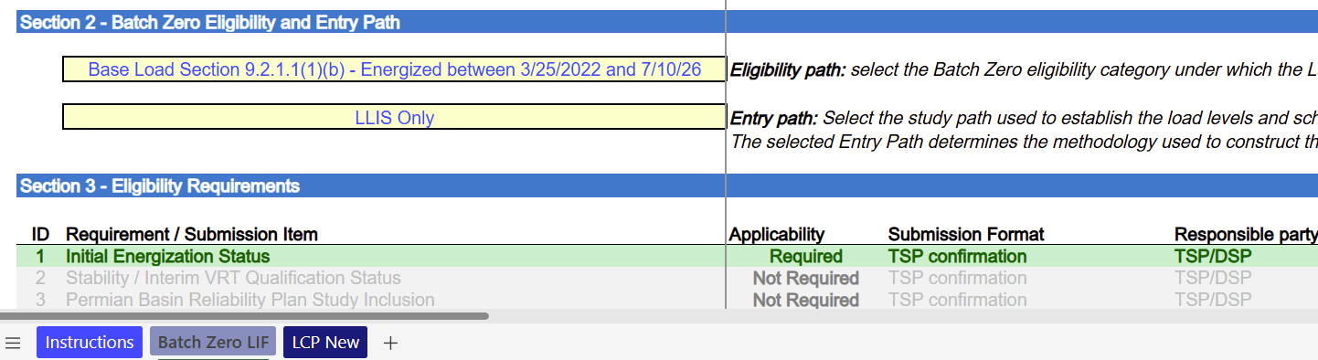
LIF Updated to Incorporate Entry Path Selection and Dynamic LCP Logic (1/2)
Updated LIF screenshot
Key highlights
1
Updated LIF now captures both the Eligibility Path and Entry Path: the Eligibility Path determines the applicable Batch Zero requirements, while the Entry Path determines the methodology used to construct the modeled load schedule
The Interconnecting TSP/DSP is responsible for completing the LCP: based on the selected Entry Path, the TSP/DSP populates the applicable LCP information and applies the corresponding modeling methodology
Seven Entry Paths are currently supported in the workbook: LLIS Only, RPG Only, RPG + Complete and Valid LLIS, PBRP Only, PBRP + Complete and Valid LLIS, Studied Load / PCLR / WLPUN, and Energized / QSA / IVRT
Different Entry Paths require different inputs and calculations: study-based pathways use LLIS, RPG, PBRP, TPIT, and Interconnection Agreement information, while Energized / QSA / IVRT and Studied Load / PCLR / WLPUN pathways use simplified modeling methodologies based on existing LCPs, RTP RFI information, and/or Interconnection Agreements
1
2
2
Source: Batch-Zero-Load-Information-Form-06172026

Slide 75
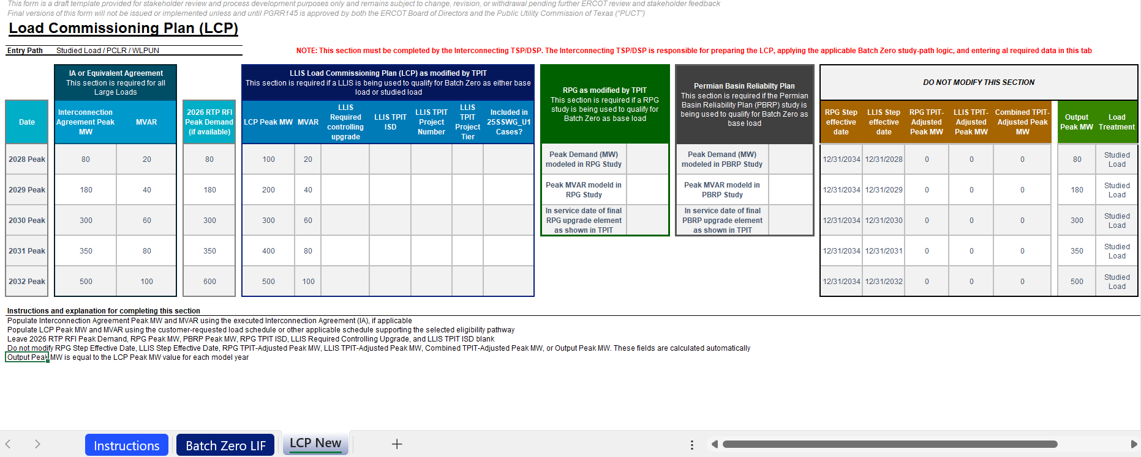
LIF Updated to Incorporate Entry Path Selection and Dynamic LCP Logic (2/2)
Updated LIF screenshot
“LCP New” sheet layout redesigned to improve usability: sections were reorganized, color-coded inputs and calculated fields were introduced, and pathway-specific instructions were added to help TSPs/DSPs complete the workbook more efficiently and consistently
Source: Batch-Zero-Load-Information-Form-06172026

Slide 76
Qualifying Study: RPG AND a complete and valid LLIS
Review the RPG report and identify the in-service date of the last upgrade in the project.
Construct LCP for the load that is 0 MW for all years prior to the in-service of the last upgrade
Review TPIT and modify any dates in the RPG LCP according to 9.2.1.1(2)(c)(ii)(A)
Load is base load in that year according to this schedule
Use the ramp schedule from the IA
IA
Compare the modified LCP and the executed IA in each year. Which is lower?
Obtain the LCP from the approved LLIS study
Review TPIT and modify any dates in the LLIS LCP according to 9.2.1.1(2)(c)(ii)(B)
For each year prior to the in-service of last upgrade, take the greater value between the modified RPG LCP and the modified LLIS LCP
Obtain the ramp schedule in the executed IA for the load.
Modified RPG
Load is base load in that year according to this schedule
Use the RPG/LLIS mash-up ramp schedule as modified by TPIT
76

Slide 77
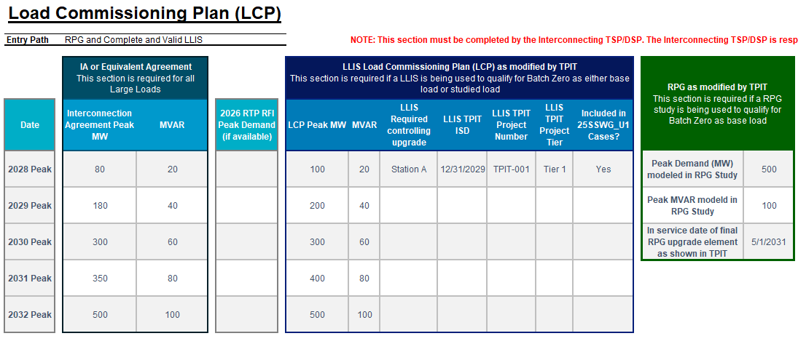
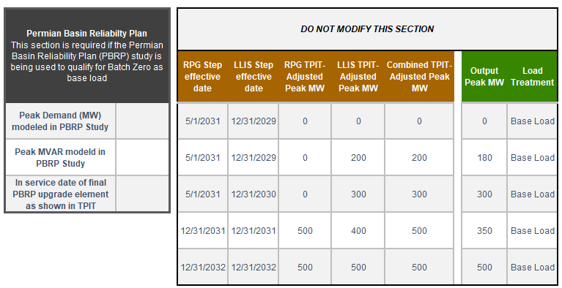
Case Study (1/8): RPG AND a complete and valid LLIS
Populate Interconnection Agreement Peak MW using the executed IA
Supporting screenshots
Process description
  Populate Interconnection Agreement Peak MW and MVAR using the executed Interconnection Agreement (IA) or equivalent agreement
  Enter the maximum load level contractually permitted in each annual model year
  These values are used later to determine the final Output Peak MW schedule
Source: Batch-Zero-Load-Information-Form-06172026

Slide 78
Case Study (2/8): RPG AND a complete and valid LLIS
Populate Existing LCP Peak MW and MVAR
Supporting screenshots
Process description
  Populate Existing LCP Peak MW and MVAR using the approved LLIS Load Commissioning Plan (LCP)
  These values establish the baseline LLIS-supported load schedule used throughout the example
  The LLIS schedule is subsequently adjusted using TPIT information for any required transmission upgrades
Source: Batch-Zero-Load-Information-Form-06172026

Slide 79
Case Study (3/8): RPG AND a complete and valid LLIS
Enter LLIS upgrades and TPIT dates
Supporting screenshots
Process description
  For each load increase that depends on a transmission upgrade, enter the controlling upgrade in LLIS Required Controlling Upgrade
  If the upgrade appears in the latest TPIT report, enter the latest TPIT in-service date in LLIS TPIT ISD
  If a load increase depends on a transmission upgrade but the upgrade is not included in the latest TPIT report, enter the controlling transmission upgrade in LLIS Required Controlling Upgrade and leave LLIS TPIT ISD blank
  These entries determine whether the LLIS load increase remains available in the original year or is deferred to a later year
Source: Batch-Zero-Load-Information-Form-06172026

Slide 80
Case Study (4/8): RPG AND a complete and valid LLIS
Populate LLIS supporting information
Supporting screenshots
Process description
  For each LLIS load increase that depends on a transmission upgrade, identify the associated TPIT project
  Populate the applicable TPIT Project Number, TPIT Project Tier, and indicate whether the upgrade is reflected in the 25SSWG_U1 cases
  This information is provided for reference and validation purposes and supports ERCOT review of the TPIT assumptions
Source: Batch-Zero-Load-Information-Form-06172026

Slide 81
Case Study (5/8): RPG AND a complete and valid LLIS
Populate RPG Study Information
Supporting screenshots
Process description
  Populate Peak Demand (MW) modeled in RPG Study and Peak MVAR modeled in RPG Study using the qualifying RPG study
  Populate the In-service date of final RPG upgrade element as shown in TPIT
  These values define the load level supportable through the RPG process and when that load becomes available
Source: Batch-Zero-Load-Information-Form-06172026

Slide 82
Case Study (6/8): RPG AND a complete and valid LLIS
Leave PBRP Inputs Blank
Supporting screenshots
Process description
  This example follows the RPG + Complete and Valid LLIS Entry Path and does not rely on the PBRP study pathway
  Leave all PBRP-related fields blank
  No PBRP adjustments are applied in this example
Source: Batch-Zero-Load-Information-Form-06172026

Slide 83
Case Study (7/8): RPG AND a complete and valid LLIS
Review Combined TPIT-Adjusted Peak MW
Supporting screenshots
Process description
  No user input is required in this section
  The workbook automatically calculates both the RPG TPIT-Adjusted Peak MW schedule and the LLIS TPIT-Adjusted Peak MW schedule
  Combined TPIT-Adjusted Peak MW reflects the higher of the RPG TPIT-Adjusted Peak MW schedule and the LLIS TPIT-Adjusted Peak MW schedule for each year
Source: Batch-Zero-Load-Information-Form-06172026

Slide 84
Case Study (8/8): RPG AND a complete and valid LLIS
Review the Output Peak MW
Supporting screenshots
Process description
  No user input is required in this section
  The workbook compares the Combined TPIT-Adjusted Peak MW schedule against the Interconnection Agreement schedule
  Output Peak MW is determined automatically as the lower of the Interconnection Agreement Peak MW schedule and the Combined TPIT-Adjusted Peak MW schedule for each year
  The resulting Output Peak MW schedule is modeled as Base Load in all years
Source: Batch-Zero-Load-Information-Form-06172026

Slide 85

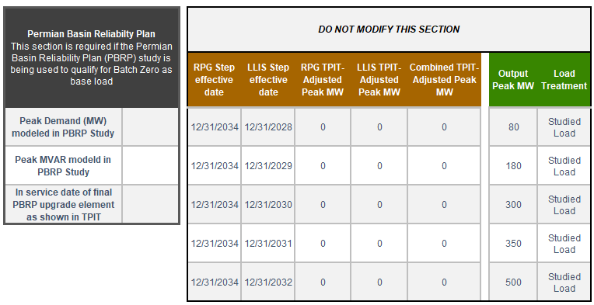
Case Study (1/4): Studied Load
Populate Interconnection Agreement Peak MW using the executed IA
Supporting screenshots
Process description
  Populate Interconnection Agreement Peak MW and MVAR using the executed Interconnection Agreement (IA) or equivalent agreement
  Enter the maximum load level contractually permitted in each annual model year
  These values are used later to determine the final Output Peak MW schedule
Source: Batch-Zero-Load-Information-Form-06172026

Slide 86
Case Study (2/4): Studied Load
Populate Existing LCP Peak MW and MVAR
Supporting screenshots
Process description
  Populate Existing LCP Peak MW and MVAR using the approved LLIS Load Commissioning Plan (LCP)
  These values establish the baseline LLIS-supported load schedule used throughout the example
  The LLIS schedule is subsequently adjusted using TPIT information for any required transmission upgrades
Source: Batch-Zero-Load-Information-Form-06172026

Slide 87
Case Study (3/4): Studied Load
Leave 2026 RTP RFI Peak Demand, RPG Peak MW, PBRP Peak MW, RPG TPIT ISD, LLIS Required Controlling Upgrade, and LLIS TPIT ISD blank
Supporting screenshots
Process description
  This example follows the Studied Load Entry Path and does not rely on the LLIS, RPG or PBRP study pathway
  Leave all LLIS, RPG and PBRP-related fields blank
Source: Batch-Zero-Load-Information-Form-06172026

Slide 88
Case Study (4/4): RPG AND a complete and valid LLIS
Review the Output Peak MW
Supporting screenshots
Process description
  No user input is required in this section
  Output Peak MW is determined automatically as it gets studied up to the Interconnection Agreement Peak MW schedule for each year
  The resulting Output Peak MW schedule is modeled as Studied Load in all years
Source: Batch-Zero-Load-Information-Form-06172026

Slide 89
PUCT Updates from June 18th Open Meeting
  Prior to the June 18 Open Meeting, several commenters filed comments on PGRR145 asking for clarification that an ILLE can rely on an affiliate to satisfy the eligibility criteria
  ERCOT filed a letter indicating it agrees that allowing an ILLE to rely on an affiliate is a reasonable clarification. ERCOT also suggested it will use the bright-line ownership and officer tests in subparagraphs (A) through (E) of the definition of a public utility's affiliates in 16 Tex. Admin. Code § 25.5(3) to determine an ILLE's affiliates
  PUCT Staff expressed support for ERCOT’s position
  To reflect this change, an ILLE that relies on an affiliate (as defined in subparagraphs (A) through (E) of 16 Tex. Admin. Code § 25.5(3)) must note that reliance in the first reserved field in Section 4 of the LIF. ERCOT may also require a supporting form
    ERCOT will provide written guidance with respect to this in the next few days
  Chairman Gleeson and PUCT Staff provided an additional clarification around the refundability of financial security. Interested stakeholders should refer to the June 18 Open Meeting for more information

Slide 90
Batch Zero Numbers
ERCOT has issued new Batch Zero unique identifier numbers to all Large Loads currently being tracked and provided these numbers to the appropriate TSP.
These numbers use the format BZ-####
The BZ number is randomly generated and does not indicate inclusion status in Batch Zero.
Records of previous LLIS and RPG numbers will be retained and associated with the new BZ number.
BZ numbers are required to complete the LIF and all attestations.
In the event a Large Load request is issued multiple BZ numbers, the ILLE should use the lower number to complete the forms and notify the TSP of the duplicate.
LLIS
LLI-####
RPG
yyRPG###
Energized Load
Batch Zero Number
BZ-####
Permian Reliability Plan
SB6 NMA
QSA / IVRT
On or before May 1

Slide 91
WLPUN and FIS application
For new Generation Projects intending to co-locate with Large Load under a Withdrawal-Limited Private Use Network (WLPUN), the Full Interconnection Study (FIS) request must be submitted to ERCOT and deemed complete by ERCOT on or before July 10, 2026, in accordance with Planning Guide Section 9.2.2.2(3)(a)
The submission must include all requirements described in Planning Guide Section 5.3.2(3). Upon receipt of the application, ERCOT will notify the Interconnecting Entity (IE) within ten business days if the application fails to include information necessary for approval
To allow time for ERCOT’s completeness review, any Generation Project intending to be a WLPUN must submit its FIS application to ERCOT by June 26, 2026

Slide 92
Q&A: Modifying the LCP or reducing the MW request for base load LLI
Question: Can a large load expecting to qualify as base load submit an LCP that differs from the LCP in the qualifying study?
Answer: TSPs and ILLEs are permitted and encouraged to submit LCPs that reflect the most realistic picture of the load’s projected ramp schedule. A Batch Zero LCP that shows a slower ramp or a lower MW amount in a given step of the LCP than the qualifying study is permitted. A Batch Zero LCP that shows a faster ramp or a higher MW amount in a given step is not permitted.
Question: Can a large load submit a peak MW amount that differs from the amount in the qualifying study? (e.g. a Large Load was studied for 1000 MW in the qualifying study but wishes to enter Batch Zero with a 600 MW peak demand.)
Answer: For both base load and studied load, the ILLE may submit a lower peak MW amount for Batch Zero without penalty. The existing studies will still be considered valid. The ILLE may not request a peak MW amount that is higher than the amount in the qualifying study.
Additional information available from updated FAQs

Slide 93
Batch Zero Q&A: Studied Load Treatment for Portion of Base Load LLI
Question: Can an interconnection request projected to qualify as base load be split so that the initial portion of the LCP qualifies as base load while the remainder of the LCP enters Batch Zero as studied load instead? Both portions would rely on the same set of studies for qualification.
Answer: ERCOT has determined splitting an interconnection request in this way is permitted under PGRR145.
In order to make this change,
The interconnecting TSP, on behalf of the ILLE, should email LargeLoadInterconnection@ercot.com with the request as soon as possible. The request should specify the portion of the qualifying LCP that will be submitted as base load and the portion that will be submitted as studied load.
ERCOT will issue a second BZ number for the portion of the LCP that will be submitted as studied load and communicate it to the TSP.
The TSP will need to send ERCOT a complete set of Batch Zero forms for each of the two BZ numbers, with the LIF indicating the desired qualification path.
Additional information available from updated FAQs

Slide 94
Q&A: Sale of a Large Load projected to qualify for Batch Zero
Question: Will the sale by the ILLE of a Large Load interconnection request to another party impact the inclusion of the Large Load in Batch Zero?
Answer: A transfer of ownership only will not impact the inclusion and classification of the Large Load in Batch Zero. The interconnecting TSP should send ERCOT an updated LIF to reflect the new ILLE. Any changes to the load design, end use activity, point of interconnection, or other changes that might impact the electrical characteristics may impact Batch Zero qualification. These will be reviewed on a case-by-case basis.
Additional information available from updated FAQs

Slide 95
Q&A: Refundability of Security for Large Loads
Question: If an ILLE modifies its LCP to show a lower MW amount before July 10, can it also lower its posted security or receive a refund for a portion of its direct interconnection costs?
Answer: PGRR145 does not address refundability of financial security or direct interconnection costs. The ILLE's recourse is with its Interconnecting TSP or DSP directly.
Additional information available from updated FAQs

Slide 96
Q&A: Section 9.7(2) and (3) Disclosures
Question: What information does an ILLE need to disclose to satisfy the requirements in Section 9.7(2) and (3)?
Answer: To satisfy Section 9.7(2), an ILLE must disclose its plans, expected timing, and progress for site-related studies and engineering services required before energization. Similarly, for Section 9.7(3), the ILLE must disclose its plans, expected timing, and current progress for obtaining non-ministerial discretionary approvals from state and local regulatory authorities required for the development before energization. An ILLE is not required to provide its actual studies or documents related to the ILLE’s efforts to obtain non-ministerial discretionary approvals. However, ERCOT may request such information to verify the ILLE's attestation; an ILLE that cannot substantiate its attestation is subject to removal
Additional information available from updated FAQs

Slide 97
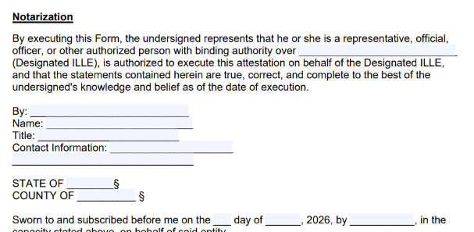
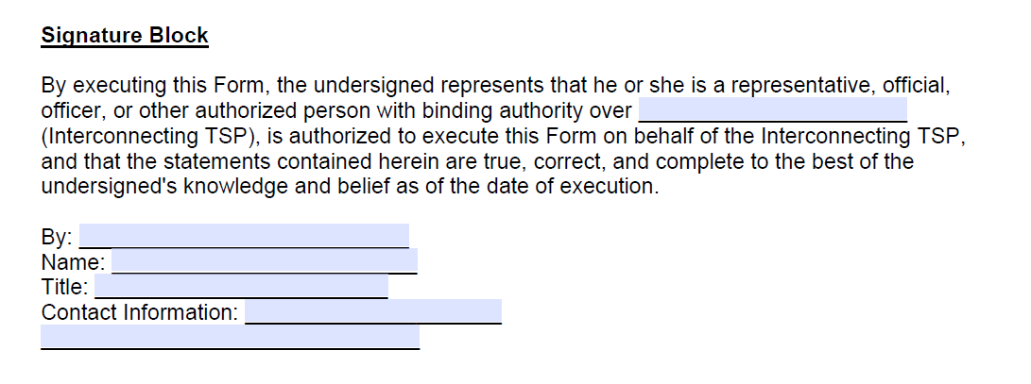
Update to Forms and Attestations
Path 9.2.1.1(1)(f) and (g) Attestation
Key updates
1
Fillable Notarization field
Updated the Designated ILLE field within the notarization section to be fillable, allowing individuals to complete the form electronically prior to notarization
1
9.2.2(3) Valid Stability Form
2
2
Signature Block
Updated “Notarization” to “Signature Block”, Paragraph (3) of Section 9.2.2 requires a written confirmation, not an attestation
Source: ERCOT Large Load Integration- Batch Zero Interconnection Study Process https://www.ercot.com/services/rq/large-load-integration

Slide 98
Eligibility Criteria and Affiliates and Non-Affiliates
An ILLE may rely on an affiliate to meet the eligibility criteria. The ILLE's affiliate must qualify as an affiliate under a definition adapted from subparagraphs (A) through (E) of 16 Tex. Admin. Code § 25.5(3). An ILLE relying on an affiliate must note that reliance in the first reserved field in Section 4 of the Batch Zero LIF and complete and submit the Affiliate Form posted on the Large Load Integration page. The ILLE must complete the Affiliate Form for each affiliate it relies on to meet the eligibility criteria.
An ILLE may satisfy one or more eligibility criteria through the actions of a non-affiliated entity that has been designated by the ILLE to perform such actions as the ILLE’s agent under a contractual arrangement. The ILLE must note that it designated a non-affiliated entity to satisfy one or more eligibility criteria in the second reserved field in Section 4 of the Batch Zero LIF. There is not an additional form. However, during the verification process, ERCOT may request a copy of the contractual arrangement and evidence that the non-affiliated entity satisfied the eligibility criteria on behalf of the ILLE.

